Slide 1
“Torsion Field Theory and Unification Thought”
Lecture at Sun Moon University
by Mr. William S. Stoertz
HyoJeong Academy of Arts and Sciences
April 24, 2018

Slide 2
Outline of Lecture Program
Introduction — Dreams and Purpose
The Quest for a Unified Field Theory
Unification Thought — My Encounter
Fundamental Physics — Issues and Problems
The Physical Vacuum — Puzzle in Physics
Torsion Field Theory — From the Other Side
Unification — Building the Bridge
Remaining Questions to be Solved
The Physicist’s Hope for Humanity
Questions and Answers — Discussion

Slide 3

Mankind’s Age-Old Dream

Slide 4

Dream of Flight

Slide 5

Modern-day Reality

Slide 6
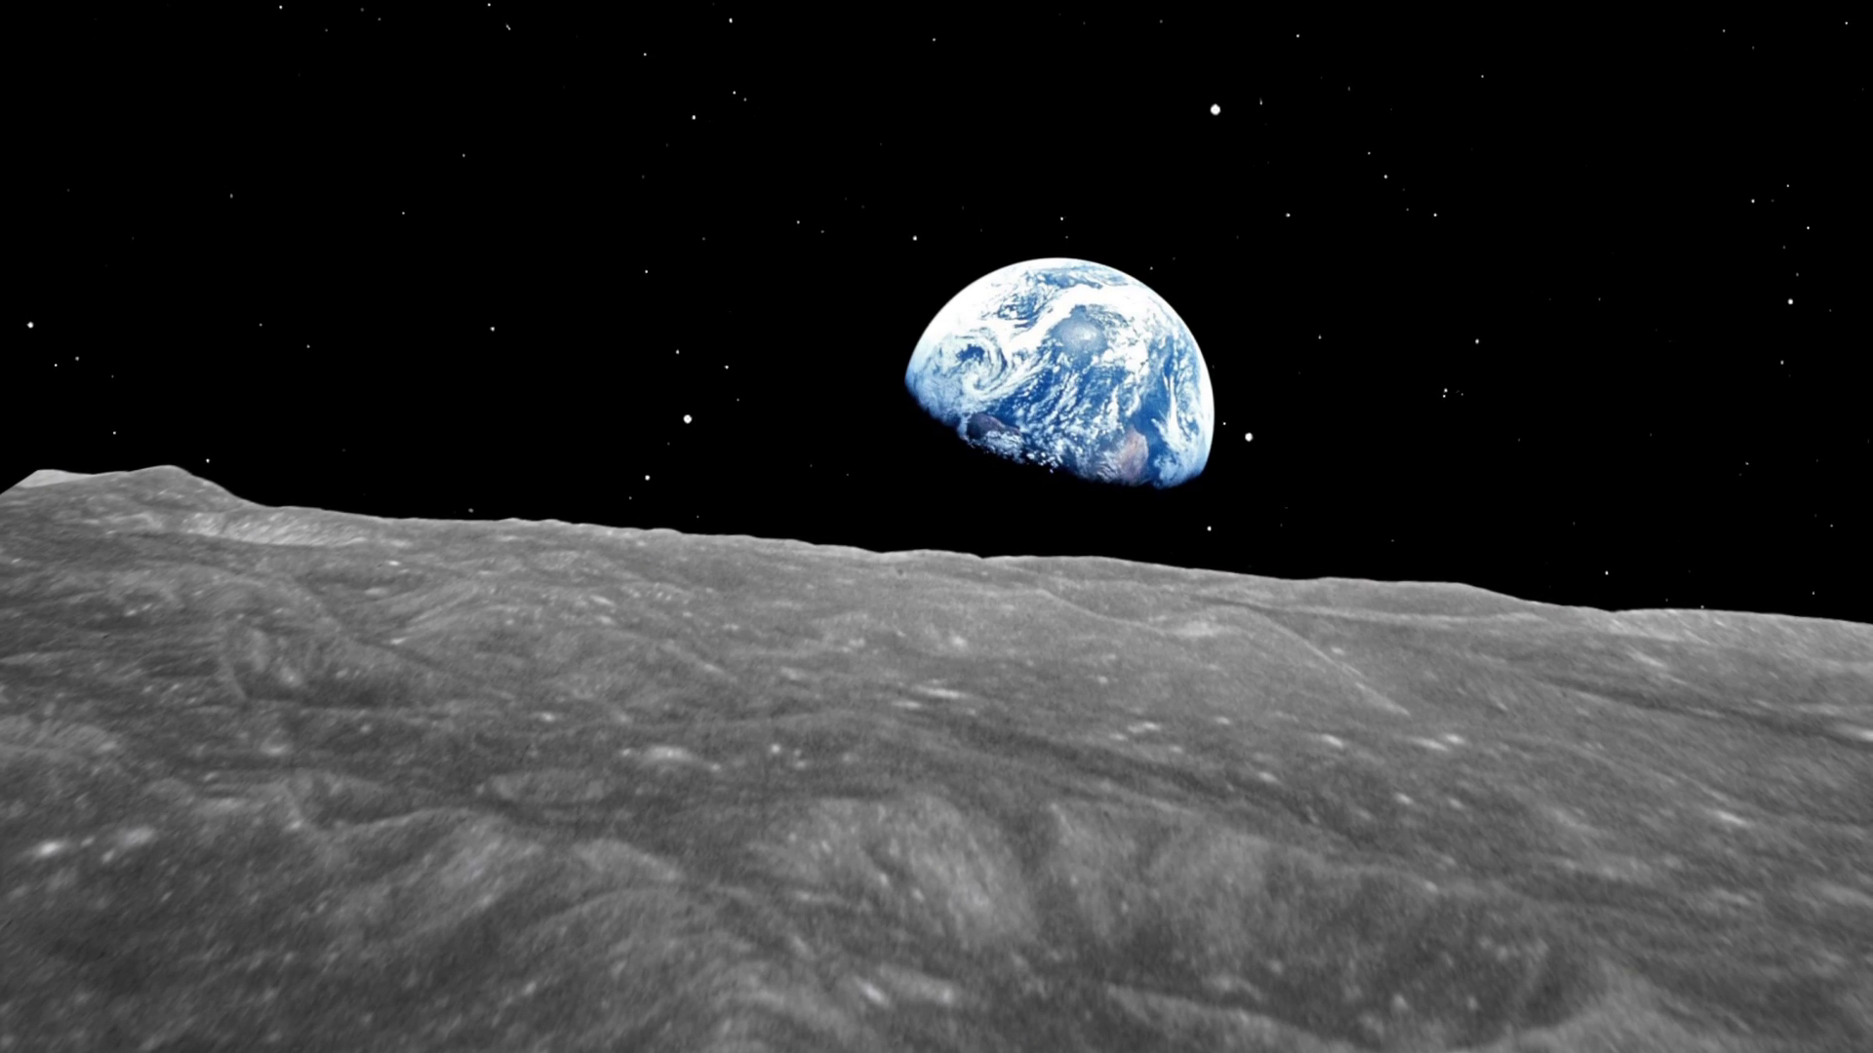
The sky’s the limit (what limit?)

Slide 7
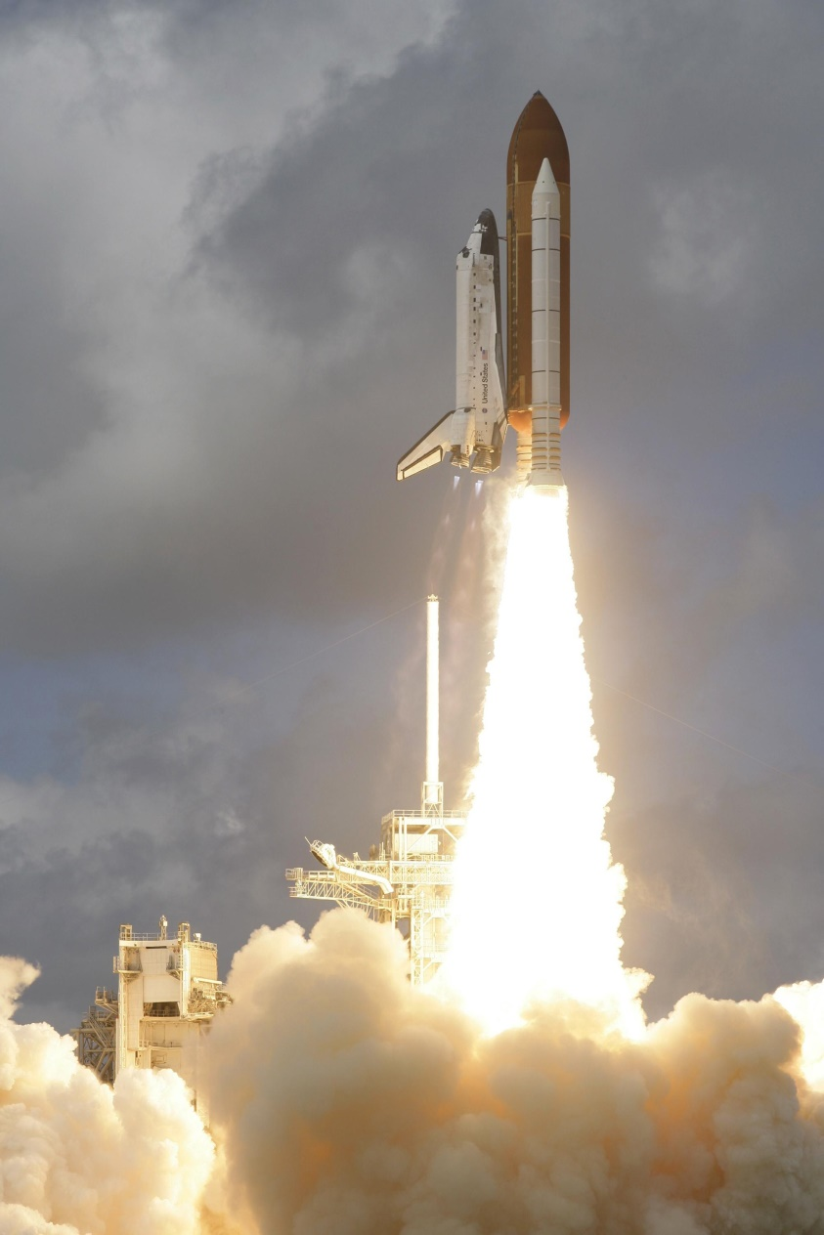

Not only material goal or dream

Slide 8

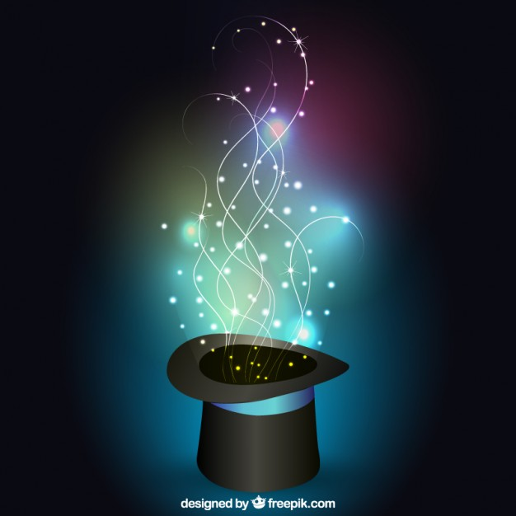
Magic? …..or….. Miracles?

Slide 9
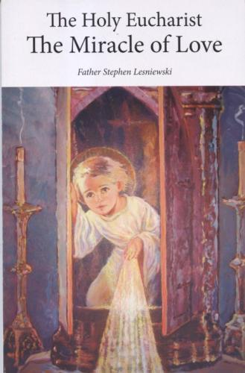

Miracles are our daily reality!

Slide 10
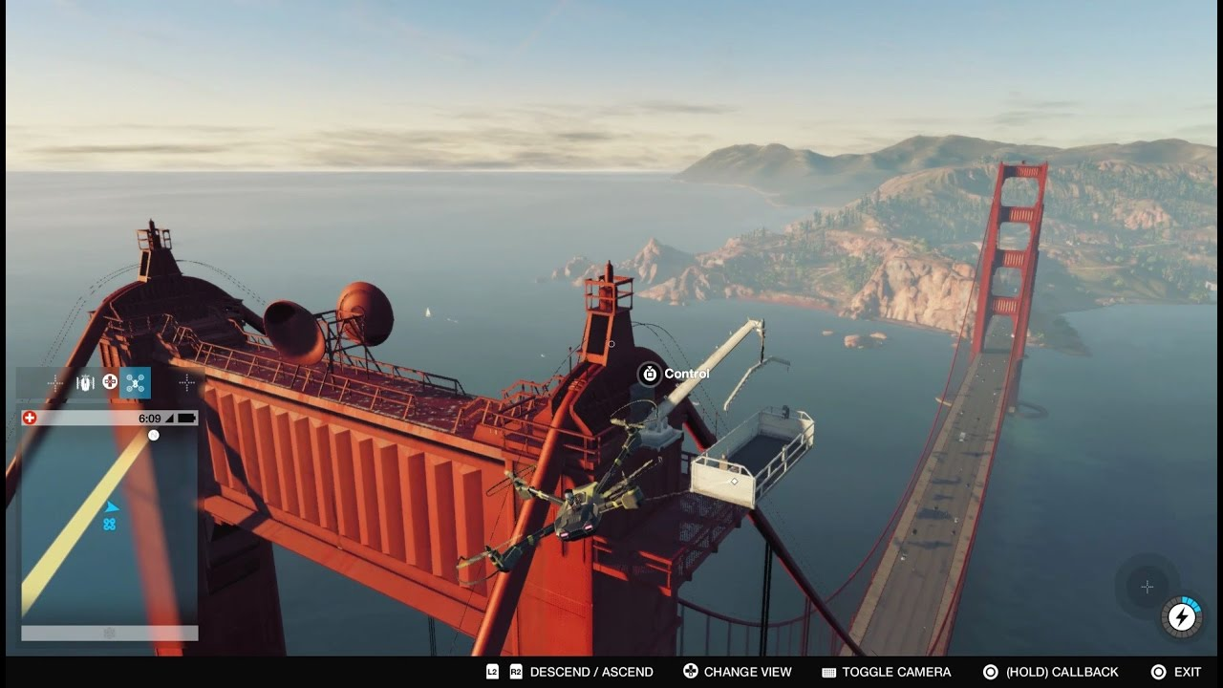
Solutions in physics come through bridging incompatible opposites.

Slide 11
Triangulating the Physical Theories
Unification
Thought
(Godism)
Quantum Torsion
Mechanics Field Theory
Unified Field Theory
Theory of Everything

Slide 12
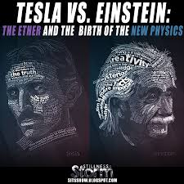
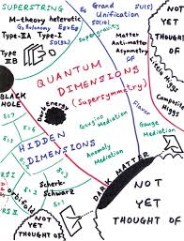
Birth of the New Physics

Slide 13
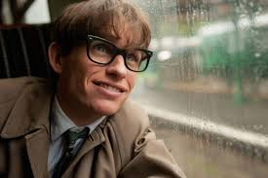
Quest for a “Theory of Everything”

Slide 14
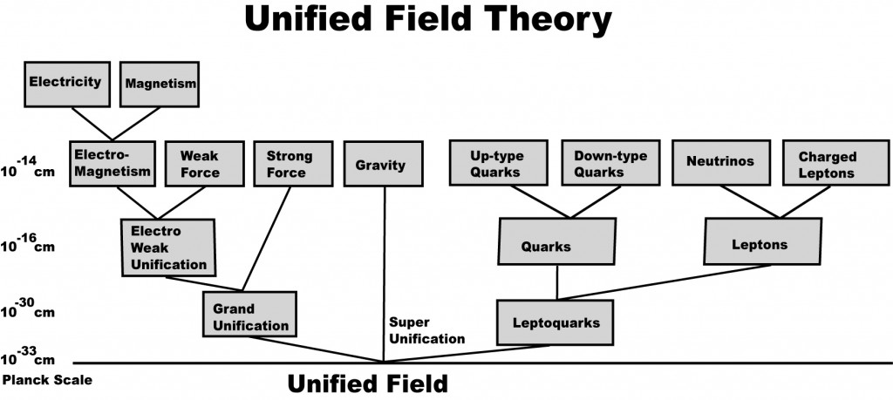
The Unified Field Theory

Slide 15
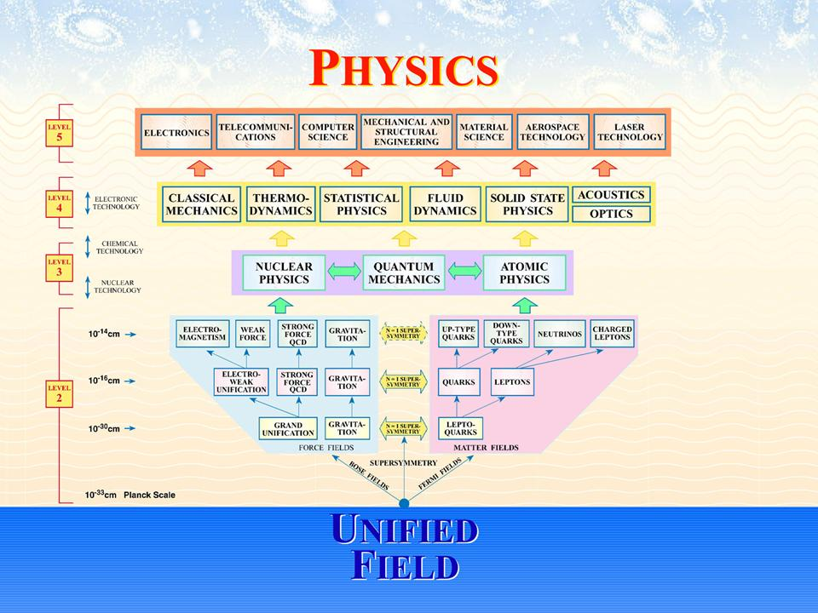

Slide 16
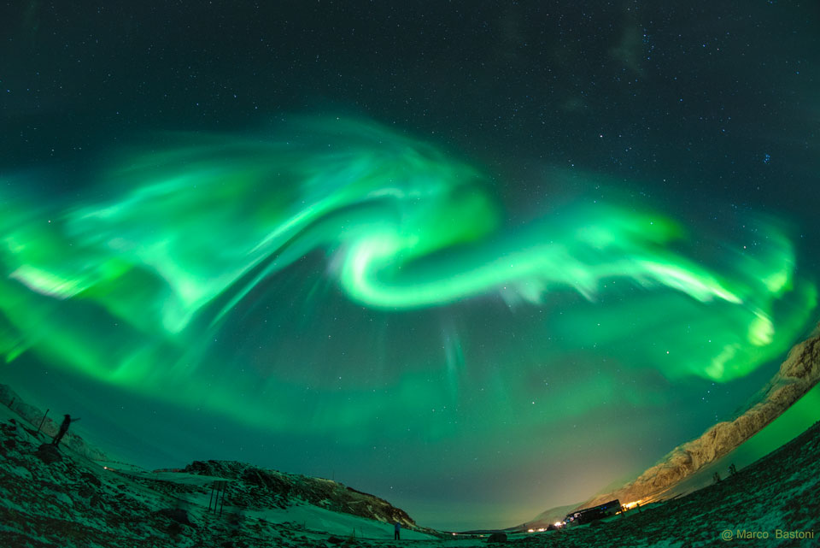
So the $24 million question:
What is this “Unified Field”?

Slide 17
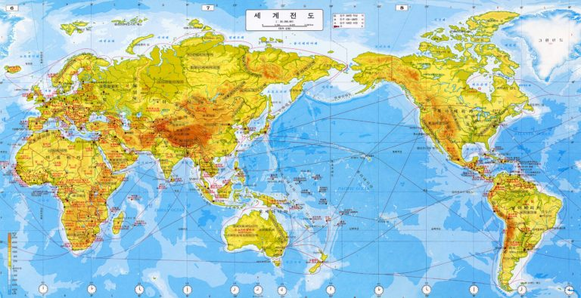
Global quest for this “Holy Grail”

Slide 18
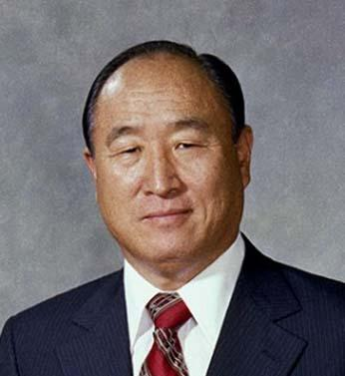
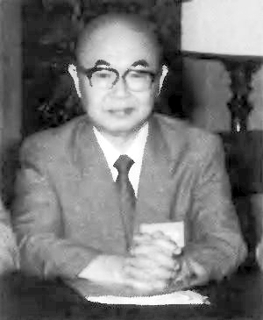
The two witnesses of the truth who founded Unification Thought
Dr. Sun Myung Moon
Dr. Sang Hun Lee

Slide 19
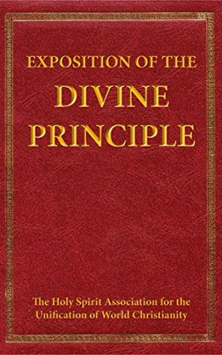
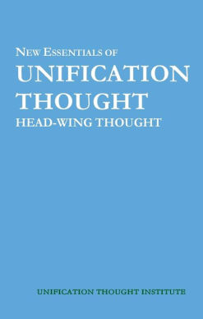
The religious and philosophical angles

Slide 20
First tenet of Unification Thought:
There must be God, variously termed
“Original Image”
“Creator”
“Ultimate Reality”
“Absolute Spirit”
“Absolute Consciousness”
“I Am that I Am”
“Heavenly Parents”
“하나님”
“창조주”

Slide 21
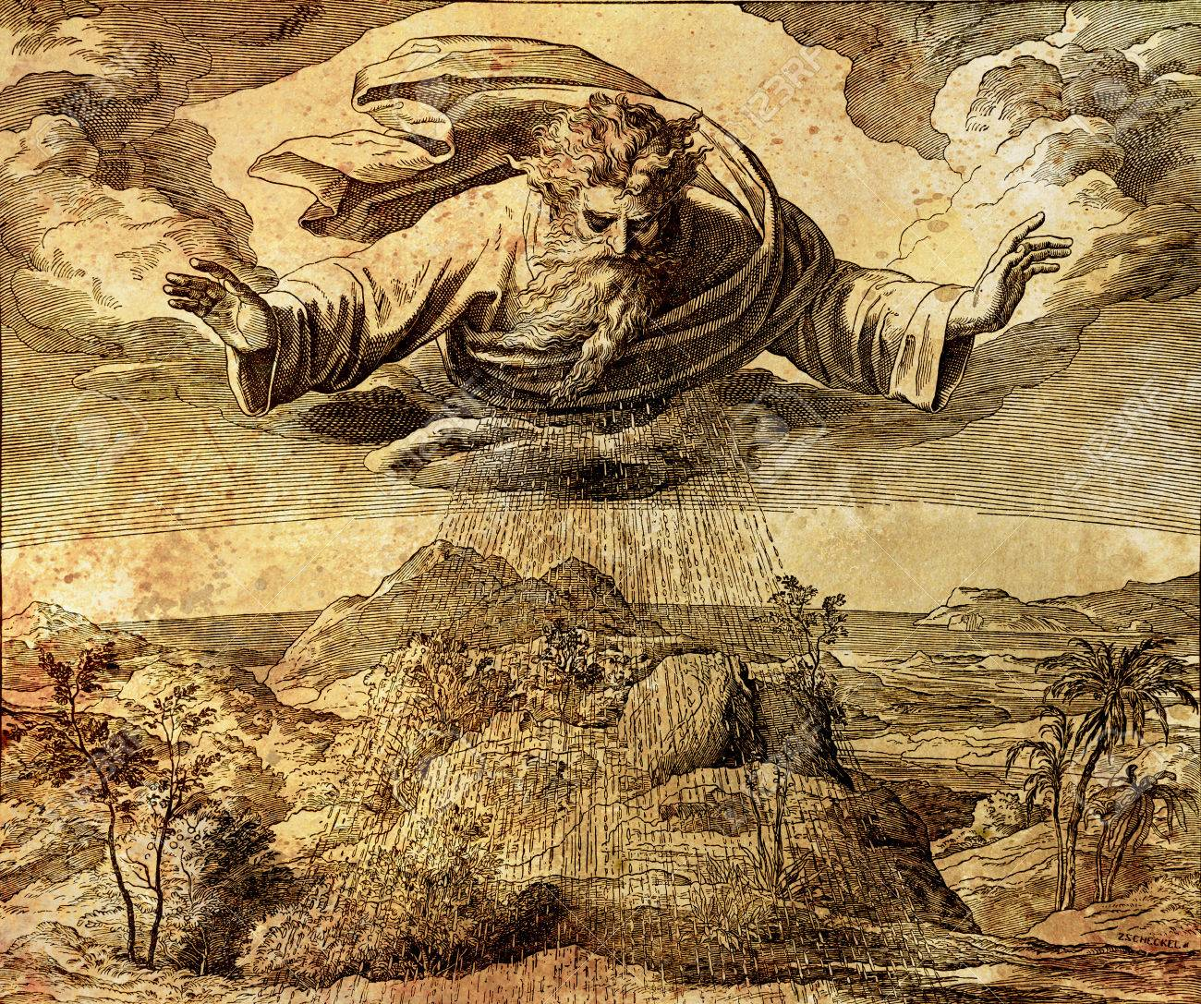
Jehovah יַהְוֶה‬ Yahweh

Slide 22
Second tenet of Unification Thought
2. We can know God’s nature by observing nature all around us and in ourselves as human beings too.
Bible: Romans 1:20 “For His invisible attributes, namely, His eternal power and divine nature, have been clearly perceived, being understood by what He has made…”

Slide 23
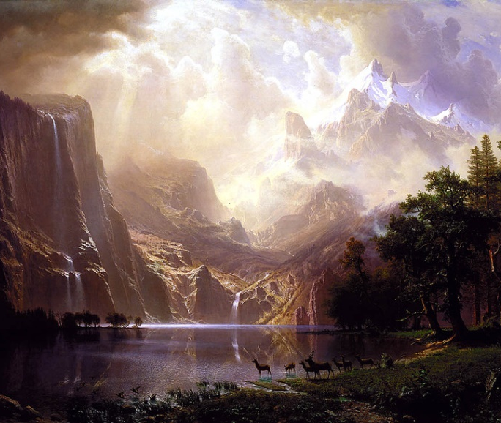
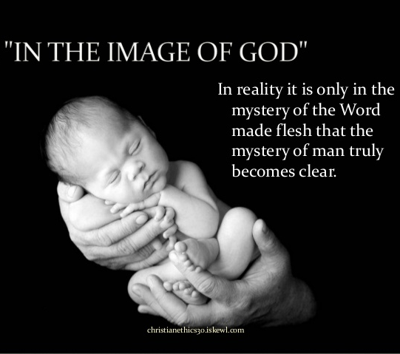
Symbol and Image of God

Slide 24
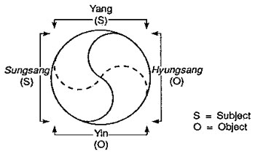
Two sets of Dual Essentialities

Slide 25
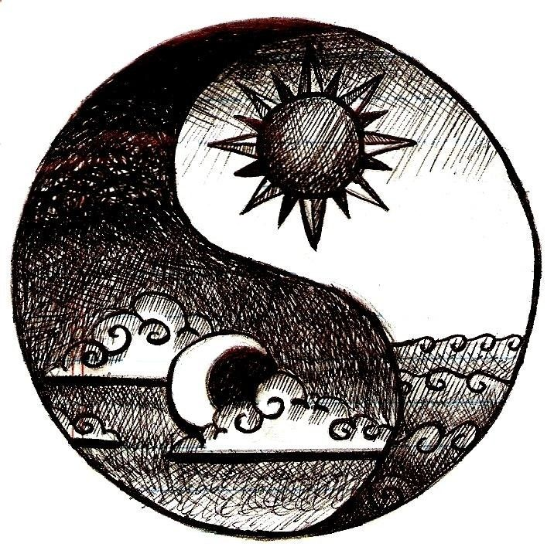

Yin & Yang (Male & Female)

Slide 26
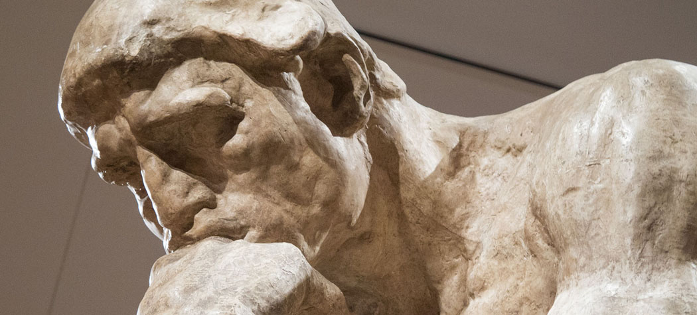
성상과 형상 (Mind and Body)
Auguste Rodin Le Penseur

Slide 27
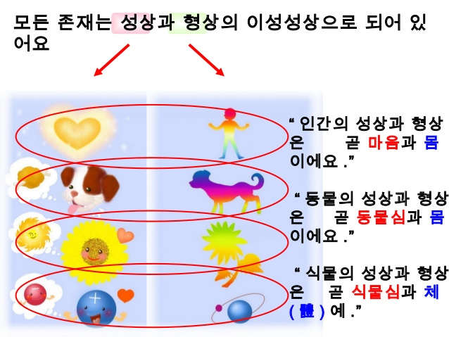
All beings reflect the dual essentialities.

Slide 28
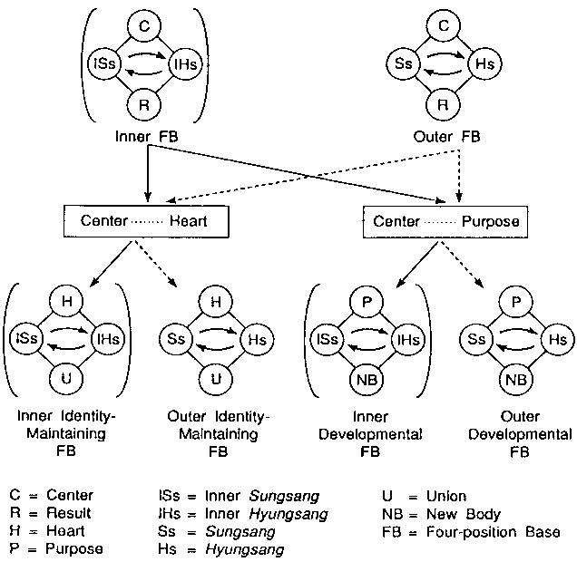
Structure of the Original Image

Slide 29
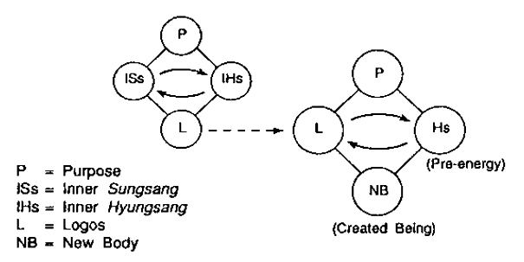
Two-stage structure of the Original Image

Slide 30
Inner Sungsang of God
Every direction or command comes from God imbued with all of these three elements together.
Heart (Purpose, Love)
Logos (Truth, Reason, Intellect, Plan)
Creativity (Volition, Will)

Slide 31
Inner Hyungsang of God
Absolute Values
Values
Ideals
Forms
Principles
Laws
Formulas
Images
This corresponds closely to Plato’s theory of forms, ideas, or ideals.
This also includes religions and the “spiritual world.”

Slide 32
Outer Hyungsang of God
“Prime Force” (Prime Energy, Pre-energy)
This enables and conveys execution of God’s directions according to His Will.
This channels the “information” by which God directs things in the world.
This manifests in the physical realm as “Universal Prime Force.”
Prime Force and UPF are imbued with the elements of God’s Inner Sungsang and Inner Hyungsang.

Slide 33
Advisory:
These diagrams may look plain and clear and simple; however, as you know, in the real world everything is much more complex. Things happen on many levels.
Moreover, continual feedback, reporting, correction and adjustment is constantly taking place between God and the world. God is intimately involved in the universe.

Slide 34
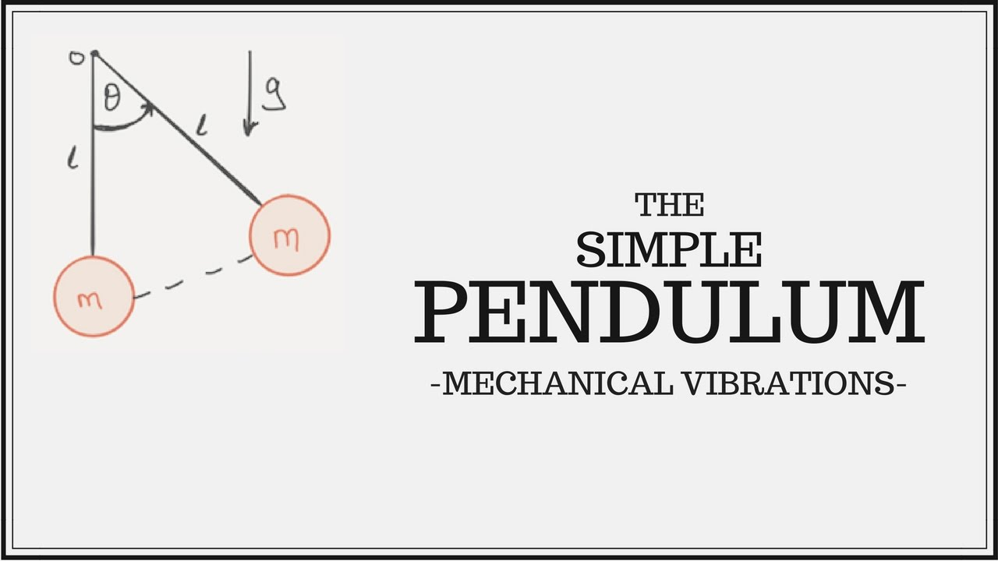
The simple pendulum……..

Slide 35
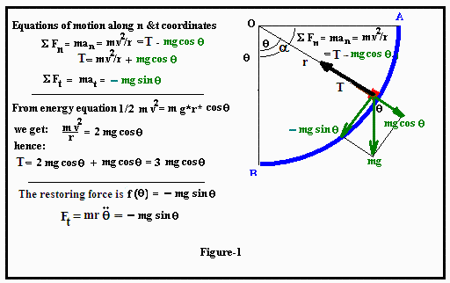
…is not at all simple!

Slide 36

A lingering question in UT: What exactly is the bridge between Prime Force and the physical world?

Slide 37
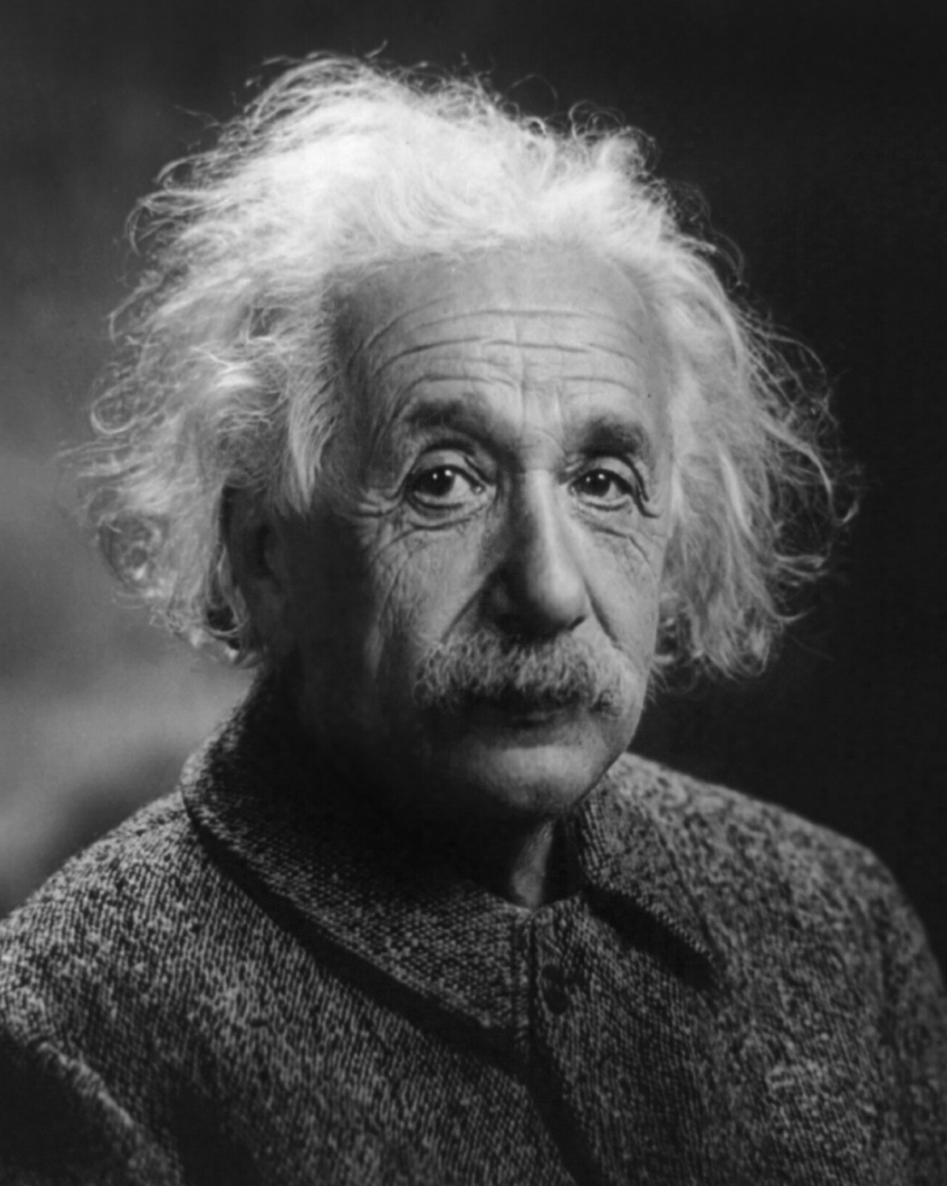
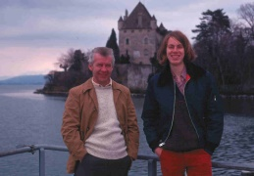
As a young man, encountering the Unification Movement in 1975, I realized the secret to the Unified Field Theory lay in these Principles.

Slide 38
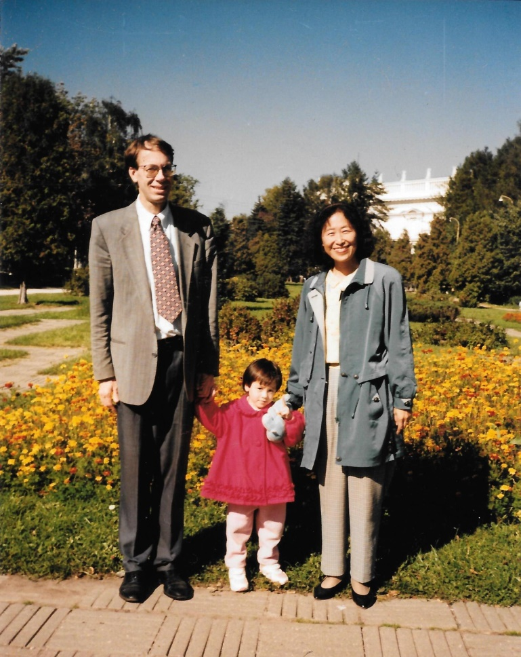
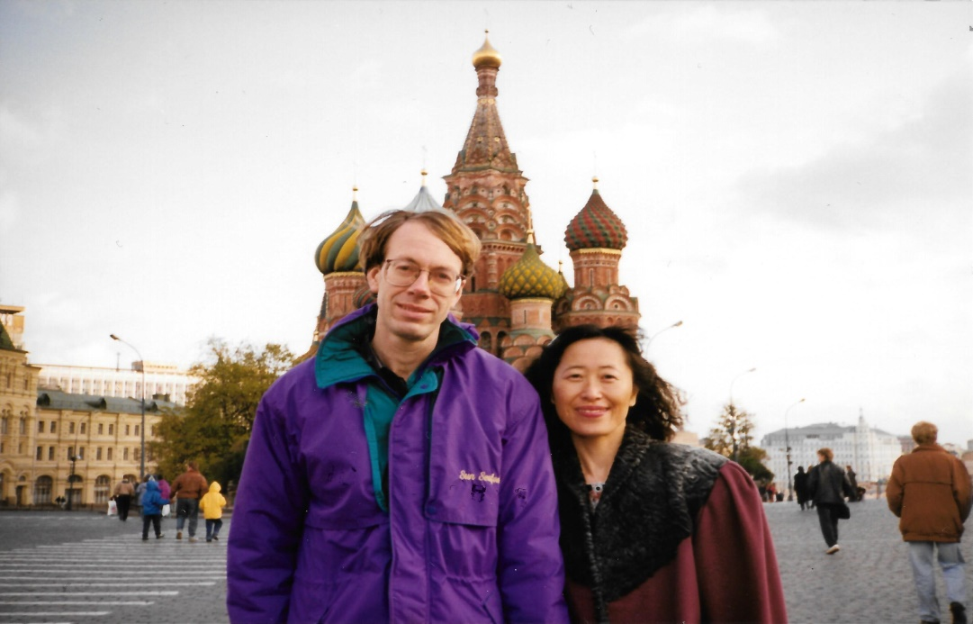
Our family mission work in the former USSR from 1991 to 2008

Slide 39
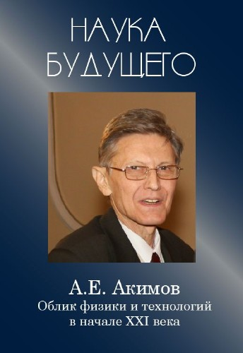
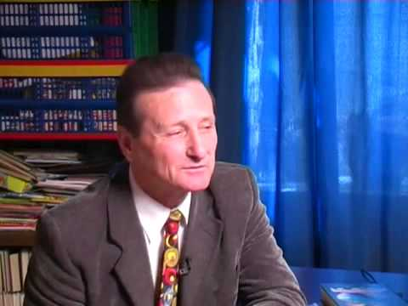
Torsion Field Research in USSR
Dr. Anatoly Akimov: Philosopher & Pioneer
Dr. Gennady Shipov: Scientist with Business Mind

Slide 40
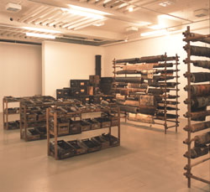
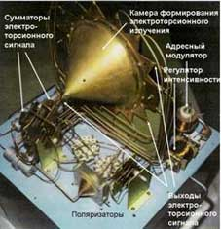
Research lab and equipment during 1970s and 1980s

Slide 41
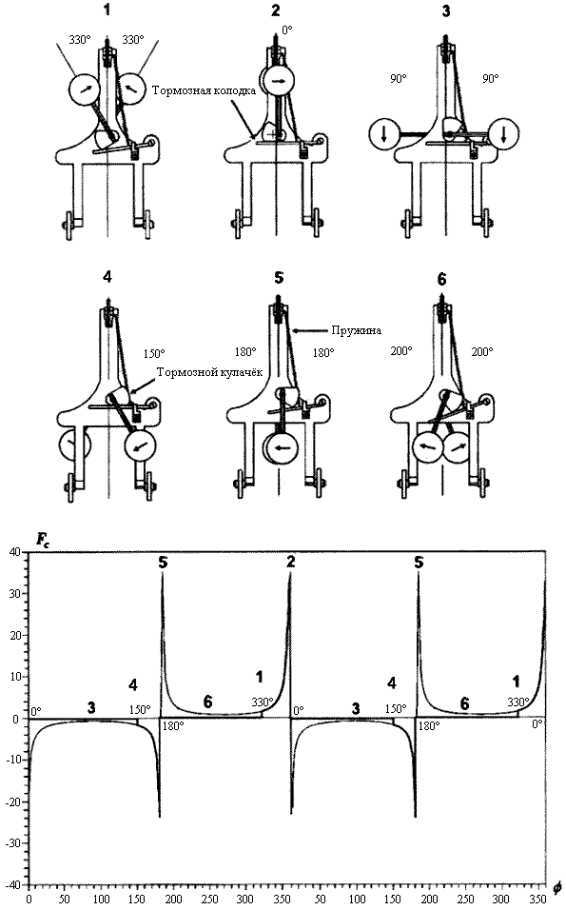
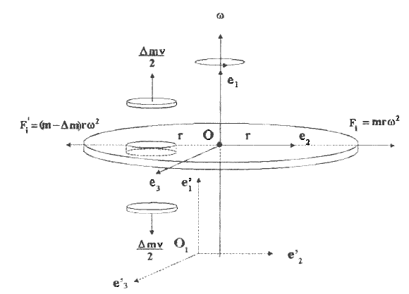
Early diagrams of Torsion Field

Slide 42
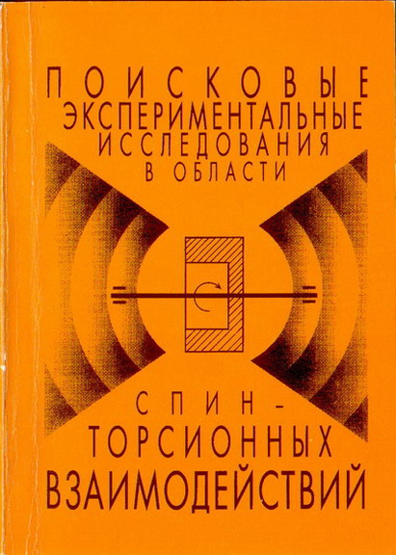
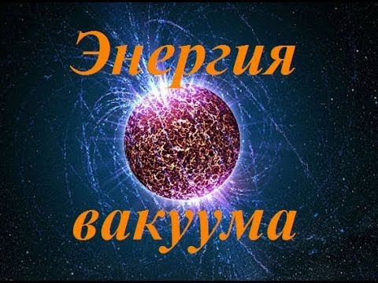
Early treatises on the theory

Slide 43
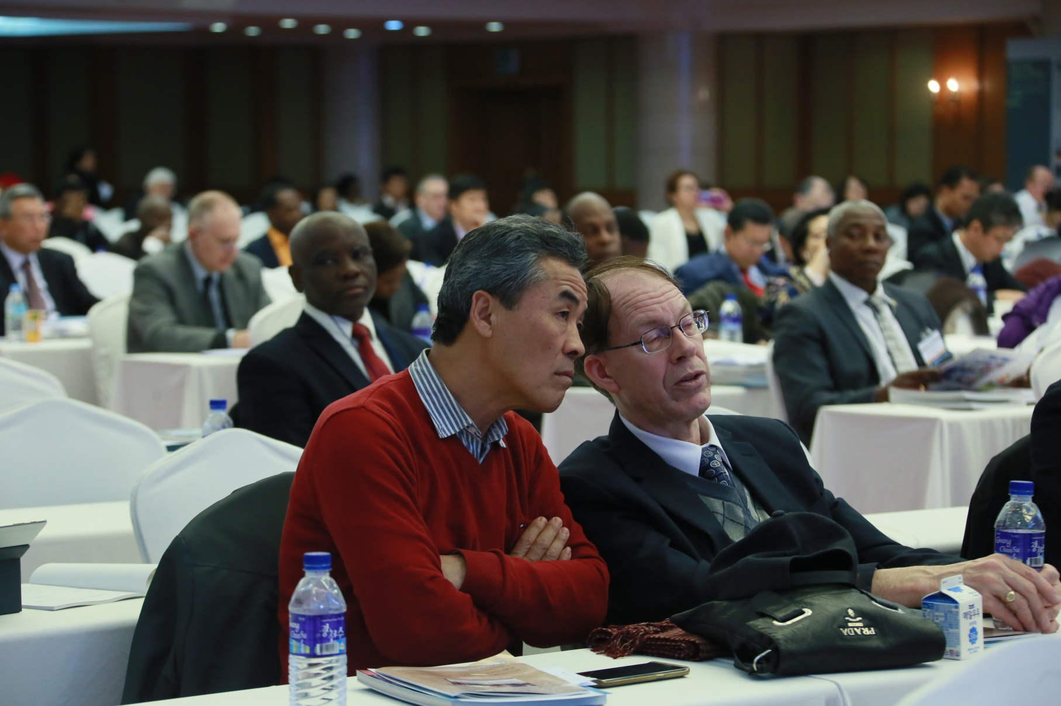
I met TFT again here in Korea!

Slide 44

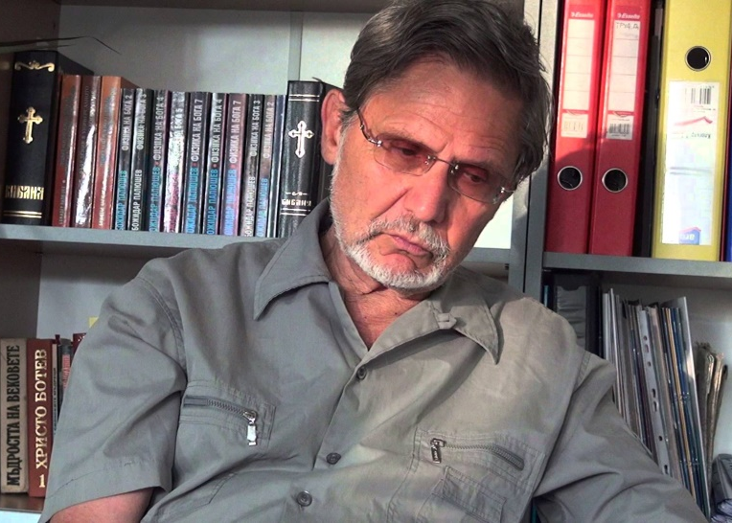
Dr. Bozhidar Paliushev: Physics of God

Slide 45
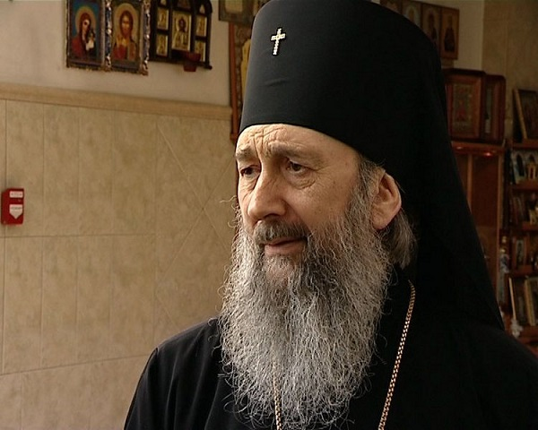
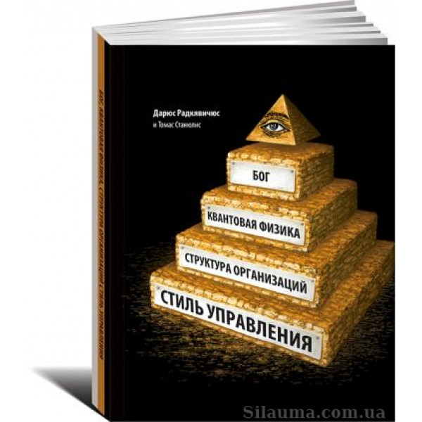
Russian scientists believe in God
Archimandrite Feodosiy
Physics leads to God

Slide 46
Issues in Fundamental Physics
Structure, components, and geometry of the Physical Vacuum, foundation of space.
Why are the physical constants perfect?
What powered the “Big Bang”?
How are quantum fields regulated and integrated?
How to unite the physical interactions?
How are time and light-speed regulated?

Slide 47
…and questions physics won’t address:
What is consciousness?
Is the mind a function of the brain?
What about paranormal phenomena?
Dreams, prophecies, visions, ghosts…
Are UFOs aliens or angels or what?
God.
The efficacy of religious faith and rites.
Near-death experiences and afterlife.

Slide 48

Dark matter remains elusive.

Slide 49
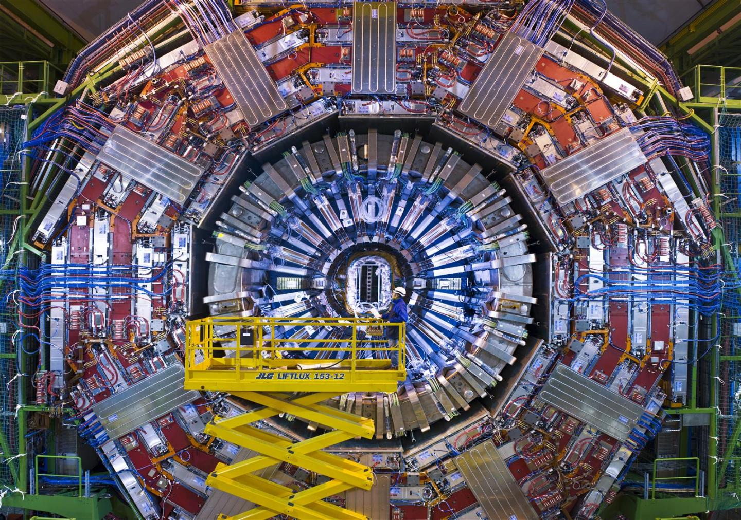
The CERN particle accelerator has failed to confirm Supersymmetry.

Slide 50
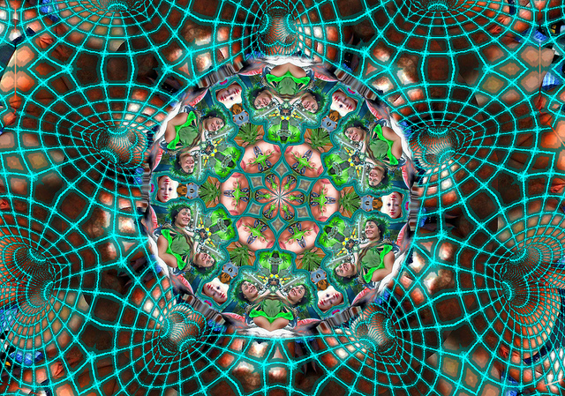
Torsion Field Theory can answer these!

Slide 51
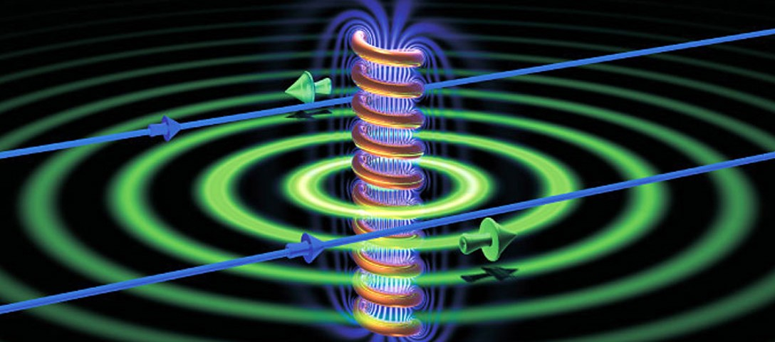
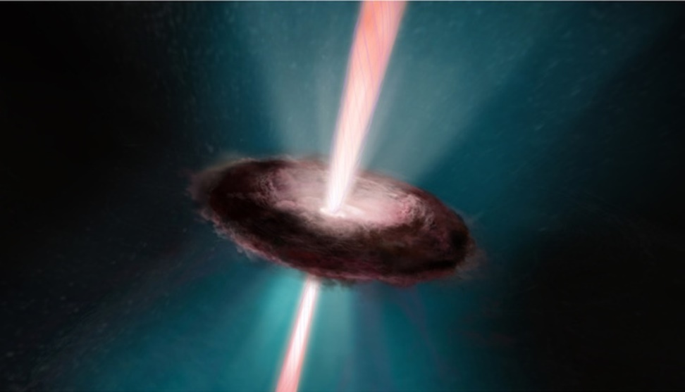
Basis of torsion field: spin!
Very high rate of spin generates a torsion field, similar to a magnetic field, but on a much finer scale.

Slide 52
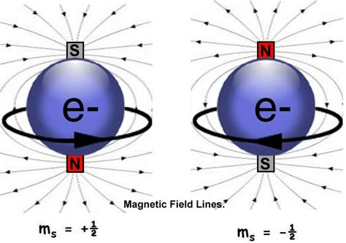
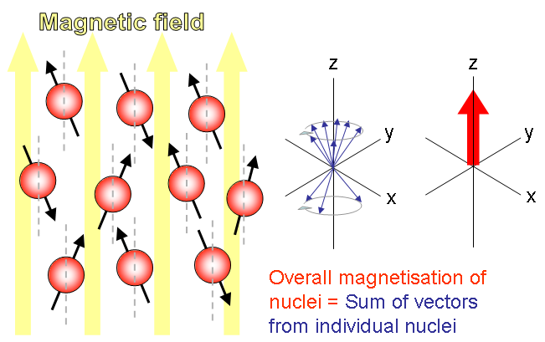
Electron spin: Magnetism

Slide 53
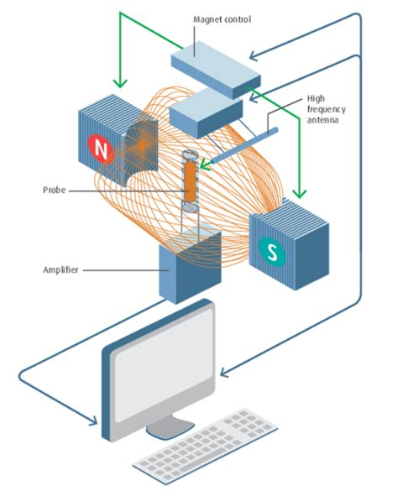

Nuclear Spin: NMR resonance

Slide 54


Polarization of spinning nuclei

Slide 55

Torsion Field Particle: “phyton”
Planck size 10⁻³⁴ m
Very rapidly spinning
Very high energy
Dualistic nature
Information field
Physical Vacuum
Quantum wave
Gravitational field
Memory records
Superluminal links

Slide 56

Geometric array of phytons makes up the physical vacuum (space).

Slide 57


Slide 58

Three levels underlying “space”

Slide 59
Two-stage structure of the Original Image

Slide 60
Hierarchy of Existence
ABSOLUTE NOTHING
God
Inner Sungsang
Inner Hyungsang
Prime Force
Universal Prime Force
MATERIAL WORLD
PRIMARY VACUUM
PHYSICAL VACUUM
PRIMARY TORSION FIELD
PARTICLES (MATTER)

Slide 61
The Primary Torsion Field is responsible for:
Programming the particles of the physical vacuum
Maintaining unity & integrity of the whole
Storing as memory every event
Connecting instantaneously across space
Serves as a computer
Enables the quantum field
Enables the gravity field

Slide 62

It all comes down to Reality

Slide 63

Order is out there

Slide 64

Beauty is everywhere!

Slide 65

……..that’s Physics!

Slide 66
♣ Q & A ♣
Time for your questions and also open discussion!

