Slide 1

Ancestor Liberation and Blessing
Cheongpyeong Heaven and Earth Training Center
Notes:
Good afternoon. I would now like to begin the lecture on the introduction of ancestor liberation and blessing ceremony.

Slide 2
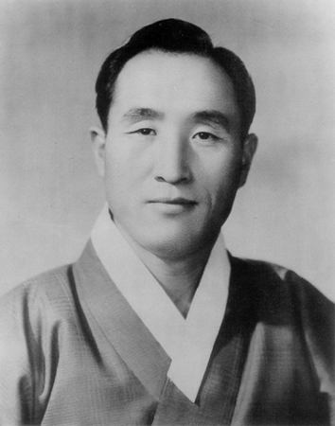
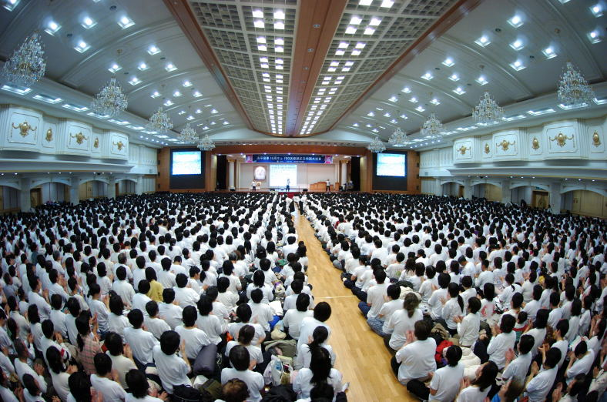
1. Meaning
True Parents’Words
After the fall of Adam and Eve, all human beings came to
belong to Satan’s lineage. Ancestor liberation is the ceremony
through which we can completely change the lineage of all
human beings back into God’s lineage, as completely ideal
sons and daughters between heaven and earth, in the name of
the True Parents. (January 1, 1991)
Notes:
Let us look at True Parents' words on the ancestor liberation ceremony. After the fall of Adam and Eve, all human beings came to belong to Satan’s lineage. Ancestor liberation is the ceremony through which we can completely change the lineage of all human beings back into God’s lineage, as completely ideal sons and daughters between heaven and earth, in the name of the True Parents. (1991.1.1)
The ancestor liberation ceremony is the ceremony of changing from the Satanic lineage back to the good lineage of God.

Slide 3
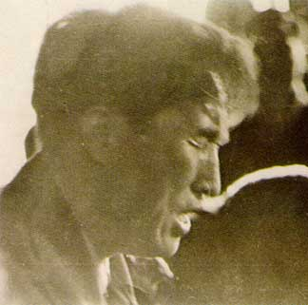
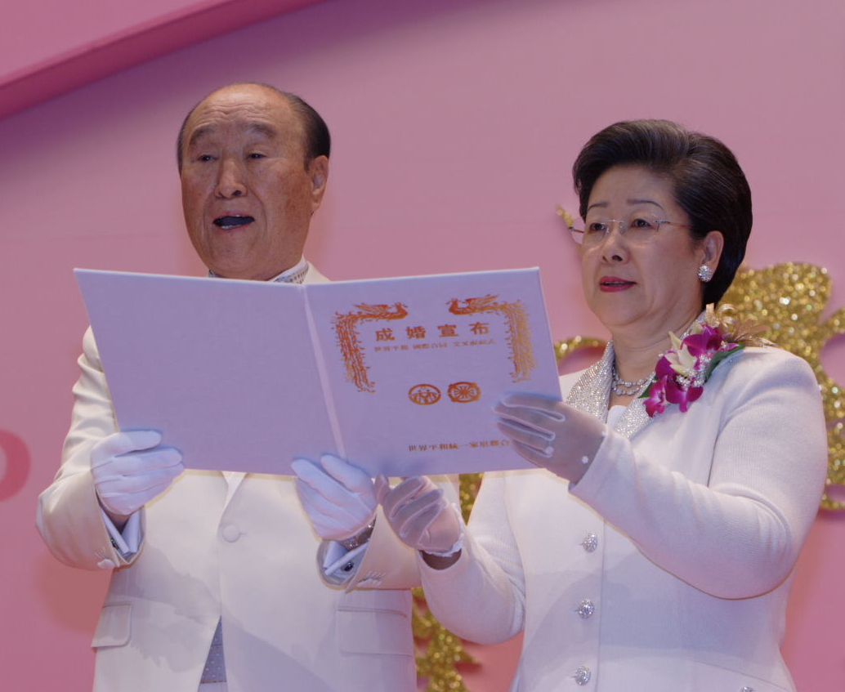
2-1. How it began
True Parents’ responsibility
Liberate God
Restore the fallen world
Setting up conditions
Restoration of lineage
through the blessing
Notes:
Let us consider how much effort has been made in order for us to receive this grace of the ancestor liberation ceremony from True Parents.
True Parents came to this world with the responsibility to liberate and release Heavenly Father, to complete the restoration of the fallen world, and to save all human beings.
In order for True Parents to accomplish these things, they needed to set up numerous indemnity conditions, and they liberated Heavenly Father through the coronation ceremony of God's kingship. Furthermore, True Parents opened the door for the restoration of the blood lineage through the blessing, in order to liberate all human beings.
True Parents, the Messiah of humankind, have to save not only all men on earth but also all spirits in the spirit world. In order to do this, True Parents prepared these special works of Cheongpyeong.

Slide 4
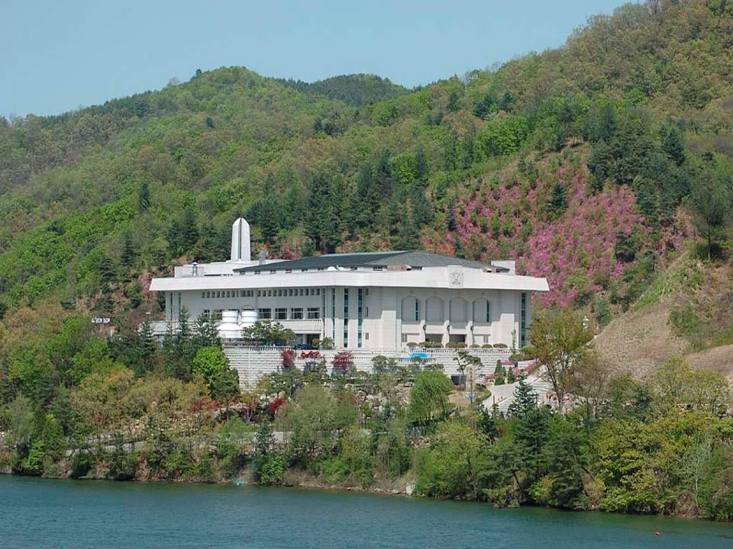
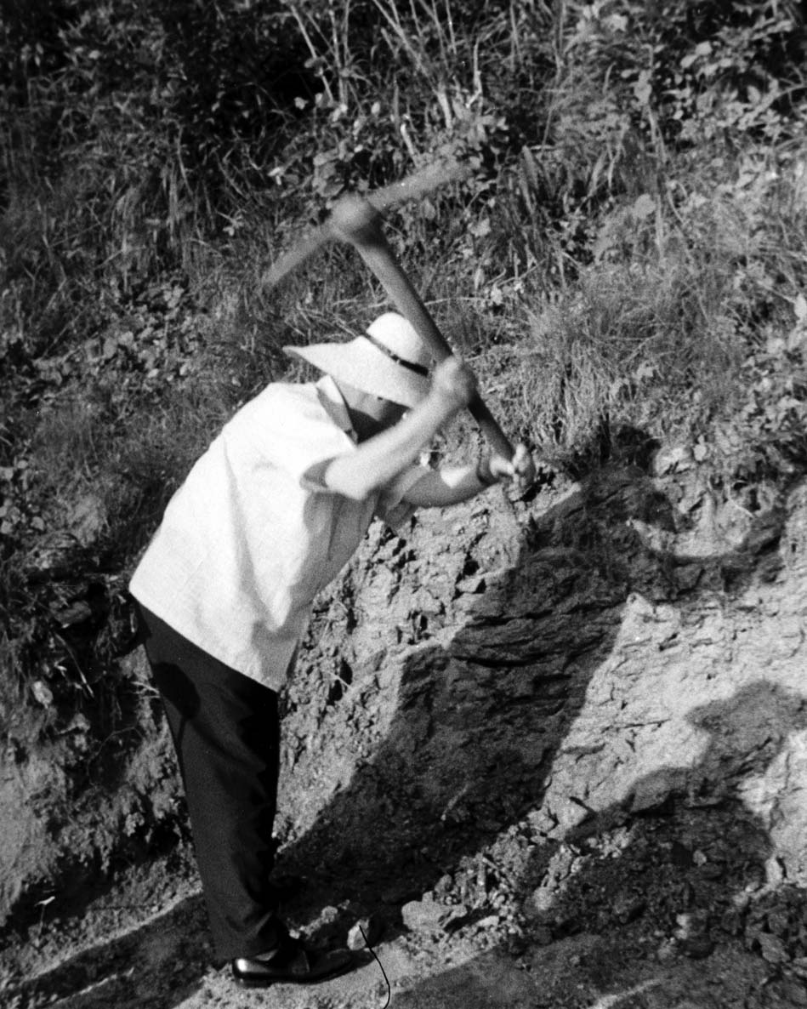
2-2. How it began
True Parents’ Jeong Seong for CP
Nobody knows how much Jeong Seong (sincere devotion) I have offered. To make this place the restored and completed Garden of Eden, I offered unimaginable amounts of Jeong Seong.
Notes:
The history of the providence of restoration is the history of restoration through indemnity. Without paying indemnity, there can be no progress in God's providence. In order to open the special works of Cheongpyeong, and to establish this place as the restored and completed Garden of Eden, True Parents exerted their hearts and souls in achieving incredible Jeong Seong.
The following are words which True Parents gave me when I first came here. "Nobody knows how much Jeong Seong (sincere devotion) I have offered. To make this place the restored and completed Garden of Eden, I offered unimaginable amounts of Jeong Seong. So go there and fulfill your mission, and make the restored and completed Garden of Eden" These are the words he (Father) gave me (Dae Mo Nim) .(774WS May 14, 2006)

Slide 5
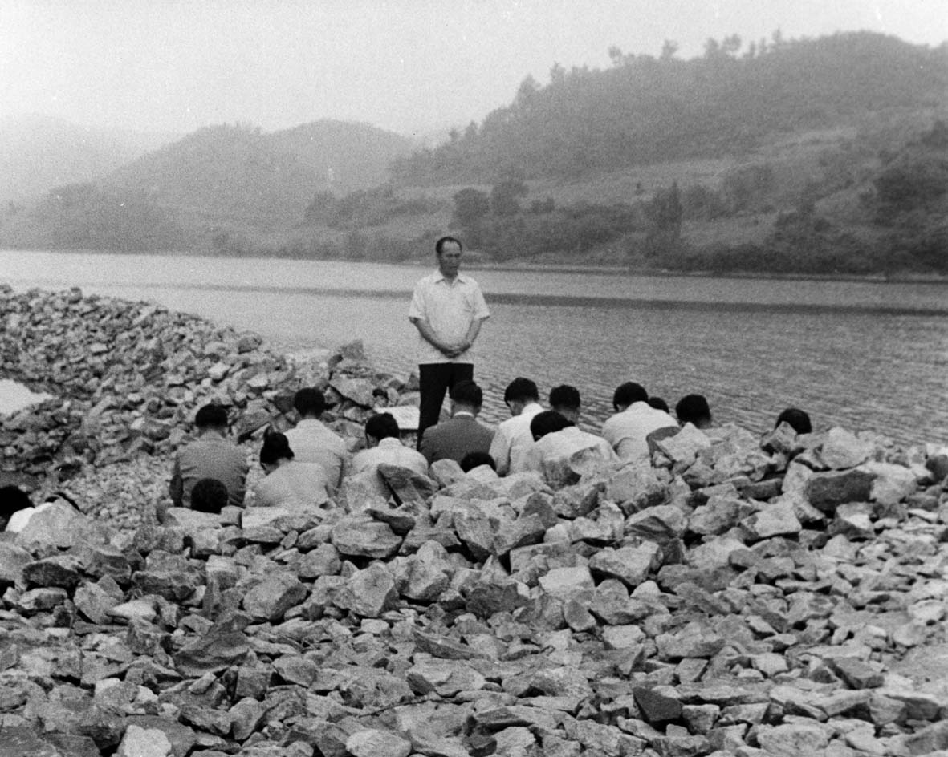
Notes:
From the late 1960’s, True Parents frequently came to Cheongpyeong, where they began to offer sincere devotion, or Jungsung. From that time, Father has continued to come to Cheongpyeong often, and offer sincere devotion. Father at one point purchased the land (or estate) of Cheongpyeong, which was a mulberry field at the time.

Slide 6
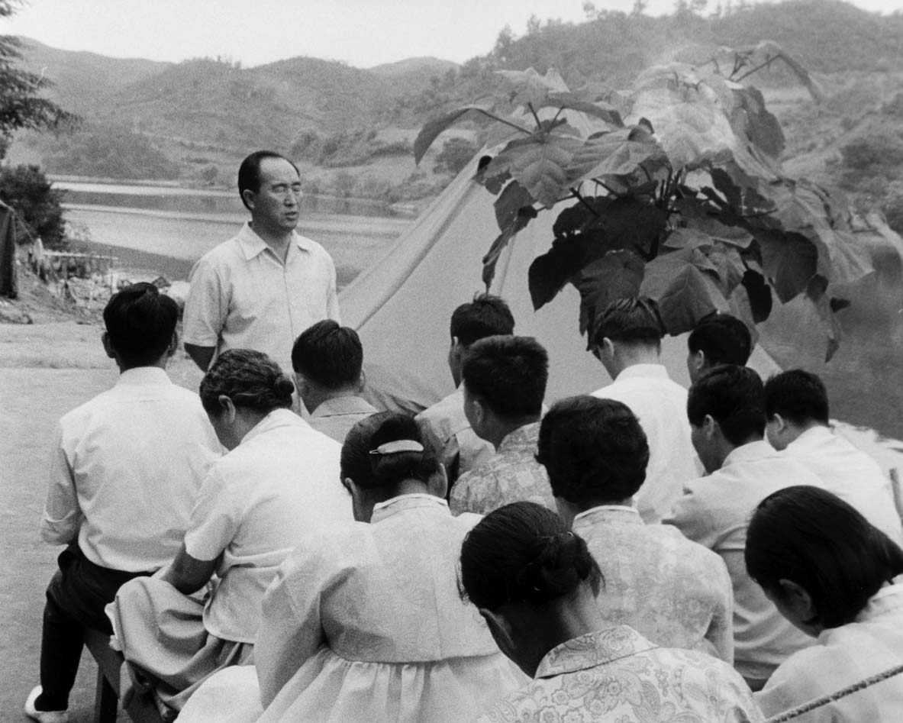
Notes:
True Parents grand vision was to make Cheongpyeong into the hometown of all people, a place to which all humankind could come in order to be reborn as clean and ideal human beings of creation. This was possible once they could separate from themselves all the evil spirits which had come to be in their bodies, and once they could eradicate their hereditary sins, collective sins and individual sins, and wash off all of their fallen nature.

Slide 7
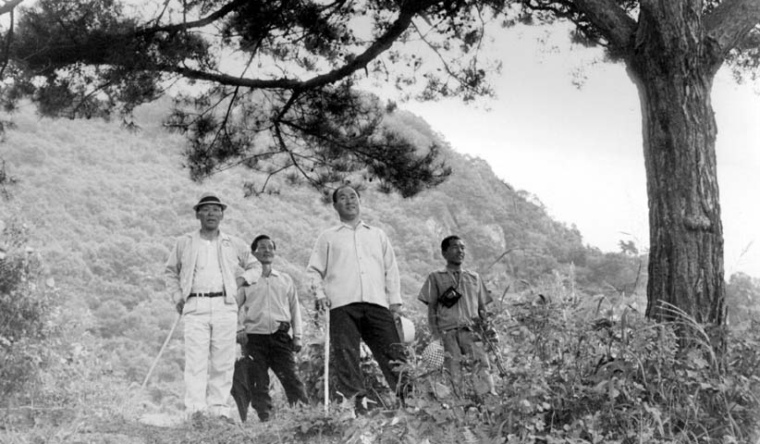
Notes:
Since this beginning time, True Parents have been coming to Cheongpyeong during every crisis that arose within the important providence of God, and they have continued to offer sincere devotion. In this way True Parents could pass victoriously through many difficult and crucial providential moments.

Slide 8
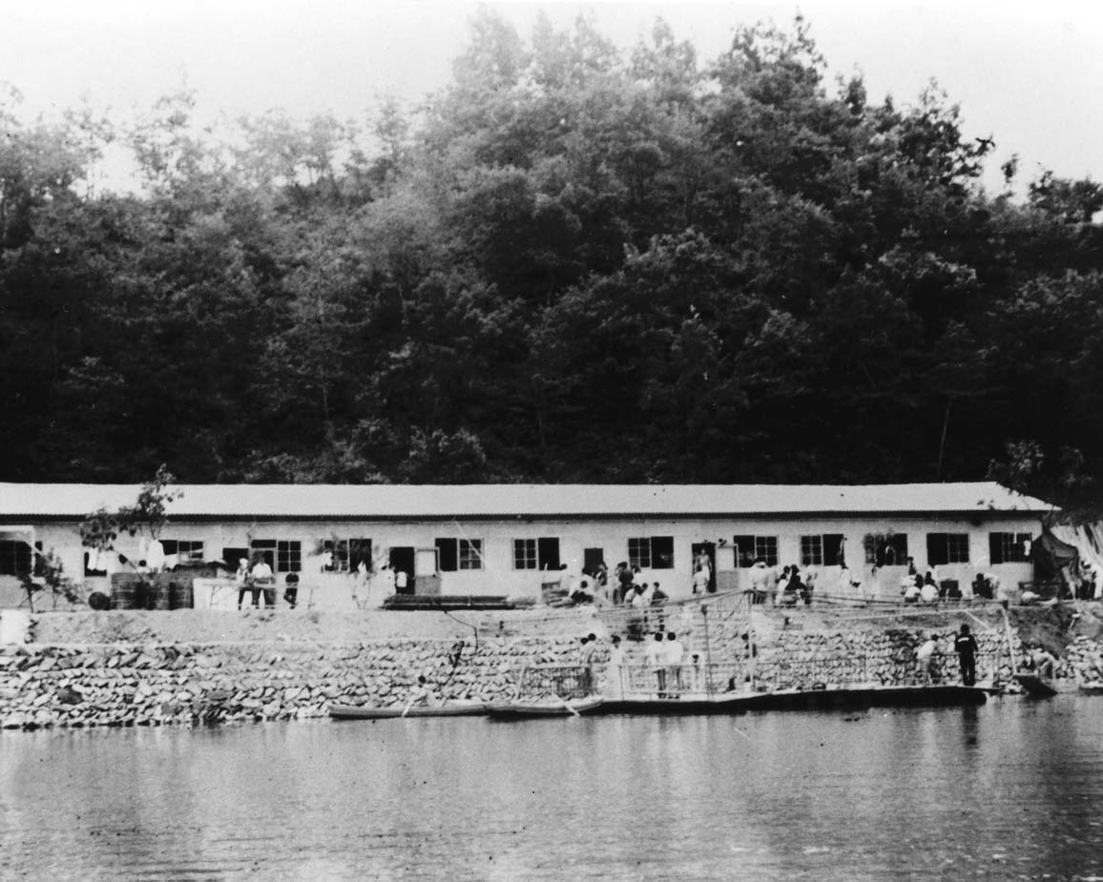
Notes:
This grand plan of True Parents came into substantial realization with the construction of the original sanctuary in 1971. Under the loving guidance of True Parents, the construction of the original sanctuary, started in 1971, was completed within the short time period of 2 weeks with the leaders who had not yet been appointed.

Slide 9
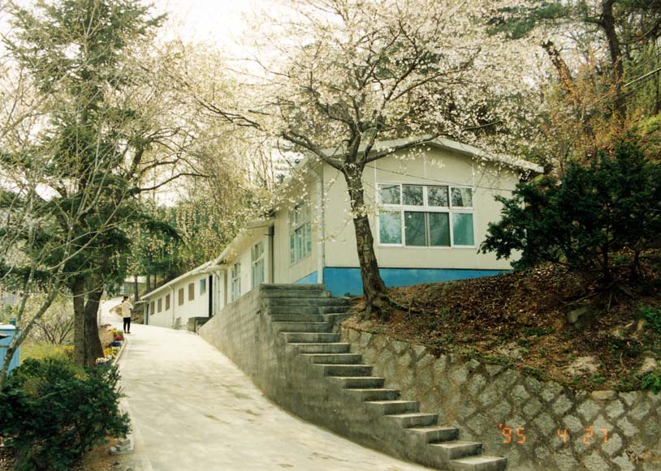
2-3. How it began
The beginning of CP providence
True Parents cleared this land and they waited for someone to come who could do the necessary works. But that person did not appear, and finally, many years later True Parents had no choice but to send Dae Mo Nim to the spirit world and give her the mission. From 1989 to 1991 she opened all of the spirit world, and resurrecting in 1992, together with Hoon Mo Nim she offered a great amount of sincere devotion to begin the CP providence in 1995, January 19. (502nd WS)
Notes:
How it all began (The beginning of the CP providence)
True Parents cleared this land and they waited for someone to come who could do the necessary works. But that person did not appear, and finally, many years later, True Parents had no choice but to send Dae Mo Nim to the spirit world, and give her the mission. From 1989 until 1991 she opened all of the spirit world and, resurrecting in 1992, together with Hoon Mo Nim she offered a great amount of sincere devotion to begin the CP providence in 1995, January 19. (502, WS)
This is how the CP providence began, and how the grace of separation of evil spirits, and ancestor liberation and blessing were bequeathed from True Parents, which opened the gates to God's Kingdom, so not only those ancestors that are in hell, but also we, who suffer from sicknesses, pain, and sins could become the restored and completed sons and daughters of God.

Slide 10
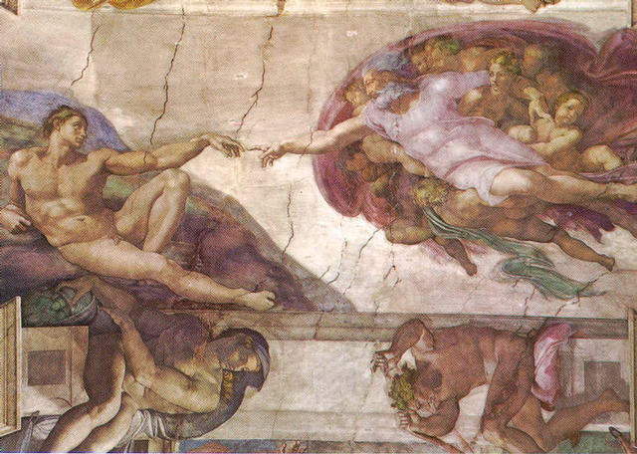
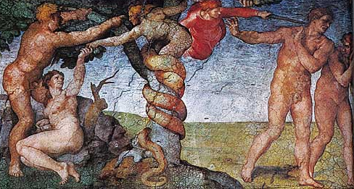
3-1. Why we must liberate
Human fall & the start of evil history
Original sin
Hereditary sin
Collective sin
Fallen nature
Individual sin
War, poverty
Conflict, sickness
Miserable history
The beginning of
history of evil
Notes:
Why we must liberate, 3-1 (Human fall and the start of evil history)
So, fundamentally, why do we need to do ancestor liberation?
We can generally state the reason from two perspectives (standpoints).
The first perspective is from that of our ancestors who are in the spirit world, the other is from our perspective, through seeing the influence exerted on us, by/from those ancestors, and evil and resentful spirits.
First of all, why do our ancestors in the spirit world really need to receive the grace of being liberated?
In order for us to understand this, we must first know about the creation of humankind, and the Fall of Man.
In the beginning, after God created Adam and Eve, through the words of the three great blessings, God wanted Adam and Eve, the ancestors of humankind to realize a peaceful world, a world of happiness and, after finishing their lives on earth, to go to Heaven to live eternally. However, due to the fall, this ideal of God was completely shattered.
As a result, the ancestors of humankind, Adam and Eve, initiated an evil lineage centering on Satan, and the history of evil started. Due to the fall, the ancestors of humankind committed the original sin and inherited fallen nature. As the history of humankind continued down to the following generations, it became an increasingly miserable and unhappy one permeated with war and poverty, conflict and sickness, all mixed up with hereditary sin, collective sin and individual sin.
The resentment that various spirits (such as comfort women, and those forced to become soldiers, and surrogate mothers) have towards our ancestors is merged with our own fallen nature and becomes completely mixed up, thus causing pain and sickness and misery in the descendant’s body.
So why do we need to do ancestor liberation?
We can generally find the reason from two perspectives (standpoints).
One is through the ancestors who are in the spirit world, the other is through seeing the influence from our ancestors and evil spirits and resentful spirits to us.
First of all, why do our ancestors in the spirit world really need to receive the grace of being liberated?
In order for us to know this, we must first know the creation of humankind and the Fall of Man.
In the beginning, after God creating Adam and Eve, through the words of the three great blessings, God wanted Adam and Eve, the ancestor of humankind to realize a peaceful world, a world of happiness and to go to Heaven to live eternally after finishing their lives. However, due to the Fall, this ideal of God was shattered into pieces.
So, the ancestor of humankind, Adam and Eve had received the evil lineage centering on Satan and the history of evil started. Due to the Fall, the ancestor of human being committed the original sin and inherited fallen nature. As the history of humankind comes down to next generations, it became a miserable and unhappy one studded with war and poverty, conflict and sickness, mixed up with hereditary sin, collective sin and individual sin.

Slide 11
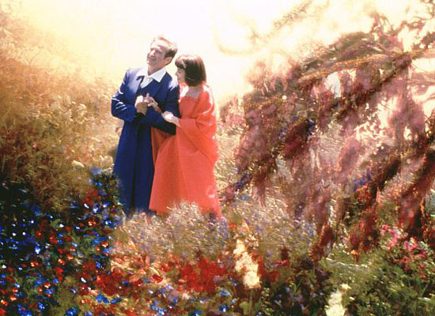

3-2. Why we must liberate
Heaven
True Love
Joy
Happiness
Notes:
Why we must liberate, 3-2 (Heaven)
Originally, after living in heaven on earth, human beings were created to go to heaven in heaven where True Love, Joy and happiness are overflowing.
However, due to the Fall of our first ancestors, Adam and Eve, our ancestors had no choice but to go to hell.

Slide 12
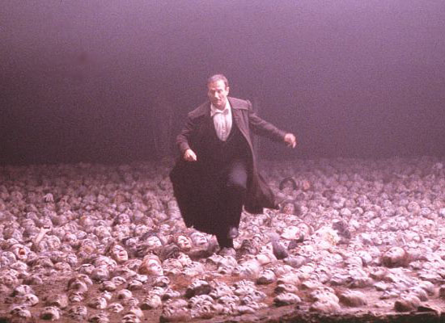
3-3. Why we must liberate
Hell
Where evil began
The smell of rotting flesh
Frightening, painful
War scene
Buried in sins
Hardships and pain
They want to be liberated
Notes:
8 Why we must liberate, 3-3 (Hell)
This photo is a scene from the movie entitled “What Dreams May Come.” Like this scene depicts, the spirits in the spirit world exist buried deep in all their sins, all the way up to their necks. The ancestors' hereditary sins, individual sins, fallen nature, and collective sins in the spirit world have been built up and accumulated, and now fills them all the way to their necks.
After the fall, they could go nowhere else but hell, and that is where our ancestors are.
Hell is where evil started, when Adam and Eve ran away from God after they fell.
Hell is not pleasant. It has the odor of rotting flesh. It is like a battlefield, very scary and painful, and devoid of any freedom. Therefore, our ancestors there are earnestly and sincerely looking forward to being saved and liberated.
In view of this excruciating situation, because our ancestors are in this pitiful situation, and suffering in hell, we must liberate our ancestors!!

Slide 13
3-4. Why we must liberate
Words on evil spirits
If you go to CP, you are told there are many evil spirits inside the body. We must get rid of those spirits. True Parents (1999.5.1)
Not only 6000 years, but for a much longer time Satan has put evil spirits inside our bodies, and worked. Therefore evil spirits are completely rooted in our bodies. Dae Mo Nim (2006.2.26)
Notes:
Why we must liberate, 3-4 (Concerning evil spirits)
Let us examine the next reason why we have to do liberation, based upon the influence on us from the evil and resentful spirits inside us. Let us consider True Parents’ words on evil spirits.
True Parents said on May 1, 1999 "If you go to Cheongpyeong, you are told there are many evil spirits inside the body. We must get rid of those spirits."
Dae Mo Nim said, "Not only 6000 years, but for a much longer time Satan has put evil spirits inside our bodies, and worked. Therefore, evil spirits are completely rooted in our bodies."

Slide 14
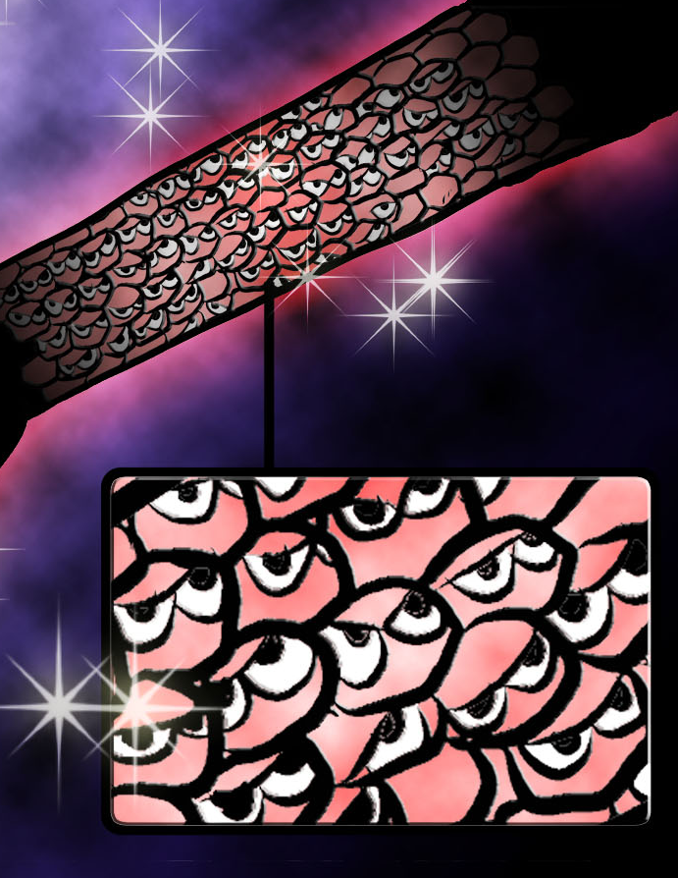
3-5. Why we must liberate
Evil Spirits inside the body
Piled up like ant eggs
They are rooted all over the body in order
Centering on the most resentful spirit
Notes:
Why we must liberate, 3-5 (Evil and resentful spirits in the body)
In which way are these evil and resentful spirits inside our bodies?
Evil spirits are inside our bodies piled up like ant eggs such as you can see in this picture.
They are rooted all over the body in order, centering on the most resentful spirit like ant eggs.
These evil spirits and resentful spirits can also make their spiritual bodies large or small, as they wish. So they make their spiritual bodies as small as ant eggs and are inside our bodies like this.

Slide 15
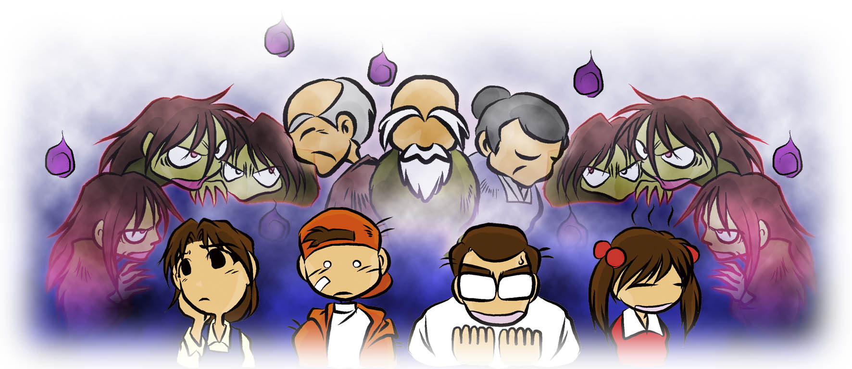
3-6. Why we must liberate
Why are they inside us?
The spirits who have resentment towards our
ancestors are inside our bodies to resolve that
resentment.
Floating spirits are also persuaded to come.
Notes:
Why we must liberate, 3-6 (Why are they inside us?)
Why, then, are they inside us?
The spirits who have resentment towards our ancestors are inside our bodies to resolve that resentment. Also, people should go to the spirit world after ascending, but if they do not go within 40 days, they become a ghost, like a floating spirit. The spirits with resentment towards our ancestors persuade these spirits and drag them inside our bodies.
Regrets towards one’s life

Slide 16
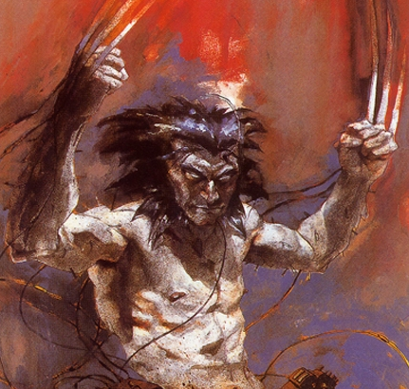
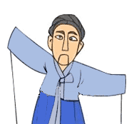
3-7. Why we must liberate
The influence of evil spirits 1
Evil spirits
Resentful spirits
Anger
Greed
Lechery
Sin
Pain
The subject
of Evil Forces,
Making the
Evil World
Fallen nature
Notes:
Why we must liberate, 3-7 (The influence of evil spirits and resentful spirits, 1)
Let us next consider the influence of evil spirits and resentful spirits.
Satan is the subject of evil forces and has been making the evil world.
Satan has the power to control the evil spirits and resentful spirits inside us.
We human beings have evil and resentful spirits, and fallen nature after the Fall.
If the subject of evil forces, Satan, gives direction to the evil spirits and resentful spirits in us, these spirits and our fallen nature engage in give and receive action. Then these spirits make us commit mistakes and sins, such as having anger, greed, lechery (immorality), and other sins. They also cause untold pain and suffering.
In view of this, we are not in a normal mental state. We are controlled like puppets, and basically live under Satan's dominion.

Slide 17
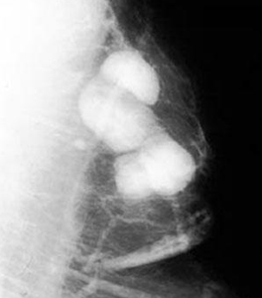
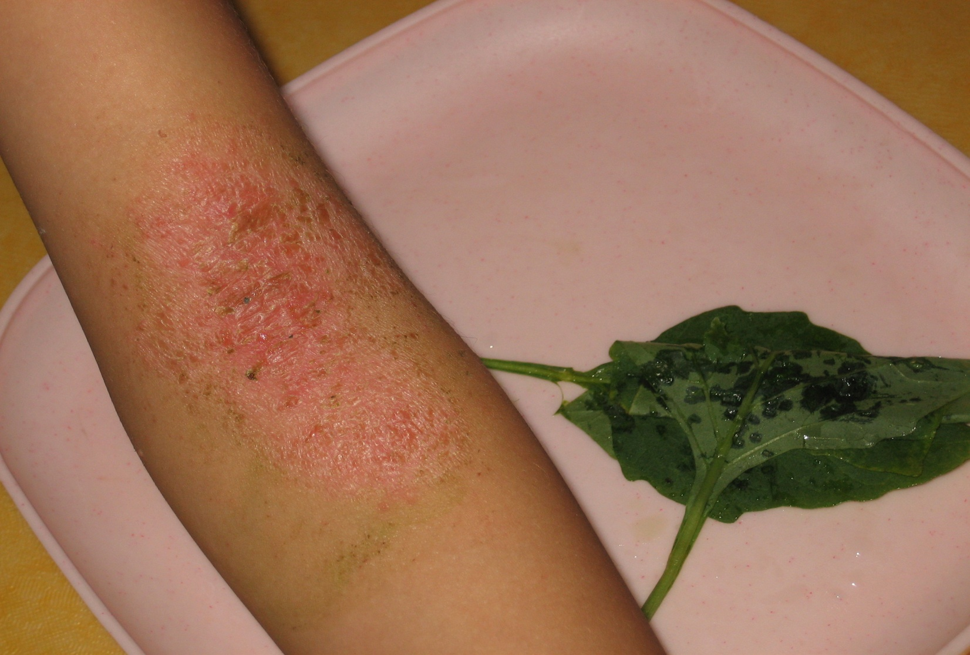
3-8. Why we must liberate
The influence of evil spirits 2
Breast Cancer
Atopy
The reason we become sick is because
spirits are inside our bodies and they
clog our veins, make our skin rot, and
cause all sorts of diseases like cancer
and atopy
They make many diseases
Notes:
Why we must liberate, 3-8 (The influence of evil spirits and resentful spirits, 2)
The other important influence from evil and resentful spirits is like the following.
The reason we become sick is because spirits are inside our bodies clogging our veins, making our skin rot, and causing all manner of diseases like cancer and atopy.
In this manner, the evil spirits and resentful spirits inside us make many diseases.
This is why we need to liberate our ancestors!! As we liberate them, so too, can we be liberated from sin and suffering, and various diseases. This can be accomplished though our doing ancestor liberation and blessing. That is how important it is.

Slide 18
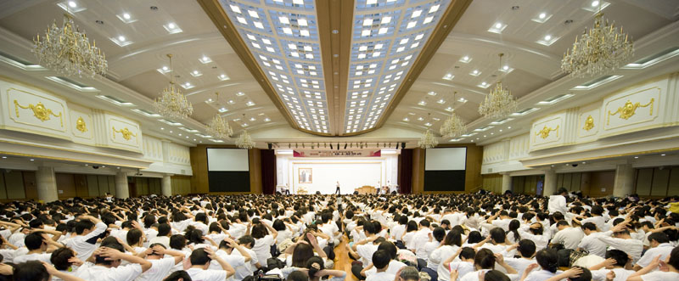
Ancestor Liberation
Notes:
Ancestor Liberation

Slide 19
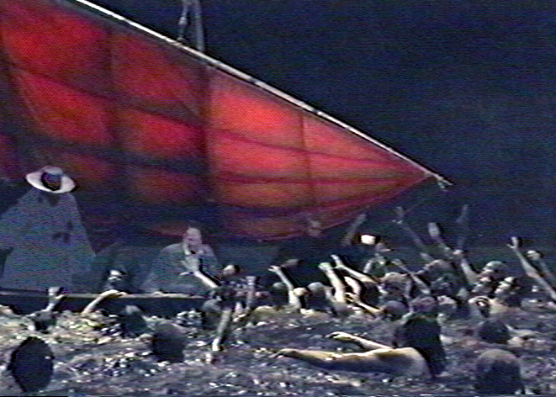
4-1. Ancestor liberation
Looking for our ancestors
Satan do not let
them go easily
I am the ancestor!!
Please take me! My descendant is coming
Notes:
Ancestor Liberation, 4-1 (Looking for our ancestors)
How are our ancestors liberated? When you register for the workshop, Dae Mo Nim takes that name list to the spirit world. There are three places where our ancestors can be found. She looks in all three places to find our ancestors.
Heung Jin Nim, Dae Mo Nim, Hoon Mo Nim, the angels and absolute good spirits all go to look for our ancestors.
Sometimes she has to look for spirits that just float around, without any stable location.
If they are inside someone's body, they must go directly inside.
The resentful spirits make it very difficult to find them.
When she goes to the spirit world to look for these ancestors they are in a situation just like this, buried in sins up to their necks, just as we are. In that situation, they plead to her: “Save me!”
When she (Dae Mo Nim) looks for your ancestors it is incredible how much other spirits implore her, saying “I am the ancestor!” Some ancestors tell her that if she can make them into absolute good spirits, they will witness to other spirits. Sometimes the descendant has not yet come to Cheongpyeong for liberation, but the ancestor will say “They are in their car, now, on their way here. It is very difficult for you to come here twice, so please take me now.” (502th WS)
Seen from Satan’s point of view, Dae Mo Nim’s looking for ancestors means Satan is losing spirits on the evil side, so Satan and evil spirits do not let go so easily.

Slide 20
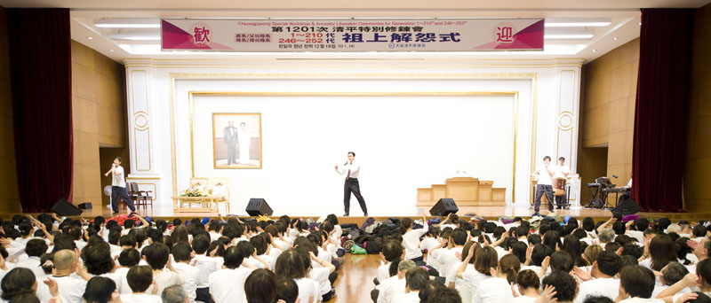
4-2. Ancestor liberation
Ancestor Liberation Ceremony
Notes:
Ancestor Liberation, 4-2 (Ancestor Liberation Ceremony)
This is a picture of ancestor liberation.
It is basically the same as a regular Holy Song session, except for the fact that at the end we sing the song Hallelujah (Amazing Grace) and take the time to communicate with our ancestors with a prayer. During this time, the ancestors come to your right side, so hold your right hand firmly in you left hand, and pray with a sincere heart. In this case, we do not do separation of evil spirits from the whole body (no strong hitting with the hands).

Slide 21
4-3. Ancestor liberation
Workshop course of the spirit world
See one’s
spirit body
See all of
the spirit
world
Time to
scrub sins
Confirm
one’s place
to live
Repeating workshop course
Lectures
Ideal world
of creation
Notes:
Ancestor Liberation, 4-3 (Workshop course in the spirit world)
The liberated ancestors go to the workshop in the spirit world. The course of the workshop is as follows:
1. First, they see their spiritual body.
In the spirit world, when they are told, ”look at your spiritual body, look at your body,” there is not one spirit that is not surprised by looking at their own spiritual body. “Wow! ... Is my body this ugly? Is my body this dirty?” They just don’t know what to do.
2. Then, starting from Heaven, they tour the entire spirit world. They end below hell. You think hell is the bottom, but actually there is one more place even under Hell. What kind of place is it? It is a place where lewd spirits, and spirits that committed suicide, go to.
3. After showing them all of the spirit world, we say “go according to your spiritual body’s shape and color.”
If we say, “Go look for your house,” they go. If they had not first seen heaven, they would say ”this is my house. What can I do about it?” This is how they would think. But because they have seen heaven, they cannot live where they are in pain and suffering, not being able to go to heaven. We leave them in those places until they begin to think like this.
4. When they think only “I wish they would take me to the training center quickly!” they are once again called to the training center.
What do we show them at the training center? We show them all creation and humankind as the ideal world of creation that God created. It is beautiful. They see all of that. The reason God created this world. The way God felt when he was creating humans and creation so he could feel joy through them feeling joy. “We could have lived in that kind of world, but we did wrong and had to be expelled.” This is how they begin to think.
5. They hear a lecture on the Fall, and how Lucifer approached Eve.
“Confess everything you did while living on earth based on these 3 points: how you had much greed, and you felt diminishing love, you then fell. This is where we have to start to cleanse your sins.”
6. Cleanse your sins. If you stay like this, you will never go to heaven, so start scrubbing!
When they scrub, they can see it come off. Some places have dirt, like this. Can they see the dirt come off as they scrub and scour? Can they not see? They can see. They cry “This is how inside me there is what came from the fall of Adam and Eve!” and in embarrassment they cannot raise their faces, but they can only cry shedding tears.
After that, they learn about the providence of restoration.
7. As they scrub they can see themselves become clean little by little. They begin to see hope and say “Wow~. I am a little closer to heaven now.” Then they listen to more lectures. The lecturer changes and they listen to new lectures and learn about their sins, and scrub their sins.
Like this, our liberated ancestors participate in a 100-day workshop, and follow this course, repeating the various stages.

Slide 22
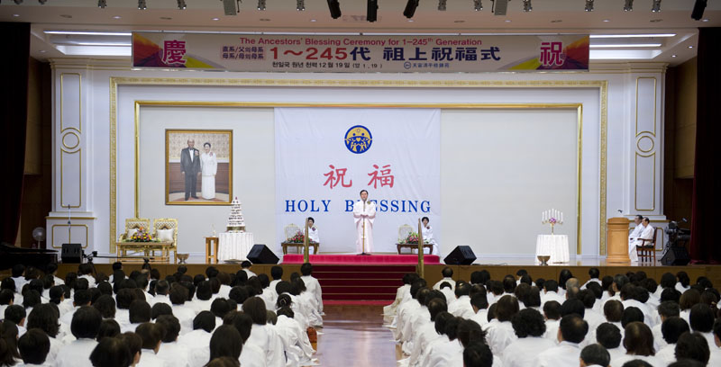
Ancestor Blessing
Notes:
Ancestor blessing
After clearing up all their sins except for the original sin in the 100-day workshop, the ancestors can come down once again to the Cheongpyeong Heaven and Earth Training Center to receive the Ancestor Blessing, at the time when their descendant comes to the Cheongpyeong Heaven and Earth Training Center for the blessing.

Slide 23
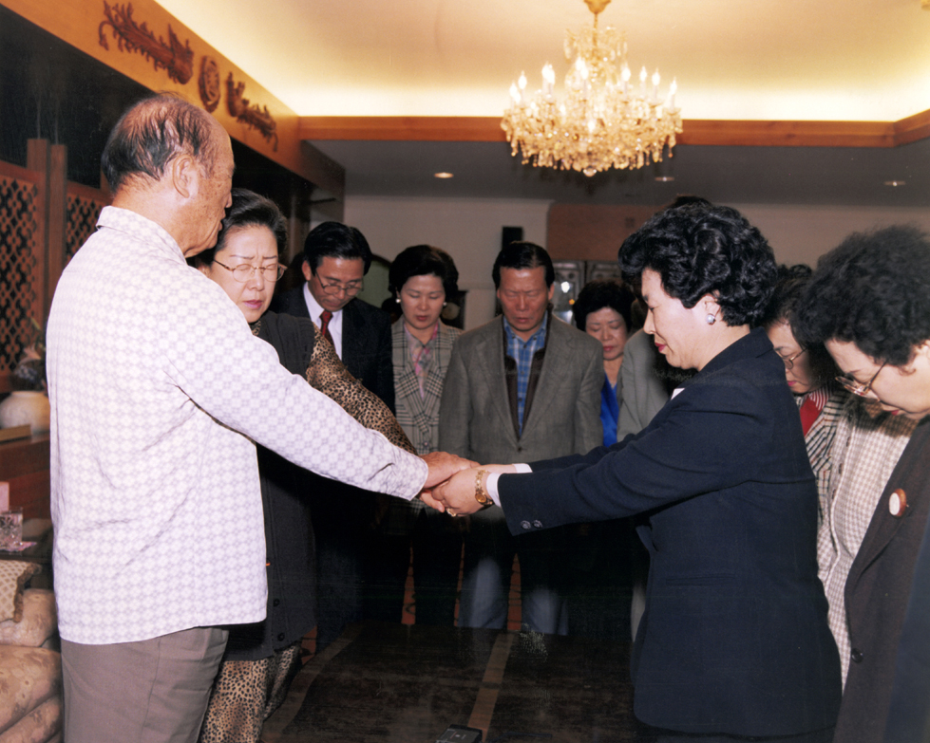
5-1. Ancestor blessing
The opening of the spirit world
Nov. 30, 1997
Notes:
Ancestor blessing, 5-2 (Proclamation of the opening of the spirit world)
Let us consider the ceremony for the proclamation of the opening of the spirit world.
This is the photo taken at the ceremony for the proclamation of the opening of the spirit world at East Garden on Nov 30, 1997.
This was the ceremony during which Heung Jin Nim and Dae Mo Nim received the authority of giving the ancestor blessing to our liberated ancestors from True Parents.
After this, Heung Jin Nim and Dae Mo Nim could start the ancestor blessing, instead of True Parents.

Slide 24
5-2. Ancestor blessing
Words on ancestor blessing
The words True Father gave us at the proclamation of the
opening of the spirit world when he made it possible for me to do ancestor liberation and blessing was, ”When we see the principle, spirits were not made to receive the blessing. Only humans on earth are supposed to receive the blessing, and spirits in the spirit world are not supposed to be blessed.” But why do we do this? True Parents made conditions to a level that Satan could not accuse them of anything, and based on this victory they can give the blessing which removes Original Sin, even for the liberated ancestors.
Notes:
Ancestor blessing, 5-1 (Words on the ancestor blessing)
The words True Parents gave us at the proclamation of the opening of the spirit world when they made it possible for me to do ancestor liberation and blessing were, "When we see the principle, spirits were not made to receive the blessing. Only humans on earth are supposed to receive the blessing, and spirits in the spirit world are not supposed to be blessed. " Then, how is this possible? True Parents made conditions to a level where Satan could not accuse them of anything and, based on this victory, they can give the blessing which removes Original Sin, even for the liberated ancestors. (Dae Mo Nim heard this from True Parents)

Slide 25
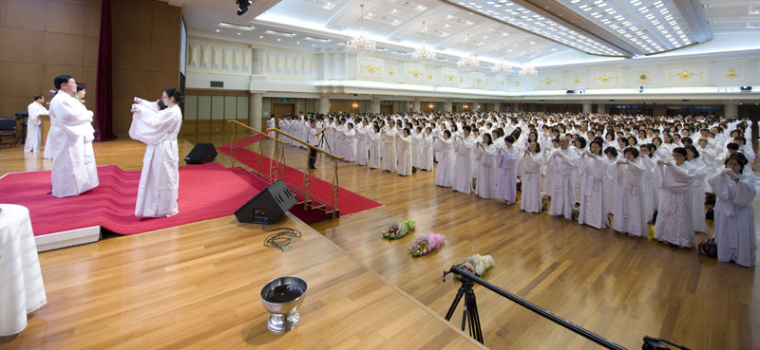
5-3. Ancestor blessing
Ancestor Blessing Ceremony
Notes:
Ancestor blessing, 5-3 (Ancestor blessing ceremony)
The ancestor blessing ceremony is the moment that our ancestors' original sin can be removed through the holy wine ceremony. How amazing this is!!
This is the moment that our ancestors' original sin can be removed through the holy wine ceremony. How amazing this is !!

Slide 26
6. Absolute good spirits
The role of the absolute good spirits
in our
lives
Absolute
good
spirits
help
everything
Generally
Notes:
The Role of the Absolute Good Spirit
By participating in the ancestor blessing ceremony, those liberated ancestors become absolute good spirits. Absolute good spirits are those spirits without any sins.
The role of these absolute good spirits is to help, generally, with everything in their descendants' lives and in God's providence.
For example, they resurrect to the descendants, help with God's providence, take part in Hoon dok family church activities, help to look for ancestors during ancestor liberation, help separate spirits from their descendants' bodies, help their descendants inherit heavenly fortune, guide them when the descendants go to spirit world and so on.

Slide 27


Help of Absolute Good Spirits
Lane 3
Absolute Good Spirits (Our Ancestors)
Lane 2
Lane 1

Slide 28


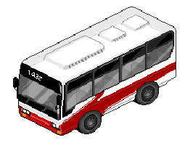
Help of Absolute Good Spirits
Male Member
Lane 3
Lane 2
Lane 1

Slide 29

7. Process of AL & B
The process of ancestor liberation & blessing
Training Center in the spirit world
100-day Workshop
40-day Family Workshop
Liberation
Blessing
To help
CP Heaven and Earth Training Center
Registration
Notes:
The process of ancestor liberation & blessing, 7
Let us consider the process of the ancestor liberation and blessing ceremony, by examining this flow chart:
After the liberation ceremony, the liberated ancestors go to Heung Jin Nim's Training Center in the spirit world to receive education and to clean up all their sins except for the original sin.
After 100 days from the liberation ceremony, if you come to the Cheongpyeong Heaven and Earth Training Center to get them blessed, they come down to the training center to receive the blessing. The moment they smell the holy wine, their original sin is removed.
After this, they go to a 40-day workshop for blessed families, in Heung Jin Nim's Training Center.
After 40 days, if you, the descendants, come to the Cheongpyeong Heaven and Earth Training Center to bring them to your home, they will follow you.
For those members who live overseas, as it is difficult to come to Cheongpyeong to bring them home, Heung Jin Nim and Dae Mo Nim will send them to your home after 40 days.

Slide 30

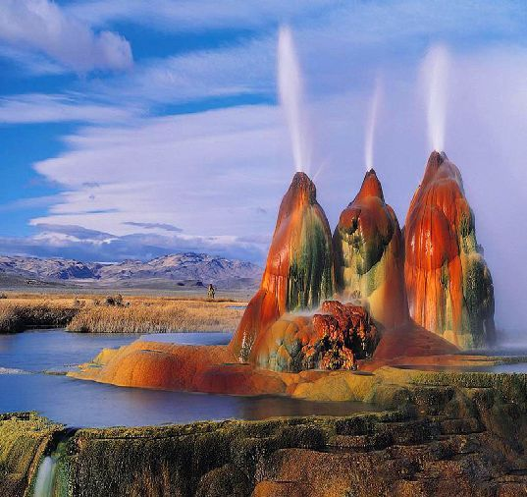
8-1 The value
The works of recreating the original world
God’s original world of creation
The ideal world of creation before Adam and Eve’s fall
Notes:
The value of the ancestor liberation, 8-1 (The works of making the ideal world)
Next we consider the value of the ancestor liberation ceremony.
First of all, the ancestor liberation ceremony is the work of recreating the original world.
There is God and there is Satan. And, who’s lineage were we part of? We were in Satan’s lineage. Even now, due to hereditary sins, collective sins, individual sins, fallen nature, and evil spirits inside our bodies, we are on Satan’s side. We are still not on God’s side. But what ancestor liberation does is recreate God’s world. We need to know this. God has carried on the history of restoration through Cain and Abel, Esau and Jacob, Noah, Abraham, Moses, Jesus, and now the Second Advent. This was all done in order to recreate God’s world.
This is, in other words, the world before Adam and Eve’s fall, the ideal world of creation, a world of good, absolute good spirits. Ancestor liberation is the incredible work that recreates this world, transforming it into the world before the fall of Adam and Eve. Furthermore, it cuts the lineage of evil and engrafts it into the lineage of good. Just like engrafting a bitter persimmon tree into a sweet persimmon tree, we engraft this history of evil into God’s absolute history of good. (December 8, 2005; 749th WS)

Slide 31



8-2 The value
Family tree based on God
Father’s side
GMF
Mother’s side
GMM
Grandfather
Grandmother
Grandfather
Grandmother
Father
Mother
I , myself
GMF: Grandmother on father’s side
GMM: Grandmother on mother’s side
Notes:
The value of the ancestor liberation, 8-2 (Family tree based on God)
The second accomplishment of great value is making a family tree based on God. Let us look at the family tree based on God.
Centered on myself, a blessed family member, there is the father’s side and mother’s side, and the father’s mother which is the grandmother on father’s side (GMF) and the mother’s mother which is the grandmother on mother’s side (GMM).
Ancestor liberation is the process of the recreation of the lineage which started through the works of God, changing it from the dirty lineage after the fall of Adam and Eve, to a good, clean lineage, centered on a blessed family and progressing in reverse.
Dae Mo Nim's words:
And the problem is that you usually think that your ancestors are one grandfather and one grandmother, but the further you go up, the more complex it is. Now the women are smart so they do not let other women live in the same house. The young people now do not do it, but the more you go back in time, there were cases in which they brought other women into the house to live, and that is why there were many grandmothers to one grandfather.
Even when members do ancestor liberation, sometimes there is one grandfather and 20 grandmothers.
This is how complex the lineages are. It is completely tangled up. What is this? It is lechery. You cannot clear lewd things like this. You write your family name and do registration, but when I actually go to look for the ancestors, many times it does not match.
If a grandmother secretly sees another man and becomes pregnant, the family name is not the lineage any more. And many sins are added to that, right? I had to cut the many sins and bring your grandmother, grandfather today…But what should be done when there is only one grandfather and many grandmothers? Who and who should I match and bless? The rule is one grandfather and one grandmother. The first grandmother is the one that was there though the hardships when they were poor. But if it is not the lineage that gave birth to the blessed families, they are not matched.
The grandmother who gave birth to the blessed families can be matched to the grandfather. Do you understand this? (502th WS)
They are matched according to the blessed families’ lineage, so what happens to all the other women? Will it or will it not become resentment? It becomes resentment. We must not leave any resentment, so it depends on whether or not the woman was married or single when she came to the grandfather. If she was single, I match her with a male spirit who died without marrying, and if she was married I match her to her original spouse. That is how it is.

Slide 32
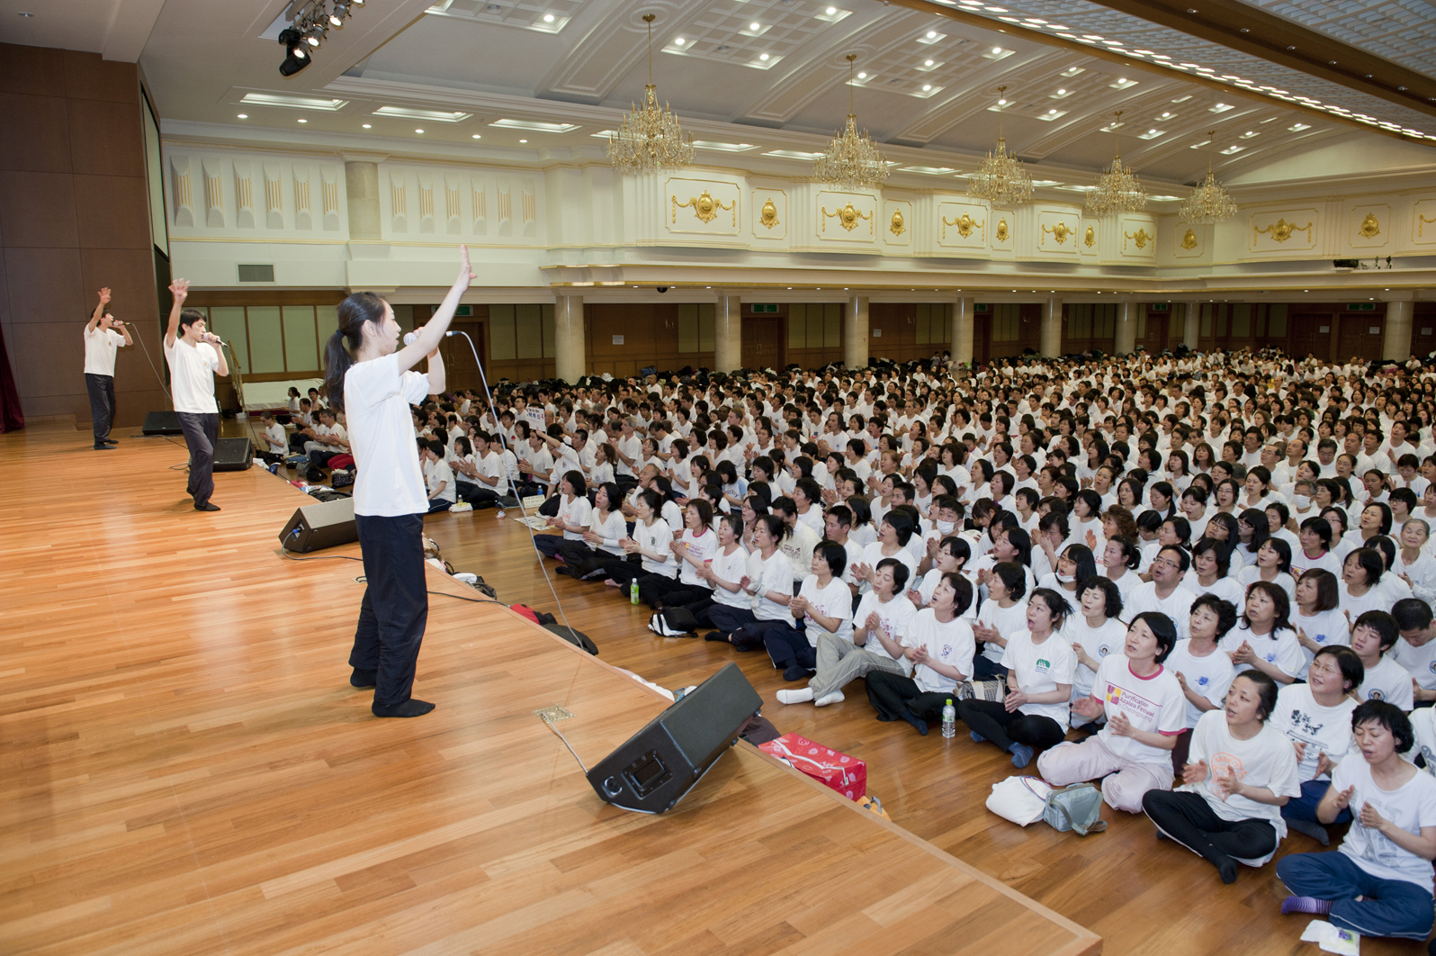
8-3 The value
Separating resentful spirits
Notes:
The value of the ancestor liberation, 8-3 (Separating resentful spirits)
Next, there is the precious grace and value of separating the spirits that are burning with revenge towards our ancestors (6,000 years of ancestors wrong-doings) and cutting the fallen nature and sins and bad habits connected to our ancestors.
How big are the sins that our ancestors committed in the past, that human history committed in the past? What are the results of human history? It is our lineage. It is our ancestors.
So, how big are the sins we commit during our lifetime compared to all the sins committed throughout human history? Unless you have committed a really big sin of misusing public money, or hurting someone’s feelings, or sexual problems, our sins are not so big. The reason why we must really work hard with absolute faith, absolute love and absolute obedience, is because all of human history is inside who? Inside us!
All of our ancestors’ mistakes are inherited and rooted inside us. That is why we cannot resolve past mistakes unless we strive to get rid of our bad habits from the past and work on new good habits, learning from God and True Parents way of living. (page 63)
And as we do ancestor liberation there are 6,000 years, and even more, of what our ancestors did during their lives, inside our bodies. All their sins and faults are inside us. We should know that it is easier to cleanse all of these hereditary and collective sins and fallen nature if we do ancestor liberation first. (502th WS)

Slide 33
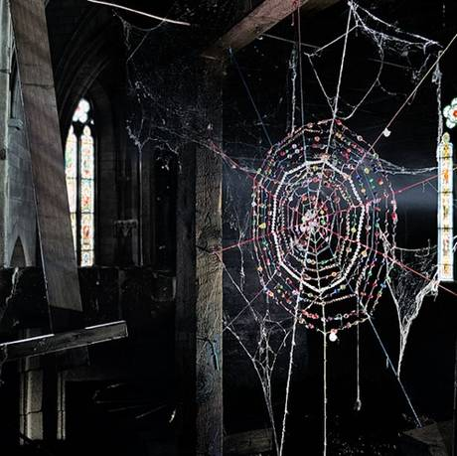
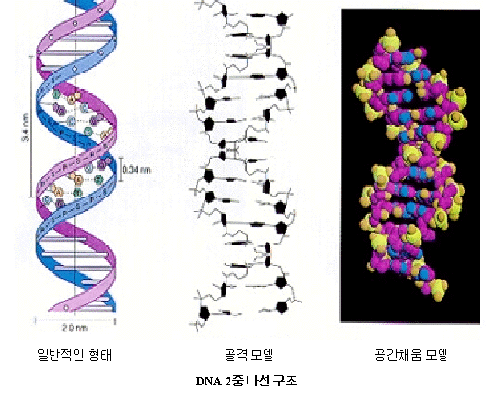
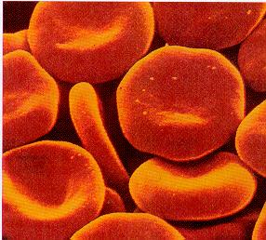
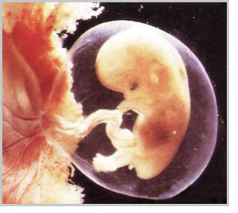
8-3. The value
Cutting off fallen nature, sins, bad habits

Fallen nature

Sins

Gene

Bad habits
Blood
Notes:
The value of the ancestor liberation, 8-3 (Cutting off fallen nature and sins, and bad habits)
In our genes and blood, fallen nature and sins and bad habits are connected from our ancestors like a spider web or an umbilical cord.
Through the ancestor liberation ceremony this will be cut off.

Slide 34
8-4 The value
Words on Heavenly Fortune
When there are many spiritual illnesses and spiritual
pain, it is difficult for God to come inside us.
Because I know this, by clearing this we, blessed
families can live in joy and happiness in this era to
move heavenly fortune.
Dae Mo Nim’s words in January 2006
Notes:
The value of the ancestor liberation ,8-4 (Words on Heavenly Fortune)
The fourth benefit is inheriting heavenly fortune. Let us look at these words:
Now, in 2006, it is a time when God can be inside us. God can be very close to us, not far away. God is close to us together with the absolute good spirits, but the more evil spirits inside our bodies, the more difficult it is for God to come inside
When there are many spiritual illnesses and spiritual pain from evil spirits, it is difficult for God to come inside us. Because I know this, by clearing this we, blessed families, can live in joy and happiness in this era to move heavenly fortune.
(Dae Mo Nim's words in January 2006, on the 11th anniversary)
The more we have absolute good spirits through the ancestor liberation and blessing ceremony, and we live principled lives with the absolute good spirits, the more heavenly fortune we inherit and move. So this heavenly fortune will move us and we will live according to heavenly fortune.

Slide 35
Number of Absolute Good Spirits
F 210th=420 F 420th=840
M 210th=420 M 420th=840
GMF 210th=420 GMF 420th=840
GMM 210th=420 GMM 420th=840
4 lineages=1680 4 lineages=3360
Husband + Wife=3360 Husband + Wife=6720

Slide 36
Expansion of Heaven
- Moving the spiritual training center alongside the line between heaven and hell where once evil spirits occupied the area
We are creating a house for the Absolute Good Spirits to live from December 13, 2008 and this house is being built within that area
- The evil spirit world had covered 80% of the whole spirit world but had stopped, and since then Heaven had started to expand

Slide 37
Works of Heaven’Expansion
Spirit World
Cheon Jeong Gung
House
Training Center
ABS-H
House
House
80%
20%
House
Heaven
Hell
House for Absolute Good Spirits

Slide 38
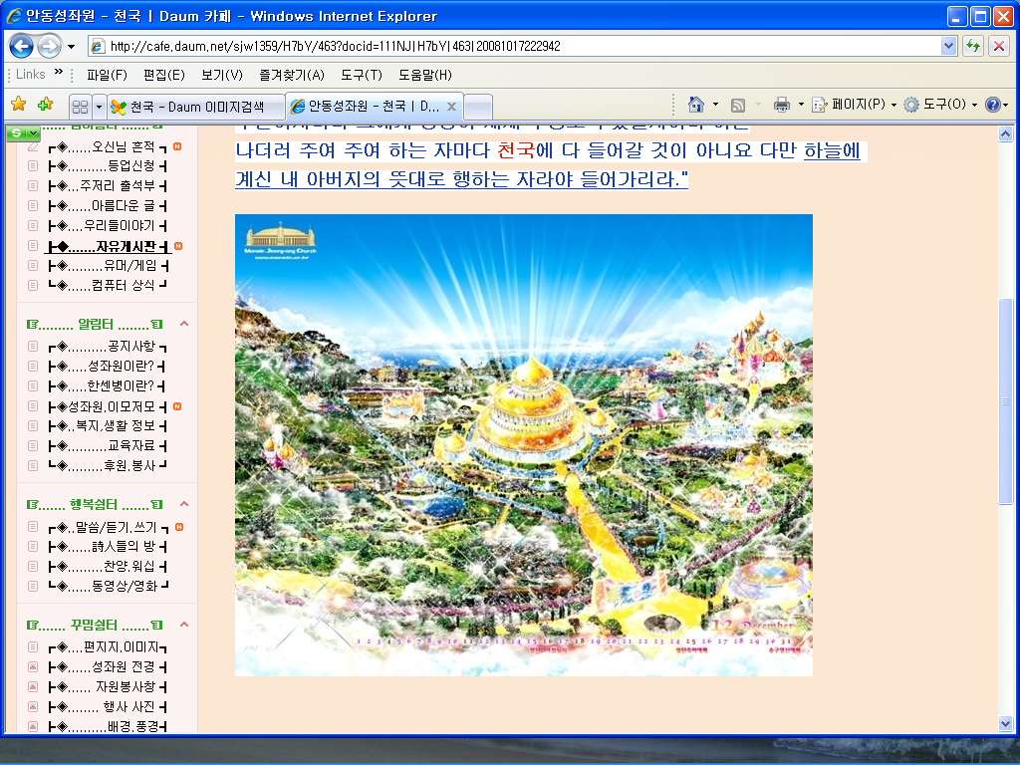
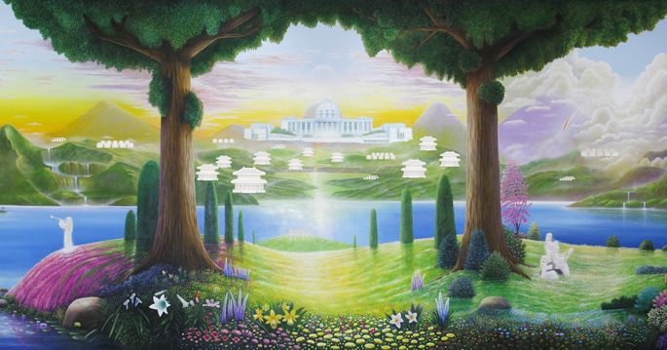
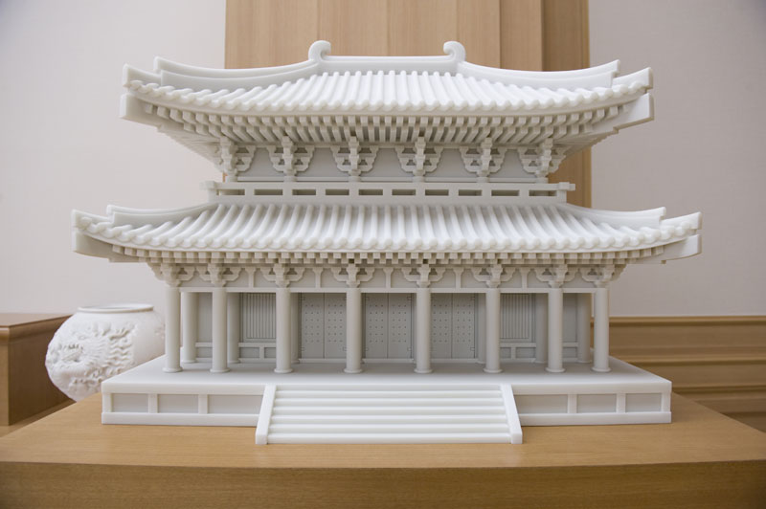

Slide 39

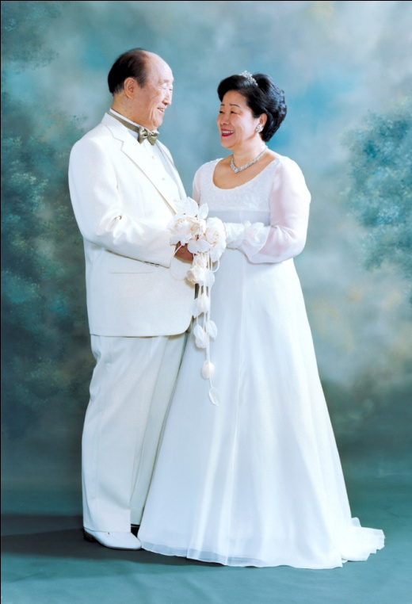
The Ideal World
realize
Citizen of CIG
on earth
God’s children
in heaven
Notes:
Conclusion
We are living in a very happy time.
Attending and serving True Parents, and helping God's providence as the citizen of Cheon Il Guk on earth and the absolute good spirits in heaven, let us realize God's ideal world of Creation!!
Thank you so much!!

Slide 40
Thank you!

