Slide 1
True Parents’ Life Course
Prof. Oh, Taek Yong

Slide 2
Lecture 1 True Mother’s Status as True Parents of Heaven, Earth, and Humankind
CIG Year 2, January 21 HC (2014.2.20)

Slide 3
I. Introduction
God Before the Creation and God After the Creation
True Mother’s Birth and Status (1943-1960)
True Parents’ Holy Wedding and Status (1960, 2003, 2013)
CIG Foundation Day and Blessed Families (2013.1.13)

Slide 4
II. God Before the Creation and God After the Creation
A. God Before the Creation and God After the Creation
1. Exposition of the Divine Principle
Because God exists as the subject partner having the qualities of internal nature and masculinity, He created the universe as His object partner with the qualities of external form and femininity. (EDP, 19)

Slide 5
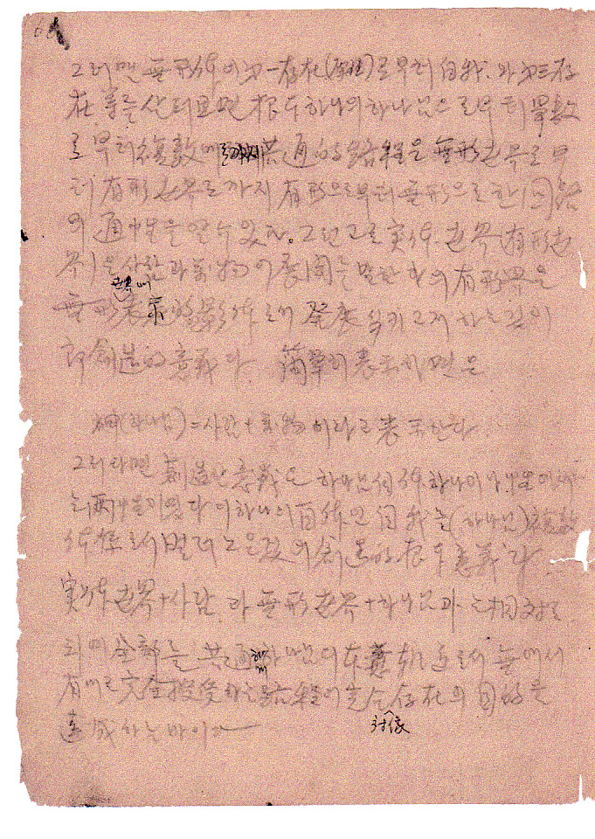
2. OTDP, 6
God = Human beings +
All Things”
Then the significance of Creation lies in the fact that God Himself is one, but has
dual characteristics(兩性)
in gender (性).

Slide 6
B. God Before the Creation (EDP, 21)
God before the creation:
Exists as the subject partner having the qualities of internal nature and masculinity
Has dual characteristics (兩性) in gender (性) (OTDP, 6)
Is the Heavenly Parent (333:32, 2000.9.24; 356:123, 2001.10.11)
Cosmic Parent: Vertical Parent, Parent of Mind, Incorporeal Parent (2003.1.16)
Position (格位): Masculine, Heavenly Father (EDP, 27; 1996.4.16)
Absolute, unique, unchanging, eternal, inactive sex (靜性) settlement, harmony, unification (415:272-74, 2003.8.15.; 423:40-42, 2003.10.25)
Cannot feel this because it is one with Himself (1996.8.1)
Is the God of Night (2010.7.13)

Slide 7
C. God after the Creation (2010.7.13)
God after the creation:
Exists as the object partner with the qualities of external form and femininity
As Adam and Eve as substance of dual characteristics (兩性) in gender (性)
(OTDP, 6)
3. Is the Earthly Parent (333:32, 2000.9.24; 356:123, 2001.10.11)
Is the Parent of Heaven and Earth: Horizontal Parent, Parent with a Body, Corporeal Parent (2003.1.16)
5. Has Position (格位): Feminine, Heavenly Mother (1996.8.1)
Is one mind, one body, one thought, one core, active sex (動性) settlement, harmony unification (415:274-78, 2003.8.15; 423:42-43, 2003.10.25)
7. Can feel because two are one (1996.8.1)
8. Is the God of Day (2010.7.13)

Slide 8
D. God After the Creation is of the One Essence as He was Before the Creation (1998.4.27; 5.3)
Communion of internal nature and external form, masculinity and femininity, subject partner and object partner
Has dual characteristics (兩性) in gender (性)
Heavenly Parent + Earthy Parent = Parent of Heaven and Earth
Parent of HEH : Vertical/Horizontal Parent, Mind/Body Parent, Incorporeal/Corporeal Parent
Position(格位) : Parent, Heavenly Parent
AF, AL, AO, Absolute Subject, Absolute Sex settlement, harmony, unification (415:278-80, 2003.8.15; 423:43-45, 2003.10.25)
Can feel because two are one.
God of Night + God of Day = God of Night and Day

Slide 9
E. God’s Purpose of Creation
(View of the Principle of the Providential History of Salvation, 1996.8.1)
In order for two to become one, and feel (1996.8.1)
Adam and Eve reach individual perfection
In the place where Adam and Eve become one horizontally
God comes down vertically
God, Adam, and Eve become one eternally, and are stimulated with joy.
Endlessly multiplying God’s direct children
One harmonious union of God Before the Creation and God After the Creation

Slide 10
F. The Place Where God’s Purpose of Creation is Fulfilled (EDP, 30)
Central place of goodness
Place where God rests eternally
Place where God feels stimulating happiness eternally
Place where God’s Words are realized substantially
Central place of truth
Central place of original mind
c.f. PM, 17.

Slide 11
G. God’s Purpose of Creation and “I”
Origin: Cosmic Parent, God before the Creation (dual characteristics)
Division: Parent of Heaven and Earth, God after the Creation (substance of masculinity + substance of femininity)
Union: Parent of HEH, God before the Creation + God after the Creation
Multiplication: Children of TP of HEH

Slide 12
God Before Creation
Formation
Growth
Perfection
Perfection
Growth
Formation
Adam God After Creating Eve

Slide 13
III. True Mother’s Birth and Status (1943.1.6-1960.3.16)
God’s Purpose of Creation and TP’s Perfection
(35:218, 1970.10.19)
Must find a mother of the original Creation
There must be a mother of original nature
Parents: Fallen parents, restored parents, parents who have not fallen
Must find and restore three generations of parents

Slide 14
B. The Lord of the Second Coming comes to find his bride as the mother of humanity (35:218)
“That bride is not a bride found within the fallen realm. It is finding the person born with a pure lineage that has no connection with the fall. On what foundation does that kind of bride, or mother, need to be born? She needs to be born on the foundation of an Abel-type mother of the fallen world. … There needs to be a mother who can take the position of mother (True Mother) as a virgin who has no connection with sin.”

Slide 15
C. Eve of the original Creation is created through Adam
(35:224, 1970.10.19)
Principle of Creation: Eve was created after Adam
Principle of Restoration: Perfected man creates woman
Jesus’ Birth: Beginning point of finding Eve
Eve: Needs to be made through Adam

Slide 16
D. True Mother’s Self-Consciousness
Grandmother Won Mo Jo’s teaching: Your father is Heavenly Father!
True Mother: Always thought of “Heavenly Father” when calling “Father!”
Lived with a feeling of being wrapped all around with warmth
Mother of Ho Bin Heo: When TM is 4 years old, she will become Heaven’s bride!
True Mother: Revelation that she was born with the destiny to become Heaven’s bride
Notes:
wi

Slide 17
E. TM’s Resolution directly after the Holy Wedding (2012.8.15)
Will end restoration through indemnity in my generation.
Will liberate God no matter what
Knew everything before meeting True Father
“I have already achieved these resolutions.”

Slide 18
IV. True Parents’ Holy Wedding and Status (1960, 2003, 2013)
A. TP’s Holy Wedding
TP’s1st Holy Wedding (1960.3.16)
TP’s 2nd Holy Wedding as TP of HE (2003.1.6)
TP’s 3rd Holy Wedding as TP of HEH (2013.1.13)

Slide 19
B. Holy Wedding of TP of HEH and TM
G
G
G
①
A
E
A
③
A
E
U
②
E
Holy Wedding of TP, 1960
Holy Wedding of
TP of HE, 2003
Holy Wedding of
TP of HEH, 2013

Slide 20
C. Changes in TM’s Status
Behind TF(1960-1991.7.1)
Beside TF(1991.7.1)
Equal place as TF (1999.6.14)
Same place as TF (2000.6.1)
One body with TF (2003.2.6)
No longer bows to TF (2003.3.16)
One Essence with God (2006.6.13)
No Longer bows to God(2006.6.13)

Slide 21
D. Substantial Trinity as seen through ODU Action
(292:269-331, 1998.4.27.; 293:49-78, 1998.5.3)
ODU Action: One mind, one body, one essence
One mind (一心): One mind between Heavenly Father and Adam, and Heavenly Mother and Eve
One body (一身): One body between perfected Adam and Eve
One essence (一体): One essence between God, Adam, and Eve
Substantial Trinity: Holy Father, Holy Son, Holy Daughter (279:118, 1996.8.1; 358:178, 2001.11.3; 487:179, 2005.2.16)
Substantial Trinity: Through “absolute sex”

Slide 22
E. ODU Action and the Four Position Foundation
G
G
O
G
O
+
=
A
E
A
E
A
E
D
D
U
U
Unification
C
Multiplication
C

Slide 23
V. CIG Foundation Day and Blessed Families
A. CIG Foundation Day Coronation Ceremony (2013.1.13)
Holy Wedding of TP of HEH: Holy Wedding of Parent of HEH
Coronation Ceremony of TP of HEH as the CIG Emperor and Empress
Proclamation of CIG Year One

Slide 24
B. CIG Foundation Day Registration Blessing Ceremony:
Children of TP of HEH
Reborn in the Garden of Eden in the original Creation
Permission to register as CIG citizens: Elysium

Slide 25
VI. Conclusion
Perfected Adam and Eve, each as God’s independent substances of masculinity and femininity, are yet one gender of God.(2012.3.4)
TM was born as the Eve of the original Creation.
TP of HEH: Conclusion of the Age of Indemnity, Liberation of God and salvation of humankind
TM: Leading the Providence with True God and True Father

