Slide 1
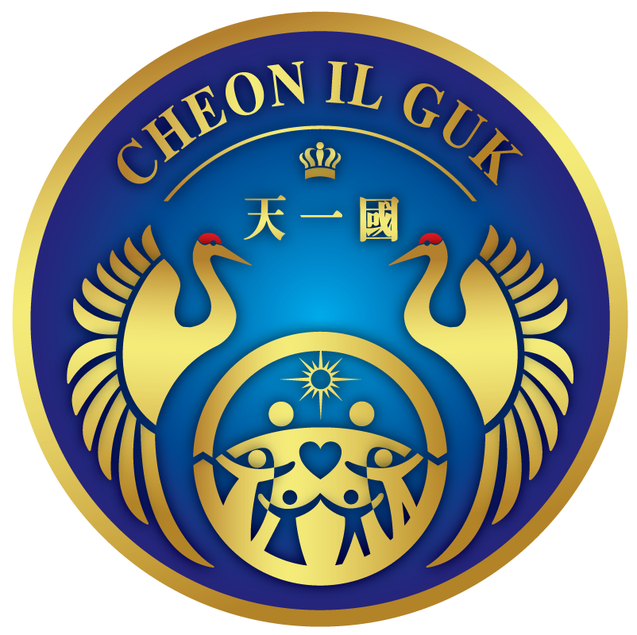
Holy Ground Vitalization Program Plan
Education Department of
FFWPU International HQ

Slide 2

I. The Meaning of Holy Grounds
Holy Ground: Holy grounds are purified land. Due to the fall of man, it became a world in which Satan temporarily resides. Holy Grounds are purified land where God can be present, and blessed families, who have been engrafted as God’s children, can offer sincerity and be connected directly with God. Because of this, it is a sacred ground where God can leave His Will. With the condition of loving the Holy Ground, we can establish the foundation of loving the nation [13-14]

Slide 3
II. The Meaning of Choosing the 120 Holy Grounds
There has to be land in order to create people. So, we need to get entangled with historical problems by choosing holy grounds. The 120 nation’s holy grounds are needed to make a base for God’s love. There is no base for God’s love on this earth. There is no place to stand, because there is no base. Therefore, True Parents who have full authority have chosen holy grounds in their name. [191-121]

Slide 4

III. Planning a project of loving Holy Ground s
Purpose : Holy grounds are the base of love where we can meet God, and are used as a place where members can come and go, unite, and multiply love. Moreover, the Holy ground can be marked as part of a pilgrimage tour the following of which foreign members can visit and pray for that country.
Expected Outcome
It can become a part of God’s land where we can unite.
Through the vitalization of one’s own country, a foundation can be established as a base to expand God’s nation.
3) Holy grounds can be used as one chapter of the traditional education for church members, 2nd and 3rd generation.

Slide 5
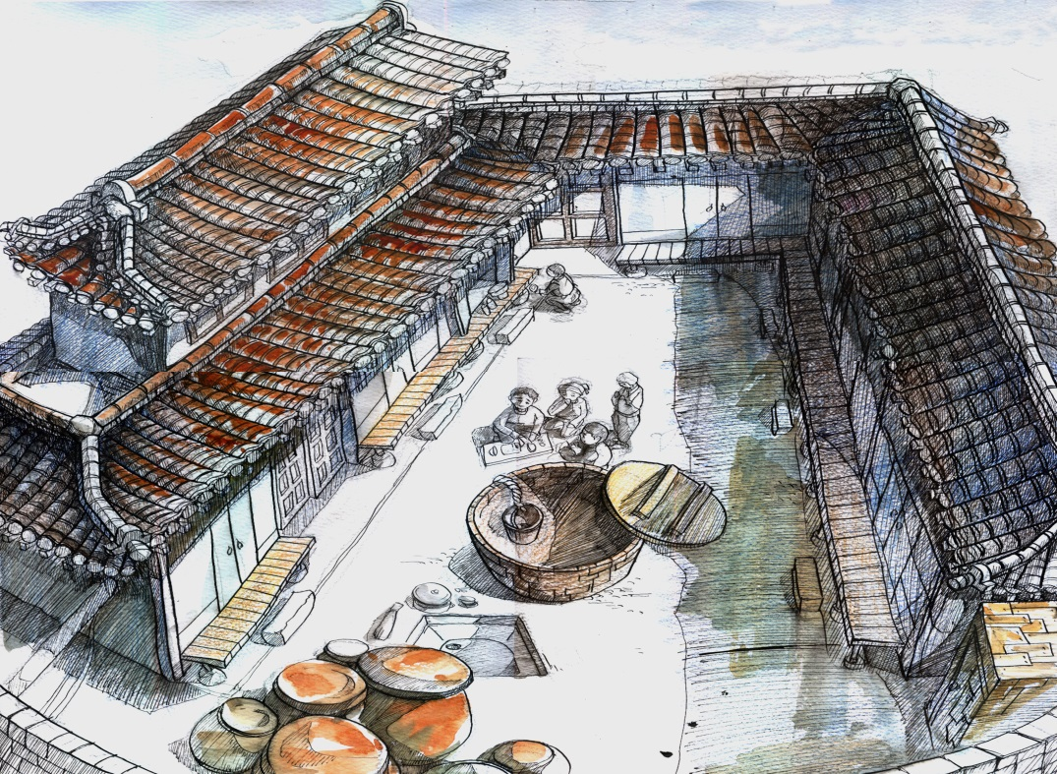
1. Heuksok Dong Holy Ground
Ex) Giving traditional education through the training of holy grounds guides

Slide 6
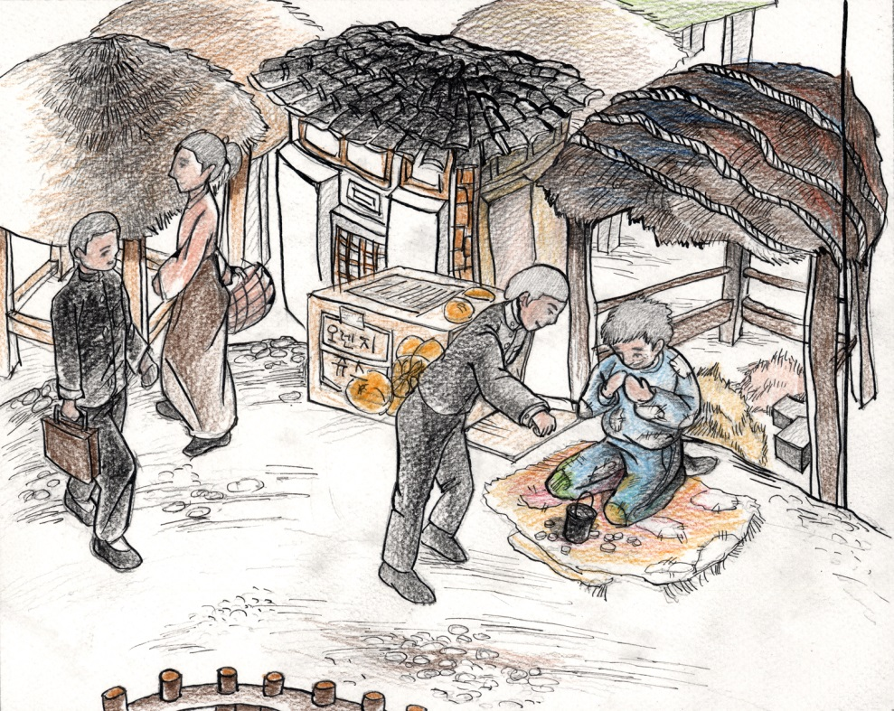
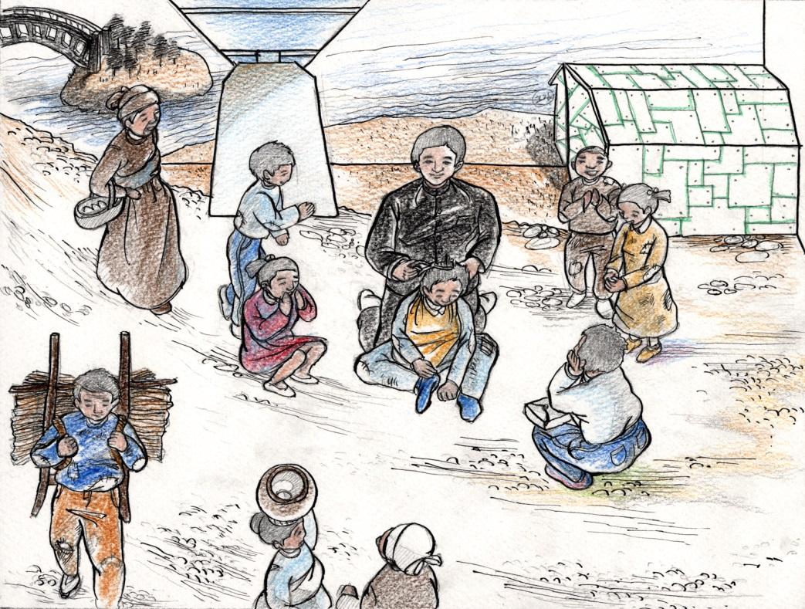
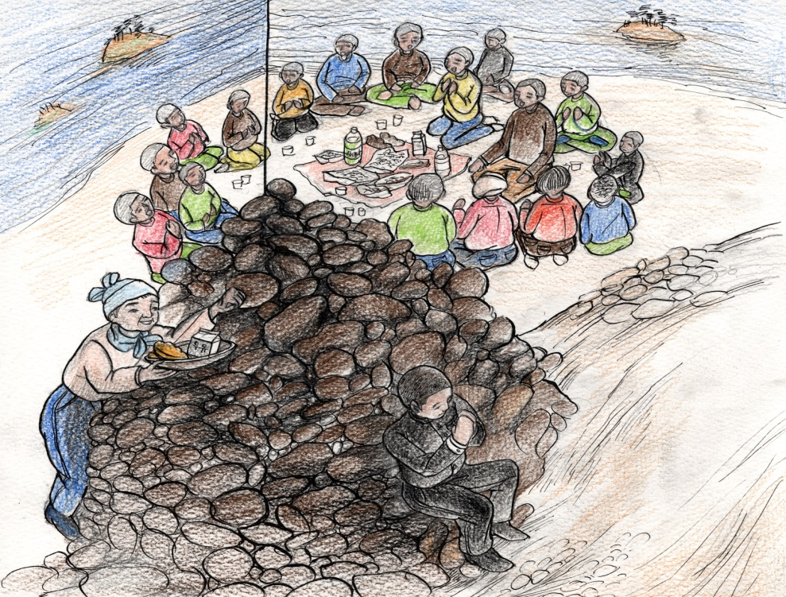
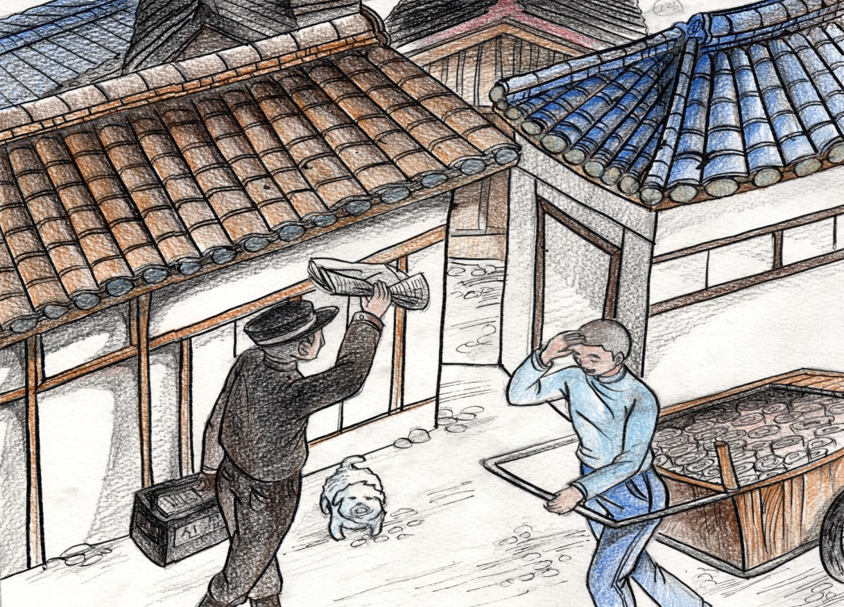

Slide 7
2. Holy Ground Guide Training Course
Create a text compiled from historical records from headquarters and counsel from elders or members who have extensive and accurate knowledge of the holy ground.
2) Learn what happens at the holy grounds from members who
live nearby.
3) Specify the program depending on the age group of the visitors.
4) Grant a holy ground guide license to members who are qualified.
5) Advertise so that those from a church or organization who want to visit the holy grounds can easily contact a guide.

Slide 8



3. Syllabus and Program Plan by Age Group
Ex) Draw Your Life Graph
60
40
20
Age 10
Age 20
Age 30
Age 40
Age 50
Age 60
Age 70
0
-20
-40
-60

Slide 9
3. Syllabus and Program Plan by Age Group
60
Compare your life cycle with True Father’s life cycle
40
Heuksok Dong Holy Ground
(Middle School)
Yeoi-do
Holy Ground
(towards the world)
Holy Marriage(41)
20
Age 10
Age 20
Age 30
Age 40
Age 50
0
Rural Enlightenment Movement (youth)
Ya-mok Holy Ground
Beach Fishing
<Instead of Jeong-ju, North Korea>
(childhood before 16)
Chungcheong-do Gap-sa
Dispatch Missionaries
(in forties)
-20
-40
Cheongpa Dong
Holy Ground
1955.7.4
Ehwa, Yeonsei Un. Incidents (college)
-60
Seodaemoon Holy Ground
Independence Movement
(High school & college)

Slide 10
3. Syllabus and Program Plan by Age Group
Ex) Compare your life cycle with True Father’s life cycle
Establishment of the TP UN(age90)
Completion of settlement of TP of HEH
(age91)
60
40
Olympic Stadium
Founding of Women’s Federation
Proclamation of True Parents(age 73)
Seonghwa(聖華)
(age 93)
Holy Marriage
20
Age 50
Age 60
Age 70
Age 80
Age 90
Age 100
0
Heungnam Premier Palace
Meeting Kim Il-sung: lay the foundation for North & South Unification
(age 72)
Cheongpyeong Holy Ground
Start Ancestor Liberation
& Blessing (age 78)
Coronation Ceremony for
the Kingship of God (age 82)
Coronation of the Blessed Family King
(age 84)
Coronation and Entering Cheon Jeong Gung (age 87)
Founding of True Parent UN (age 90)
Completed Settlement of Cosmic True Parents (age 91)
Washington Monument
Rally(age 57)
Led the Mental Revolution in America
Danbury Prison
(age 65)
-20
-40
-60

Slide 11

3. Syllabus and Program Plan by Age Group
For Elementary Students
Use easy (elementary) language
Emphasize True Father’s school days
Instruct them to learn his attitude towards life
Have them carry out an action step program so they can practice love towards their friends and neighbors
Do a puppet show related to True Parent’s school life

Slide 12

3. Syllabus and Program Plan by Age Group
For Middle/High School Students
Use relatively easy language
Emphasize True Father’s school days and his time studying abroad
Instruct them to compare what True Father did at their age compared to what they are doing, and what they can do in their life or at church
Do a imitation program about the things True Father did during his school days and the time he lived in a boarding house
Ex) Prayer on Heuksok Dong holy ground, cooking food,
carrying his friend on his back, etc.

Slide 13

3. Syllabus and Program Plan by Age Group
For General People
Compose a textbook with detailed content
Address anecdotes of the whole of that region
Have them reflect on their life as they visit the holy grounds
Instruct them to learn about patriotism and the attitude of life they should have about True Parents and Heavenly Parent.

Slide 14
4. Grant a Holy Ground Guide License
Educate the Holy ground guides to be able to train their hearts in accord with historicity and reality.
The guide is a member who has acquired a capability among the members, benefits from lecture programs and then experiences various tests of being a real guide.
A Holy Ground Guide License should be granted according to the situation of each country.

Slide 15
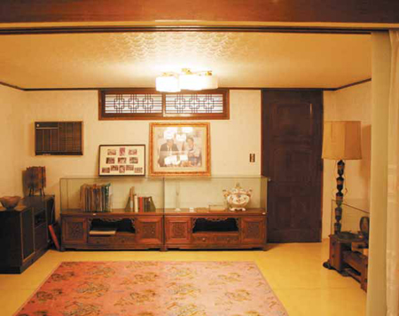
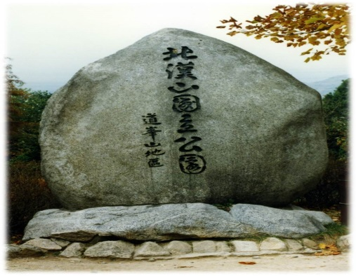
5. Advertise Holy Grounds
Make a connection network so that every church which has a holy ground can be connected directly with a holy ground guide.
Advertise through the headquarters homepage or other church media.

Slide 16
6. Program Progress
As you go around together, explain each holy ground based on holy ground-related material.
Provide a separate program that is connected with the holy grounds.
After doing the program with the visitors, have them fill out an evaluation survey.
Based on their feedback, continue to create an enhanced program.

Slide 17
V. Plan a Holy Ground Program
1. What did you feel as you compared your own life cycle with True Father’s ?
Think about the challenges and dreams you may have as you compare your future life cycle with True Father’s.
2. How many holy grounds are there in your country, and what are their historical contents?
3. What is the connection between the meaning you understand about the environment around a holy ground, and the feeling you receive, and your offering sincere devotion there?
4. How do you want your country’s holy grounds to be vitalized?

Slide 18
Thank You!

