Slide 1
The Role of a Pastor’s Wife
in the Individual
Churches of Family Federation
Yoo, Jung-hwa,
the wife of the pastor of Cheongshim Family Church

Slide 2

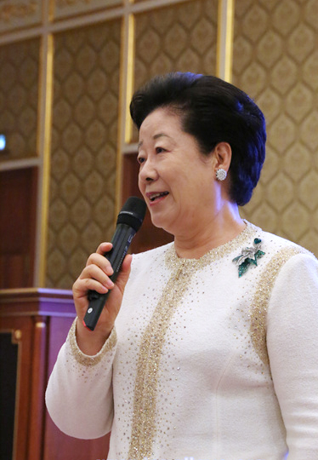
Content
1. Presenting the problem
2. Plan to improve the role of the wife
3. Leadership model for the pastor’s wife
4. Characteristics of leadership
5. My ideal image of a pastor’s wife

Slide 3
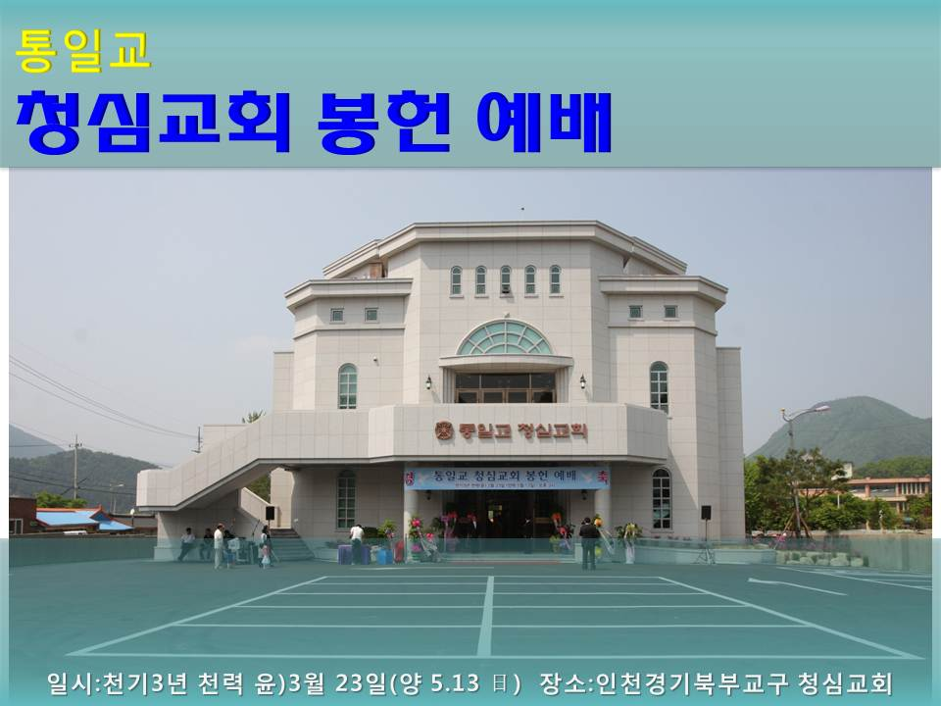
1. Presenting the Problem
Why do we need to discuss the role of the pastor’s wife?
-> Although the Era of Cheon Il Guk has already arrived, church development is less than expected.
-> There are various causes to consider, including the role and tasks that can be performed by the pastor’s wife.
-> In general there is no role for the pastor’s wife in many FFWPU
churches.
-> There is an urgent task to clarify the pastor couple’s ministry activities so they can work toward a common goal.
-> We should set up a balanced ministry in which
both the pastor and his wife play an active
role.

Slide 4
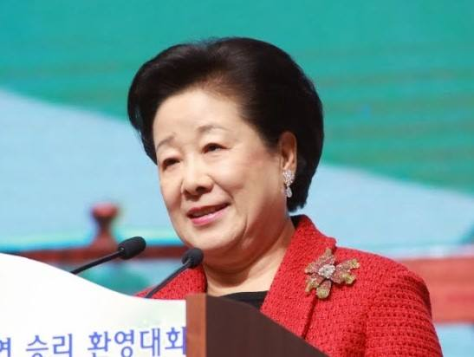
2. Plan to Improve the
Role of the Wife
(1) The wife’s role
(2) The current reality of the
wife’s role in many FFWPU
churches
(3) Improvement plan

Slide 5

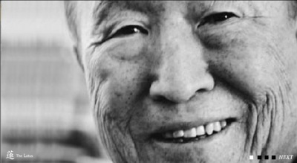
True Parents’ Words
A wife should serve God in the position above her, her husband beside her, and her children below her. After that, she should serve the church members as spiritual sons and daughters.
If you do not become a wife who can digest these four great positions, there will be no development in your church.
[044-166] (1971.05.06)

Slide 6
True Parents’ Words
In order to be a pastor’s wife, you must take the role of a teacher and a mother. A pastor’s wife should be better than the pastor. In other words, she can become the pastor’s wife only when she can fulfill the role of a teacher and a mother. [114-161] (1981.10.18)
Where is the pastor’s wife? She must earn money and feed [the children]; you need to feed and save them. The church needs this kind of wife. [114-180] (1981.10.18)
If you are the church leader’s wife, when he asks ‘How was today’s sermon?’ you can answer, ‘It was splendid! But if you had used more adjectives and included this kind of good phrase, it would have been 100% perfect. You just need a little more improvement.’ When you correct the sermon for him by writing down the additional adjectives and phrases in his notebook and say lovingly, ‘This kind of content will spread like a flower’s fragrance and move everyone’s heart,’ Then he will reply, ‘Phew!’ with a sigh of relief. You become the teacher. Then you can continue to encourage him to speak publicly. Encourage him to pray before a meal. If you keep doing this, he will change into a great pastor within three years. [256-137] (1994.03.12)
In order to live for the whole and take the mother’s role in the church as the pastor’s wife, you need to take entire responsibility and deal with it. [274-245] (1995.11.03)

Slide 7
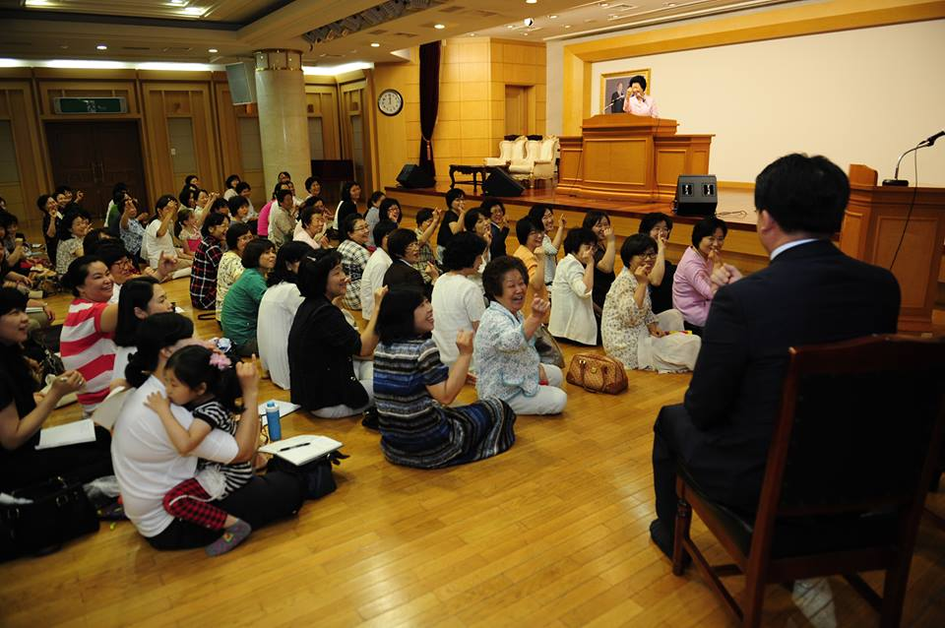
The Three Roles of the Pastor’s Wife
(1) As the Wife of the Pastor (the subject)
Attend the pastor publicly.
Assist the pastor as his partner in ministry.
Raise up the pastor.
(2) As the Eldest Daughter or Daughter-in-law of the Senior Families
(the grandparents)
Attend the senior families.
Protect and care for the elder senior families.
Raise up the elder senior families until their
passing (seonghwa).
(3) As the Mother of the Members (the children).
Give birth to and take care of the members.
Protect and care for the members.
Nurture and educate the members.

Slide 8
Nine Tasks of the Pastor’s Wife
Partner
Follower
Leader
  (1) Attend the senior families
  (Attend the grandparents from
  the parents’ position)
  ☞ Mission to attend the senior families
  (2) Protect and care for the elder senior families
  (Protect the grandparents from the parents’ position)
  ☞ Mission to protect the senior families
  (3) Raise up the elder senior
  families until their passing
  (Raise the grandparents until
  their passing from the parents’ position )
  ☞ Mission for the internal
  maturity of the senior families
  (1) Give birth to and
  take care of the members
  (Birth and care of the children)
  ☞ Mission to witness to new members
  (2) Protect and care for the members
  (Protect and care for the children)
  ☞ Mission to protect and care for the members
(3) Nurture and educate the members
  (Children’s growth and education)
  ☞Mission for the internal
  maturity of the members
  (1) Attend the pastor publicly
  (Attend the subject from the wife’s position)
  ☞ Mission to attend the pastor
  (2) Assist the pastor as his partner in ministry
  (Take a role relative to that of the pastor)
  ☞ Mission to assist the pastor
  (3) Raise up the pastor
  (Raise the subject in the wife’s position)
  ☞ Mission to support the pastor’s growth

Slide 9

The Reality of
Many Pastor’s Wife
▶ Lack of a clear role
▶ Ambiguous position
▶ Expected to remain silent and unnoticed
according to social norms
▶ Is both existent and nonexistent
▶ The Era of Cheon Il Guk is the Era of Completion, Era of the Heifer;
Era of the Mother
▶ Must add value to the woman’s role
▶ The new era demands the reestablishment of the wife’s role

Slide 10
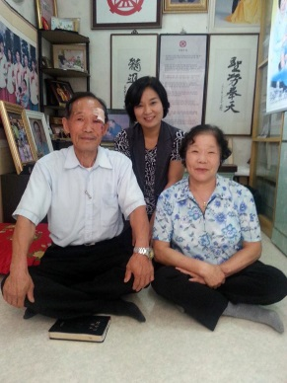
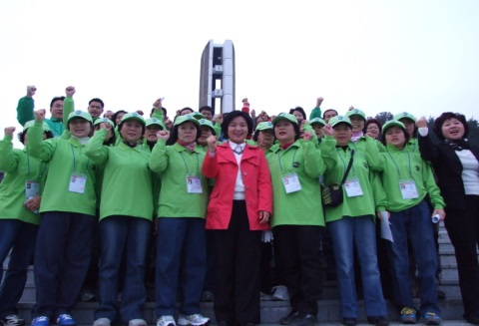
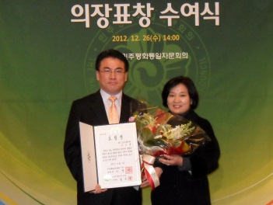
3. Leadership Model for the Pastor’s Wife
Partner
Attend: Attend the pastor (subject) from the object position
Assist: Assist the pastor (positive) from the negative position
Grow: Raise the pastor as his wife
Follower
Attend: Attend the senior families as the eldest daughter from the parent’s position
Protect: Protect the senior families as the eldest daughter
Grow: Plan the growth of the senior families until their passing as the eldest daughter
Leader
Care: Serve as a mother who gave birth to her children
Protect: Serve as a mother who protects her children
Nurture: Serve as a mother who brings up her children

Slide 11
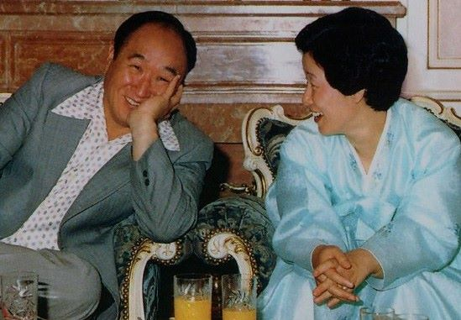
4. Characteristics of Leadership
∙ Partner
∙ Follower
∙ Leader

Slide 12

Partner
In their relationship as a couple, the pastor is in the subject position and the wife (spouse) is in the object position.
The wife must fulfill the role of an object partner.
Public Partner
Preparation Partner
Complimenting Partner
External Partner
Complementing Partner
Prayer (Devotion) Partner
Discussion Partner

Slide 13
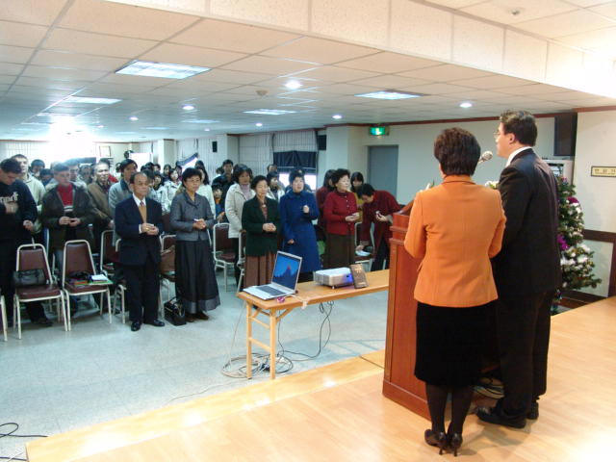
(1) Public Partner
Concept
The pastor and his wife are both public figures.
Characteristic
The wife attends the pastor publicly.
Examples
Attending the pastor in his ministry.
Recognizing the husband’s public
position.
Bringing the husband out to public
activities.

Slide 14
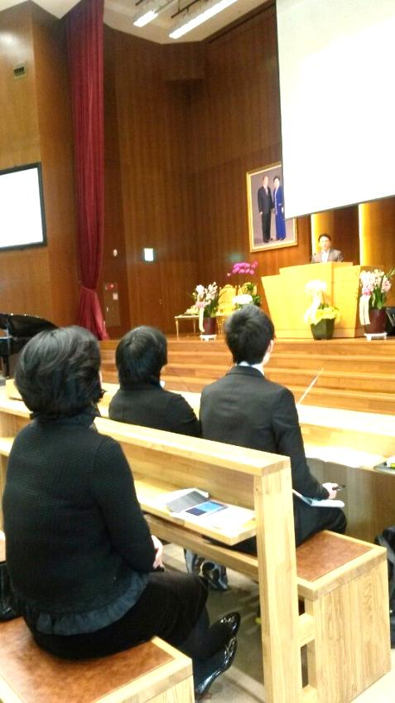
(2) External Partner
Concept
The wife takes responsibility for other matters so the pastor can
concentrate on his ministry.
Characteristics
Coordinates the pastor’s external appearance.
Takes care of the family education and
finances on her own.
Examples
Coordinating clothing to increase
positive feelings and trust from others.
Taking responsibility for family education and
financial problems so the pastor can concentrate on his ministry.

Slide 15
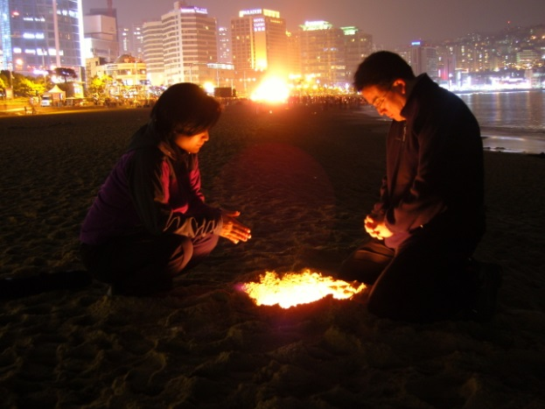
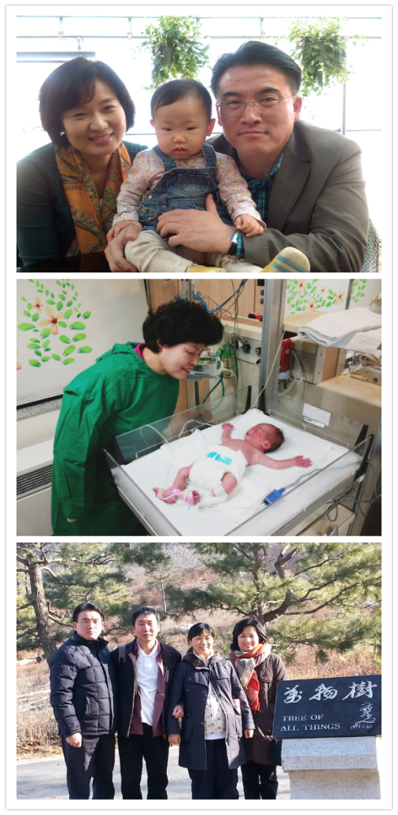
(3) Prayer Partner
Concept
Performs devotional activities together for
the sake of the ministry.
Characteristics
Always offers prayer (devotion)
together as a couple.
Performs devotions when the pastor is busy.
Creates and checks the spiritual atmosphere.
Examples
Zipporah in the Bible.
Result of devotion:
Conceiving a child after 10 years.

Slide 16
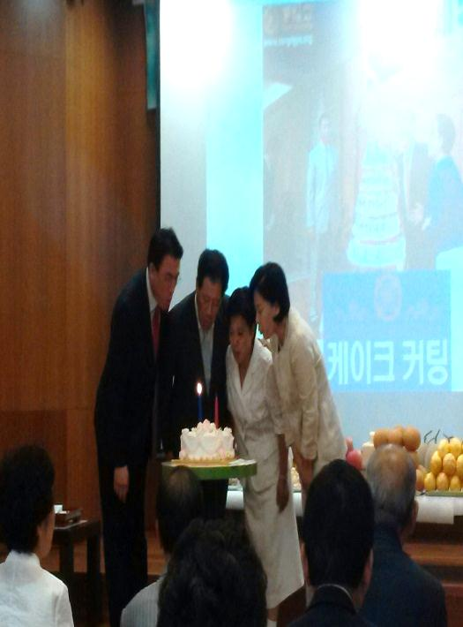
(4) Preparation Partner
Concept
The wife takes responsibility for other matters so the pastor can
concentrate on his ministry.
Characteristics
Prepares for the sermon, Sunday service,
education and events, etc.
Creates the environment to fully prepare for
ministry activities.
Examples
Being responsible for all external preparations:
morning altar preparation, ceremonial events,
checking the schedule, Seonghwa ceremony,
managing holy candles, etc.

Slide 17
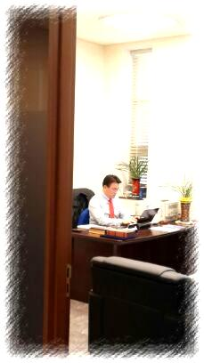
(5) Complementing Partner
Concept
If the pastor handles the entire church organization, the wife should take care of
the details in the church.
∙ Characteristics
Ability to see the details.
While the pastor sees the big picture,
the wife checks the minute details.
In charge of reading the church atmosphere.
Examples
Conveying the atmosphere of the membership community
to the pastor and prevent him from making mistakes.
Correcting any misunderstanding of the ideas conveyed in the
pastor’s sermon.
Consoling and strengthening the members’ painful hearts.

Slide 18
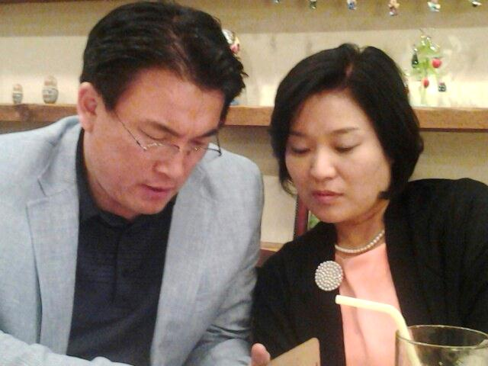
(6) Discussion Partner
Concept
Discussion partner for ministry activities.
∙ Characteristics
The pastor is in a lonely position.
He needs a partner to discuss things with.
Give inspiration for preparing the sermon,
check the script for the sermon, discuss church
management, policies, decision-making and
development.
Examples
The couple together discussing appointments to the
organizing committee for big church events, etc.
The pastor greatly considering his wife’s opinion when matching
100 couples.

Slide 19
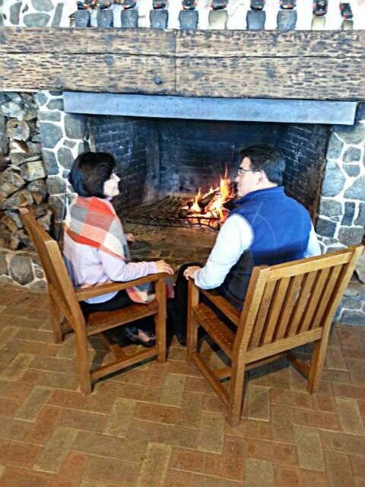
(7) Complimenting Partner
Concept
Become a wife who can raise the pastor as God’s representative.
∙ Characteristics
The pastor needs to gain strength by being moved and consoled.
Examples
Giving words of encouragement to the pastor.
(You did well. You’re amazing. I received grace through your sermon.)
Positive expressions and physical affection are very
important. There is strength in your prayer.
Providing motivation for him to become a great pastor.
Conveying members’ reactions and compliments.

Slide 20
Summary of the Role of Partner
# | Conceptualizing | Competency Making | Explanation
1 | Service “Be a model in attending the pastor” | Public partner | The pastor and his wife are both public figures
 |  | External partner | The pastor is more internal and the wife is more external
2
 |  | Prayer partner | Work separately as a couple in a lifestyle of devotion
3
4 | Assistance “Be a partner for ministry activities” | Preparation partner | Work separately in preparing for ministry activities
 |  | Complement partner | Work separately by content and form to carry out ministry activities
5
 |  | Discussion partner | Share in decision-making for the ministry
6
7 | Growth “Be God’s representative for the pastor’s growth” | Compliment partner | Be God’s representative who can raise the pastor

Slide 21
Follower
In a relative position, when the senior families in the church are the subject in the parents’ position, the pastor’s wife is the object in the daughter’s position. The wife is a follower as the object partner.
Serving Follower
Companion Follower
Nurturing Follower
Learning Follow
Guiding Follower

Slide 22
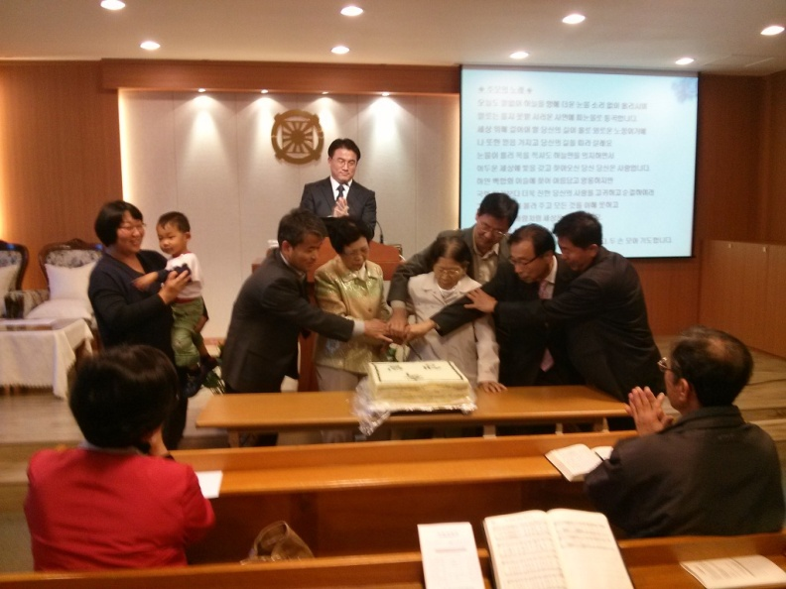
(1) Serving Follower
Concept
The wife takes the role of attending the senior families who are in the grandparents’ position.
∙ Characteristics
Should go down to the position of the daughter or daughter-in- law and serve the parents.
Examples
Discussing major decisions and
public events with the senior families first.
Giving advice to the pastor so he can
approach the senior families first.
Celebrating their birthdays and anniversaries,
telephoning them when they can’t come to
the service.

Slide 23
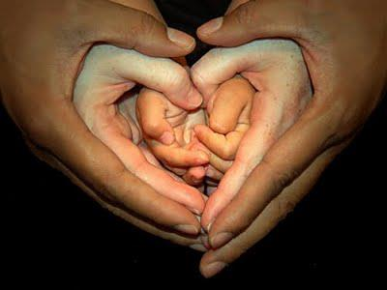
(2) Learning Follower
Concept
Become a wife who can convey the senior families’ tradition, wisdom and experience to future generations.
∙ Characteristics
Help pass down the senior families’ wisdom to future generations.
Become a mediator between elder and younger families.
The senior families need to give education in tradition.
The pastor’s wife should take responsibility to create
such activities.
∙ Examples
Providing educational opportunities for members to
inherit the Unification tradition through the
senior families.

Slide 24
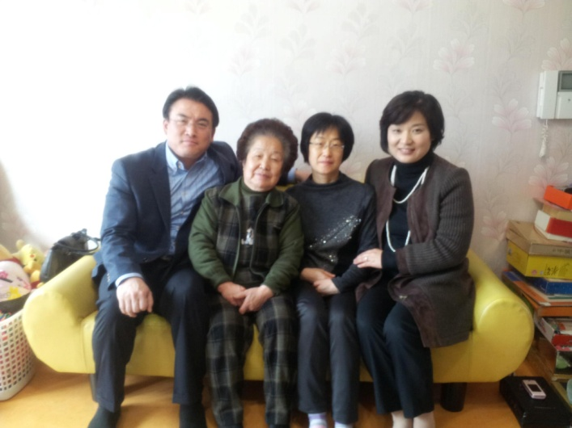
(3) Companion Follower
Concept
Become a wife who can share the heart of the family members
by attending lonely single members.
∙ Characteristics
It is part of the wife’s role to attend and take care of lonely
single members.
Examples
Serving as a family for isolated single
members.
Bringing food to elderly single members.
Showing concern for them can help them
live a happier life of faith.

Slide 25
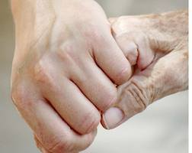
(4) Guiding Follower
Concept
The wife supports the life of faith of senior families who
are in the grandparents’ position.
∙ Characteristics
Guide and care for elderly members to make them feel
comfortable.
Convey information about events and announcements to the
senior families.
Examples
Serving as a guide for the elder deacons,
elder families, and retired members.

Slide 26
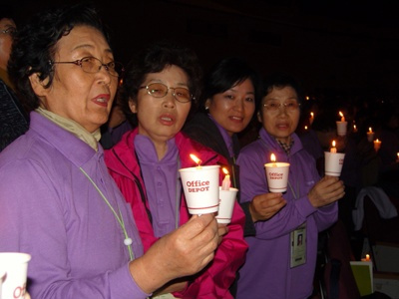
(5) Nurturing Follower
Concept
Become a wife who can help the senior families, who are in the
grandparents’ position, to mature in their life of faith until their
passing.
∙ Characteristics
No matter how old the members are, when they have difficulties in
their families or need counseling, the wife will
take the position and heart of an ardent
child attending her parents.
Examples
Daegu district – Liberation ceremony for
Ms. Sooja Lee (deaconess)
Cheongshim Church

Slide 27
Summary of the Role of Follower
# | Conceptualizing | Competency developing | Explanation
1 | Service “Attend the senior families in the grandparents’ position by representing the children’s position” | Serving Follower | Pastor couple, who are in the parents’ position, attends the senior families in the grandparents’ position
2 |  | Learning Follower | The wife conveys the senior families’ tradition, wisdom, and experience to future descendants
3 | Protection “Protect the senior families” | Companion Follower | The wife attends single members as a family member
4 |  | Guiding Follower | The wife who supports the senior families in their lives of faith
5 | Growth “Raise up the senior families” | Nurturing Follower | The wife who supports the senior families to grow until their passing

Slide 28
Leader
In a relative position, the pastor’s wife is the mother-figure leader when the church members are in the object position.
The wife needs to display leadership.
Calling Leader
Humble Leader
Sympathetic Leader
Spiritual Leader
Probing Leader
Discipline Leader
Sacrificial Leader
Executing Leader
Forgiving Leader
Exemplary Leader
Service Leader

Slide 29
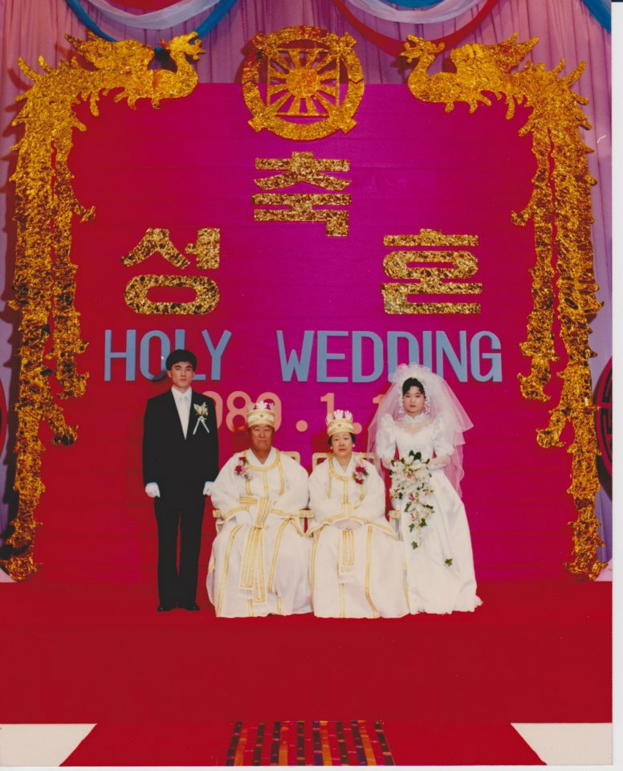
(1) Summoned Leader
Concept
The pastor’s wife should have a sense of calling
(level of self-awareness in her life).
∙ Characteristics
The spirit of one who has been called.
Should have a plan and philosophy for the ministry.
True Mother was aware of her mission right away
when she met True Fathe.r
Although she did not study the Principle, she attended
and became one with True Father from the beginning
by pouring out all of her heart and devotion.
True Mother knew spiritually and by intuition about
the mother’s mission to save humanity.
She has a sense of calling as the True Mother of humanity.

Slide 30
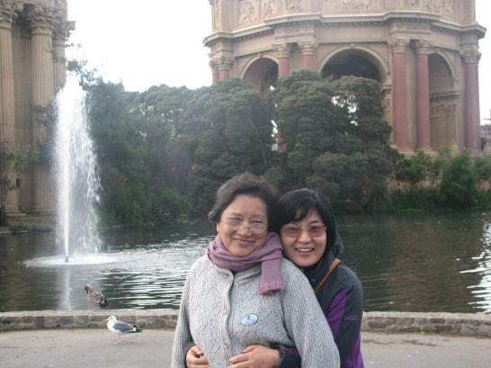
(1) Calling Leader
Examples
My dream-To become a good wife and a wise mother as a
pastor’s wife.
I became aware of a wife’s role through my physical mother.
After receiving my calling, my awareness of a wife’s role
could be fully manifest.
True Mother also gained her sense of
calling as God’s daughter and the Mother of
humanity through Daemonim’s education.

Slide 31

(2) Spiritual Leader
Concept
A pastor’s wife needs a high level of spiritual capability.
∙ Characteristics
Needs to offer endless devotion and go through spiritual training in
order to display motherly leadership.
Stands in the position to diagnose the
members’ spirituality.
Higher spirituality opens the gate to wisdom
and good judgment.
Gives the ability to clearly separate good and evil.
Spirituality is the gateway to true love.
Examples
Achieving wisdom through prayer.
Receiving revelations through dreams.

Slide 32
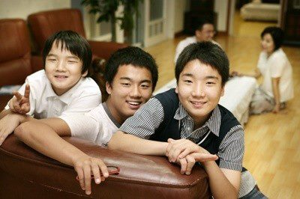
(3) Sacrificial Leader
Concept
The pastor couple’s privacy is not guaranteed.
The pastor and his wife have no choice but to concentrate on caring for the
members from their respective positions.
∙ Characteristics
The activities of the pastor and his wife are independent
Examples
Lack of communication with their children.
Lack of time to invest in their children.
There are times when they use 30% of their
earnings for the members.
Need to endure financial sacrifice.
This can cause the pastor’s children to avoid the ministry.
This can cause the pastor’s children to avoid the Blessing.

Slide 33
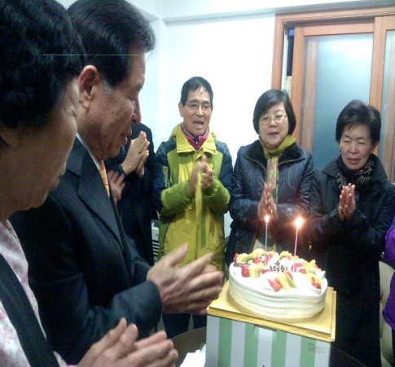
(4) Forgiving Leader
Concept
For a pastor’s wife, patience is the process and forgiveness is the result.
∙ Characteristics
Display the virtues of caring and forgiveness.
Need to sacrifice and yield by lowering oneself.
True Father said that nothing is unforgivable through true love.
Embrace everyone in the woman’s bosom.
Examples
Harmonizing, forgiving, empathizing and showing compassion
by loving the members’ families.
Rotating members’ meetings - Bulgwang Church
The need for patience comes frequently; forgiveness is the
final result.

Slide 34
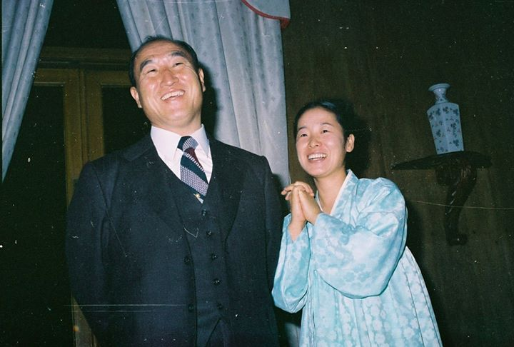
(5) Humble Leader
Concept
Be in the body of a servant with the heart of a parent.
∙Characteristics
A humble attitude elevates the pastor quickly to the parent’s position.
Humility is the fastest way to become one with the members.
In conveying humility, action is important, words are limited.
Humility without action is meaningless.
Daemonim’s Speech-The pastor’s family is the adult of
the church. No matter how the members anger you and
give you a hard time, you should never talk back loudly.
If you do so, you are not an adult.
In the end, the inherent fallen nature is the problem.
You need to work hard to remove the fallen nature.

Slide 35
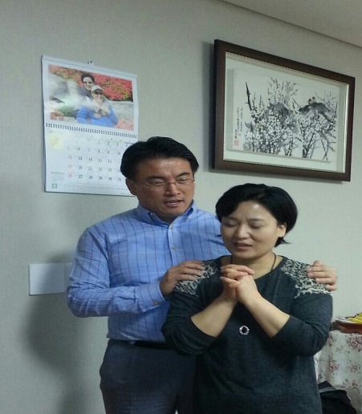
(5) Humble Leader
Example
I learned from my mother.
Ultimately, the greatest thing that I learned from my mother
was humility.
The most beautiful quality the pastor’s wife can show to the
members is that of humility.
It takes a heart of courage to lower oneself
endlessly.
Instead of standing in the position to claim
authority, stand in the position of attendance.

Slide 36
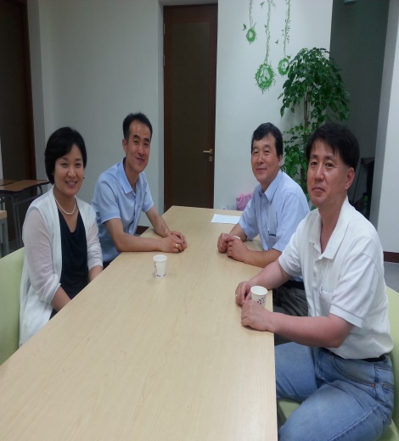
(6) Probing Leader
Concept
Become a wife who can check the state of members’ faith and mentality by observing and paying attention to them in daily life.
∙ Characteristics
Needs to fulfill Rebekah’s mission to observe from above and below carefully, with a providential viewpoint.
Examples
Observing the members’ way of speaking and
expressions carefully.
Observing the state of faith and family atmosphere
through family visits.
Starting a conversation, showing interest.
Attention is the first step toward resolving members’ family problems.

Slide 37
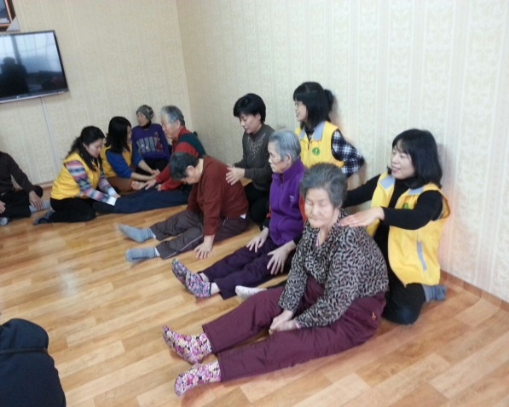
(7) Executing Leader
Concept
Become a model through action, not words.
∙ Characteristics
Living up to one’s principles is what matters in the end. Action is
possible when spirituality and personality are harmonized.
This is only possible by removing fallen nature.
Practice is the shortcut to individual perfection.
Let’s recover spirituality and become living souls
as earthly human beings.
Examples
I learned many things through Daemonim’s Cheongpyeong works. The Fall interferes with the will to take action.
If you reduce the fallen nature, human beings can take action to follow the original mind.

Slide 38
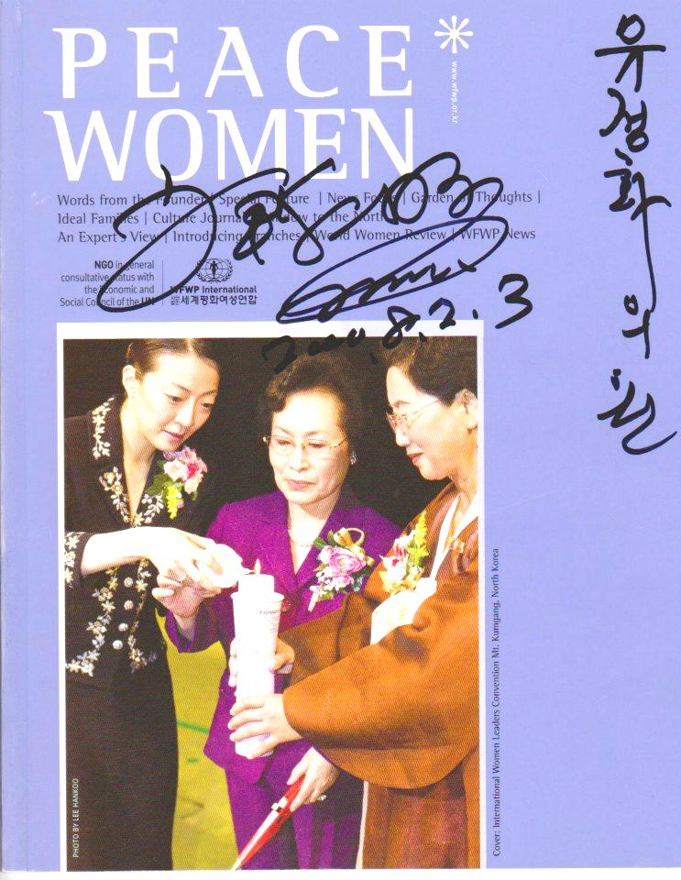
(8) Exemplary Leader
Concept
A pastor’s wife needs to demonstrate an exemplary lifestyle.
∙ Characteristics
The leader must go first
Examples
Answering the providential call by running
for Congress representing the Family Party
During ministry, Cheong Gung Ryu
prepared meals for 200~300 people

Slide 39
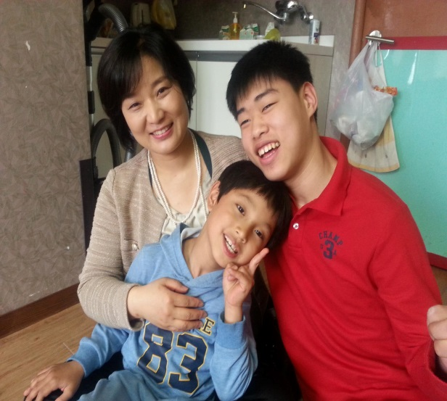
(9) Service Leader
Concept
The pastor’s wife takes action to love the church and the local residents
with a motherly heart.
∙ Characteristics
The residents in the local community are under the pastor’s jurisdiction
in a broad sense.
It is important to live for the sake of others by
doing service work with a parental heart, and
becoming a service leader for the neighbors.
Examples
The Women’s Federation activities are a
precious providence for the pastor’s wife in this
sense – volunteering to cook and clean for senior citizens, etc.
Cheong Shim Church - Janet (Philippine member)

Slide 40
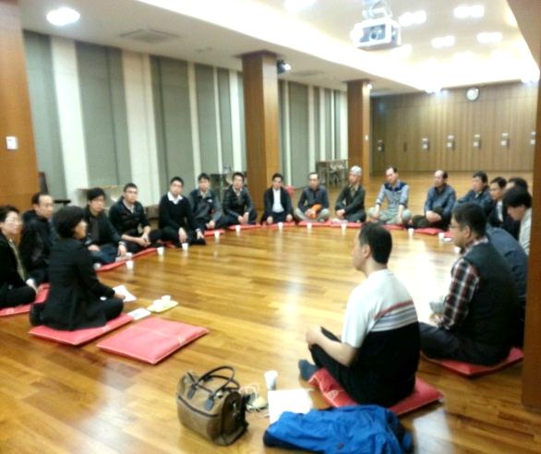
(10) Sympathetic Leader
Concept
The pastor’s wife needs to listen closely and help resolve the
problems of church members or local residents from a mother’s position.
∙ Characteristics
Listen to the members’ stories. Be an active listener.
Listen a lot, share their pain and pray together.
The pastor has less time to listen to members.
Examples
I have preferred being a listener since I was born.
I am good at making the members speak
everything that’s in their hearts.
I feel it most rewarding when the members pour out all their resentments and return home with a smile.

Slide 41
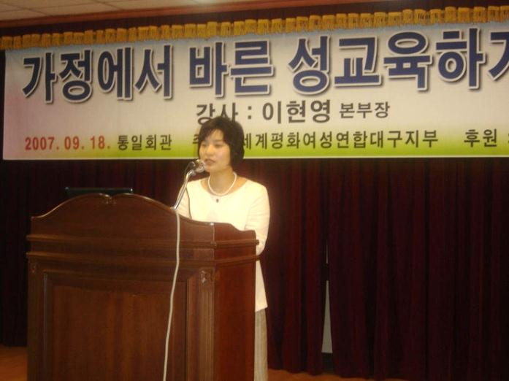
(11) Discipline Leader
Concept
The pastor’s wife supplements the contents of the pastor’s educational
programs, and educates the members from the mother’s position.
∙ Characteristics
Has the mission to discipline the members with God’s words and love.
The wife needs to be able to fill in for the pastor in his absence.
She is in the position to stand at the podium when
the pastor is absent.
There are many times when it is important
to supplement the pastor.
Examples
The members can understand the pastor better by
having the opportunity to listen to his wife’s words.

Slide 42
Summery of the Leadership of a Pastor’s Wife
# | Conceptualizing | Competency Developing | Explanation
1 | Care “Mother’s character of giving birth to children” | Calling Leader | The pastor’s wife needs to have a sense of calling (level of self-awareness).
2 |  | Spiritual Leader | Pastor’s wife needs a high level of spiritual ability.
3 |  | Sacrificial Leader | The pastor doesn’t have privacy, and his wife has less. The pastor and his wife need to care for the members individually.
4 |  | Forgiving Leader | As a mother who has born children, patience toward the members is the process and forgiveness is the result.

Slide 43
# | Conceptualizing | Competency Developing | Explanation
5 | Protection “Mother’s character to protect the children ” | Humble Leader | The wife needs to show humility in the servant’s position rather than from the generous parent’s position.
6 |  | Probing Leader | The wife needs to check the members’ state of faith and mentality by observing and paying attention to them.
7 |  | Execution Leader | The wife needs to show through action, not by words.
8 |  | Exemplary Leader | The wife should expect the members to follow by showing the example first.
9 |  | Service Leader | The wife puts into action the love of a wise mother toward the church members and the local residents, from the parent’s position.
10 | Nurturance “Mother’s character to raise the children” | Sympathetic Leader | The wife listens carefully to the church members and the local residents’ circumstances and helps resolve their problems from the mother’s position.
11 |  | Discipline Leader | The wife needs to educate the members with content supplementary to the pastor’s educational content, from the mother’s perspective.

Slide 44
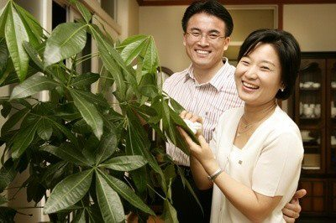
My Ideal Image of a Pastor’s Wife
♥ A true wife, a true daughter, a true mother, and a true woman leader
♥ My dream was to become a good wife, a wise mother and a pastor’s wife.
Seeing my mother and father, who ministered for 35 years, gave me a great motivation to follow my dream. I don’t know whether I am a good wife and good mother, but I have accomplished my dream of becoming a pastor’s wife.
♥ But this doesn’t mean I have accomplished all of my dreams.
I need to work harder with vocation until I can
become a wife who is acknowledged and loved
by everyone.
♥ Let’s become a family who is united as one
spiritually and physically!

Slide 45
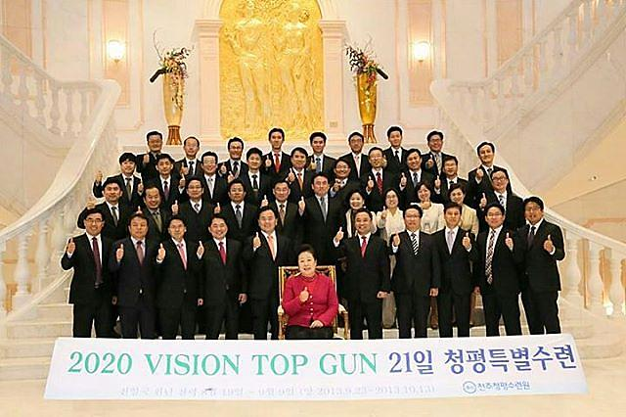
Thank you for listening!!

