Slide 1
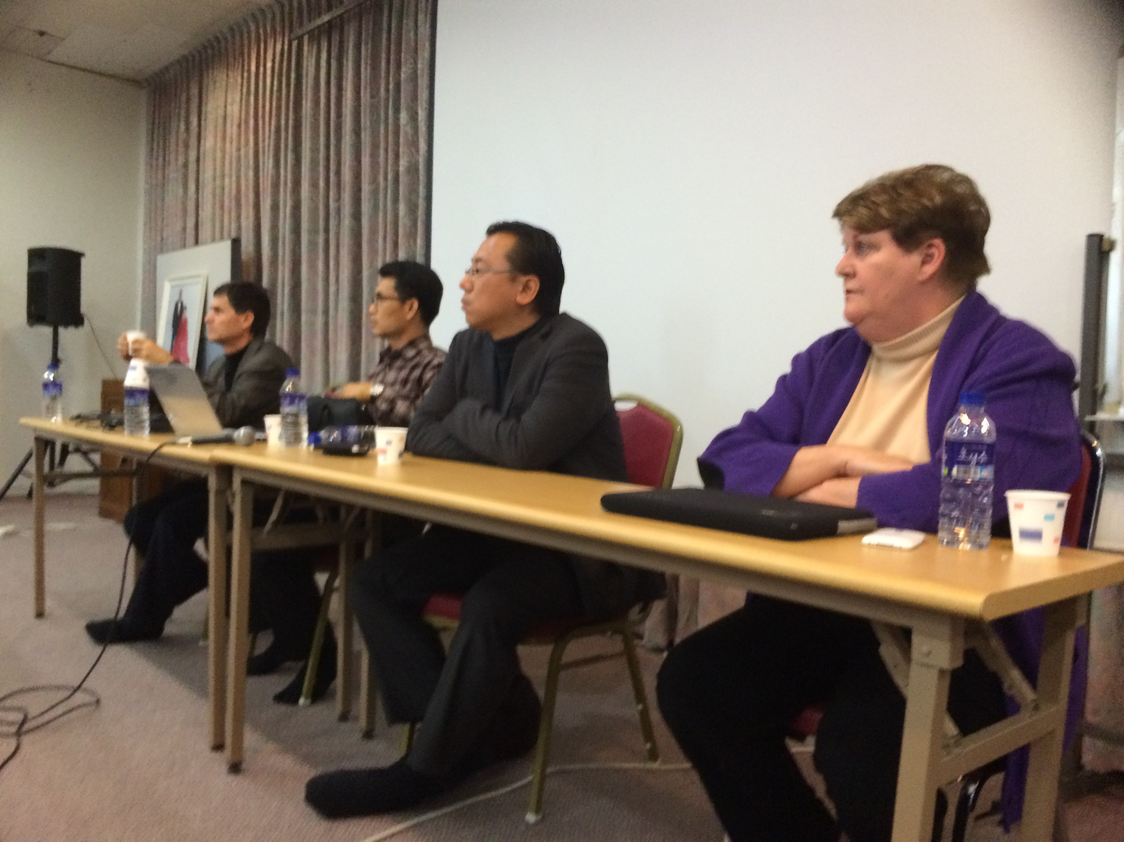
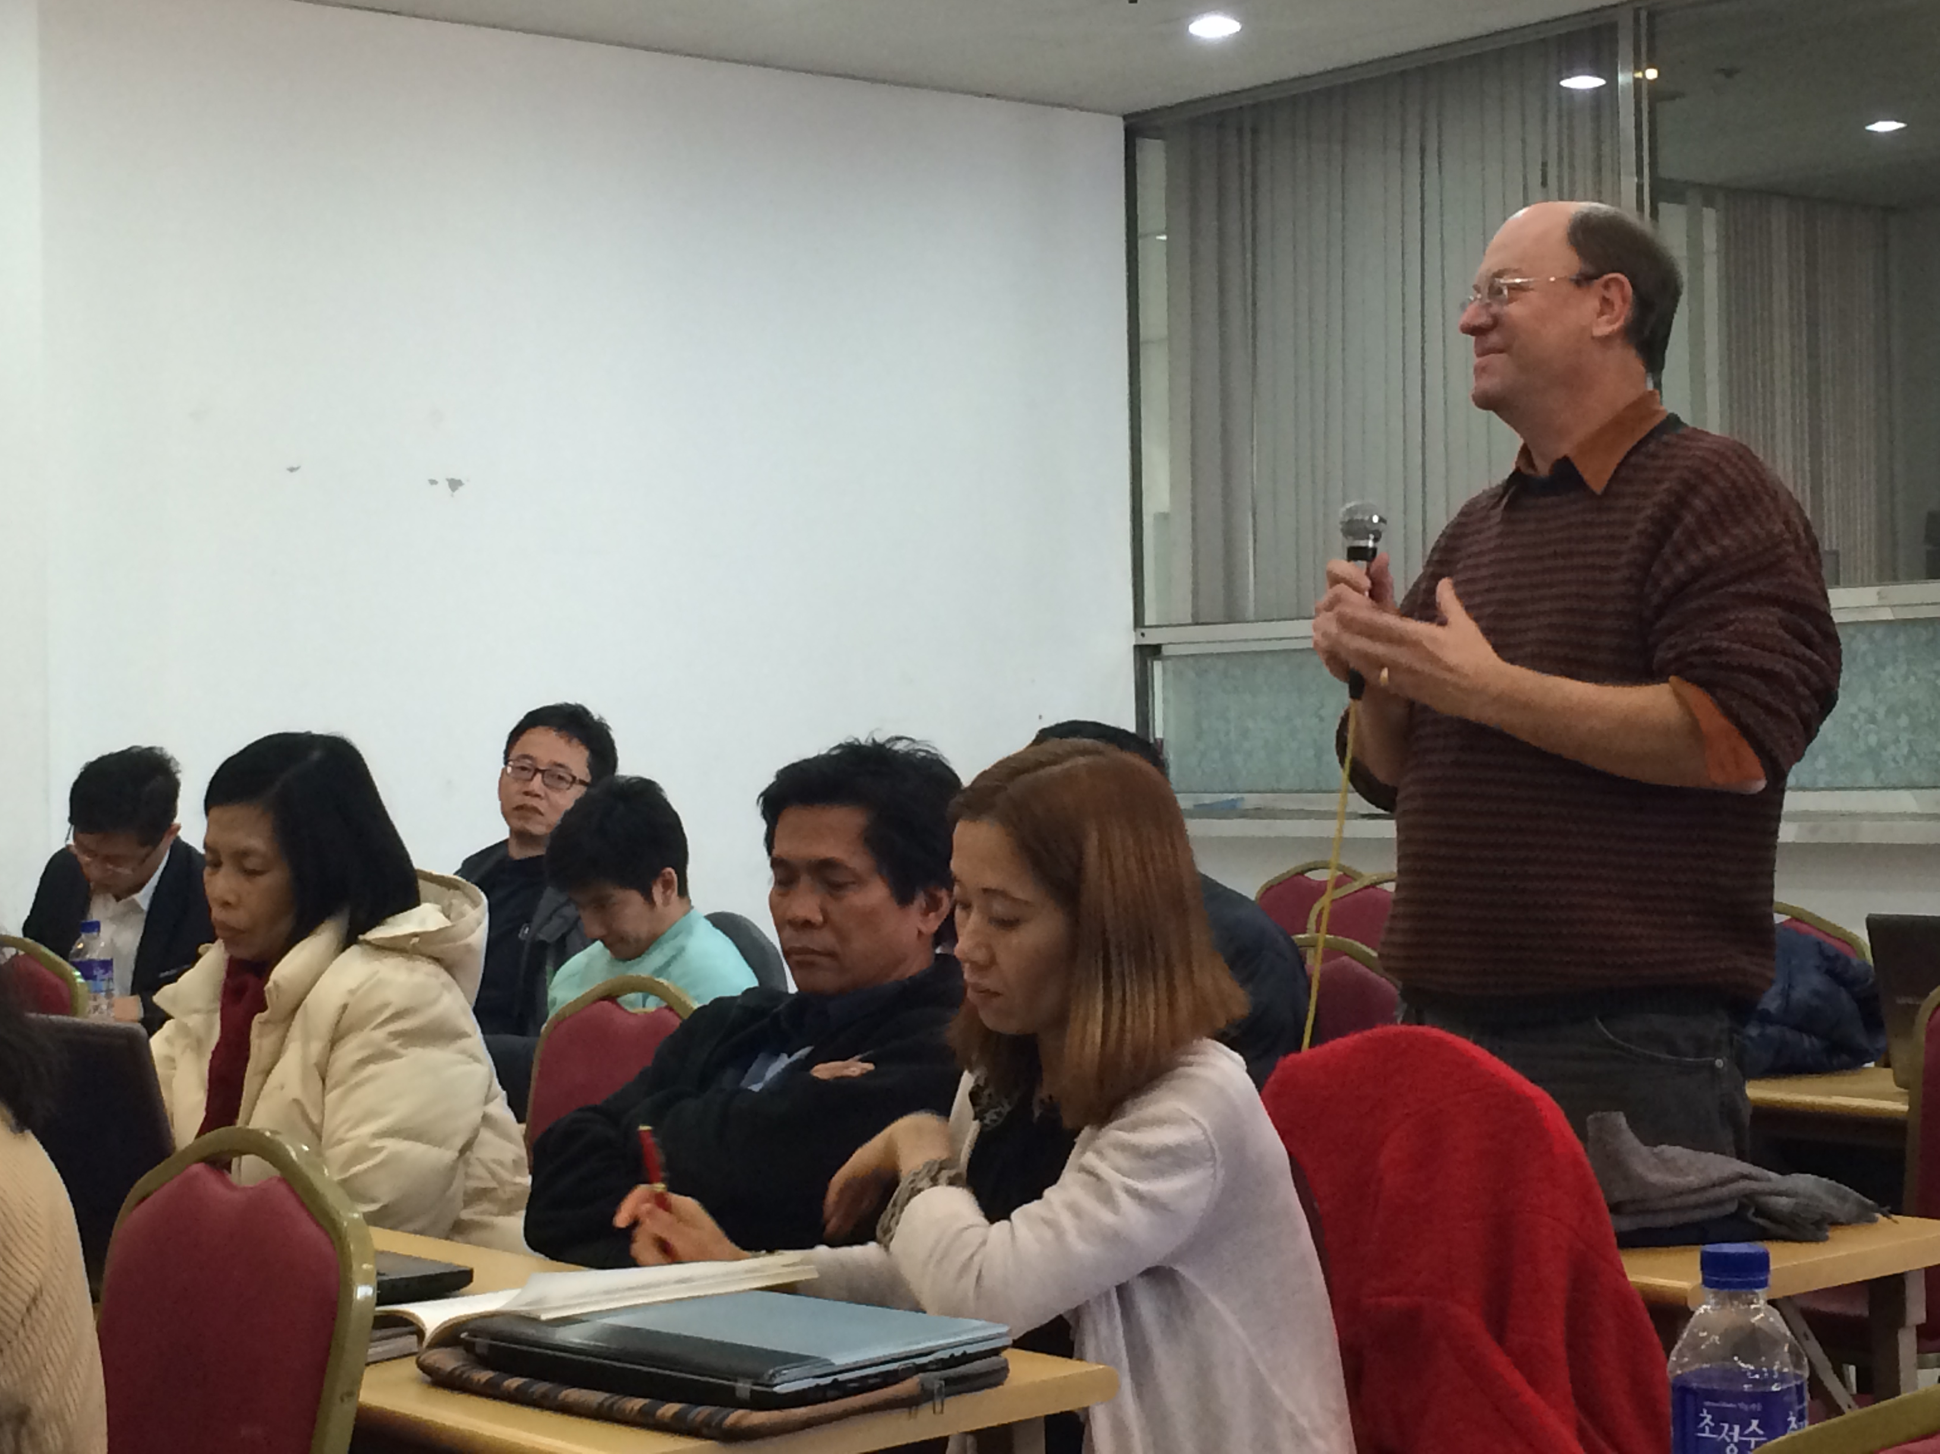
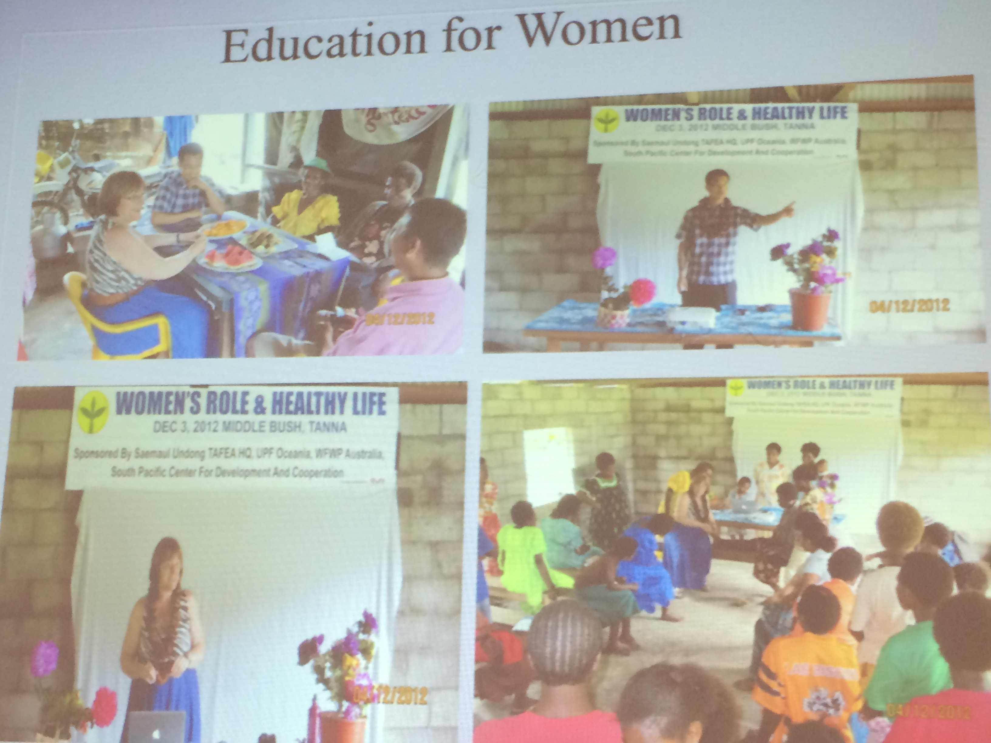
MISSION PIONEERING
Breakout Session

Slide 2
KEY OBJECTIVES
1). Rediscover the root of successful missionary pioneering
2). Provide ample opportunity for effective networking
3). Identify areas for International HQ to support

Slide 3
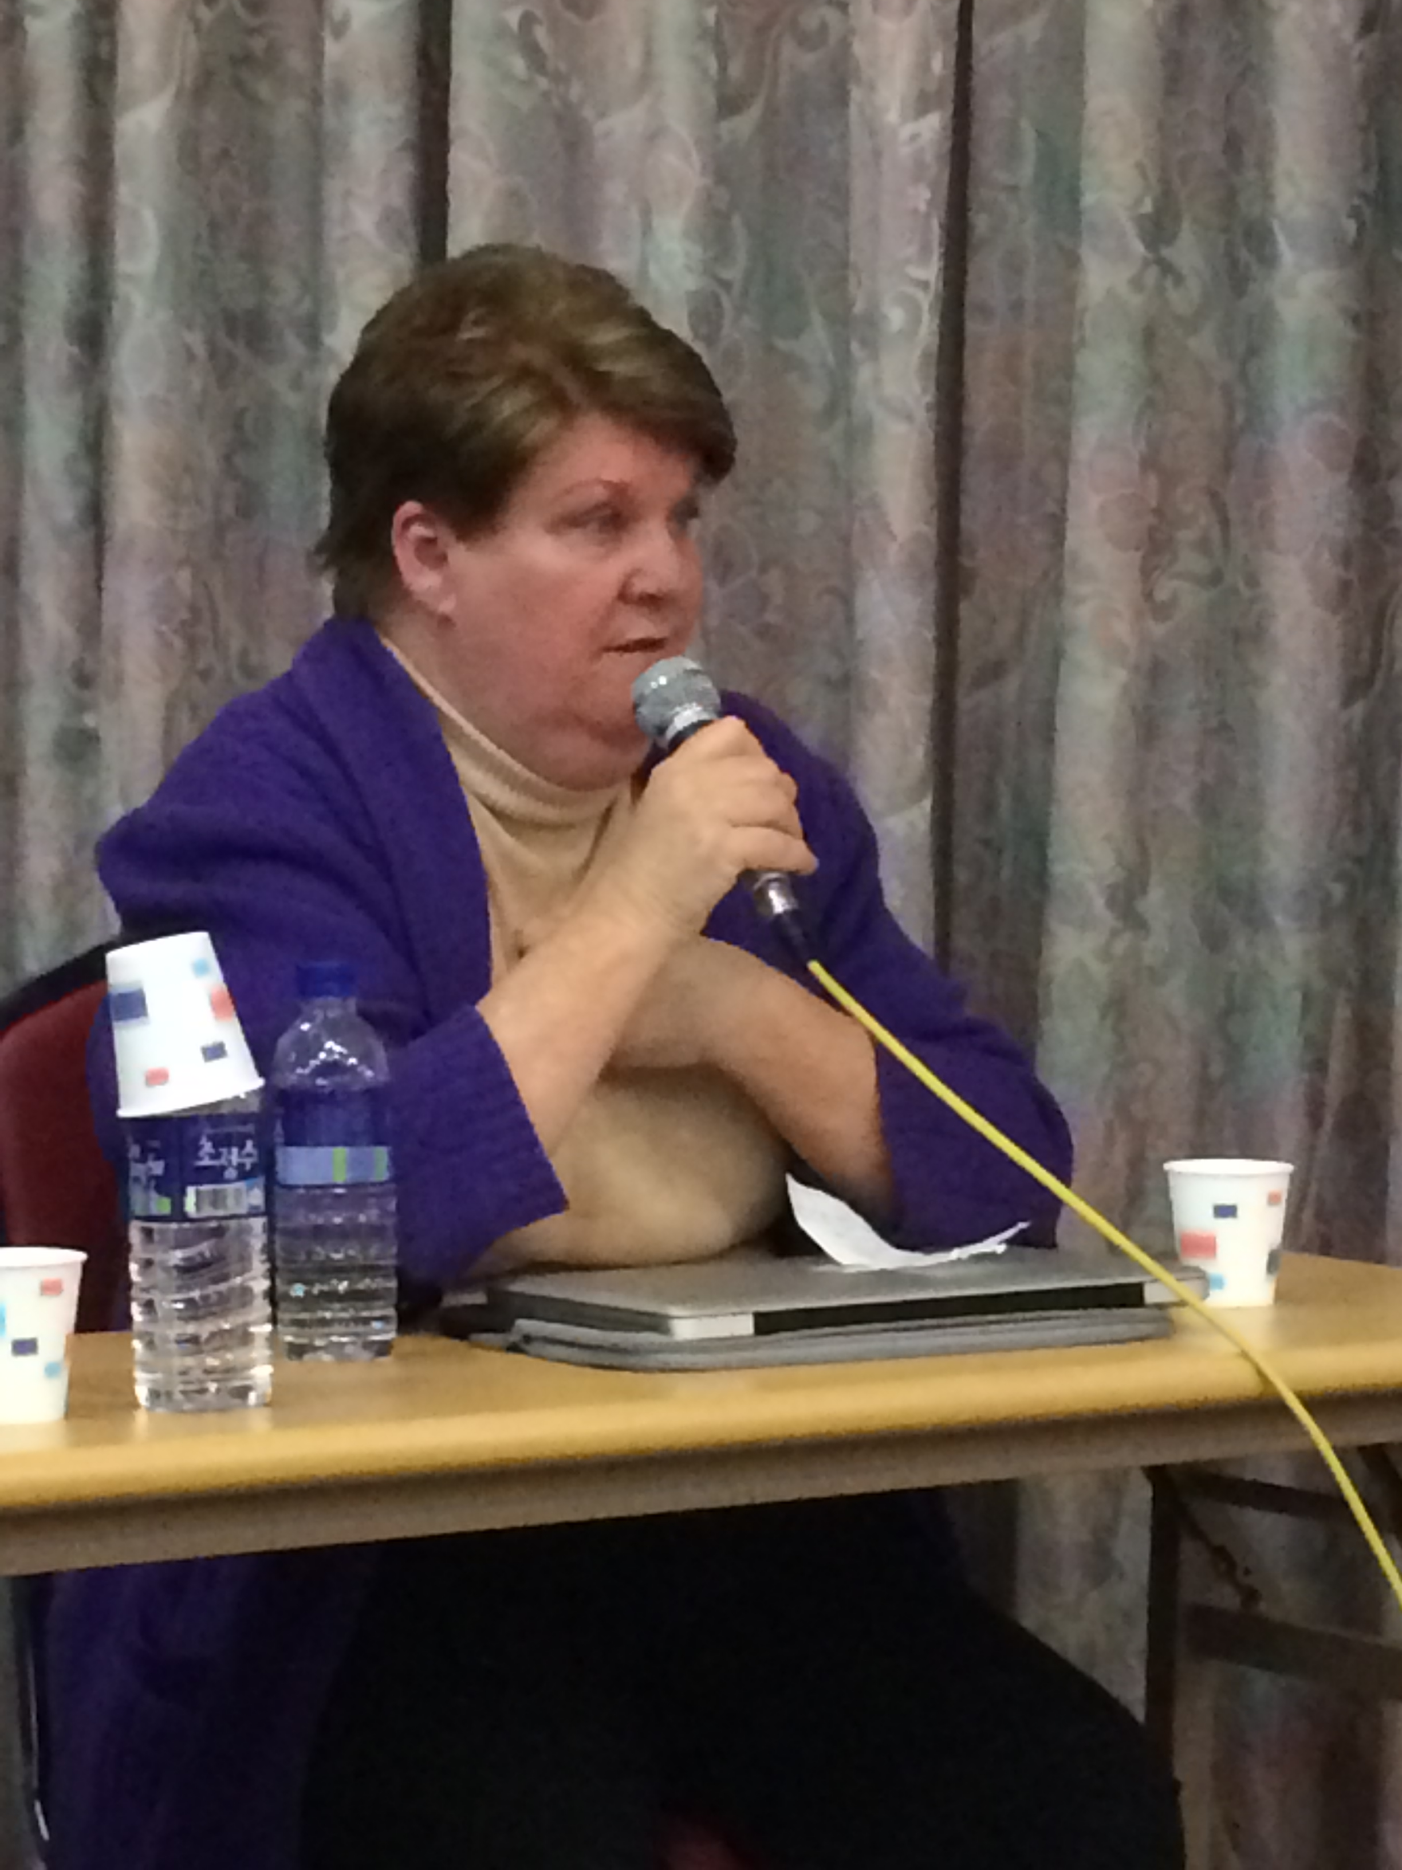
Kathy Rigney
Panelist #1 – Special Envoy to Benin (Africa)
Shared True Father’s guidance to 1975 Missionaries
Internal & External Secrets to Successful Pioneering
“I love the people. I love Africa. That’s the secret. People want to be loved.”

Slide 4
Internal Secrets to Mission Pioneering
Unity
Ancestor of Nation
Parental Heart
Sexual Ethics
Divine Principle
Indemnity
Spiritual Sensitivity
Don’t Make Enemies
Have Courage
Overcome Difficulties

Slide 5
External Secrets to Mission Pioneering
Wear many hats
Raise your replacement
Customize strategies based on local audience
Connect with the nation’s VIPs
Build economic foundation

Slide 6
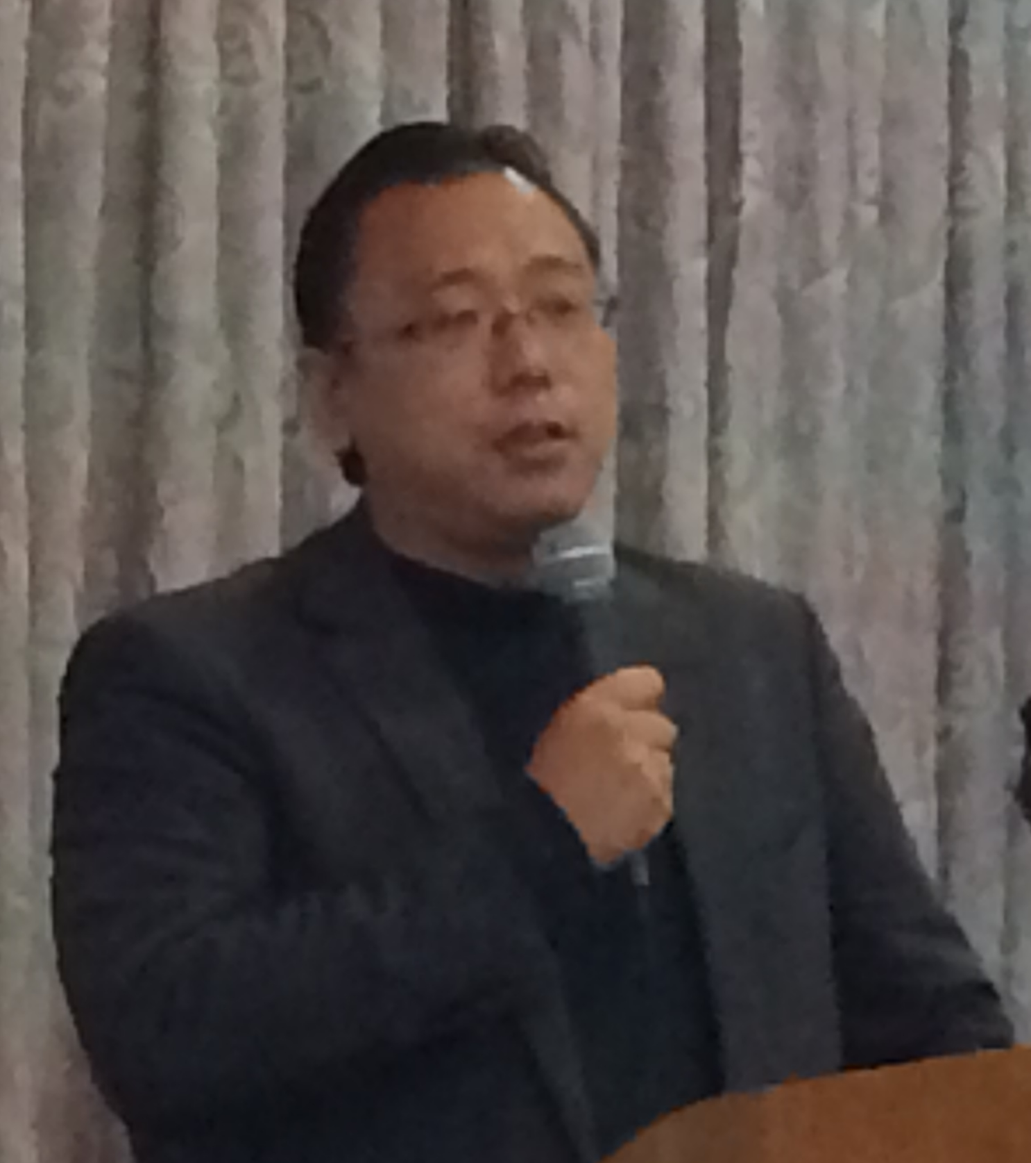
Hajime Saito
Panelist #2 – Missionary to Cambodia & Myanmar
Even without many followers, the leader should have a vision for the nation.
Protect the sexual organ
= Protect Life of Faith

Slide 7
Customized Strategies
Buddhist Community
  First 2-day workshop focuses on introducing God and Spirit World
Reassure Parents – Good PR
  Welcoming parents to the center for Filial Piety Workshop
Very Small Community in Myanmar
  Focus on teaching English, math & music as part of Sunday School

Slide 8
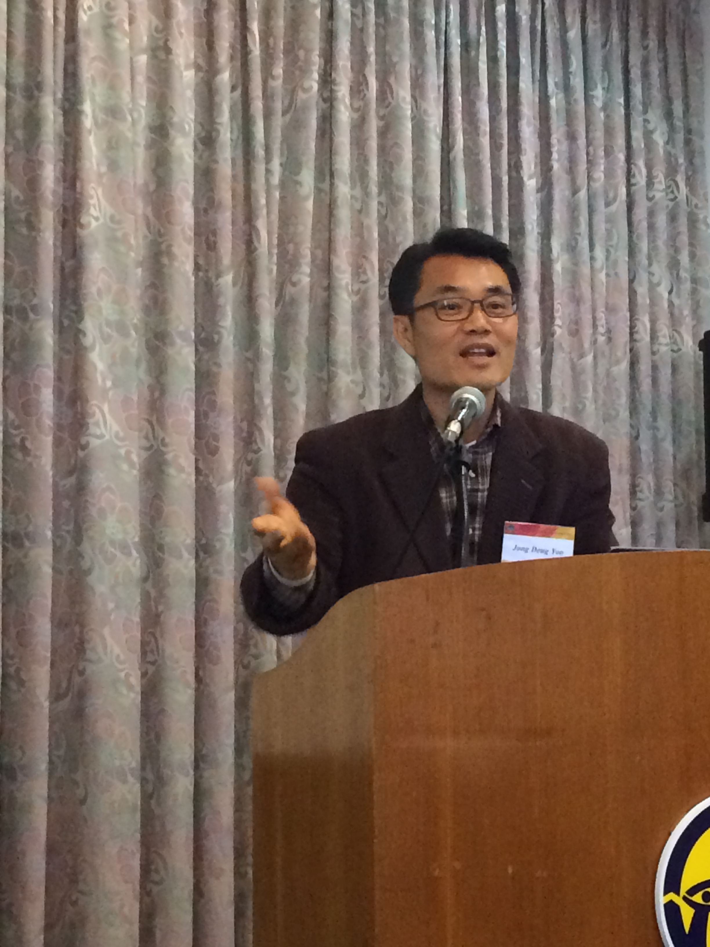
Jong-deug Yoo
Panelist #3 – Missionary to Vanuatu
Invest in the community
Meet VIPs and develop good relationships
Bring experts and activities to benefit local people
Do service projects together

Slide 9
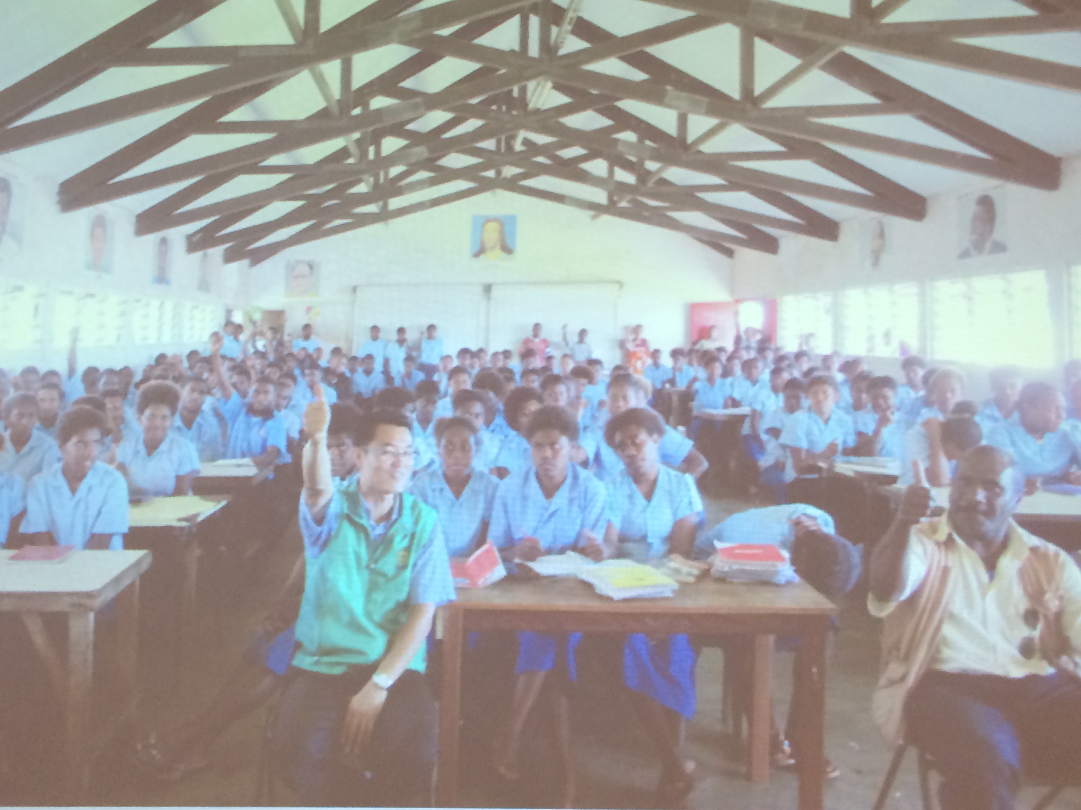
Vanuatu

Slide 10
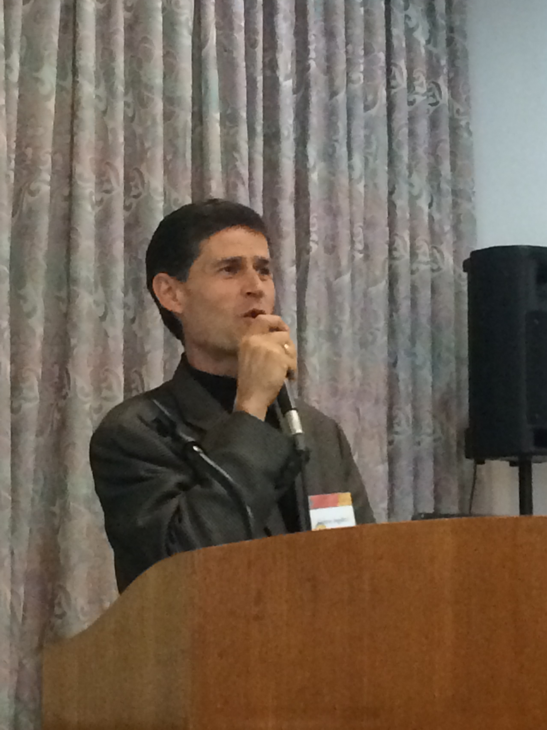
Umberto Angelucci
Panelist #4 – Missionary to Afghanistan
Lessons Learned from 21 Years of Pioneer Mission
You are not separate from the local people: Love Islam, Love the Prophet.
Our Mission: Inspire the 3.5mil of Muslim world to understand and accept TPs

Slide 11
Lessons Learned
It’s a family mission to represent God & TPs
Mission not limited to your nation- ultimately to reach the whole world
Invest in people one-by-one

Slide 12
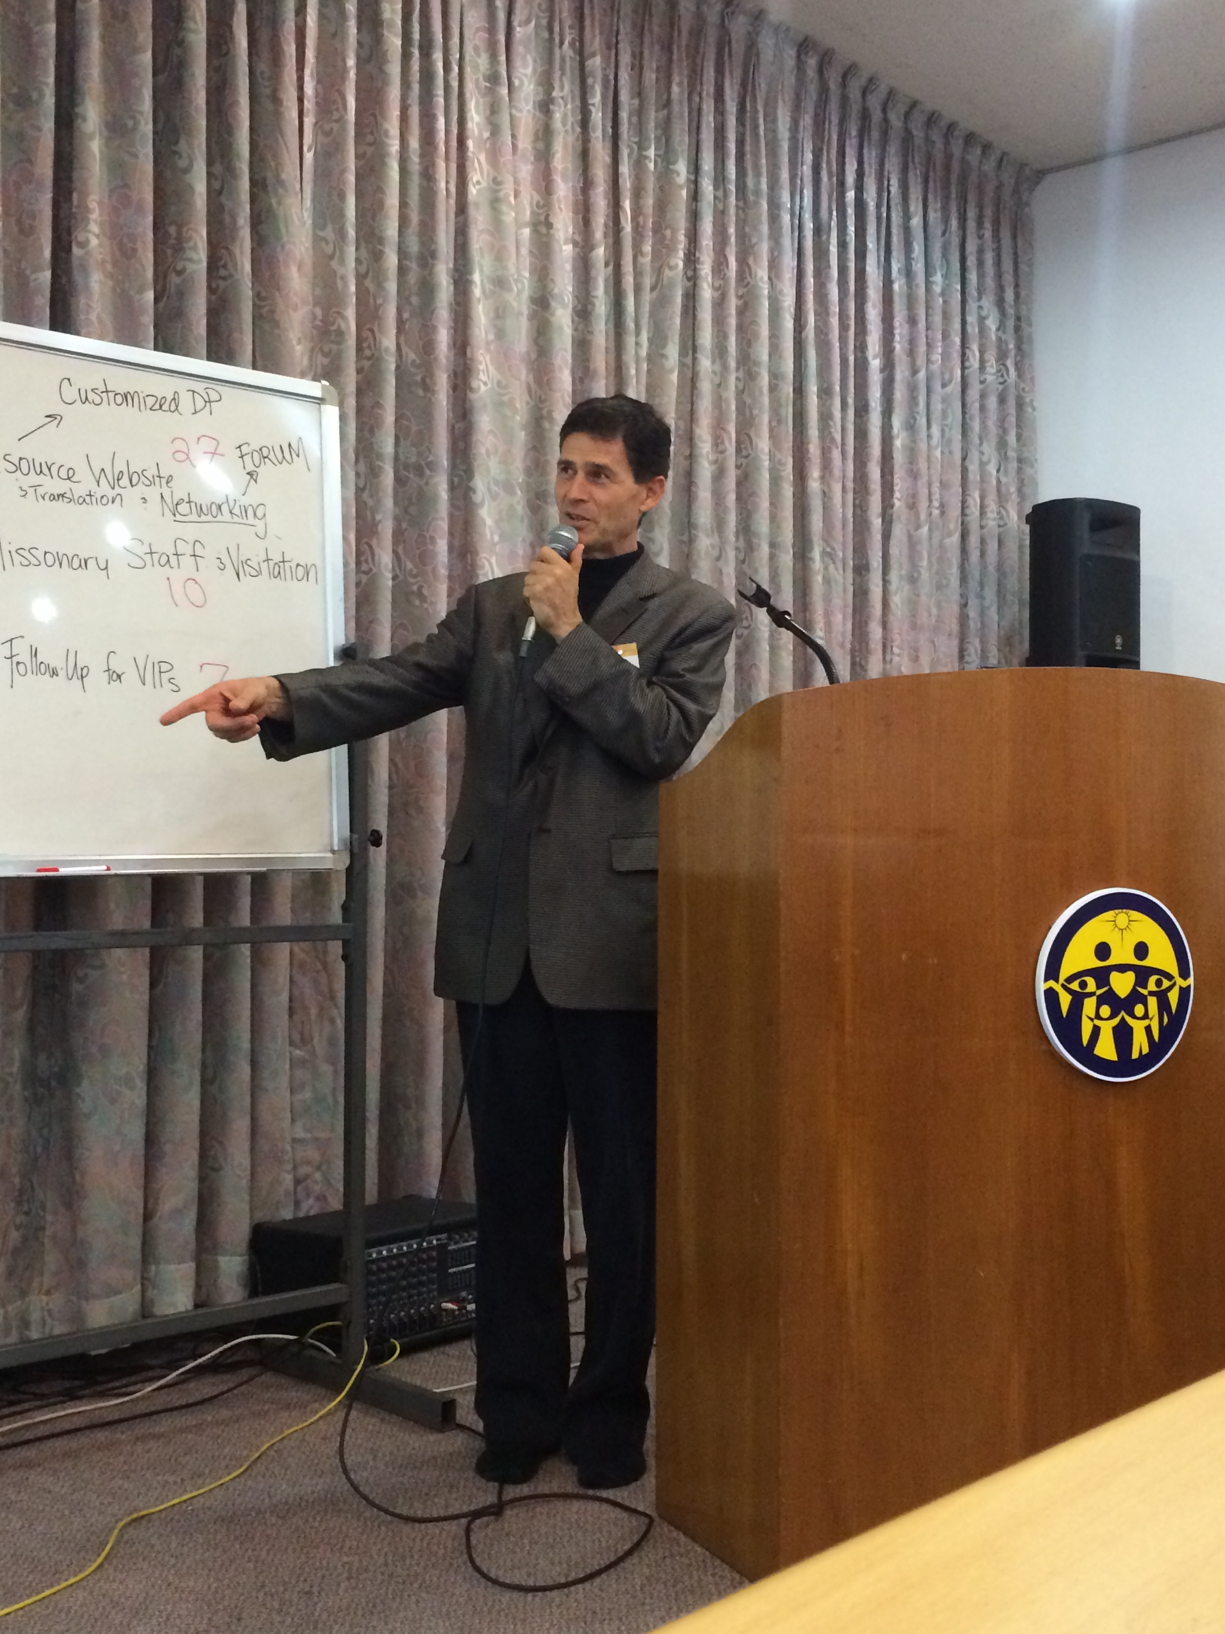
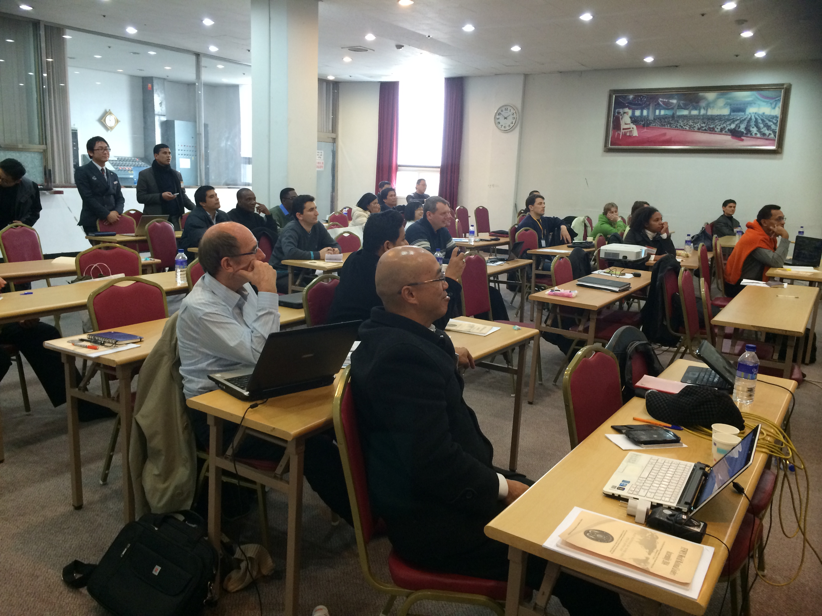

Slide 13
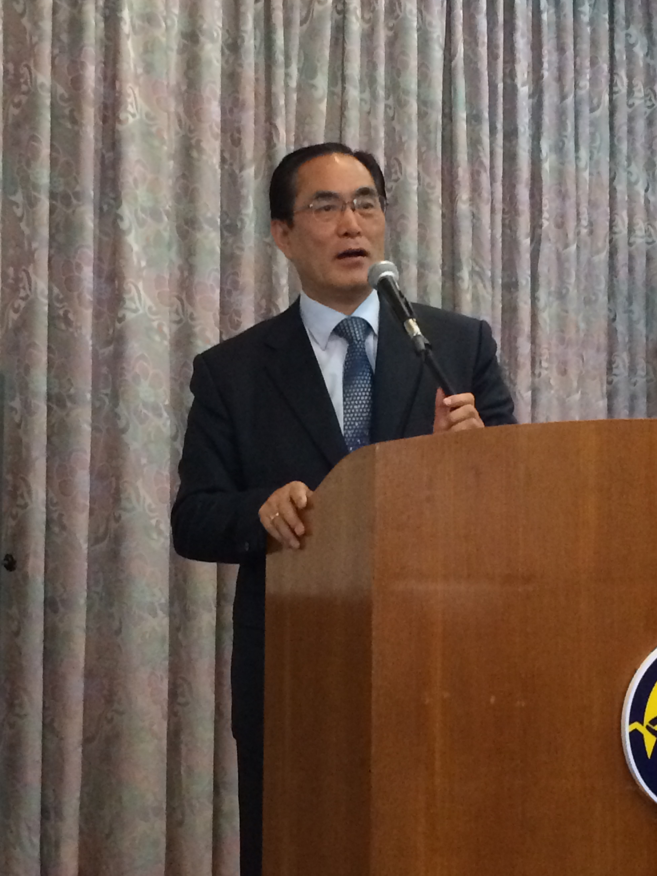
Rev. Hwang
International HQ – Vice President
Leaders must have heartistic relationships → create the environment for CIG
International HQ wants to hear from you – all communication should be heartistic.
All people and UC members deserve love and respect.

Slide 14
How can I-HQ Support YOU?
Top 3 Most Requested:
Financial and Material Resources [29]
International Resource Website (translation, networking forum, and customized DP resources) [27]
Standard Missionary Training & Manual (in Developmental stages) [25]

Slide 15
How can I-HQ Support YOU?
HQ Missionary Staff Position & Visitation [10]
Access to International Business Network [10]
  CIG Citizens Bank
Clear Communication Procedures [8]
Strategic Follow-Up for VIPs [7]
Platform for Cross-Continental Matching & Blessing [6]

Slide 16
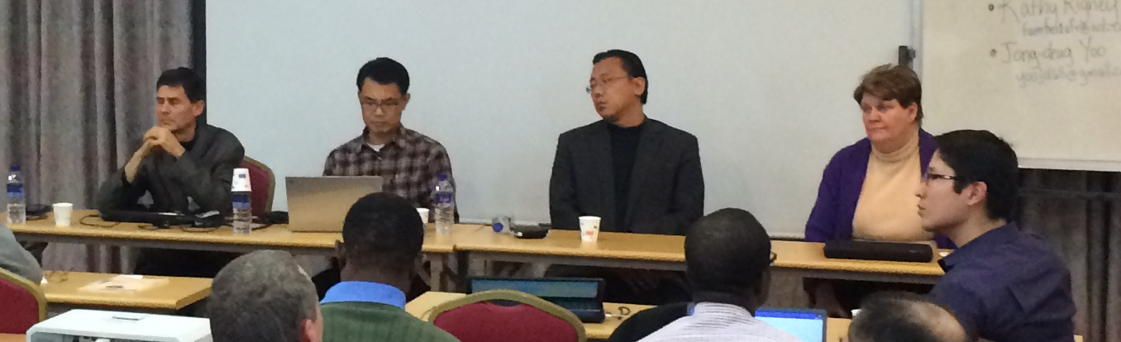
Mission Pioneering Panelists
Kathy Rigney
  famfedafr@aol.com
Hajime Saito
  turnintostone@yahoo .com
Jong-deug Yoo
  yoojd68@gmail.com
Umberto Angelucci
  angelucci45@hotmail. com

