Slide 1
Noah’s family
Notes:
Again God had no idea take such a long time before could again intervene. 1600 years later the earth is terrible. Noah descended from Seth. 10 generations.

Slide 2
What was God thinking?
The Lord saw that the wickedness of man was great in the earth, and that every imagination of the thoughts of his heart was only evil continually. And the Lord was sorry that he had made man on the earth, and it grieved him to his heart. So the Lord said, "I will blot out man whom I have created from the face of the ground, man and beast and creeping things and birds of the air, for I am sorry that I have made them.” Genesis 6:5-7
Notes:
God wanted to start all over again. But he couldn’t because he created people with eternal soul. Anyway people his creation, his children, his responsibility. But things so desperate had to use desperate method. So found a good family which was to restore Adam’s family

Slide 3
Noah’s family = Adam’s family
8 members
Adam
Cain
Abel
Seth
1600 years
10 generations
8 members
Noah
Shem
Ham
Japeth
Notes:
Naamah - name Noah’s wife

Slide 4
Restoration in Noah’s family
Foundation for the Messiah
And the Word
became flesh
Divine Grace + Human Will → God’s Will
Foundation
of substance
Remove sinful nature
Central person - Noah
Foundation
of faith
Offering - Ark
Time period - 40 days

Slide 5
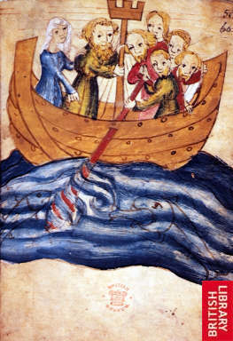
Foundation of faith
Central person - Noah
Offering - the ark representing the universe
120 years preaching
Time period - 40 days flood
Noah’s family to purify themselves and separate from Satan
God said, “You [Noah] shall come into the ark, you, your sons, your wife, and your sons’ wives.”
  Genesis 6:18
Noah told his family not to have sexual relations during flood judgement
Notes:
Talmud says 120 years of preaching while building the ark. But people didn’t listen. God wanted to save others. Noah had dream.sense flood coming. God often warns about disasters ut people usually ignore
Noah’s family represented Adam’s family
Purpose of the flood to eliminate sinful humanity. Restore number 40 (10 times 4)(10 generations of 4 position foundation which were lost to Satan)
Went in as men and women - living separate quarters. No conjugal relations.
Noah didn’t argue with God about flood.

Slide 6

God – mathematical being
Principle of
creation
Numbers
Mathematical
Principle of
restoration

Slide 7
Numbers in the Principle
Perfection
Origin
Completion
3 + 4 = 7
4 x 3 = 12
3 x 7 = 21
4 x 10 = 40
Subject
Object
Growth
Union
Formation
4 Position Foundation 3 Stages of Growth

Slide 8
Numbers in Noah’s family
1 - God
2 - Dual characteristics - pairs of animals
3 - Stages of growth - 3 levels of the ark
12 - Relationships in 4PF - 120 yr preaching
40 - 10 generations X 4PF - Flood
21 - Dove sent out 3 times after 7 days

Slide 9
Timeline
1600 years from Adam to Noah.
120 years of preaching and building the ark
40 days and nights of rain
Ark lands on Mount Ararat
40 days later Noah sends out the raven
7 days later a dove
7 days later a dove
7 days later a dove
1st day of new year the earth was dry = new beginning – God’s Day

Slide 10
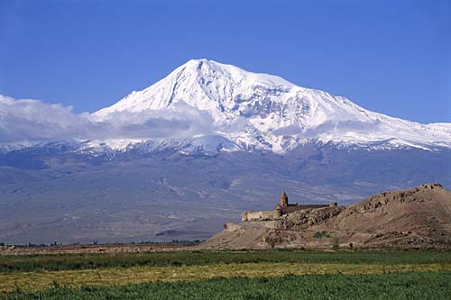
Covenant with Noah
God said to Noah, “Go forth from the ark, you and your wife, and your sons and your sons’ wives with you.”
Genesis 8:15
Noah built an altar to the Lord and offered burnt offerings on the altar.
And God blessed Noah and his sons, and said to them, “Be fruitful and multiply, and fill the earth.”
Genesis 8:20, 9:1
Mount Ararat
Notes:
Came out as husband and wife. God allowed to continue with conjugal relations. Rainbow sign of the covenant.

Slide 11
Foundation of substance
Noah
Ham to inherit foundation
of faith established by Noah
One in
heart
Ham
Shem
Abel
Cain
Indemnity condition
to remove fallen nature
Notes:
Noah had made the foundation of faith. TO be able to stand in the position of Abel Ham had to inherit Noah’s foundation by demonstrating unity of heart with him.

Slide 12
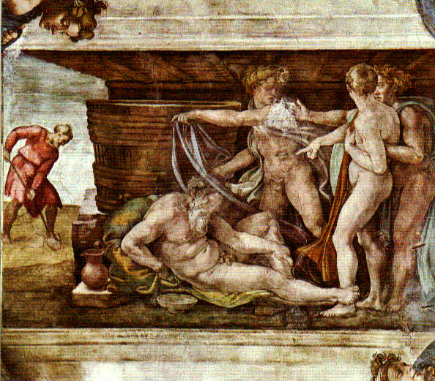
The incident in the tent
Noah plants a vineyard
He makes wine, becomes drunk and lies naked in his tent
Ham sees Noah naked
He tells Shem and Japeth to cover Noah
Noah wakes up and curses Ham’s son Canaan
Notes:
So what is going on here. Why was Ham’s act so wrong??

Slide 13
Test of Ham’s unity with Noah
Noah
Felt
ashamed
Rebuked
Japeth
Ham
Shem
Stirred up &
multiplied sin
Abel
Felt ashamed
covered Noah
Notes:
Why was this all a problem? After the fall Adam and Eve felt ashamed that they were naked. Feeling of shame due to sexual fall. Indicates impurity. When Ham felt ashamed of Noah being naked showed that he was impure. Why did he have this feeling? What sin had he committed so that Satan could invade his inner life?
Why could Satan invade Ham and thus Noah’s family? Qur’an and Jewish Talmud says that Noah told his sons and daughters-in law that for 40 days they should have no sexual relations. Ham and his wife had sexual relations:
“After the sacrifice was completed God blessed Noah and his sons. He made them to be the rulers of the world as Adam had been, and he gave them a command, saying, “Be fruitful and multiply upon the earth,” for during their sojourn in the ark, the two sexes, of men and animals alike, had lived apart from each other. This law of conduct had been violated by none in the ark except by Ham, by the dog, and by the raven.” (Ginsberg)
If Ham had kept his purity for the 40 days he would not have felt ashamed at seeing Noah naked. This ‘fall’ was the condition for Satan to invade Ham’s feelings so that he felt ashamed when he saw Noah naked. So if one has wrong feelings, look back and see if one made some bad condition and clear it up before one makes a mistake.

Slide 14
Why was it a sin to feel ashamed?
Satan needs an object partner to exist and act
Sin – condition for Satan to invade
Before the fall Adam and Eve were naked and unashamed – innocent
After the Flood Noah’s family should have separated from Satan and been innocent
Feeling ashamed showed still of Satan’s lineage
Ham felt ashamed covered Noah
could not restore position of Abel
Notes:
Why was it such a sin to feel ashamed of nakedness? To understand these matters, let us first recall what constitutes sin. Satan cannot manifest his powers - including the power to exist and act - unless he first secures an object partner with whom he can make a common base and engage in a reciprocal relationship of give and take. Whenever a person makes a condition for Satan to invade, it means that he has allowed himself to become Satan's object partner, thereby empowering Satan to act. This constitutes sin.
We can thus understand that when Noah's sons felt ashamed of their father's nakedness and covered his body, it was tantamount to acknowledging that they, like Adam's family after the Fall, had formed a shameful bond of kinship with Satan and were thus unworthy to come before God. Satan, like the raven hovering over the water, was looking for a condition to invade Noah's family. He attacked the family by taking Noah's sons as his object partners when they in effect acknowledged that they were of his lineage.
When Ham felt ashamed of his father's nakedness and acted to cover it up, he made a condition for Satan to enter; hence his feeling and act constituted a sin. Consequently, Ham could not restore through indemnity the position of Abel from which to make the substantial offering. Since he could not establish the foundation of substance, the providence of restoration in Noah's family ended in failure.
Satan could invade and Ham didn’t inherit Noah’s foundation of faith. Therefore shame a sin. Should have had compassion for Noah.

Slide 15
Ham’s fallen nature
1. Failed to love Noah from God’s viewpoint
2. Left position of responsibility
3. Reversed order of authority
4. Multiplied evil
Notes:
Ham knew well that his family had been saved by his father's labors. Considering these things, Ham should have had such respect for his father that he would overcome his personal offense at Noah's nakedness and have some understanding of it. Yet instead of trusting Noah, who had been justified by Heaven, Ham criticized him from a self-centered perspective and showed his displeasure by his actions.
Should have had compassion.
Ham self centred. Accused Noah of own sin,

Slide 16
Ham fails to inherit from Noah
God
Satan
Foundation of faith
Noah
Lost
opportunity
Shem
Ham
Foundation of substance

Slide 17
Why did Ham feel ashamed?
  Ham, like Adam’s family, had formed a shameful bond of kinship with Satan (EDP)
  Talmud it says that Ham and his wife had sexual relations during period of the flood
  Ham projected own send of guilt onto Noah
  Accused Noah own his own sin
Notes:
We can thus understand that when Noah's sons felt ashamed of their father's nakedness and covered his body, it was tantamount to acknowledging that they, like Adam's family after the Fall, had formed a shameful bond of kinship with Satan and were thus unworthy to come before God.

Slide 18
What lessons can be learnt from Noah’s family?
Ham should have been grateful to his father for saving the life of the family
Ham should have had compassion for his father after all he had done
Ham should have overcome his shameful feelings and shown respect for his father
If you make a bad condition, indemnify it quickly or Satan can use it to invade something important

Slide 19
Next
Abraham’s family

