Slide 1
”Reading our lives through the Principle"

Slide 2
1. What is the role of stories in our lives?
Notes:
We all read and tell stories. Why?

Slide 3
How do we make sense of our world?
Some thoughts on identity
Notes:
Man is a meaning making being. Children always asking why. Always wanting to understand causality

Slide 4
How do we make sense of ourselves?
If someone asked you to tell them about yourself what would you say?
Nationality
Physical statistics
Religion
Job
Story
Notes:
We reveal ourselves by telling stories about ourselves. Our identity is constructed as a narrative.
Parents, grandparents, research. Ancestry
Judaism, Christianity, Moonie

Slide 5
Why stories?
Man is essentially a story-telling animal. He becomes through his history, a teller of stories that aspire to truth. But the key question for men is not about their authorship; I can only answer the question 'What am I to do?' if I can answer the prior question 'Of what story or stories do I find myself a part?' We enter human society with one or more imputed characters - roles into which we have been drafted - and we have to learn what they are in order to be able to understand how others respond to us and how our responses to them are apt to be misconstrued.
Alasdair Macintyre, After Virtue, 1985

Slide 6
It is through hearing stories about wicked step-mothers, lost children, good but misguided kings, wolves that suckle twin boys, oldest sons who receive no inheritance but must make their own way in the world and youngest sons who waste their inheritance on riotous living and go into exile to live with the swine, that children learn or mis-learn both what a child and what a parent is, what the cast of characters may be in the drama into which they have been born and what the ways of the world are. Deprive children of stories and you leave them unscripted, anxious stutterers in their actions as in their words. Hence there is no way to give us an understanding of any society, including our own, except through the stock of stories which constitute its initial dramatic resources.

Slide 7
Which stories?
Bible stories
  Adam and Eve
  Cain and Abel
  Abraham’s family
  Moses and the Israelites
  Jesus
Why the Bible?
  Central thread of God’s providence
  Reveals the heart and character of God
  Father’s scripture
Notes:
Are fairy stories true?
Very important which stories constitute a community

Slide 8
What kind of story is Adam and Eve?
All cultures, religions, political philosophies etc. have myths
A myth is a sacred narrative in the sense that it holds religious or spiritual significance for those who tell it, and it contributes to and expresses systems of thought and values. Use of the term by scholars implies neither the truth nor the falseness of the narrative. To the source culture, however, a myth by definition is "true", in that it embodies beliefs, concepts, and ways of questioning and making sense of the world.
  May or may not have a historical basis

Slide 9
Alternative myths
Norse myths – Asgard
  Virtues
Greek myths
  Hesiod’s cosmogony
  Prometheus – gods are hostile to humans
  Fate – no free will
  Good and evil woven into fabric of the universe
Most myths support status quo
Values of myths become embedded in cultural assumptions
Notes:
He begins with Chaos, a yawning nothingness. Out of the void emerged Gaia (the Earth) and some other primary divine beings: Eros (Love), the Abyss (the Tartarus), and the Erebus.[24] Without male assistance, Gaia gave birth to Uranus (the Sky) who then fertilized her. From that union were born first the Titans—six males: Coeus, Crius, Cronus, Hyperion, Iapetus, andOceanus; and six females: Mnemosyne, Phoebe, Rhea, Theia, Themis, and Tethys. After Cronus was born, Gaia and Uranus decreed no more Titans were to be born. They were followed by the one-eyed Cyclopes and the Hecatonchires or Hundred-Handed Ones, who were both thrown into Tartarus by Uranus. This made Gaia furious. Cronus ("the wily, youngest and most terrible of Gaia's children"[24]), was convinced by Gaia to castrate his father. He did this, and became the ruler of the Titans with his sister-wife Rhea as his consort, and the other Titans became his court.

Slide 10
What are some of the lessons of the Adam and Eve story?
There is God
God is good and everything God created is good
Everything was created for a purpose
God cares about us
Human beings are God’s children
Human beings are created in God’s image
The world is created for us to look after
Time is linear
Equality of masculinity and femininity
Freewill and responsibility
Evil is a mistake
Restoration is possible

Slide 11
Why did God create the universe and me?

Slide 12
What kind of being?
God created man in His image and likeness: male and female He created them. Genesis 1:26
Why?
  To have a being with whom He could relate as His object. A being with whom he could share his heart, mind, love and everything and that would be able to receive what he wanted to give and reciprocate

Slide 13
How can we become ‘like God?
“Therefore be imitators of God,
as beloved children.” Ephesians 5:1
Notes:
Stephen Hawkins says at the end of “A Brief History of Time ” that if we were to understand the total theory of everything, we would know the mind of God. I said that Stephen Hawkins, great scientist, might be less than great as a theologian and that I preferred the much more profound remark of an American Jewish mother a few years after the births of her children. She said, “Now I find I can relate to the Almighty much better, because now I know what it is to create something that you can’t control.”
Actually I think that is a very profound theological statement. It is quite clear, and this language deeply shoots through the Bible, that when the Almighty creates the universe, He is not acting as a scientist experimenting in a laboratory. He is doing so as a parent creating new life out of love.

Slide 14
What is God like?
Heart
  Intellect, emotion, will
Logos
  Reason and law
  Ethics - relationships of ordered love
  Four Great Realms of Heart
Creativity
To become like God, God gave human beings
the Three Great Blessings
Notes:
Allah who is Compassionate and Merciful.
Aristotle - Someone who does live according to virtue, who chooses to do the right thing because it is the right thing to do, is living a life that flourishes; to borrow a phrase, they are being all that they can be by using all of their human capacities to their fullest. The most important of these capacities is logos - a word that means "speech" and also means "reason" (it gives us the English word "logic"). Human beings alone have the ability to speak, and Aristotle says that we have been given that ability by nature so that we can speak and reason with each other to discover what is right and wrong, what is good and bad, and what is just and unjust.

Slide 15
The three great blessings
And God blessed them, and God said to them, “Be fruitful and multiply, and fill the earth and subdue it.” Genesis 1:28
God
Heart
Logos
Creativity
Fruitful
Multiply
Dominion
Human
Notes:
And God blessed them, and God said to them, “Be fruitful and multiply, and fill the earth and subdue it.”
Genesis 1:28
What is a blessing?
Gift
Ability
Opportunity
Responsibility
Goal

Slide 16
Four great realms of heart
God
Husband Father
Wife Mother
Man
True Love
Woman
Son
Brother
Daughter
Sister
Children
Notes:
Best way to describe is through stories

Slide 17
2. The Fall and corruption of human relationships

Slide 18





How did we get into this state?
Tree of the Knowledge of Good and Evil
Tree of Life
Fruit
Serpent
Adam
Eve

Slide 19
What should have happened?
Adam and Eve should have achieved individual maturity – the First Blessing
Then God would have blessed them in divine marriage – the Second Blessing
They would have had children and established a happy family
Notes:
The happiest day for God would have been seeing his children happily married and having a happy family

Slide 20
And what should Lucifer have done?
God
God
God
Closest
to God
Adam & Eve
Lord of creation
Adam & Eve
Servant of God
Children
of God
Lucifer
Lucifer
Lucifer
Angels
Angels
Angels
Universe
Universe
Universe

Slide 21
Why did the fall take place?

Slide 22
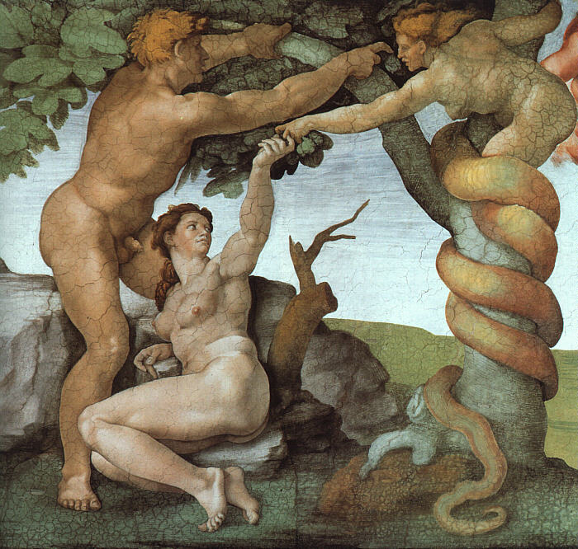
How did it all start?
Lucifer was the channel of God's love to the angelic world. In this position he virtually monopolized the love of God. God loved his children much more than he loved his servant Lucifer. God’s love for Lucifer did not change. It was the same before and after the creation of human beings. When Lucifer saw that God loved Adam and Eve more than him, he felt as if there had been a decrease in the love he received from God. EDP, 63
Notes:
Michaelangelo
The fundamental motivation which engendered these primary characteristics of the
fallen nature lay in the envy the Archangel felt toward Adam, the beloved of God. How
can there be anything such as envy and jealousy in an archangel, whom God created
for a good purpose? The Archangel was endowed with desire and intellect as a part of
his original nature. Because the Archangel possessed an intellect, he could compare
and discern that God's love for human beings was greater than the love God gave to
him. Because he also possessed desires, he had a natural yearning for God to love him
more. This desire of the heart was naturally conducive to envy and jealousy. Envy is
an inevitable by-product of the original nature, like the shadow cast by an object in
the light.

Slide 23
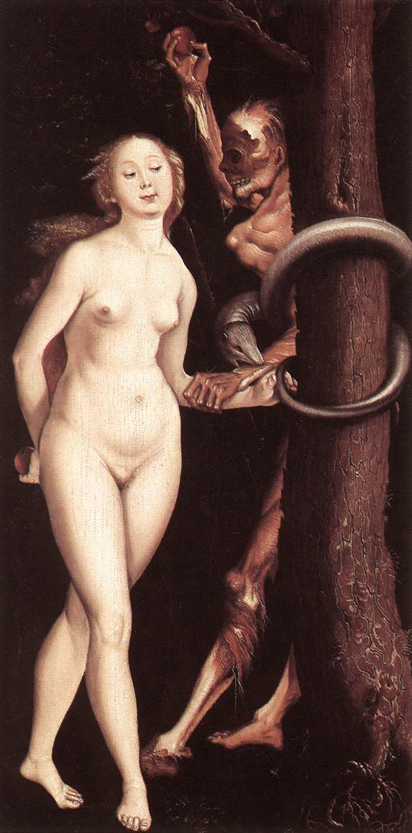
What was the motivation for the fall?
Lucifer, feeling as though he was receiving less love than he deserved, wanted to grasp the same central position in human society as he enjoyed in the angelic world, as the channel of God’s love. This was why he seduced Eve and this was the motivation of the spiritual fall. EDP, 64
Notes:
Lucifer was channel of God’s love to angelic world. He was closer to God than any other being as he was the most like God.
After God created A&E as his children he loved them many times more than he loved Lucifer. Whom he created and loved as his servant. A&E more like God than Lucifer so had a greater capacity to receive God’s love. God’s love to Lucifer didn’t change.
Parable of labourers in Vinneyard. Mt 20:1-15
Lucifer wanted a lineage
After she ate the fruit Eve realised that she had sinned and felt guilty and cut off from God. Her eyes had been opened – she had lost her innocence. She realised that Adam was supposed to be her husband and not Lucifer.

Slide 24
How did the fall start?
God
Closest to
God
Adam
Felt less love
Jealousy
Eve
Lucifer
The fundamental motivation . . .
lay in the envy the Archangel felt
towards Adam, the beloved of God.
EDP, 72
Wanted to
rule humans

Slide 25
Lucifer tempts Eve
When Eve responded to his
temptation, the angel felt
the stimulation of her love
to be deliciously enticing.
EDP, 64
God
Adam
Felt less love
Wanted to
rule humans
Wanted to experience
love before time was ripe
Eve
Lucifer
Desire for unprincipled love

Slide 26

Freedom and the law
Since Eve’s heart and intellect
were still immature when she was
tempted by the angel, she
became confused emotionally
and intellectually. Although the
freedom of her original mind
induced in hear a sense of
foreboding, she crossed
the boundary and fell. EDP, 75
STOP
Prescriptive law
Loss of freedom
Descriptive law
Notes:
Freedom and restoration. Original mind seeks for freedom - freedom to be good, be repsonsibilnsiblee
to own
Descriptive law - gravity
Prescriptive law - ‘do not’

Slide 27
How would the commandment work?
No matter how freely Eve related to
the angel, if she had maintained
faith in the commandment and not
responded to the temptation, then
the power of unprincipled love
would not have been generated and
she would not have fallen. EDP, 75
God
Prayer is the education of desire
Eve
Lucifer
No unprincipled relationship possible

Slide 28
Fall between Lucifer and Eve
Eve was traumatised by her relationship with Lucifer
  Sexually, emotionally, psychologically abused
  Sense of worthlessness and being needy
  Wanting to be loved
Loss of innocence

Slide 29
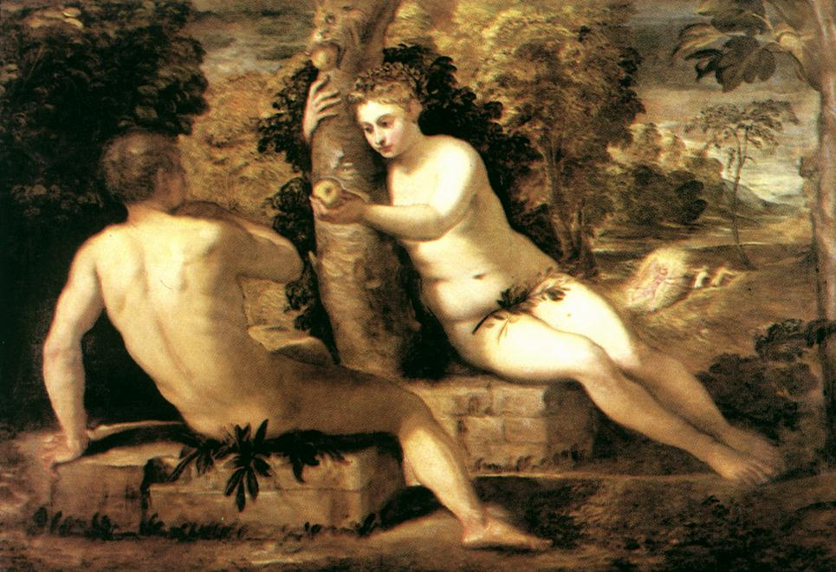
Adam and Eve

Slide 30
Eve tempts Adam
Eve very needy. Vulnerable.
Hurt. Abused. Wanted to be
comforted and loved. Wanted
To receive love and comfort
from Adam who she realised
should be her spouse
God
Adam
Eve
Rid herself of guilt
and stand before God
Lucifer

Slide 31
Results of the second fall
God
Adam
Fear
Guilt
Premature knowledge
Eve
Lucifer

Slide 32
What were the consequences of the fall?

Slide 33
Loss of the first blessing
Confused identity
Satan
Conflict between spirit and flesh
People born with original sin
Mind
Body
Object
Subject
Contradictory nature
Good inclination vs evil inclination
Addiction
Greed
Laziness
Lust
Dishonesty
Conflicted
Person
“You are of your father the devil, and
your will is to do your father’s desires.”
John 8:44

Slide 34
Loss of the second blessing
Satan
“I will greatly multiply your pain in child-bearing; in pain you shall bring forth children, yet your desire shall be for your husband and he shall rule over you.”
Genesis 3:16
Man
Woman
Unfaithfulness
Abuse
Tyranny
Violence
Children

Slide 35
Loss of the third blessing
Satan
Materialism
Consumerism
Environmental
degradation
Natural
World
Person
“Cursed is the ground because of you; in toil you shall eat of it all the days of your life; thorns and thistles it shall bring forth to you.”
Genesis 3:17-19
Poor
Environ-ment

Slide 36
What happened at the fall?
Eve was traumatised by her relationship with Lucifer
  Sexually, emotionally, psychologically abused
  Sense of worthlessness and being needy
  Wanting to be loved
Adam was damaged by his relationship with Eve
  Inherited the archangelic nature
  Weak and hard to respect
Notes:
Give and take of love -> exchange of elements.
Eve TRAUMATISED
And yes, William Haines, I believe that the "original sin" could be renamed "original trauma". I found, in my work as an Emotion Code practitioner that, with women esp., the negative trapped emotion of worthlessness is found over and over and over. One day, i had an epiphany. I felt that this goes way back, all the way back to Eve. This has been transmitted for generations and many women , as in Arabic cultures, still pay the price just for 'being a woman. not just emotionally but by physical limitations/even abuse'.
It is really time to restore all that, the suffering has gone on way to long. It is time, for women and for men to reclaim their original status as loved and loving children of God. But the work needs to be done by each individual to consciously drop what no longer serves them which is the shame and guilt and feelings of lack of value that are all residues from the original ancestral trauma.
Isn't that what is called "being reborn" in Christianity?

Slide 37
What happened at the fall?
All the relationships of the Four Great Realms of Heart were corrupted and distorted
  Man – woman
  Husband – wife
  Parents – children
  Sibling – sibling
Restoration is putting all these relationships right

Slide 38
What needs to be restored?
Relationship between Archangel and Adam
  Adam needs to win the respect of the AA to become the Lord of creation
  Abel, in the position of Adam, needs to restore the birthright by winning the respect of Cain, in the position of the AA, and become the elder brother, head of the family
  This takes many attempts

Slide 39
What needs to be restored?
Relationship between Archangel and Eve
  Men have inherited the archangelic nature to want to control and possess and have sexual relationships with women for their own pleasure and gratification. Lust, not love
    Droit du seigneur – ‘lord’s right’
    Sexual harassment and worse
  Women have inherited the tendency to be seduced by a powerful men

Slide 40
What needs to be restored?
Relationship between Adam and Eve
  Man needs the respect of his wife
  Man needs to love his wife
  Become a good subject
  Woman needs the love of her husband
  Woman needs to respect her husband
  Become a good object

Slide 41
What needs to be restored?
The relationship between parents and children
  Parents need to love and take care of their children
  Children need to honour their parents

Slide 42
3. Indemnity and restoration
If the function of the conscience were absent in fallen people, God’s providence of restoration would be impossible. EDP. 36

Slide 43
Restoration through indemnity
To restore something one must make the necessary effort or pay the due price
Indemnity is the process of restoring the original position
An indemnity condition is what has to be done to restore something to its original position or state
An indemnity condition is a reversal of the process which led to the loss of the original position or state
Notes:
To recover lost position or reputation or health make necessary effort or pay the price
To bring about reconciliation have to do appropriate things
e.g. you break someone’s vase -> problem in relationship. To restore relationship have to apologise. If that’s not enough have to repair vase. If that’s not enough have to replace it. If too expensive to replace? Do something with sincere repentant heart.
Indemnity what ever needs to be done to restore something to the way it was before something went wrong
Equal indemnity - replace something. Compensation, repair something.
Lesser indemnity - apologise, forgiveness, don’t worry, its all right,
Greater indemnity - pay fine, parking, court, state satan, stick in time saves 9
Principle of justice – eye for an eye -> satisfies desire for justice.
Indmenity is not suffering. Indemnity is not makijng mistakes but correcting the, indmnity is not repeating errors of history but doing whjat is necessary to not repeat. Indemnity is not stupidity.

Slide 44
What is restoration?
Restoration occurs when you find yourself in a similar position to Adam, Eve, the archangel, Cain or Abel etc.
And you have to face the same temptation to make the same mistake that they did and continue the pattern of fallen history
But you choose not to do so and instead of acting out of your fallen nature you act according to your original nature and follow your conscience. You break the cycle of abuse and pattern of fallen history

Slide 45
Stories of restoration
Adam – Eve – Lucifer
  Abraham – Sarah - Pharaoh
Lucifer – Adam
  Cain and Abel
  Esau and Jacob
  Joseph and his brothers
Parent – child
  Noah - Ham
  Abraham and Isaac
  Rebecca and Jacob
Husband and wife
  Isaac and Rebecca
Sister – sister
  Sarah and Hagar
  Rachel and Leah

Slide 46
What should have happened?

Slide 47
The two conditions
For Adam and Eve to realize the purpose of creation, they were supposed to fulfill two conditions.
First, Adam and Eve should have established the foundation of faith.
The second condition which Adam and Eve were supposed to fulfill in order to realize the purpose of creation was to establish the foundation of substance. After Adam and Eve established an unshakable foundation of faith, they were then to become one with God, thereby establishing the foundation of substance. This means they would have become the perfect incarnation of the Word with perfect character, fulfilling God’s first blessing.

Slide 48
Adam and Eve should have kept God’s commandment
God
The commandment was to
protect Adam and Eve
Maintained their sexual purity
Developed their spiritual life
Followed their conscience
Vertical
Word
Archangel
Adam
Eve
Creation
Foundation of faith
Notes:
Faith is the confident belief or trust in the truth or trustworthiness of a person, concept or thing.
Adam and eve should have had faith in the commandment God gave them and obeyed it. They thus would have resisted any temptation from the AA.
Original responsibility

Slide 49
Foundation of faith
God
What is faith?
Confident belief or trust in the truth
or trustworthiness of a person or concept
Vertical
Faith is the art of holding onto things
your reason has once accepted,
in spite of your changing moods.
Mere Christianity C.S. Lewis
Word
Adam
Eve
Archangel
Creation
Notes:
You know sex before marriage is wrong BUT you feel like doing it
Adam and eve should have had faith in the commandment God gave them and obeyed it. They thus would have resisted any temptation from the AA.
Original responsibility
To understand the true meaning of sacrifices in temple times, we first need to consider the Hebrew word for sacrifice, korban, coming from the root, kuph reysh vet, meaning to be or to draw near. From this we begin to develop a deeper insight into what sacrifices truly were, a means of connecting people and the Infinite. For our more distant ancestors, sacrifices were not a loss, but the opposite. They were an act to gain a closer relationship with God, to solicit God’s favour, and it was this intention behind them that made them meaningful when the Temple still stood.

Slide 50



Adam and Eve should have reached maturity
God
Lord of Creation
Proper order in the created world
Word
Word
Horizontal
Foundation of substance
Notes:
Beyond just having faith in God’s Word A&E should have come to embody the word. They should have become the substantiation or incarnation of the word just as Jesus later became. Thus Jesus could say, “I am the way, the truth and the life.” They should have reached perfection. If they did, God would have dwelled in them. Then Lucifer would have respected a mature and perfect A&E because they would have stood as God before him and from them he would have received God’s love and truth and guidance. Lucifer would have loved Adam and Eve in the right way and served them. Thus the proper order would have been established and goodness would have been multiplied.
Formed by the word. Conform oneself to the word

Slide 51
First blessing - be fruitful
The ability to create and complete our character
We create our character
through our thoughts,
words and deeds
“Be complete as your
heavenly Father is complete.”
Matthew 5:48
God
Sensitivity to the Heart of God
Fulfill potential
Mind
Body
Joy
Whole hearted
Subject
Object
Virtuous
“You are the temple of God and God’s spirit dwells in you.”
1 Corinthians 3:16
Keep promises
True Person
Unity of mind and body
Words and deeds are one
Meditation
Notes:
Mind body unity
1. Be Fruitful – the ability to perfect our character. This involves achieving mind-body unity so that God can be present in this unity. The most important aspect of this is to develop a sensitivity to the heart of God. By fulfilling the 1st blessing a person would become the incarnation of God, feeling how God feels, thinking as God thinks and acting as God would act etc. Here we have the basis of human rights as each person is a child of God, conscience, personal ethics etc.
Taqwa, God consciousness
Sport, snooker, games,
The Heart of the Buddha’s Teaching, a book by a man I’d never heard of, Thich Nhat Hanh. There was a quote on the jacket: “Thich Nhat Hanh is a holy man, for he is humble and devout. He is a scholar of immense intellectual capacity.” Those words were written by Martin Luther King, nominating Nhat Hanh, a monk from Vietnam, for the Nobel Peace Prize more than 40 years ago. It could hardly hurt to try his book.
So I did, and I was blown away by the simplicity of what Nhat Hanh wrote, urging readers gently and warmly to enjoy the here and now. The secret was to approach all of life much like meditation, including the bits that we think of as boring or unpleasant. “Every act is a rite,” he says at one point. “While washing the dishes one should be completely aware that one is washing the dishes. At first glance, that might seem a little silly: why put so much stress on a simple thing? But that’s precisely the point. If while washing dishes we think only of the cup of tea that awaits us, thus hurrying to get the dishes out of the way as if they were a nuisance, we are not ‘washing the dishes to wash the dishes’. What’s more we are not alive during the time we are washing the dishes. In fact, we are completely incapable of realising the miracle of life while standing at the sink.
“If we can’t wash the dishes, the chances are we won’t be able to drink our tea either. While drinking the cup of tea, we will only be thinking of other things, barely aware of the cup in our hands. Thus we are sucked away into the future — and incapable of actually living one minute of life.”

Slide 52
No foundation of faith or substance established
God
Lost faith in God’s Word
Didn’t keep commandment
Dominated by Archangel
Developed Fallen Nature
Word
Eve
Archangel
Adam
Creation
Notes:
The AA couldn’t respect and love A&E from God’s point of view. He didn’t think they deserved respect and didn’t think they were qualified to be Lords of Creation and certainly not his Lord. So he decided to see if he could gain control over them. He drew Eve towards himself and tempted her to eat the fruit. Eve lost faith in God’s commandment when she couldn’t answer the AA questions. She turned away from God and became self-centred. She allowed the AA to dominate her. Then she tempted Adam to eat the fruit and instead of resisting her he gave in to her and allowed her to dominate him. So instead of perfecting themselves A&E developed fallen nature – self-centred instead of God centred.

Slide 53
How is the foundation of faith restored?
The foundation of faith is restored by
making an acceptable symbolic offering
EDP, 195
Central figure
  Me
Object or gift/offering
Foundation to restore creation - e.g. gift
Restore oneself symbolically
Tithing, reading, prayer, bows etc. - consistent
Time period
Moses and
the fox
Decides
ownership
Condition to stand as central person in foundation of substance
Notes:
In offering a thing I am offering myself to God. Can be done on a desert island. Not confronted with FN.
First, there must be a central figure. From the time Adam failed to establish the foundation of faith, God has been looking for central figures who could restore the lost foundation of faith. God had Cain and Abel offer sacrifices for this purpose. Likewise, God called men such as Noah, Abraham, Isaac, Jacob, Moses, the kings and John the Baptist for the purpose of raising them up as central figures.
Second, an object for the condition must be offered. When Adam lost faith in God, he lost the Word of God which had been given him for the fulfillment of the condition to establish the foundation of faith. As a result, fallen people could no longer directly receive the Word of God to restore the foundation of faith. It then became necessary to offer objects for the condition as substitutes for the Word. Human beings were degraded by the Fall to a status lower than the things of creation, as it is written, "the heart is deceitful above all things." 8(Jer. 17:9)CEV|KJ|NI Hence, in the age prior to the giving of the Old Testament, people could establish the foundation of faith by offering a sacrifice or its equivalent, such as the ark, procured from the natural world. Thus, the foundation of faith also functioned as the foundation to restore all things, which had been defiled by Satan. In the Old Testament Age, either the Word as revealed in the Law of Moses or representatives of the Word - such as the Ark of the Covenant, the Temple and various central figures - served as objects for the condition, substituting for the original Word. In the New Testament Age, the Word as revealed in the Gospels and Jesus, the incarnation of the Word, were the objects for the condition. From the standpoint of human beings, these objects for the condition were offered for the purpose of establishing the foundation of faith. From God's perspective, the offering of objects for the condition would secure God's ownership of the dispensation.
Third, a numerical period of indemnity must be completed. To accomplish a task need to have deadline. If no deadline failure.
Restoring self symbolically – right frame of mind to do substantial
Moses and the fox
Moses finds a shepherd in the desert. He spends the day with the shepherd and helps him milk his ewes, and at the end of the day he sees that the shepherd puts the best milk he has in a wooden bowl, which he places on a flat stone some distance away. So Moses asks him what it is for, and the shepherd replies, "This is God's milk." Moses is puzzled and asks him what he means. The shepherd says, "I always take the best milk I possess, and I bring it as an offering to God." Moses, who is far more sophisticated than the shepherd with his naive faith, asks, "And does God drink it?" "Yes", replies the shepherd, "He does." Then Moses feels compelled to enlighten the poor shepherd and he explains that God, being pure spirit, does not drink milk. Yet the poor shepherd is sure that he does, and so they have a short argument, which ends with Moses telling the shepherd to hide behind the bushes to find out whether in fact God does come to drink the milk. Moses then goes out to pray in the desert. The shepherd hides, the night comes, and in the moonlight the shepherd sees a little fox that comes trotting from the desert, looks right, looks left and heads straight for the milk, which he laps up, and disappears into the desert again. The next morning Moses finds the shepherd quite depressed and downcast. "What's the matter?" he asks. The shepherd says, "You were right, God is pure spirit and he doesn't want my milk." Moses is surprised. He says, "You should be happy. You know more about God than you did before." "Yes, I do," says the shepherd, "but the only thing I could do to express my love for Him has been taken away from me." Moses sees the point. He retires into the desert and prays hard. In the night in a vision, God speaks to him and says, "Moses, you were wrong. It is true that I am pure spirit. Nevertheless I always accepted with gratitude the milk which the shepherd offered me, as the expression of his love, but since being pure spirit, I do not need milk, I shared it with this little fox, who is very fond of milk."
Anthony Bloom, School for Prayer, London: D.L.T., 1970.
Progressive Judaism does not aim to resurrect the act of sacrifice as a way of developing a connection to God, however it still embraces the intention behind the act of sacrifices, of finding a way of linking ourselves more closely to the divine. We now have to strive to find a way to do this. Tefillah is a tool that can help us embark on the path to a connection with the Unknowable. Professor Art Green has written "Since the destruction of the Temple in Jerusalem, prayer has taken the place of sacrifice, but that does not imply that sacrifice was abolished when the sacrificial rite went out of existence. Prayer is not a substitute for sacrifice. Prayer is sacrifice. What has changed is the substance of sacrifice: the self takes the place of the thing. The spirit is the same... The word is but an altar. We do not sacrifice. We are the sacrifice. Prayer is a hazard, a venture of peril. Every person who prays is a kohen at the greatest of all temples. The whole universe is the Temple."However if the intention behind our prayer is only to seek forgiveness, will they be heard? Surely, to release ourselves in prayer, we need to follow the example of our ancestors, who gave of the little they had, equivalent to their whole being, to make a connection with the divine. We don’t need to give up our possessions any more to connect with the unknown, but maybe if we put our nefesh, our very essence on the line, as our forebears tried to do, we might bring ourselves one step closer to God.

Slide 54
How is the foundation of substance restored?
The foundation of substance is restored by making
an acceptable substantial offering which is fulfilling
the indemnity condition to remove fallen nature.
Person in Cain’s position honours the person in Abel’s
position and sets him above himself as an offering.
Restoring the relationship between archangel and Adam
Through this they are restored as good children.
Condition for restoration of parents

Slide 55
4. Rethinking Cain and Abel

Slide 56
How important is Cain and Abel?
What impressed me recently is that only I have discovered and clarified that the principle of Cain and Abel is the fundamental principle of the cosmos. If one understands this principle, one understands 70% of the secret of the cosmos. All the relationships in the cosmos are based on the principle of Cain and Abel. Then where should be the centre of it? It is exactly in the middle.
True Father 24.11.2011

Slide 57
Foundation of substance
Relatively
Worse
Cain
Relatively
Better
Abel
Fallen
person
Horizontal
Fallen
person
Archangel position
Older brother
Adam position
Younger brother
In relationships at every level of society – from those between individuals to those at the level of families, communities, societies, nations and the world – we find that one party is in the role of Abel and the other is in the role of Cain. EDP, 194
Notes:
The substantial offering means fulfilling the indemnity condition to remove the fallen nature. This is essential for the actual restoration of human beings. The substantial offering is carried out when a person in Cain's position honours the person in Abel's position and sets him above himself as an offering. Through this, they fulfill the indemnity condition to be restored as good children. At the same time, it is also reckoned as the indemnity condition for the restoration of their parents. In this manner, the substantial offering can meet God's expectation.
Someone better at something -> either respect, learn from, be with, inherit from. Or feel envious, jealous, critical, fault finding
Humility, courage
Find an abel - someone better, closer to god and unite, learn from

Slide 58
Who decides who is Abel?
God teaches us that fallen people must constantly seek for an Abel-type person. By honouring, obeying and following him, we can accomplish God's Will even without understanding every aspect of it.
Universal tendency to seek out good leaders and righteous friends stems from our innermost desire to come before God through an Abel figure who is closer to God. EDP, 194
Notes:
God teaches us that fallen people must constantly seek for an Abel-type person. By honoring, obeying and following him, we can accomplish God's Will even without understanding every aspect of it.
the universal tendency to seek out good leaders and righteous friends stems from our innermost desire to come before God through an Abel figure who is closer to God. By uniting with him, we can come closer to God ourselves. The Christian faith teaches us to be meek and humble. By this way of life, we may meet our Abel figure and thus secure the way to go before God.
Want to learn violin? Search for a teacher to learn from. Person who is better. Then respect them, obey and do what they tell you to do and follow their example. Role model.
People want to play tennis etc. with someone who is better than they are. Improves their game.
If find someone who is better than you at something how do you react??? Should admire and want to listen and learn. Alternatively may feel jealous and resentful because they show up one’s inadequacies, shortcomings etc.
So Cain decides who is Abel. Original mind tells you that someone is better than you at something or closer to God than you or loved more than you. Then what??? Honour, obey and follow or try to destroy?

Slide 59
Originally the eldest should be first when everyone goes to stand before God. But because of fallen history it is Abel who should be first. Cain will say, "Abel is better than me and therefore he ought to go first. I will follow after him and then meet God." It is Cain who will point out Abel. Abel cannot say, "This person is my Cain." It is not Abel who decides the situation, but Cain. You have to work out among yourselves who is Cain and who is Abel.
Sun Myung Moon, Abel’s right path from the providential point of view, 30.12.1979

Slide 60
Cain and Abel relationships
In relationships at every level of society – from those between individuals to those at the level of families, communities, societies, nations and the world – we find that one party is in the role of Abel and the other is in the role of Cain. EDP, 194
Cain is the older brother / Abel is the younger brother
Abel is relatively better than Cain at something
Sometimes both
Notes:
Tennis – person who is better is Abel. Person who is worse is Cain. How does one respond? Out of original or fallen nature?

Slide 61
Fallen nature
Due to the fall all human beings inherited fallen nature
Fallen nature is misdirected original nature
Both Cain and Abel have fallen nature

Slide 62
Different ways to be Abel
Original nature
Fallen nature
Loveable
Humble
Sharing
Cooperative
Hard to love
Arrogant
Not helpful
Uncooperative
Notes:
FN Abel – arrogant winner

Slide 63
Different ways to be Cain
Original nature
Fallen nature
Loves Abel
Respects Abel
Wants to be guided by Abel
Wants to work together
Can’t love Abel
Can’t respect Abel
Doesn’t want to be guided
Doesn’t want to work together
Notes:
FN of Cain – bad loser

Slide 64
Who is my Abel?
The best way to remove fallen nature is to serve millions of people as your Abels. If someone cannot recognise the value of your serving him this way, his blessing will be transferred from him to you.
Sun Myung Moon Way of God’s Will
The ideal of unification will be fulfilled when you treat everyone as your Abel.
Father, Blessed Family and the Ideal Kingdom, Vol. 1, 65.

Slide 65
Abel and Cain positions change
If you examine your daily life, there are times when you are Abel-like and times when you are Cain-like, between morning and evening of any given day, or even within one hour the dynamics of the Cain-Abel relationship are working. All directions -- back and front, right and left, up and down -- have something to do with the Cain and Abel relationship.
True Father, God’s Will and the World
Notes:
Father speaking in Camberg about Cain and Abel and drinking a glass of water
Then you have to understand how to distinguish Cain and Abel. Even among the Unification Church members, if there are two people, then among the two there is Cain and Abel. To define which one is Cain and which one is Abel, the one who is struck is Abel and one who strikes is Cain. Even if you call out rudely to someone who has brought no harm to you, you become a Cain. Let's take an example and say that there are two sons before parents, and the age difference between the two is quite substantial. However, even if for consultation or in any other aspect the older brother can act on behalf of the parents, if the older brother hits the younger, that is without any fault, then the parents will stand on the side of the younger son. People do not understand that this is the criterion for judging good and evil that applies to today's society. The one who is harming others always becomes the Cain figure.

Slide 66
It is decided by love
Any two of you are in a relationship of Cain and Abel. Who loves the other more will be in Abel's position.
Father, The Brothers & I 4-8-73
To define which one is Cain and which one is Abel, the one who is struck is Abel and one who strikes is Cain. Even if you call out rudely to someone who has brought no harm to you, you become a Cain.
Notes:
"The person who lives most fully for the sake of others is the one who
is closest to me and to the central figure position. If you have some
question about whether to listen to one leader or another, you can
evaluate them yourself according to this standard. Who lives for the
sake of other people more? Whichever leader fulfills that standard
better is the one to whom you should listen.
There is no established seniority within our system – no matter who a
person is or what position he has, if he is living for the sake of
others more than anyone else then he should be the center of the whole
movement. Therefore because of this standard, there is no place for
factions or divisions within our Church. We don’t determine our
leaders by vote but by asking our consciences, “Which person is living
the most for the sake of the country and for God?” Your own conscience
can answer that question for you."
REVEREND SUN MYUNG MOON
Original Palace of Utmost Happiness
December 1, 1983

Slide 67
You can tell who is Abel
The person who lives most fully for the sake of others is the one who is closest to me and to the central figure position. If you have some question about whether to listen to one leader or another, you can evaluate them yourself according to this standard. Who lives for the sake of other people more? Whichever leader fulfills that standard better is the one to whom you should listen.
Father, Original Palace of Utmost Happiness 1.12. 1983
Notes:
Still a leader – ie responsible for project etc

Slide 68
Conscience decides
“There is no established seniority within our system – no matter who a person is or what position he has, if he is living for the sake of others more than anyone else then he should be the centre of the whole movement. Therefore because of this standard, there is no place for factions or divisions within our church. We don’t determine our leaders by vote but by asking our consciences, “Which person is living the most for the sake of the country and for God?” Your own conscience can answer that question for you.”
Father, Original Palace of Utmost Happiness 1.12. 1983

Slide 69
Is the leader necessarily Abel?
“Aren’t you teaching a principle I do not teach, when you say, ‘I am Abel because I am a church leader. You are Cain. Cain obeys Abel. This is the Principle. So obey.’ There is no such Principle. A person who does not fulfil his mission and become an embodiment of love is not Abel.”
True Father, The day when we welcome the blessing, 22nd September 1978
Notes:
Among the members of Unification Church today, there are those crazy ones who say, "I am Abel because I joined earlier and those who joined later are Cain; so you should serve me!" There are many such crazy people. What kind of person is Abel? Abel is one who lives according to the will of God. One who is more public is Abel. You have to understand this. Who is Cain? He stands on the side of Satan. Who is Satan? Satan starts off from selfish thoughts. Abel begins from thinking not about himself but about God. You should understand this.
Even if you joined earlier, one who is satisfying one's own greed is Cain. One who thinks about oneself first is Cain. This kind of person must be chased out. This is the Principle that I use when I am dealing with people.
No matter how long one has been in the church, if one is living selfishly, I completely ignore him or her. I cannot do anything about it now, but when the time comes, I will tell him to pack up and leave. You are not Abel just because you joined earlier. Do you understand? One who pursues personal agendas more is Cain and one who thinks more about the public matters and heaven than about oneself is Abel. You have to understand this clearly. (58-68)
Centering on the Cain-Abel problem . . . You might say, "I am the regional leader, area leader or district leader sent by the headquarters, so you should listen to me." But, this is not how it is. This is God's side and that is Satan's side, so would Satan's side listen to you? He won't. To make him listen to you, you must put in three times more effort. When you put in three times more effort, then a third of that will return. Why is this? Since the number of completion arrived at after passing through the formation and growth stage belongs to God, so in order to save Cain in the course of restoration today, we are to put in three time the effort to take one. This is how it is. However, ignorant of this Principle, you just order people and do not know how to receive orders. This attitude is wrong.
This is not how the principles of Cain and Abel are. Abel is supposed to shed blood and tears . . . The difference is that he is shedding tears to open the way through which Cain can survive. This is where the precious thing, the foundation of victory is. You are the same. How much did all of you fulfill the responsibility of Abel for the sake of the members? Sacrificing for the sake of that one life . . . You must reflect and answer to yourself the question, "How much you have exerted yourself to raise the life of one person considering it as the ultimate goal of your life?" (70-149)
Among the members of the Unification Church, what kind of person is Cain? Those who raise their heads high and order others around are Cain. Then who is Abel? Those who are trying to complete their responsibility are Able. Do you understand? [Yes] Despite the fact that those who joined first are originally Cain, they try to act like Abel. This is like falling into a trap set by oneself. For that kind of person, no matter what he does and how hard he tries, unless he does things according to the principle, I will not use him. (49-214)
Then you have to understand how to distinguish Cain and Abel. Even among the Unification Church members, if there are two people, then among the two there is Cain and Abel. To define which one is Cain and which one is Abel, the one who is struck is Abel and one who strikes is Cain. Even if you call out rudely to someone who has brought no harm to you, you become a Cain. Let's take an example and say that there are two sons before parents, and the age difference between the two is quite substantial. However, even if for consultation or in any other aspect the older brother can act on behalf of the parents, if the older brother hits the younger, that is without any fault, then the parents will stand on the side of the younger son. People do not understand that this is the criterion for judging good and evil that applies to today's society. The one who is harming others always becomes the Cain figure.
Among the Unification members, if you mock one who is working hard and exhibiting great devotion for the sake of the church, "Why does he act so special?" then you become Cain. You must understand this. This is how Cain and Abel set themselves apart from each other. One who is being criticized and being harmed without having committed any sin is always Abel, while one who criticizes and strikes others always becomes Cain.
This is how it is even when saying just one word. Even when you are speaking, one who speaks words that are beneficial is Abel, and one who speak words that harm others is Cain. In other words, when you benefit someone you are not striking him, but when you are doing something for someone for your own sake, it is the same as harming the other person. For this reason, the public position is the place whose purpose is to benefit others, and the private position is the place where one lives for the sake one's own benefit. In this way, centering on public and private, Cain and Abel as well as good and evil are differentiated. You have to understand this. (56-85)
Some of you, today, say as soon as you arrive at some place, "Since Teacher authorized me to be a regional leader or a district leader, I am Abel." This person has not become Abel. He was sent to do the mission of Abel. However, without even doing the mission of Abel, he is saying, "Serve me, obey my orders." When parents order children to do things, if they just sit idly and give the orders then those parents are stepparents. Do you understand? They are stepparents. Real parents will accompany the children and work together. They will teach while they work. Isn't this true? It is, right? [Yes] This is a true parent. (75-168)
From today, you have to throw away thoughts centered on the leader that you had up to now and take up the ideology that always centers on the members. Why is this so? If there is a head of the family, then in order to create heaven in the family, the head must enforce the perspective, not for his own sake, but for the sake of the family members. Otherwise, heaven cannot be built in the family. It is the same. Until now, we must change what has been centered on me in the Unification Church until now to something that is centered on all of you, so that the effort can be focused on linking up the congregation of love horizontally. It won't do if we are trying to do only vertically.

Slide 70
Is this a problem?
“I do not know where this kind of strange thought that Abel is the central figure and in the position to command came from. I don't know how it crept into our movement. Many young members have left the church because of their leaders.”
True Father, Today’s World, Dec. 83

Slide 71
More of Father’s quotes
“Among the members of the Unification Church, what kind of person is Cain? Those who raise their heads high and order others around are Cain. Then who is Abel? Those who are trying to complete their responsibility are Abel.”
“Even when you are speaking, one who speaks words that are beneficial is Abel, and one who speak words that harm others is Cain.”
Notes:
Is our church leadership always one with God? It is of course very difficult to be always absolutely on God’s side. For this reason it is all the more decisive that Father’s guidance in his speech about the importance of prayer is taken seriously and applied consequently with the clear understanding that our Heavenly Father answers the prayers of central figures through people standing in the Cain position to them. This means for leaders that they must listen to their members attentively in order to find out what God would like to show them through one or the other of their members according to Father telling us: “The answer to prayer does not come from you but down from heaven and it takes time to reach you… If you are in the Abel position, the answer comes from Cain…” The whole speech is uploaded at http://www.tparents.org/Moon-Talks/SunMyungMoon79/SM790415.htm

Slide 72
What should Abel do?
“Just as God loves fallen man, Abel must have the heart of love toward Cain and restore him at the risk of his own life. The way of Abel is the way of sacrifice. The history of Abel became a history of shedding blood. This is the fundamental teaching of the Bible.”
True Father, Why we have to go through hardships
11th September 1972
Notes:
When you look at it centering on Abel, Abel made the offering with the same degree of devotion as Cain. However, because Abel was on the side of God from the beginning point God accepted it. For this reason, Abel should have been grateful and humble even if God accepted his offering. Then would Cain have tried to kill him? Nevertheless, since God only received his offering, Abel must have expressed great joy to the extent that aroused intense feeling of jealousy in Cain. It would have been good if he just kept the feeling of happiness to himself and not expressed it, but he boasted to his older brother. Don't you also want to boast about some happy events in your life? Don't you want to brag about it? Similarly, Abel must have boasted to his brother. In the process, he must have gone overboard and said, "God did not receive older brother's offering and just accepted mine. Therefore, I am better than my older brother." Thus, Cain's face must have grown red, and he must have felt intense anger. It is reasonable to have this kind of thought.
“Abel should not have bragged that he felt happy because he received the blessing from God. Instead, when he received the blessing, he should have realized his shortcomings and said, ‘Older brother, I am sorry.’ If he did that, would Cain have beaten him to death? He probably would not have killed him. This is the mistake of Abel.” “Do you like Abel or do you like Cain? [Abel] I like neither Cain nor Abel. Why? Abel made the offering together with his older brother Cain, so even when God accepted only his offering and rejected his older brother's, he should have been nice to his older brother. He should have been more considerate toward his brother. What do you think God would have done if at that moment Abel wept and make a havoc protesting, ‘Father, why did you only receive my offering?’ and then go to his older brother and say, ‘I dislike God who only accepted my offering.’ God would have had to love Cain for sure. However, since God accepted only his offering, Abel thought that this was because he was better and God only liked him. Thus, he must have bragged to his older brother, ‘Older brother, see, my offering was accepted.’ This must be what he did. Otherwise, why should Cain, who did not do anything, grow red in his face? Do you think this took place even when Abel did not do anything? For sure, Abel went before Cain to mock him, ‘What are you? My offering was received.’ Abel must never be arrogant. He must be humble. For this reason, he deserved to be beaten to death. There was no choice but to be beaten to death.” http://www.tparents.org/Moon-Books/wsl2/Wsl2-5-2b.htm

Slide 73
What is Abel’s responsibility?
“Abel is supposed to shed blood and tears to open the way through which Cain can survive. This is where the precious thing, the foundation of victory is. How much did all of you fulfil the responsibility of Abel for the sake of the members? Sacrificing for the sake of that one life . . . You must reflect and answer to yourself the question, ‘How much you have exerted yourself to raise the life of one person considering it as the ultimate goal of your life?’”
True Father (70-149)

Slide 74
5. Abraham, the idols and the burning palace

Slide 75
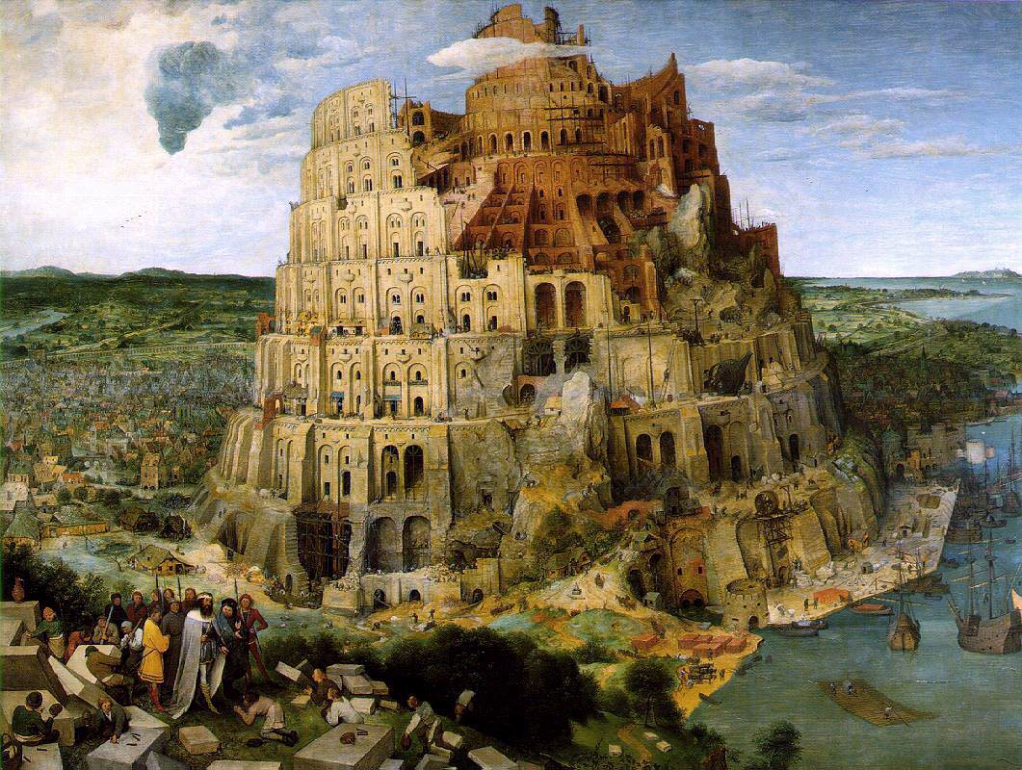
What was Abraham’s world?
Abraham came from Ur
Ur was ruled by Nimrod
  Dictator with a personality cult
  Name means ‘let us revolt’
  Built the Tower of Babel
Tower of Babel
Notes:
Archaeology has been one of biblical history's greatest tools to sift out better verified facts of Bible stories. In fact, over the past few decades archaeologists have learned a great deal about the world ofAbraham in the Bible. Abraham is considered to be the spiritual father of the world's three great monotheistic religions, Judaism, Christianity and Islam.
The Patriarch Abraham in the Bible
Historians date Abraham's bibilical story around 2000 B.C., based on clues in Genesis Chapters 11 through 25.
Considered the first of the biblical patriarchs, Abraham's life history encompasses a journey starts that in a place called Ur. In Abraham's time, Ur was one of the great city-states in Sumer, a part of the Fertile Crescent located from the Tigris and Euphrates Rivers in Iraq to the Nile in Egypt. Historians call this era from 3000 to 2000 B.C. "the dawn of civilization" because it marks the earliest documented dates when people settled in communities and began such things as writing, agriculture and commerce.
Genesis 11:31 says that the patriarch's father, Terah, took his son (who was then called Abram before God renamed him Abraham) and their extended family out of a city called Ur of the Chaldeans.
CONTINUE READING BELOW OUR VIDEO
How Does Color Affect How You Feel?
0:14
/
1:00
Archaeologists took this notation as something to investigate, because according to The Biblical World: An Illustrated Atlas, the Chaldeans were a tribe that didn't exist until somewhere around the sixth and fifth centuries B.C., nearly 1,500 years after Abraham is believed to have lived. Ur of the Chaldeans has been located not far from Haran, whose remnants are found today in southwestern Turkey.
The reference to the Chaldeans has led biblical historians to an interesting conclusion. The Chaldeans lived around the sixth-to-fifth century B.C., when Jewish scribes first wrote down the oral tradition of Abraham's story as they put together the Hebrew Bible. Therefore, since the oral tradition mentioned Ur as the starting point for Abraham and his family, historians think that it would have been logical for scribes to assume the name was tied to the same place they knew in their period, says The Biblical World.
However, archaeologists have uncovered evidence over the past several decades that sheds new light on the era of city-states which corresponds more closely to Abraham's time.
Ads
Abraham Bible
Where in the Bible
Land of the Bible
Abraham & Sarah
The Bible the Bible
Clay tablets offer ancient data
Among these artifacts are some 20,000 clay tablets found deep inside in the ruins of the city of Mari in today's Syria. According to The Biblical World, Mari was located on the Euphrates River some 30 miles north of the border between Syria and Iraq. In its time, Mari was a key center on the trade routes between Babylon, Egypt and Persia (today's Iran).
Mari was the capital of King Zimri-Lim in the 18th century B.C. until it was conquered and destroyed by King Hammurabi. In the late 20th century A.D., French archaeologists looking for Mari dug through centuries of sand to uncover Zimri-Lim's former palace. Deep within the ruins, they discovered tablets written in an ancient cuneiform script, one of the first forms of writing.
Some of the tablets have been dated back 200 years before Zimri-Lim's time, which would place them around the same time that the Bible says Abraham's family departed Ur. Information translated from the Mari tablets would seem to indicate that the Sumerian Ur, not Ur of the Chaldeans, is more likely the place where Abraham and his family started their journey.
Reasons for the Journey of Abraham in the Bible
Genesis 11:31-32 gives no indication why Abraham's father, Terah, would suddenly uproot his large extended family and head toward the city of Haran, which was some 500 miles north of the Sumerian Ur. However, the Mari tablets offer information about political and cultural strife around Abraham's time that scholars think offers clues to their migration.
The Biblical World notes that some of the Mari tablets use words from the Amorite tribes that are also found in Abraham's story, such as his father's name, Terah, and his brothers' names, Nahor and Haran (also ironically the name for their destination). From these artifacts and others, some scholars have concluded that Abraham's family may have been Amorites, a Semitic tribe that began to migrate out of Mesopotamia around 2100 B.C. The Amorites' migration destabilized Ur, which scholars estimate collapsed around 1900 B.C.
As a result of these findings, archaeologists now surmise that those who wanted to escape the era's civil strife had only one direction to go for safety: north. South of Mesopotamia was the sea known now as the Persian Gulf. Nothing but open desert lay to the west. To the east, refugees from Ur would have encountered Elamites, another tribal group from Persia whose influx also hastened Ur's downfall.
Thus archaeologists and biblical historians conclude that it would have been logical for Terah and his family to head north toward Haran to save their lives and livelihoods. Their migration was the first stage in the journey that led Terah's son, Abram, to become the patriarch Abraham whom God in Genesis 17:4 terms "the father of a multitude of nations."
Bible Texts Related to the Story of Abraham in the Bible:
Genesis 11:31-32: "Terah took his son Abram and his grandson Lot son of Haran, and his daughter-in-law Sarai, his son Abram's wife, and they went out together from Ur of the Chaldeans to go into the land of Canaan; but when they came to Haran, they settled there. The days of Terah were two hundred and five years; and Terah died in Haran."
Genesis 17:1-4: When Abram was ninety-nine years old, the Lord appeared to Abram, and said to him, 'I am God Almighty; walk before me, and be blameless. And I will make my covenant between me and you, and will make you exceedingly numerous.' Then Abram fell on his face; and God said to him, 'As for me, this is my covenant with you: You shall be the ancestor of a multitude of nations.' "
Sources:
The Oxford Annotated Bible with The Apocrypha, New Revised Standard Version (1994).
The Biblical World: An Illustrated Atlas (National Geographic 2007)

Slide 76
The story of the Tower of Babel
After the Flood 70 nations and languages
One imperial power conquered smaller nations and imposed their language and culture on them, thus directly contravening God’s wish that humans should respect the integrity of each nation and each individual. When at the end of the Babel story God “confuses the language” of the builders, He is not creating a new state of affairs but restoring the old. Interpreted thus, the story of Babel is a critique of the power of the collective when it crushes individuality
Notes:
Now the whole earth had one language and the same words. ² And as people migrated from the east, they found a plain in the land of Shinar and settled there. ³ And they said to one another, “Come, let us make bricks, and burn them thoroughly.” And they had brick for stone, and bitumen for mortar. ⁴ Then they said, “Come, let us build ourselves a city and a tower with its top in the heavens, and let us make a name for ourselves, lest we be dispersed over the face of the whole earth.” ⁵ And the Lord came down to see the city and the tower, which the children of man had built. ⁶ And the Lord said, “Behold, they are one people, and they have all one language, and this is only the beginning of what they will do. And nothing that they propose to do will now be impossible for them. ⁷ Come, let us go down and there confuse their language, so that they may not understand one another's speech.” ⁸ So the Lord dispersed them from there over the face of all the earth, and they left off building the city. ⁹ Therefore its name was called Babel, because there the Lord confused^{[a]} the language of all the earth. And from there the Lord dispersed them over the face of all the earth.
Nimrod the prototype for dictators such as Hitler and Stalin and Kim Il Sung. Planned economy.
Babel is the opposite, and we now have important historical evidence as to exactly what was meant by the sentence, “The entire land had one language and a common speech.” This may not refer to primal humanity before the division of languages. In fact in the previous chapter the Torah has already stated, “From these the maritime peoples spread out into their lands in their clans within their nations, each with its own language” (Gen. 10: 50. The Talmud Yerushalmi, Megillah 1: 11, 71b, records a dispute between R. Eliezer and R. Johanan, one of whom holds that the division of humanity into seventy languages occurred before the Flood).
The reference seems to be to the imperial practice of the neo-Assyrians, of imposing their own language on the peoples they conquered. One inscription of the time records that Ashurbanipal II “made the totality of all peoples speak one speech.” A cylinder inscription of Sargon II says, “Populations of the four quarters of the world with strange tongues and incompatible speech . . . whom I had taken as booty at the command of Ashur my lord by the might of my sceptre, I caused to accept a single voice.” The neo-Assyrians asserted their supremacy by insisting that their language was the only one to be used by the nations and populations they had defeated. On this reading, Babel is a critique of imperialism.
There is even a hint of this in the parallelism of language between the builders of Babel and the Egyptian Pharaoh who enslaved the Israelites. In Babel they said, “Come, [hava] let us build ourselves a city and a tower . . . lest [pen] we be scattered over the face of the earth” (Gen. 11: 4). In Egypt Pharaoh said, “Come, [hava] let us deal wisely with them, lest [pen] they increase so much . . .” (Ex. 1: 10). The repeated “Come, let us … lest” is too pronounced to be accidental. Babel, like Egypt, represents an empire that subjugates entire populations, riding roughshod over their identities and freedoms.
If this is so, we will have to re-read the entire Babel story in a way that makes it much more convincing. The sequence is this: Genesis 10 describes the division of humanity into seventy nations and seventy languages. Genesis 11 tells of how one imperial power conquered smaller nations and imposed their language and culture on them, thus directly contravening God’s wish that humans should respect the integrity of each nation and each individual. When at the end of the Babel story God “confuses the language” of the builders, He is not creating a new state of affairs but restoring the old. Interpreted thus, the story of Babel is a critique of the power of the collective when it crushes individuality
Now the whole earth had one language and the same words. ² And as people migrated from the east, they found a plain in the land of Shinar and settled there. ³ And they said to one another, “Come, let us make bricks, and burn them thoroughly.” And they had brick for stone, and bitumen for mortar. ⁴ Then they said, “Come, let us build ourselves a city and a tower with its top in the heavens, and let us make a name for ourselves, lest we be dispersed over the face of the whole earth.” ⁵ And the Lord came down to see the city and the tower, which the children of man had built. ⁶ And the Lord said, “Behold, they are one people, and they have all one language, and this is only the beginning of what they will do. And nothing that they propose to do will now be impossible for them. ⁷ Come, let us go down and there confuse their language, so that they may not understand one another's speech.” ⁸ So the Lord dispersed them from there over the face of all the earth, and they left off building the city. ⁹ Therefore its name was called Babel, because there the Lord confused^{[a]} the language of all the earth. And from there the Lord dispersed them over the face of all the earth.

Slide 77
What was Abram’s world?
Abram came from Ur
Ur was ruled by Nimrod
  Dictator with a personality cult
  Name means ‘let us revolt’
  Built the Tower of Babel
Abram’s father was called Terah. He was an idol maker
Tower of Babel
Notes:
Now the whole earth had one language and the same words. ² And as people migrated from the east, they found a plain in the land of Shinar and settled there. ³ And they said to one another, “Come, let us make bricks, and burn them thoroughly.” And they had brick for stone, and bitumen for mortar. ⁴ Then they said, “Come, let us build ourselves a city and a tower with its top in the heavens, and let us make a name for ourselves, lest we be dispersed over the face of the whole earth.” ⁵ And the Lord came down to see the city and the tower, which the children of man had built. ⁶ And the Lord said, “Behold, they are one people, and they have all one language, and this is only the beginning of what they will do. And nothing that they propose to do will now be impossible for them. ⁷ Come, let us go down and there confuse their language, so that they may not understand one another's speech.” ⁸ So the Lord dispersed them from there over the face of all the earth, and they left off building the city. ⁹ Therefore its name was called Babel, because there the Lord confused^{[a]} the language of all the earth. And from there the Lord dispersed them over the face of all the earth.
Nimrod the prototype for dictators such as Hitler and Stalin and Kim Il Sung. Planned economy.
Babel is the opposite, and we now have important historical evidence as to exactly what was meant by the sentence, “The entire land had one language and a common speech.” This may not refer to primal humanity before the division of languages. In fact in the previous chapter the Torah has already stated, “From these the maritime peoples spread out into their lands in their clans within their nations, each with its own language” (Gen. 10: 50. The Talmud Yerushalmi, Megillah 1: 11, 71b, records a dispute between R. Eliezer and R. Johanan, one of whom holds that the division of humanity into seventy languages occurred before the Flood).
The reference seems to be to the imperial practice of the neo-Assyrians, of imposing their own language on the peoples they conquered. One inscription of the time records that Ashurbanipal II “made the totality of all peoples speak one speech.” A cylinder inscription of Sargon II says, “Populations of the four quarters of the world with strange tongues and incompatible speech . . . whom I had taken as booty at the command of Ashur my lord by the might of my sceptre, I caused to accept a single voice.” The neo-Assyrians asserted their supremacy by insisting that their language was the only one to be used by the nations and populations they had defeated. On this reading, Babel is a critique of imperialism.
There is even a hint of this in the parallelism of language between the builders of Babel and the Egyptian Pharaoh who enslaved the Israelites. In Babel they said, “Come, [hava] let us build ourselves a city and a tower . . . lest [pen] we be scattered over the face of the earth” (Gen. 11: 4). In Egypt Pharaoh said, “Come, [hava] let us deal wisely with them, lest [pen] they increase so much . . .” (Ex. 1: 10). The repeated “Come, let us … lest” is too pronounced to be accidental. Babel, like Egypt, represents an empire that subjugates entire populations, riding roughshod over their identities and freedoms.
If this is so, we will have to re-read the entire Babel story in a way that makes it much more convincing. The sequence is this: Genesis 10 describes the division of humanity into seventy nations and seventy languages. Genesis 11 tells of how one imperial power conquered smaller nations and imposed their language and culture on them, thus directly contravening God’s wish that humans should respect the integrity of each nation and each individual. When at the end of the Babel story God “confuses the language” of the builders, He is not creating a new state of affairs but restoring the old. Interpreted thus, the story of Babel is a critique of the power of the collective when it crushes individuality
Now the whole earth had one language and the same words. ² And as people migrated from the east, they found a plain in the land of Shinar and settled there. ³ And they said to one another, “Come, let us make bricks, and burn them thoroughly.” And they had brick for stone, and bitumen for mortar. ⁴ Then they said, “Come, let us build ourselves a city and a tower with its top in the heavens, and let us make a name for ourselves, lest we be dispersed over the face of the whole earth.” ⁵ And the Lord came down to see the city and the tower, which the children of man had built. ⁶ And the Lord said, “Behold, they are one people, and they have all one language, and this is only the beginning of what they will do. And nothing that they propose to do will now be impossible for them. ⁷ Come, let us go down and there confuse their language, so that they may not understand one another's speech.” ⁸ So the Lord dispersed them from there over the face of all the earth, and they left off building the city. ⁹ Therefore its name was called Babel, because there the Lord confused^{[a]} the language of all the earth. And from there the Lord dispersed them over the face of all the earth.

Slide 78
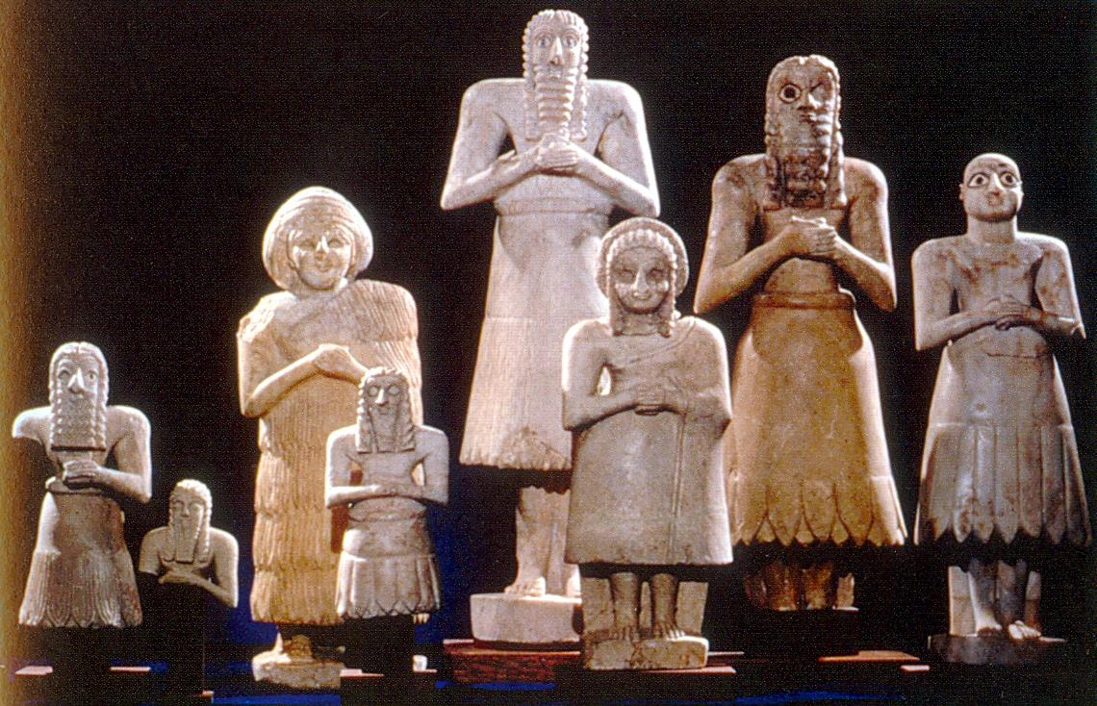
What is an idol?
A man made object worshipped as if it were a god
Worship power
“Their land is full of idols; they worship the work of their own hands, that which their own fingers have made.” Isaiah 2:8
Sumerian idols
Notes:
Idol worship – worship of self. Totem. Some religions. Nationalism.

Slide 79
Why could God choose Abram?
Satan
God
Third son of
Terah,
idol-maker
Abram
Ham
Notes:
Changed lineage from son of Satan to son of god. Change of identity at risk of life.

Slide 80
What is the change of lineage?
Where is the change of blood lineage done? On the individual level, man has to go beyond the boundary of life and death. The individual has to go through life and death situations for the sake of God and the future dignity of man.
(True Father, 1970)
Notes:
Life and death situations. Challenging situations. Extreme situations. How did Abraham change his lineage and be qualified.

Slide 81
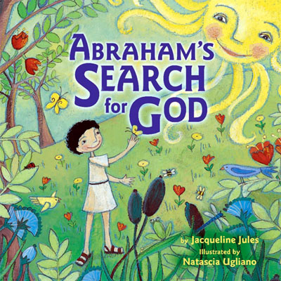
How did Abram discover God?
Abram discovers God
Abram’s belief in God was
based on reason:
There must be a First Cause
There must be an unchanging
reality behind the changing
world of phenomena
Notes:
"When night outspread over him he say a star and said, 'This is my Lord.' But when it set he said, 'I love not the setters.' When he saw the moon rising, he said, 'This is my Lord.' But when it set he said, 'If my Lord does not guide me I shall surely be of the people gone astray.' When he say the sun rising, he said, 'This is my Lord; this is greater.' But when it set he said, 'O my people, surely I quit that which you associate, I have turned my face to Him Who originated the heavens and the earth; a man of pure faith, I am not of the idolaters.'" (6:76-79)
How did Abraham discover God?
Abraham was the son of Terah an idol maker. He lived in Ur one of the first cities in human history. Now the ruler of Ur was a man called Nimrod. He was the archetype of all the dictators who ever lived. He thought he was god and there was a huge personality cult associated with him. People used to have statues of him in their homes and would worship him thinking that all good things in their city came from him. One night Nimrod had a frightening dream. He dreamt that a man would be born who would teach people about the True God and expose him was a fake. Nimrod woke up trembling with anger. He was outraged at the idea that there was a being greater than him. He decided to build a tower to attack heaven where he had heard this God lived and kill him. To do this he forced his subjects to the Tower of Babel from which his archers could shoot arrows into the clouds where God lived.
Meanwhile, Terah and his wife had a son who they called Abram. Now, Abram was a very clever little boy who was always asking questions. Why this and why that and why the other. He was really quite a little philosopher. One day he realised that he hadn’t always been alive. He must have come from somewhere. So he asked his Mum and Dad where he came from. They explained that they had given birth to him. When Abram understood the significance of this, that his parents had created him, he immediately bowed down to them and started worshipping them. Every day he would bow to his parents as if they were gods. After a while though, it occurred to him that his parents hadn’t made themselves either. So he asked them where they came from. They said that Grandma and Grandpa had given birth to him. So he left off worshipping his parents and went round to his grandparents house and started bowing to them. Soon he realised that they hadn’t made themselves either and asked them who had created them. They replied that they too had parents but they had died and were buried in the local cemetery. So Abram set off for the cemetery, found the graves, and started bowing down to worship them and all his ancestors. One day a nearby grave was dug up and he saw that all that was left of the person were white bones and he realised that the body had decayed and become part of the earth. So he started to worship ‘mother earth’ which had given him his body. One cold day he realised that without the sun there would be no life and so he became a sun worshipper. But the sun set every evening in the west and rose every morning in the east. It too was changing. But Abram realised that behind everything that was changing there must be an unchanging reality. There must be an invisible first cause that created the universe and everything in it. He decided he was going to worship and pray to the invisible God who created the heavens and the earth.
Bereshith or Genesis Rabbah: (60-61)
Terah, the father of Abraham and Haran, was a dealer in images as well as a worshiper of them. Once when he was away he gave Abraham his stock of graven images to sell in his absence. In the course of the day an elderly man came to make a purchase. Abraham asked him his age, and the man gave it as between fifty and sixty years. Abraham taunted him with want of sound sense in calling the work of another man's hand, produced perhaps in a few hours, his god; the man laid the words of Abraham to heart and gave up idol-worship. Again, a woman came with a handful of fine flour to offer to Terah's idols, which were now in charge of Abraham. He took a stick and broke all the images except the largest one, in the hand of which he placed the stick which had worked this wholesale destruction. When his father returned and saw the havoc committed on his "gods" and property he demanded an explanation from his son whom he had left in charge. Abraham mockingly explained that when an offering of fine flour was brought to these divinities they quarreled with one another as to who should be the recipient, when at last the biggest of them, being angry at the altercation, took up a stick to chastise the offenders, and in so doing broke them all up. Terah, so far from being satisfied with this explanation, understood it as a piece of mockery, and when he learned also of the customers whom Abraham had lost him during his management he became very incensed, and drove Abraham out of his house and handed him over to Nimrod. Nimrod suggested to Abraham that, since he had refused to worship his father's idols because of their want of power, he should worship fire, which is very powerful. Abraham pointed out that water has power over fire. "Well," said Nimrod, "let us declare water god." "But," replied Abraham, "the clouds absorb the water; and even they are dispersed by the wind." "Then let us declare the wind our god." "Bear in mind," continued Abraham, "that man is stronger than wind, and can resist it and stand against it."
Nimrod, becoming weary of arguing with Abraham, decided to cast him before his god--fire--and challenged Abraham's deliverance by the God of Abraham, but God saved him out of the fiery furnace. Haran, too, was challenged to declare his god, but halted between two opinions, and delayed his answer until he saw the result of Abraham's fate. When he saw the latter saved he declared himself on the side of Abraham's God, thinking that he too, having now become an adherent of that God, would be saved by the same miracle. But since his faith was not real, but depended on a miracle, he perished in the fire, into which, like Abraham, he was cast by Nimrod. This is hinted in the words (Gen. xi. 28): "And Haran died before his father Terah in the land of his nativity, in Ur of the Chaldees."

Slide 82
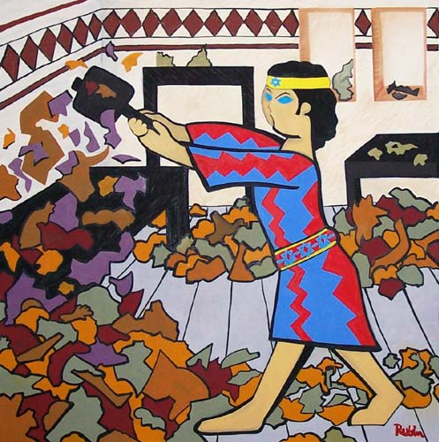
How did Abram discover God?
Abram discovers God
Abram and the idols
Notes:
Parents
Change of ID
Change of lineage
Risk of life
Idol – something not God but worship as if it were God
Qur’an 37
Surely Ibrahim belonged to the first group (who followed Nuh's way),
84 when he came to his Rabb with a pure heart.
85 Behold, he said to his father and to his people: "What are these that you worship?
86 Would you serve false gods instead of Allah?
87 What is your idea about the Rabb of the worlds?"
88 Then he looked at the stars one time
89 and said "I am feeling sick."
90 So his people left him behind and went away to their national fair.
91 He sneaked into the temple of their gods and addressed them: "Why don't you eat from these offerings before you?
92 What is the matter with you that you don't even speak?"
93 Then he fell upon them, smiting them with his right hand.
94 The people came running to the scene.
95 "Would you worship that which you have carved with your own hands," he said,
96 "when Allah is the One Who created you and that which you have made?"
97 They said to one another: "Prepare for him a furnace and throw him into the blazing flames."
98 Thus did they scheme against him: but We humiliated them in their scheme.
Abram was a very helpful boy at home even though his questions sometimes drove his parents mad. One day his father, Terah, said to him, “Abram, tomorrow is market day but I have an important meeting to go to at the palace. So would you take the idols to the market and run the stall for me tomorrow please.”
“Of course,” said Abram, “I’d be happy to.”
So next day Abram took the wagon out of the garage and loaded it up with the idols his father had made and set off for the market. When he arrived he set up his stall, carefully displaying all the idols with their price tags.
Soon an elderly woman came up to him and said, “I want to buy one of your gods Abram. How much are they?”
“Why?” asked Abram, “what happened to the gods you bought before?”
“Someone broke into my house last week and stole them,” said the woman.
“Well, they weren’t very powerful were they if someone could steal them.”
“No” said the woman, “that’s why I want to buy yours. I am sure they are much stronger.”
“How old are you, old woman?” asked Abram who could sometimes not be as polite as he ought to be.
“Eighty-five years old last month,” she replied proudly.
“Well, my Dad made these gods in his workshop last month. You are much older than they are so they ought to bow down and worship you.”
“You’re right Abram,” she said, “So who do you worship then?”
“I worship the invisible God who created the heavens and the earth,” he replied.
“I think I am going to worship him too,” she said and became Abram’s first disciple.
At the end of the day Abram packed up his stall, loaded up the wagon and went home. When he arrived Terah was eagerly waiting for him.
“How did you get on?” he asked, “Did you sell out?”
“No, Dad. I didn’t sell a single idol.”
“What!” exclaimed Terah, “What happened? Weren’t there any customers? Was someone else selling them for less?”
“No Dad,” Abram replied and he told his father what had happened.
Terah slapped his forehead and said, “You’re a useless salesman. Of course no one would buy anything from you if that was your sales patter. Next time you can stay at home and I’ll go to the market.”
The following month Terah called Abram and said to him, “Look Abram, tomorrow is market day again. I’ll take the idols to sell but I want you to remain at home and look after the gods in the temple.”
The next day, after waving good bye to his father, Abram went into the temple to see the gods. He went up to the largest one at the front of the temple and in a loud voice said to him, “If you are really god, tell me what your message is and I will tell it to the world.” The idol though said nothing.
“OK,” said Abram, “Perhaps you are hungry. I’ll go into the kitchen and make you some lunch and then we can sit down and talk.” So Abram went out and prepared lunch for the idol. He came back in, placed the food at the foot of the idol and waited for him to eat. When he didn’t Abram said, “Alright then, I expect you want to eat in peace so I’ll leave you and come back in an hour.”
An hour later Abram went back to the temple and found that the food was still untouched. So he spoke to the idol saying, “You are not a god. You have no power. You cannot speak and have no message. You are just carved stone and the rest of you are just wood.”
Then he went to his father’s workshop and picked up an axe. Returning to the temple he walked around smashing and chopping up all the small idols. Then he carefully placed the axe in the hands of the largest idol and walked out.
At the end of the day Terah came home. He was tired but happy as he had sold out. He went straight to the temple to offer the money to the gods and thank them for their help. But when he opened the door, he was greeted by a scene of destruction.
“Abram! Abram!” he shouted, “What happened? I left you to look after the gods. Did some vandals break in and destroy them?”
“No,” said Abram, “I did exactly what you said. The largest idol complained that he was hungry so I made him a delicious meal. Look you can still see it at his feet. Then I left him to enjoy it in peace. Soon I heard the other smaller gods asking him to share the food with them. But he refused and told them to shut up. But they wouldn’t so he beat them all up. And look. There is the evidence. The axe is in his hands.”
“What are you talking about?” exclaimed Terah, “They are just pieces of stone and wood. They have no power. They cannot speak or move.”
“Exactly,” said Abram, “So why do you worship them?”
Terah was stunned. “So who do you worship then son?”
“I worship the invisible God who created the heavens and the earth. I talk to him and he talks back to me. I can feel his presence around me everyday.”
“You had better come and see Nimrod with me,” said Terah, “He will want to hear about this.”
So off they went to visit Nimrod in the palace. When Terah appeared in front of Nimrod he bowed to the ground but Abram stood upright and looked him in the eyes. Nimrod and all his courtiers were shocked.
“How dare you stand there and stare at me,” shouted Nimrod. “Why don’t you bow down and worship your god like everyone else?”
“I only bow down and worship the invisible God who created the heavens and the earth. He is your creator too and one day he will judge you for your evil deeds,” said Abram boldly.
Nimrod was enraged and he remembered the dream he had had about just such a boy. He said to Abram, “If you don’t bow down and worship me I will have you put to death.”
“I am not afraid of you,” said Abram. “I believe in God. He is my creator, the one whom I love and worship. He is more real to me than this world, more real than this palace and more real than you. If you kill me I will still be with him.”
Nimrod had Abram seized and thrown into a burning furnace. But the flames didn’t touch him and he emerged unscathed. Nimrod decided the best thing to do was to expel Abram and never allow him to return. At this point Terah decided perhaps it was time for the whole family to leave. So they packed up all their belongings and set off for Haran where they could be safe and Abram could carry on telling people about the invisible God who created the heavens and the earth and with whom one talk and whose loving presence and power one could feel.
This is how Abraham changed his lineage from that of the son of an idol maker to a son of God. At the risk of his life he refused to worship Nimrod and the idols of his day. Instead he declared that his identity came from his relationship with God.
_
(Freely adapted from the stories in the Talmud and Qur'an)

Slide 83
What are the idols of the modern world?
Power
Money
Position
Cars
Computer
Celebrities
Image
Religion
Twitter – fake grief and anger
Instagram – fake envy
Tinder – fake love
Leader
Nation
Concepts
Political correctness
Notes:
I want you, says God to Abraham, to be different. Not for the sake of being different, but for the sake of starting something new: a religion that will not worship power and the symbols of power – for that is what idols really were and are. I want you, said God, to “teach your children and your household afterward to follow the way of the Lord by doing what is right and just.”
To be a Jew is to be willing to challenge the prevailing consensus when, as so often happens, nations slip into worshipping the old gods. They did so in Europe throughout the nineteenth and early twentieth century. That was the age of nationalism: the pursuit of power in the name of the nation-state that led to two world wars and tens of millions of deaths. It is the age we are living in now as North Korea acquires and Iran pursues nuclear weapons so that they can impose their ambitions by force. It is what is happening today throughout much of the Middle East and Africa as nations descend into violence and what Hobbes called “the war of every man against every man.”
We make a mistake when we think of idols in terms of their physical appearance – statues, figurines, icons. In that sense they belong to ancient times we have long outgrown. Instead, the right way to think of idols is in terms of what they represent. They symbolise power. That is what Ra was for the Egyptians, Baal for the Canaanites, Chemosh for the Moabites, Zeus for the Greeks, and missiles and bombs for terrorists and rogue states today.
Power allows us to rule over others without their consent. As the Greek historian Thucydides put it: “The strong do what they wish and the weak suffer what they must.” Judaism is a sustained critique of power. That is the conclusion I have reached after a lifetime of studying our sacred texts. It is about how a nation can be formed on the basis of shared commitment and collective responsibility. It is about how to construct a society that honours the human person as the image and likeness of God. It is about a vision, never fully realised but never abandoned, of a world based on justice and compassion, in which “They will neither harm nor destroy on all my holy mountain, for the earth will be filled with the knowledge of the Lord as the waters cover the sea” (Isaiah 11: 9).
Abraham is without doubt the most influential person who ever lived. Today he is claimed as the spiritual ancestor of 2.4 billion Christians, 1.6 billion Muslims and 13 million Jews, more than half the people alive today. Yet he ruled no empire, commanded no great army, performed no miracles and proclaimed no prophecy. He is the supreme example in all of history of influence without power.
Why? Because he was prepared to be different. As the sages say, he was called ha-ivri, “the Hebrew,” because “all the world was on one side (be-ever echad) and he was on the other” (Genesis Rabbah 42: 8). Leadership, as every leader knows, can be lonely. Yet you continue to do what you have to do because you know that the majority is not always right and conventional wisdom is not always wise. Dead fish go with the flow. Live fish swim against the current. So it is with conscience and courage. So it is with the children of Abraham. They are prepared to challenge the idols of the age.

Slide 84
Ten Words
1. I am the Lord your God. You shall have no other gods before me
2. You shall not make any graven image
3. You shall not take the Lord’s name in vain
Notes:
Morality flows out of identity – relationship with God
Chariots of fire film. What’s it with Edward VIII
Can worship other things. Marriage vows, “with my body I thee worship”
Religion can become a barrier
Not worshipping money sex power.

Slide 85
The burning palace
A man was travelling from place to place when he saw a palace in flames. He wondered: "Is it possible that the palace has no owner?" The owner of the palace looked out and said, "I am the owner of the palace." So Abram our father said, "Is it possible that the world lacks a ruler?" God looked out and said to him, "I am the ruler, the Sovereign of the universe.”
Midrash Rabbah Bereishit 39:1
Notes:
How did the Jewish faith come into existence?
The Midrash describes the birth of Judaism with the following cryptic parable:
"And G‑d said to Abraham: 'Go from your land, your birthplace, and your father's house...'" (Genesis12:2) -- To what may this be compared? To a man who was traveling from place to place when he saw a palace in flames. He wondered: "Is it possible that the palace has no owner?" The owner of the palace looked out and said, "I am the owner of the palace." So Abraham our father said, "Is it possible that the world lacks a ruler?" G‑d looked out and said to him, "I am the ruler, the Sovereign of the universe."
Abraham's bewilderment is clear. This sensitive human being gazes at a brilliantly structured universe, a splendid piece of art. He is overwhelmed by the grandeur of a sunset and by the miracle of childbirth; he marvels at the roaring ocean waves and at the silent, steady beat of the human heart. The world is indeed a palace.
But the palace is in flames. The world is full of bloodshed, injustice and strife. Thugs, abusers, rapists, kidnappers and killers are continuously demolishing the palace, turning our world into an ugly tragic battlefield of untold pain and horror.
What happened to the owner of the palace? Abraham cries. Why does G‑d allow man to destroy His world? Why does He permit such a beautiful palace to go up in flames? Could G‑d have made a world only to abandon it? Would anyone build a palace and then desert it?
The Midrash records G‑d's reply: "The owner of the palace looked out and said: 'I am the owner of the palace.' G‑d looked out and said to Abraham: 'I am the ruler, the Sovereign of the universe.’”
Rather than thinking about revelation as something which originates “out there”, the great Hassidic masters turned the focus inwards and spoke of the heart as the seat of revelation. R. Zadok Hakohen of Lublin (Tzidkat HaTzadik 261) writes that the burning palace (birah doleket) which gives birth to the faith of Avraham is the burning of his very own heart. Faith in God (as well as the Torah) is produced by the encounter with God which transpires in the heart and not necessarily through history or nature “out there”. R. Ya’akov Leiner of Radzyn goes even further than R. Zadok when he writes that if one was to be conscious of the mystery of one’s own spirit which rests in the heart, that would be tantamount to knowledge of God. (Beit Ya’akov, Mishpatim no.4).

Slide 86
Three ways to see the world
There is evil and no God
There is God and evil is an illusion
There is God and there is evil
  Abram asks God, "Where are you?" God replies, "I am here, where are you?" Man asks God, "Why did You abandon the world?" God asks man, "Why did you abandon Me?"
Notes:
Abraham sees a palace. That means that he sees the world has order. Therefore, it has a Creator. But the palace is in flames! – which means the world is full of disorder. It is full of evil, violence, injustice. Now nobody builds a building and then goes away and deserts it. Therefore, if there is a fire there must be somebody in charge to put it out. The building must have an owner. Where is he? And that is Abraham’s question. Where is God in this world?
That is the question that gives Abraham no peace. Here is the starting point of faith. In the Biblical tradition, faith does not begin with an answer. It begins with a question. It doesn’t begin in harmony. It begins in dissonance. Here it is: if God created the world then God created man. Why then does God allow man to destroy the world? How can we reconcile the order of the world with the disorder of human society? Can God have made the world only to desert it? That is Abraham’s question.– Can it be the world has no one in charge, no owner? That is his question.
I now want to outline to you the two logical possibilities which are the only possible answers to that question. Here they are – and these have been the two defining possibilities throughout most of human culture. There are two ways of seeing the world.
Way one – and this one, as you know, prevailed at certain times in the past and certainly prevails today in many quarters. According to this view, there is no God. There are only contending forces: there is chance and there is necessity. There is genetic mutation and natural selection. The strong, the well adapted survive; the weak, the maladapted die. The evolution of the universe is governed by forces which are inexorable and blind. There is no justice because there is no judge. Therefore, there is no question. We can only ever ask ‘How?’: that is, the scientific question. We can never ask the question ‘Why?’ because there is no ‘Why?’ There is no palace. There are only flames. That is the logical possibility: one.
Logical possibility: two. This is the opposite of the first. God exists. Therefore, everything that is, is because He made it. Everything that happens, happens because He willed it. In which case all injustice must be an illusion. We think it is evil because we don’t really understand. When people suffer, either it is they are being punished because they did wrong or, if they are innocent, it is to purge them, to purify them, to teach them sympathy or compassion or serenity. Somehow God organises the souls’ perfection through the bodies’ torments. All evil is good in disguise. If we could only see things through God’s perspective, we would have no question because everything, being from God, is good. There are no flames: there is only the palace.
Those are the two – and only two – logical possibilities. The faith of Abraham begins in a refusal to accept either answer. Because both contain an element of truth and between them there is a contradiction. Either God exists, in which case there is no evil. Or evil exists, in which case there is no God. But supposing both exist? Supposing there are both God and evil? Supposing there are both the palace and the flames?
Now if that is so, then Judaism begins not in the conventional place where faith is thought to begin, namely in wonder that the world is. Judaism begins in the opposite, in the protest against a world that is not as it ought to be. At the very heart of reality, by which I mean reality as we see it, from our point of view, there is a contradiction between order and chaos: the order of creation and the chaos we make.
Now the question is: how we do we resolve that contradiction? And the answer is that that contradiction between the palace and the flames, between the world that is and the world that ought to be, cannot be resolved at the level of thought. It doesn’t exist! You cannot resolve it! Logically, philosophically, in terms of theology or theodicy, you cannot do it! The only way you can resolve that tension is by action; by making the world better than it is.
That is the only way you can lessen the tension between the palace and the flames. When things are as they ought to be, when there is only a palace and no flames – then we have resolved the tension. Then we have reached our destination. But that is not yet. It was not yet for Abraham and it is not yet for us.
In other words, faced with conflicting evidence between order and chaos, between God and evil, it would have been so easy to deny the reality of one or the other. Either we deny God, in which case we have despair: or we deny evil, in which case we have consolation. Judaism refuses the premature and easy options: despair on the one hand; consolation on the other. If either of those logical alternatives were true – either there is no justice or everything in the world is just – then we could live at peace with the world. But to be a Jew is to refuse those easy answers and to live within the tension which sees evil as real and therefore rejects premature consolation, acceptance of the world. And it is also to say that God is real and therefore hope is not an illusion.
If God exists then life has a purpose. If evil exists then we have not yet achieved that purpose. Until then we must travel:– like Abraham and Sarah travelled and as Jews have travelled ever since – to the land which I will show you – which is always just over the horizon which is always not quite yet.
What is haunting about this midrash is not only Abraham’s question but also God’s reply. What He does is that He stands there and He says – I am the Owner of the palace. I am the Ruler of the world. In effect, all He says is: “I am here”. That’s all He says. Abraham asks God, – the world is on fire: where are You? And God replies in the first words He said to Adam and Eve as they were about to leave the Garden – Ayeka? – Where are you?
Abraham says: God, why did you abandon the world? God says to Abraham: Why did you abandon Me?
And there then begins that dialogue between Heaven and Earth which has not ceased in 4,000 years. That dialogue in which God and Man find one another. Whose resolution is not an answer. A solution whose resolution is an action. Because God says to Man: Only you can put out the flames and I will show you how.

Slide 87
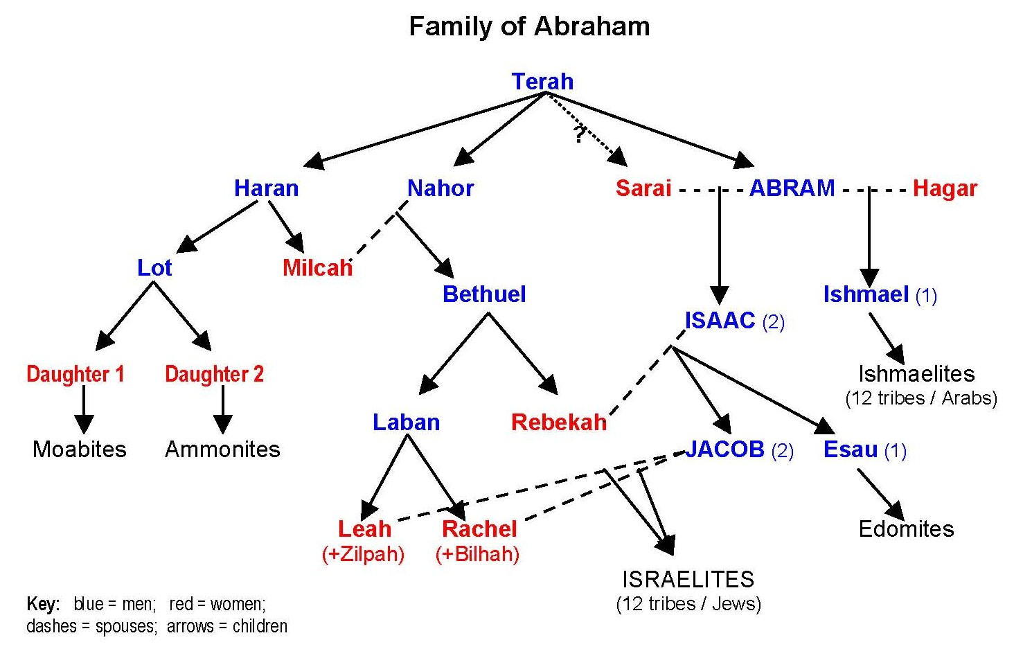
Terah’s family move to Haran
Notes:
Terah is the father of both Abraham and Sarah, by different wives. That is why Sarah was Abraham’s half-sister (Gen. 20:12). Thus, Isaac had only one grandfather.
This puts Terah in the same position as Zechariah, who was the father of both Jesus and also Jesus’ would-be bride, John the Baptist’s sister. The reason behind this providence in Jesus’ family was to make Jesus and his wife the second Adam and Eve. Adam and Eve were also brother and sisters, with only one father—God.
According to the Principle, Abraham and Sarah were supposed to “restore the positions of Adam’s family” (p. 209) in the incident when they went down to Egypt and posed as brother and sister (Gen. 12:10-20). This, it is said, would have created a ‘model course’ for Jesus. So it is significant that God set up Abraham’s family to have one grandfather-figure, Terah, in the same way that Jesus’ family was later set up to have one grandfather-figure, Zechariah.

Slide 88
What is Abram’s place in God’s providence?
Now the Lord said to Abram, “Go from your country and your kindred and your father’s house to the land that I will show you. And I will make of you a great nation, and I will bless you and make your name great, so that you will be a blessing. I will bless those who bless you, and him who dishonours you I will curse, and in you all the families of the earth shall be blessed.”
Genesis12:1-3
Notes:
75 years old left Haran
Speak about patriarchs with respect
When God says to Abraham, – Leave your land, your birthplace and your father’s house and go to the land which I will show you, that is the birth of a concept of time as a journey. Time as a way of travelling towards a destination. Time as a narrative that has a beginning, middle and an end. That is a revolutionary concept of time born in Judaism and a very important one indeed. Linear time is a Jewish idea. Ancients only had cyclical time – repetitive. No progress.
Marx said that human beings are determined by the play of economic forces, by class differences, by who owns land. Therefore God said to Abraham:– Leave the land. Spinoza said that human beings are determined by the circumstances of their birth, by what today we would call genetic instincts and therefore God said to Abraham: Leave the place of your birth. Freud said that human beings are determined by our early childhood experiences and therefore God said to Abraham: Leave your father’s house.
That, I think, is actually at least a little fragment of the truth because God was telling Abraham to leave behind all the things that determine our future. That seem to suggest that we have no choice in what we become, that are deterministic. And He is saying to Abraham: Leave that world and embark on a journey of radical freedom.

Slide 89
6. Restoring the Archangel-Eve-Adam relationship

Slide 90
What is restoration?
Restoration occurs when you find yourself in a similar position to Adam, Eve, the archangel, Cain or Abel etc.
And you have to face the same temptation to make the same mistake that they did and continue the pattern of fallen history
But you choose not to do so and instead of acting out of your fallen nature you act according to your original nature. You break the cycle of abuse
You follow your conscience

Slide 91
What needs to be restored?
Relationship between Archangel and Eve
  Men have inherited the archangelic nature to want to control and possess and have sexual relationship with women for their own pleasure and gratification. Lust, not love
    Droit du seigneur – ‘lord’s right’
    Sexual harassment and worse
  Women have inherited the tendency to be seduced by a powerful men
    Sarah and Rebecca faced and overcame this temptation

Slide 92
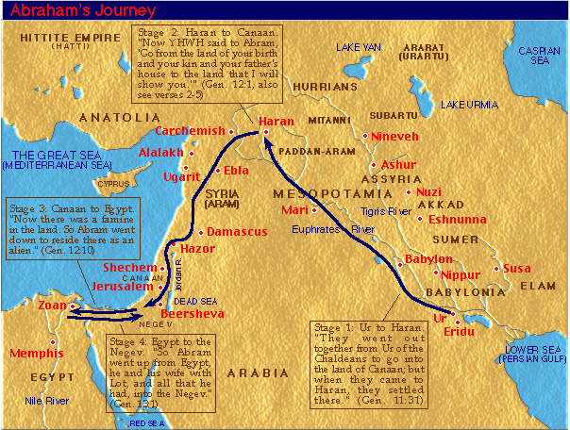
Abram’s journey
Notes:
Went with Terah to haran. Then after Terah died moved to Canaan

Slide 93
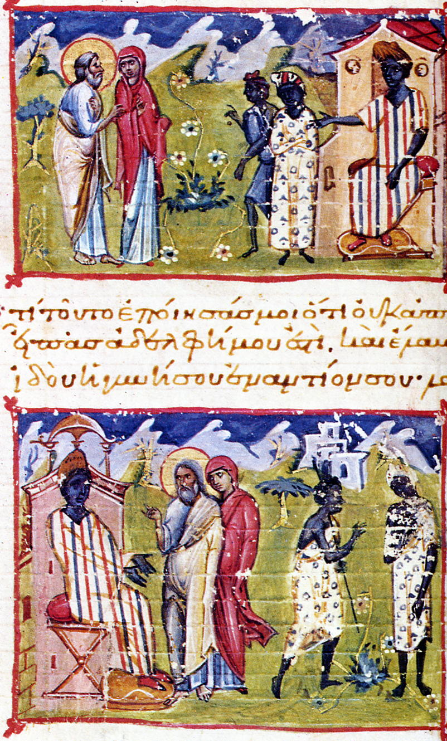
Abram, Sarah and Pharaoh
Now there was a famine in the land. So Abram went down to Egypt to stay there, for the famine was severe in the land. When he was about to enter Egypt, he said to Sarai his wife, “I know that you are a woman beautiful in appearance, and when the Egyptians see you, they will say, ‘This is his wife.’ Then they will kill me, but they will let you live. Say you are my sister, that it may go well with me because of you, and that my life may be spared for your sake.” When Abram entered Egypt, the Egyptians saw that the woman was very beautiful. And when the princes of Pharaoh saw her, they praised her to Pharaoh. And the woman was taken into Pharaoh's house. And for her sake he dealt well with Abram.
Notes:
When a famine struck the land, Abram went down toward Egypt to live as an immigrant since the famine was so severe in the land. ¹¹ Just before he arrived in Egypt, he said to his wife Sarai, “I know you are a good-looking woman. ¹² When the Egyptians see you, they will say, ‘This is his wife,’ and they will kill me but let you live. ¹³ So tell them you are my sister so that they will treat me well for your sake, and I will survive because of you.”
¹⁴ When Abram entered Egypt, the Egyptians saw how beautiful his wife was. ¹⁵ When Pharaoh’s princes saw her, they praised her to Pharaoh; and the woman was taken into Pharaoh’s household. ¹⁶ Things went well for Abram because of her: he acquired flocks, cattle, male donkeys, men servants, women servants, female donkeys, and camels. ¹⁷ Then the Lord struck Pharaoh and his household with severe plagues because of Abram’s wife Sarai. ¹⁸ So Pharaoh summoned Abram and said, “What’s this you’ve done to me? Why didn’t you tell me she was your wife? ¹⁹ Why did you say, ‘She’s my sister,’ so that I made her my wife? Now, here’s your wife. Take her and go!” ²⁰ Pharaoh gave his men orders concerning Abram, and they expelled him with his wife and everything he had.

Slide 94
What is going on here?
Satan
Eve
Adam
Humanity
Creation
Notes:
Before the fall Adam and Eve were like brother and sister. Eve was more attracted to Lucifer who appeared sophisticated.

Slide 95
How did Sarah restore the position of Eve?
Pharaoh
Sarah
Abram
Lot
Genesis 12:10-20
Wealth
Notes:
Abraham told Sarah to tell people she was his sister. Like A&E
Sarah is restoring Eve's position. Eve offered the choice between the powerful, charismatic, sophisticated, charming Lucifer and Adam playing with tadpoles in the stream chose the former. Sarah had to choose between becoming a concubine/queen of a the most powerful man in the world and living a life of luxury with silks, perfumes, shoes, feather beds, delicacies, hot baths and maids and spending here old age living in a tent with Abraham. She chose Abraham. Had she allowed Pharaoh into her bed she would have fallen just as Eve did. So Sarah overcame the temptation Eve faced, purified her womb and qualified herself to bear the next generation as the next stage in the progressive purification of the lineage. She overcame the temptation and so Pharaoh had to release her. Thus she overcame what Eve could not overcome.
In the midrashic tableau, when Abraham saw that Sarah had been taken to the palace of Pharaoh, he began to weep and pray to God. Sarah, too, cried out, saying: “Master of the Universe! when I heard from Abraham that You had told him, ‘Go forth,’ I believed in what You said. Now I remain alone, apart from my father, my mother, and my husband. Will this wicked one come and abuse me? Act for Your great name, and for my trust in Your words.” God replied: “By your life, nothing untoward will happen to you and your husband.” At that moment, an angel descended from Heaven with a whip in his hand. Pharaoh came to remove Sarah’s shoe—he hit him on the hand. He wanted to touch her clothing—he smote him (Tanhuma loc. cit.). All that night the angel stood there with the whip. If Sarah bade him “Strike,” he would strike him. If she told him “Cease,” he ceased. Even though Sarah told Pharaoh: “I am a married woman,” he did not desist from his efforts to touch her (Gen. Rabbah 41:2). These traditions emphasize what the Torah does not state, that nothing indecent happened between Sarah and Pharaoh. The midrashim present Pharaoh as someone who knows that Sarah is a married woman, but nonetheless desires her. Sarah is depicted as a strong woman, whose purity is protected by God by merit of her faith.

Slide 96
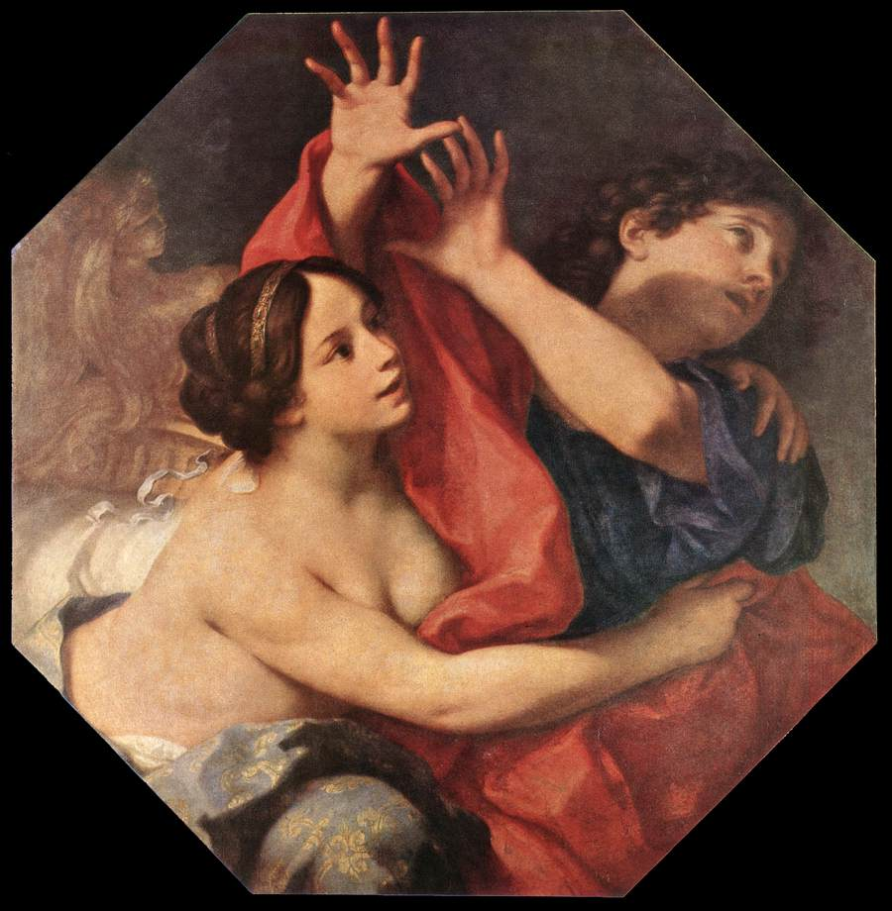
Potiphar – Zuleika - Joseph
His master’s wife cast her eyes on Joseph and said, "Lie with me." But he refused and said, "Behold, because of me my master has no concern about anything in the house, and he has put everything that he has in my charge. He has not kept back anything from me except yourself, because you are his wife. How then can I do this great wickedness and sin against God?" And as she spoke to Joseph day after day, he would not listen to her, to lie beside her or to be with her. Genesis 39:7-10
Potiphar’s wife tries to seduce Joseph
Notes:
Joseph faces same temptation as Adam and overcomes and preserves purity. Restores Adam’s position?
The third brings us to Egypt and the life of Joseph. Sold by his brothers as a slave, he is now working in the house of an eminent Egyptian, Potiphar. Left alone in the house with his master’s wife, he finds himself the object of her desire. He is handsome. She wants him to sleep with her. He refuses. To do such a thing, he says, would be to betray his master, her husband. It would be a sin against God. Yet over “he refused” is a shalshelet, (Genesis 39: 8) indicating – as some rabbinic sources and mediaeval commentaries suggest – that he did so at the cost of considerable effort.[2] He nearly succumbed. This was more than the usual conflict between sin and temptation. It was a conflict of identity. Recall that Joseph was now living in, for him, a new and strange land. His brothers had rejected him. They had made it clear that they did not want him as part of their family. Why then should he not, in Egypt, do as the Egyptians do? Why not yield to his master’s wife if that is what she wanted? The question for Joseph was not just, “Is this right?” but also, “Am I an Egyptian or a Jew?”
When Potiphar"s wife invites Joseph to lie with her, Torah tells us he refused. He said to his master"s wife, "Look, with me here, my master gives no thought to anything in this house; he has withheld nothing from me except yourself, since you are his wife. How then could I do this wicked thing and sin before God (ve-chata"ti le"lohim)?"
The Torah published by the Conservative Movement, Eitz Chayim, notes that Joseph puts forward three arguments to counter Potiphar"s wife"s advances. The first regards Joseph"s position of responsibility in the house; it is prudent for him to act uprightly. The second refers to the legal culture of Egyptian aristocracy; wives are property of their husbands, and Potiphar"s wife has been reserved for her husband. It is the third argument that approaches our notion of conscience: Joseph seems to have an inner sense that this would be a "sin before God". Nowhere prior to Joseph"s tale is this designated a sin; the Torah itself had not yet been revealed to the world, and we have no evidence that Joseph had learned it as an ethical norm from any other source. Where has Joseph"s recognition that his act would be a "sin before God" come from? Presumably it is the result of an inner ethical realisation.
According to the story, Zuleika was mocked by other aristocratic Egyptian ladies, her circle of friends, for being infatuated with a Hebrew slave boy. Inviting her friends to her home, Zuleika gave them all apples and knives to slice them with. While they engaged in this task, Zuleika had Joseph walk through the room. Distracted by his handsomeness, all the ladies accidentally cut themselves with the knives, drawing blood. Zuleika then reminded her friends that she had to see Joseph every day. Following this incident, her contemporaries no longer mocked her.^{[1]}

Slide 97
7a. Restoring the Parent - Child relationship
Noah’s family

Slide 98
Noah’s family = Adam’s family
Adam
Eve
8 members
Cain
Abel
Seth
1600 years
10 generations
Noah
Naamah
8 members
Shem
Ham
Japeth
Notes:
Naamah - name Noah’s wife
10 generations. 10 represents unity. 10 gens to get unity with God’s will. After 10 gens world should be a good place for God to be able to start working again. However by time of Noah world very sinful. Satan invaded. Therefore start all over again to restore.
40 days flood judgement to restore 1600 years invaded by Satan

Slide 99
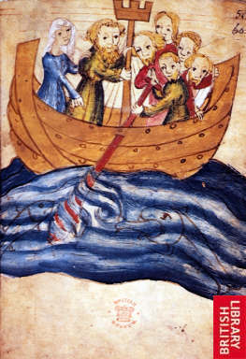
Restoring the foundation of faith
Central person - Noah
Offering - the ark represented the universe
120 years preaching
Time period - 40 days flood
Noah’s family to purify themselves and separate from Satan
God said, “You [Noah] shall come into the ark, you, your sons, your wife, and your sons’ wives.” Genesis 6:18
Noah told his family not to have sexual relations during flood judgement
Notes:
Talmud says 120 years of preaching while building the ark. But people didn’t listen. God wanted to save others. Noah had dream. Sensed flood coming. God often warns about disasters but people usually ignore
Noah’s family represented Adam’s family
Purpose of the flood to eliminate sinful humanity.
10 – unity – 10 generations to bring humanity back into unity with his will. Each gen 4 PF.
Restore number 40 (10 times 4)(10 generations of 4 position foundation which were lost to Satan)
Went in as men and women - living separate quarters. No conjugal relations.
Noah didn’t argue with God about flood.
Kedoshim
Kedoshim in a Nutshell
Aliya Summary
Haftorah in a Nutshell
In Depth
Chassidic Masters
Parshah Columnists
Kedoshim Audio Classes
Family Parshah
Current Parshah
All Parshas
Learning & Values » Parshah (Weekly Torah) » Vayikra - Leviticus » Kedoshim » Chassidic Masters
A History of Love
Based on the teachings of the Lubavitcher Rebbe
Courtesy of MeaningfulLife.com
facebookNeeded = true; document.getElementById('facebook_like_Top').innerHTML = '';
googlePlusOneNeeded = true; socialNetworks.Google.push({id:'Top', href:'http://www.chabad.org/2007'});
Share
Print
E-mail
Discuss(13)
Man, by nature, is a selfish creature. Even in his relationships with others he tends to focus primarily on himself or, at most, on his self-colored perception of his fellow. "Love" is the endeavor to transcend this intrinsic selfishness and truly relate to one's fellow, to be sensitive to and devoted to his/her needs as an individual distinct of oneself and one's own stake in the relationship.
And yet, when the Torah speaks of the mitzvah (Divine commandment) to "Love your fellow as yourself" it does so in the context of man's duty to influence, and even change, the behavior and nature of his fellow man. In Leviticus 19 (verses 18-19), the Torah commands:
Do not hate your brother in your heart; repeatedly rebuke your fellow, and do not attribute sin to him. Do not take revenge, or harbor hatred toward your people, and love your fellow as yourself; I am G-d.
As the commentaries explain, there are two possible reactions a person can have toward a fellow who has wronged him, or whom he sees behaving in a morally deficient manner: 1) he can despise him in his heart, regarding him as a "sinner," and perhaps even persecute him for his "sins"; 2) he can rebuke him in the effort to convince him of the folly of his ways and seek to influence him to change them. The path of love, says the Torah, is not to to "hate your brother in your heart" but to "repeatedly rebuke" him and seek to better him.
Obviously, the desire to influence is consistent with the idea of love. No one would stand by as a loved one suffers hunger or is threatened by violence; no less so, if one sees someone he loves suffering from spiritual malnutrition or moral blindness, he will make every effort to reach out to him, to enlighten him, to offer guidance and assistance. But this aspect of loving behavior carries an inherent paradox. On the one hand, the endeavor to influence and change implies a departure from self and concern with the well-being of the other. On the other hand, it implies a seemingly selfish view of the other: a rejection of the other as he is and a desire to impose one's own perception of what is good for him upon him.
Four Biblical Prototypes
An exploration of the history of humanity, as recounted in the Torah, reveals four figures who personified four different points of reference on the relationship between self and fellow.
Each of these individuals was considered the most righteous of his generation. Thus, their lives can be seen to reflect four stages in the spiritual development of humanity -- four stages in the movement from an instinctive selfhood toward the complete abnegation of self and self-interest in relating to others. Our examination of this process will also shed light on the acceptance/non-acceptance dilemma inherent in the love relationship.
The first of these four outstanding individuals was Enoch, a great-great-great-great-grandson of Adam, who was born in the year 622 from creation (3139 BCE). By his time, humanity had abandoned the One G-d of their fathers and had succumbed to idolatry and pagan perversity. Only Enoch still "walked with G-d."
But Enoch's righteousness was wholly selfish: he was preoccupied only with the refinement and perfection of his own spiritual self. The Midrash even relates that, for many years, he disassociated himself from his corrupt generation and secluded himself in a cave.
Not only did Enoch fail to have a lasting impact on his society, but he was ultimately in danger of being influenced by their corrupt behavior. This is why Enoch died at the "tender young age" of 365 (compared with the 800 and 900-year life spans of his contemporaries): "G-d took him to Himself" before his time, lest the only righteous man of the generation also be lost.
For such is the relationship of an individual with his environment: there is no sustained equilibrium. Where there is contact there is a flow, in one direction or the other; one either influences his society or is influenced by it.
The 120-Year Failure
Several generations later we encounter another righteous man in a corrupt generation: Noah, builder of the ark and regenerator of humanity after the Flood.
In Noah, we find the first stirrings of a departure from self to improve and rehabilitate one's fallen fellow. In the year 1536 from creation (2225 BCE) G-d told Noah that "the end of all flesh has come before me, for the earth is filled with violence" and that He therefore intends to "bring a deluge of water upon the earth, to destroy all flesh" and start anew with Noah and his family. Noah is instructed to build an ark so that they may survive the Flood. Our sages relate that Noah worked on the ark's construction a full one hundred and twenty years; all this time, he called out to his generation to mend its ways and avoid catastrophe.
However, the Zohar criticizes Noah for the fact that, despite his efforts, he did not pray for the salvation of his generation, unlike Abraham and Moses who pleaded with G-d to spare the wicked. This implies that, ultimately, it did not matter to Noah what became of them. Had he truly cared, he would not have sufficed with doing his best to bring them to repent but would have implored the Almighty to repeal His decree of destruction -- just as one who is personally threatened would never say, "Well, I did my best to save myself," and leave it at that, but would beseech G-d to help him.
In other words, Noah's involvement with others was limited to his sense of what he ought to do for them, as opposed to a true concern for their well-being. His "self" had sufficiently broadened to include the imperative to act for the sake of another, recognizing that the lack of a "social conscience" is a defect in one's own character; but he fell short of transcending the self to care for others beyond the consideration of his own righteousness.
This also explains a curious aspect of Noah's efforts to reach out to his generation. When the Flood came, Noah and his family entered the ark -- alone. His 120-year campaign yielded not a single baal teshuvah (repentant)! Perhaps public relations was never Noah's strong point, but how are we to explain the fact that, in all this time, he failed to win over a single individual?
But in order to influence others, one's motives must be pure; in the words of our sages, "Words that come from the heart enter the heart." Deep down, a person will always sense whether you truly have his interests at heart, or you're filling a need of your own by seeking to change him. If your work to enlighten your fellow stems from a desire to "do the right thing" -- to observe the mitzvot to "love your fellow as yourself" and "rebuke your fellow" -- but without really caring about the result, your call will be met with scant response. The echo of personal motive, be it the most laudable of personal motives, will be sensed, if only subconsciously, by the object of your efforts, and will ultimately put him off.

Slide 100
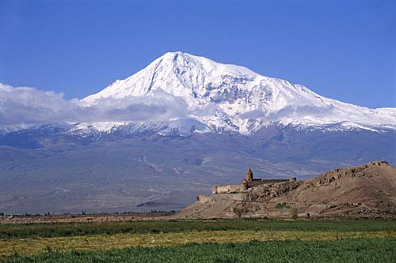
Covenant with Noah
God said to Noah, “Go forth from the ark, you and your wife, and your sons and your sons’ wives with you.”
Genesis 8:15
Noah built an altar to the Lord and offered burnt offerings on the altar.
And God blessed Noah and his sons, and said to them, “Be fruitful and multiply, and fill the earth.”
Genesis 8:20, 9:1
Mount Ararat
Notes:
Came out as husband and wife. God allowed to continue with conjugal relations. Rainbow sign of the covenant.

Slide 101
Foundation of substance
Noah
For Ham to stand in the position of Abel,
as one who had succeeded in making
the symbolic offering, he had to become
inseparably one in heart with his father
Noah. EDP, 203
One in
heart
Ham
Shem
Abel
Cain
Indemnity condition
to remove fallen nature
Notes:
Noah had made the foundation of faith. TO be able to stand in the position of Abel Ham had to inherit Noah’s foundation by demonstrating unity of heart with him.

Slide 102
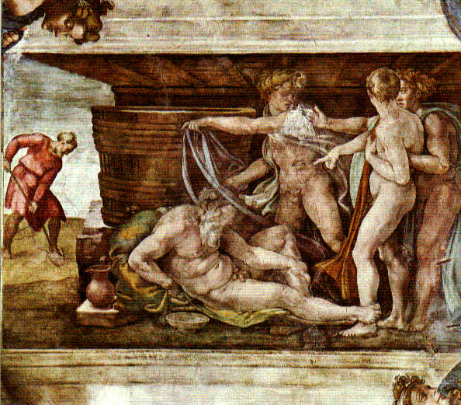
The incident in the tent
Noah plants a vineyard
He makes wine, becomes drunk and lies naked in his tent
Ham sees Noah naked
He tells Shem and Japeth to cover Noah
Noah wakes up and curses Ham’s son Canaan
Notes:
So what is going on here. Why was Ham’s act so wrong??

Slide 103
Test of Ham’s unity with Noah
Noah
Felt
ashamed
Rebuked
Japeth
Ham
Shem
Stirred up &
multiplied sin
Abel
Felt ashamed
covered Noah
Notes:
Why was this all a problem? After the fall Adam and Eve felt ashamed that they were naked. Feeling of shame due to sexual fall. Indicates impurity. When Ham felt ashamed of Noah being naked showed that he was impure. Why did he have this feeling? What sin had he committed so that Satan could invade his inner life?
Why could Satan invade Ham and thus Noah’s family? Qur’an and Jewish Talmud says that Noah told his sons and daughters-in law that for 40 days they should have no sexual relations. Ham and his wife had sexual relations:
“After the sacrifice was completed God blessed Noah and his sons. He made them to be the rulers of the world as Adam had been, and he gave them a command, saying, “Be fruitful and multiply upon the earth,” for during their sojourn in the ark, the two sexes, of men and animals alike, had lived apart from each other. This law of conduct had been violated by none in the ark except by Ham, by the dog, and by the raven.” (Ginsberg)
If Ham had kept his purity for the 40 days he would not have felt ashamed at seeing Noah naked. This ‘fall’ was the condition for Satan to invade Ham’s feelings so that he felt ashamed when he saw Noah naked. So if one has wrong feelings, look back and see if one made some bad condition and clear it up before one makes a mistake.

Slide 104
Ham fails to inherit from Noah
God
Satan
Foundation of faith
Noah
Lost
opportunity
Shem
Ham
Foundation of substance

Slide 105
Why was it a sin to feel ashamed?
Satan needs an object partner to exist and act
  Sin – condition for Satan to invade
Before the fall Adam and Eve were naked and unashamed – innocent
  After the Flood Noah’s family should have separated from Satan and been innocent
Feeling ashamed showed still of Satan’s lineage
Ham felt ashamed covered Noah
could not restore position of Abel
Notes:
Why was it such a sin to feel ashamed of nakedness? To understand these matters, let us first recall what constitutes sin. Satan cannot manifest his powers - including the power to exist and act - unless he first secures an object partner with whom he can make a common base and engage in a reciprocal relationship of give and take. Whenever a person makes a condition for Satan to invade, it means that he has allowed himself to become Satan's object partner, thereby empowering Satan to act. This constitutes sin.
We can thus understand that when Noah's sons felt ashamed of their father's nakedness and covered his body, it was tantamount to acknowledging that they, like Adam's family after the Fall, had formed a shameful bond of kinship with Satan and were thus unworthy to come before God. Satan, like the raven hovering over the water, was looking for a condition to invade Noah's family. He attacked the family by taking Noah's sons as his object partners when they in effect acknowledged that they were of his lineage.
When Ham felt ashamed of his father's nakedness and acted to cover it up, he made a condition for Satan to enter; hence his feeling and act constituted a sin. Consequently, Ham could not restore through indemnity the position of Abel from which to make the substantial offering. Since he could not establish the foundation of substance, the providence of restoration in Noah's family ended in failure.
Satan could invade and Ham didn’t inherit Noah’s foundation of faith. Therefore shame a sin. Should have had compassion for Noah.
We owe to anthropologists like Ruth Benedict[4] the distinction between shame cultures and guilt cultures. Shame is a social phenomenon. It is what we feel when our wrongdoing is exposed to others. It may even be something we feel when we merely imagine other people knowing or seeing what we have done. Shame is the feeling of being found out, and our first instinct is to hide. That is what Adam and Eve did in the garden of Eden after they had eaten the forbidden fruit. They were ashamed of their nakedness and they hid.
Guilt is a personal phenomenon. It has nothing to do with what others might say if they knew what we have done, and everything to do with what we say to ourselves. Guilt is the voice of conscience, and it is inescapable. You may be able to avoid shame by hiding or not being found out, but you cannot avoid guilt. Guilt is self-knowledge.
There is another difference, which explains why Judaism is overwhelmingly a guilt rather than a shame culture. Shame attaches to the person. Guilt attaches to the act. It is almost impossible to remove shame once you have been publicly disgraced. It is like an indelible stain on your skin. Shakespeare has Lady Macbeth say, after her crime, “Will these hands ne’er be clean?” In shame cultures, wrongdoers tend either to go into exile, where no one knows their past, or to commit suicide. Playwrights have them die.
Guilt makes a clear distinction between the act of wrongdoing and the person of the wrongdoer. The act was wrong, but the agent remains, in principle, intact. That is why guilt can be removed, “atoned for,” by confession, remorse and restitution. “Hate not the sinner but the sin,” is the basic axiom of a guilt culture.

Slide 106
What is shame?
Shame is what we feel when our wrongdoing is exposed to others. It may even be something we feel when we merely imagine other people knowing or seeing what we have done. Shame is the feeling of being found out, and our first instinct is to hide.

Slide 107
What is guilt?
Guilt is a personal phenomenon. It has nothing to do with what others might say if they knew what we have done, and everything to do with what we say to ourselves. Guilt is the voice of conscience, and it is inescapable. You may be able to avoid shame by hiding or not being found out, but you cannot avoid guilt. Guilt is self-knowledge.

Slide 108
Shame attaches to the person. Guilt attaches to the act. It is almost impossible to remove shame once you have been publicly disgraced. It is like an indelible stain on your skin.
We are not condemned to live endlessly with the mistakes and errors of our past. That is the great difference between a guilt culture and a shame culture.
Notes:
The psychology of shame is quite different to that of guilt. We can discharge guilt by achieving forgiveness –Shame cannot be removed by forgiveness. The victim of our crime may have forgiven us, but we still feel defiled by the knowledge that our name has been disgraced, our reputation harmed, our standing damaged. We still feel the stigma, the dishonour, the degradation. We are not condemned to live endlessly with the mistakes and errors of our past. That is the great difference between a guilt culture and a shame culture.

Slide 109
Why did Ham feel ashamed?
  Ham, like Adam’s family, had formed a shameful bond of kinship with Satan. EDP, 205
  Ham committed a sinful act which reaffirmed the Fall. EDP, 89
  Talmud says that Ham and his wife had sexual relations during period of the flood
  Ham projected his feeling of shame onto Noah
  Ham accused Noah of his own sin
Notes:
We can thus understand that when Noah's sons felt ashamed of their father's nakedness and covered his body, it was tantamount to acknowledging that they, like Adam's family after the Fall, had formed a shameful bond of kinship with Satan and were thus unworthy to come before God.
Why was this all a problem? After the fall Adam and Eve felt ashamed that they were naked. Feeling of shame due to sexual fall. Indicates impurity. When Ham felt ashamed of Noah being naked showed that he was impure. Why did he have this feeling? What sin had he committed so that Satan could invade his inner life?
Why could Satan invade Ham and thus Noah’s family? Qur’an and Jewish Talmud says that Noah told his sons and daughters-in law that for 40 days they should have no sexual relations. Ham and his wife had sexual relations:
“After the sacrifice was completed God blessed Noah and his sons. He made them to be the rulers of the world as Adam had been, and he gave them a command, saying, “Be fruitful and multiply upon the earth,” for during their sojourn in the ark, the two sexes, of men and animals alike, had lived apart from each other. This law of conduct had been violated by none in the ark except by Ham, by the dog, and by the raven.” (Ginsberg)
If Ham had kept his purity for the 40 days he would not have felt ashamed at seeing Noah naked. This ‘fall’ was the condition for Satan to invade Ham’s feelings so that he felt ashamed when he saw Noah naked. So if one has wrong feelings, look back and see if one made some bad condition and clear it up before one makes a mistake.

Slide 110
What lessons can be learned from Noah’s family?
Ham should have been grateful to his father for saving the life of the family
Ham should have had compassion for his father after all he had done
Ham should have overcome his shameful feelings and treated his father with respect
If you make a bad condition, indemnify it quickly or Satan can use it to invade something important

Slide 111
7b. Restoring the parent - child relationship
Abraham and Isaac
Notes:
Again God had no idea take such a long time before could again intervene. 1600 years later the earth is terrible. Noah descended from Seth. 10 generations.

Slide 112
What is restoration?
Restoration occurs when you find yourself in a similar position to Adam, Eve, the archangel, Cain or Abel etc.
And you have to face the same temptation to make the same mistake that they did and continue the pattern of fallen history
But you choose not to do so and instead of acting out of your fallen nature you act according to your original nature. You break the cycle of abuse
You follow your conscience

Slide 113
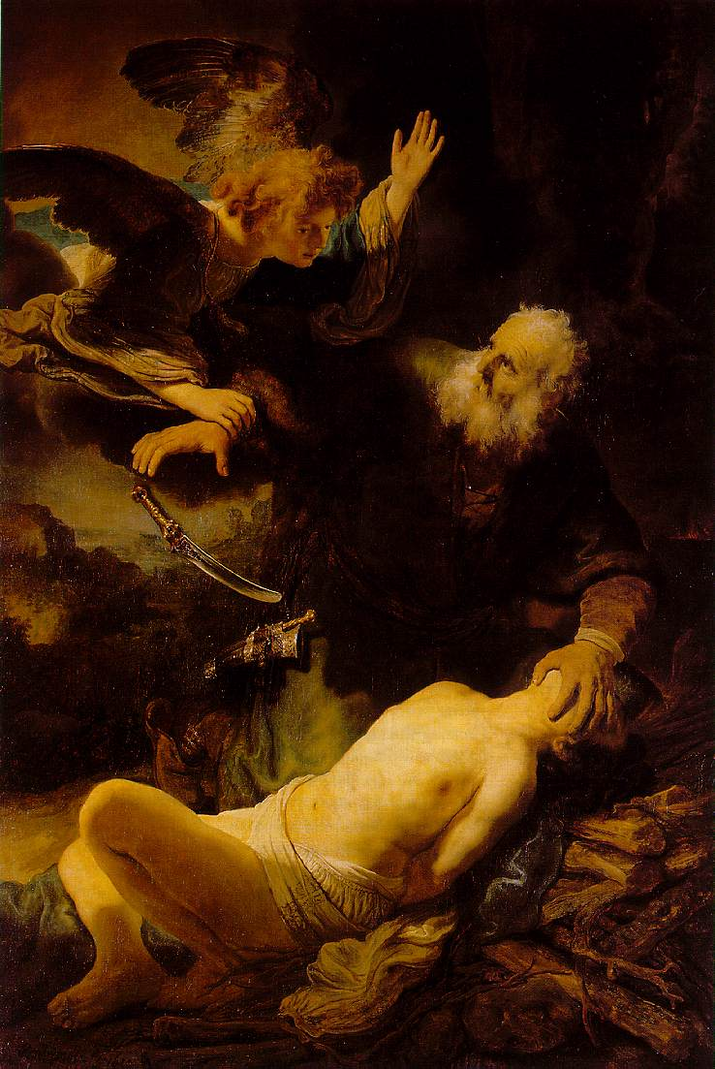
Restoring the parent-child relationship
After these things God tested Abraham and said to him, “Abraham!”
And he said, “Here am I.” He said, “Take your son, your only son Isaac,
whom you love, and offer him as a burnt offering. So Abraham rose early in the morning . . .”
Gen 22:1-2
The Binding of Isaac
Notes:
This time God told Abraham to do something more difficult. Condition of greater indemnity. If we make a mistake and try to rectify it immediately it is usually easy – often just an apology is needed. If don’t it becomes more difficult to put right – Jesus parable of man with debts.
Absolute faith. Trusted God. Knew God never ask to do something wrong. Knew must be a reason.
Abraham could only sacrifice him because Isaac was willing. 1G have to get 2G permission if going to do something sacrificial
“Take…your only son, Isaac, whom you love…and sacrifice him as a burnt offering…” Genesis 22:2
Isaac inherited Abraham’s and position as he didn’t try to run away but trusted his father.
Test to see if Abraham loved God above all else. Test of Isaac
“Do not lay your hand on the lad or do anything to him; for now I know that you fear God, seeing you have not withheld your son, your only son, from me.” Genesis 22:9-12
22 After these things God tested Abraham and said to him, “Abraham!” And he said, “Here am I.” ² He said, “Take your son, your only son Isaac, whom you love, and go to the land of Moriah, and offer him there as a burnt offering on one of the mountains of which I shall tell you.” ³ So Abraham rose early in the morning, saddled his donkey, and took two of his young men with him, and his son Isaac. And he cut the wood for the burnt offering and arose and went to the place of which God had told him. ⁴ On the third day Abraham lifted up his eyes and saw the place from afar. ⁵ Then Abraham said to his young men, “Stay here with the donkey; I and the boy^{[a]} will go over there and worship and come again to you.” ⁶ And Abraham took the wood of the burnt offering and laid it on Isaac his son. And he took in his hand the fire and the knife. So they went both of them together. ⁷ And Isaac said to his father Abraham, “My father!” And he said, “Here am I, my son.” He said, “Behold, the fire and the wood, but where is the lamb for a burnt offering?” ⁸ Abraham said, “God will provide for himself the lamb for a burnt offering, my son.” So they went both of them together.
⁹ When they came to the place of which God had told him, Abraham built the altar there and laid the wood in order and bound Isaac his son and laid him on the altar, on top of the wood. ¹⁰ Then Abraham reached out his hand and took the knife to slaughter his son. ¹¹ But the angel of the Lord called to him from heaven and said, “Abraham, Abraham!” And he said, “Here am I.” ¹² He said, “Do not lay your hand on the boy or do anything to him, for now I know that you fear God, seeing you have not withheld your son, your only son, from me.” ¹³ And Abraham lifted up his eyes and looked, and behold, behind him was a ram, caught in a thicket by his horns. And Abraham went and took the ram and offered it up as a burnt offering instead of his son. ¹⁴ So Abraham called the name of that place, “The Lord will provide”;^{[b]} as it is said to this day, “On the mount of the Lord it shall be provided.”^{[c]}
¹⁵ And the angel of the Lord called to Abraham a second time from heaven ¹⁶ and said, “By myself I have sworn, declares the Lord, because you have done this and have not withheld your son, your only son, ¹⁷ I will surely bless you, and I will surely multiply your offspring as the stars of heaven and as the sand that is on the seashore. And your offspring shall possess the gate of his^{[d]} enemies, ¹⁸ and in your offspring shall all the nations of the earth be blessed, because you have obeyed my voice.” ¹⁹ So Abraham returned to his young men, and they arose and went together to Beersheba. And Abraham lived at Beersheba.

Slide 114
Why did God test Abraham?
Test and miracle same word in Hebrew
Test – do what is impossible. Break barriers. Break habits of thinking
Abraham had passed 9 tests
Sacrificing Isaac contrary to everything
Why did he do it?
Why did Isaac go along with it?
The core of one’s being lies not in the self but in commitment to the Creator
Notes:
The Test
By Tzvi Freeman
Why did G-d test Abraham? Why does He test us? Why does an all-knowing G-d need to test anybody? Shouldn't He know what is in our hearts without testing us?
A test is any situation that demands more from you than you think you have. In a test, if you would use your rational mind you would say, "This is impossible. This is not what I bargained for. I don't have to do this because it is not within my skill set. It is beyond who I am."
You don't pass a test with understanding, with reason. You pass a test with rock solid faith and blind perseverance.
Tests are closely related to miracles. In fact, in Hebrew they are practically the same word.
A miracle is when G-d breaks out of his standard pattern of natural law and demonstrates unlimited powers. A test is when G-d invites you to do the same. That is why people who pass tests cause miracles to happen -- G-d is mirroring them.
There are different kinds of tests. All of them break barriers. Some tests take a person past old habits that bridle him. Others pull out of him new strength, a tenacity, a deep confidence in his purpose and the inherent goodness within the world.
The ultimate test is that which takes a person beyond the ultimate barrier: The barrier between creation and Creator. Such was the test Abraham passed when he was asked to offer up his son Isaac.
Abraham had passed many tests before -- nine in total. As a young man, he had chosen certain death in a fiery furnace over worship of the evil demagogue, King Nimrod, and was miraculously saved. Throughout his life, he had never questioned G-d's justice, despite his many tribulations. Except for once, when he demanded justice for the inhabitants of Sodom and Gemorrah -- and that itself was how he passed another test.
But the test of offering Isaac was a class in itself. Because this test made absolutely no sense.
Throw yourself in a fiery furnace rather than worship a megalomaniac who thinks he is a god -- you've made a statement and you've got it out there. The same with all the other tests -- they were ways to promote a cause, to publicize to the world the faith of Abraham. And as such, there always lurked a doubt that perhaps, just perhaps all this was tied to Abraham's ego. Because what could be a greater accomplishment than being the founder of the faith of Abraham?
Turn the whole world on its head and you'll be the most significant man in history. Isn't that worth fire and high water, and even death itself?
But the Akedah ("Binding" of Isaac) didn't fit that profile. The Akedah flew in the face of everything Abraham ever stood for: that G-d is good and kind, that He keeps His promises and has a destiny for His world. All this is out the window when G-d says, "Abraham! Remember that son I promised you, for which you waited for so long? The one about whom I promised he is destined to carry on all that you began so that it will continue until eternity? Remember how I told you to listen to Sarah against your own judgment and send Ishmael away so that this other son could flourish? The son who you have fostered with your wisdom and trained for his destiny these many years? The son of your old age, that you love more than any father has ever loved a son?
"Take him to the land of Moriah and raise him up for a burnt offering on one of the mountains I will show you there."
No explanation. No consolation. No excuses. Just do it. Turn around and destroy everything you have built until this day so that there will never be a chance to rebuild.
A mindless act.
So why did he do it?
Abraham was a man with a mission. A mission for which he sacrificed everything, a mission more important to him than his own life.
For many years he had agonized over the fact that there was no heir to this mission, that his work of bringing the beliefs and ethics of monotheism to a pagan world would cease with his passing from the world. Then came the divine promise: miraculously, at the age of one hundred, he will have a son, out of whom will stem the people of Israel. “You shall call his name Isaac,” said G‑d, “and I shall establish My covenant with him for an everlasting covenant, and with his descendants after him.”
And then G‑d told him to destroy it all.
When Abraham bound Isaac upon the altar, it was not in the service of any calling or cause. In fact, it ran contrary to everything he believed in and taught, to everything for which he had sacrificed his life, to everything G‑d Himself had told him. He could see no reason, no purpose for his act. Every element of his self cried out against it—his material self, his spiritual self, his transcendent and altruistic self. But he did it. Why? Because G‑d had told him to.
Abraham was the pioneer of self-sacrifice.
For Abraham bequeathed to his descendants the essence of Jewishness: that at the core of one’s very being lies not the self but one’s commitment to the Creator. And that, ultimately, one’s every choice and act is an expression of that “spark of divinity” within.
10 tests
1. He is thrown into a fiery furnace.
2. G‑d tells him to leave his homeland to be a stranger in the land of Canaan.
3. Immediately after his arrival in the Promised Land, he encounters a famine.
4. The Egyptians capture his beloved wife, Sarah, and bring her to Pharaoh.
5. He faces incredible odds in the battle of the four and five kings.
6. He is told by G‑d that his children will be strangers in a strange land.13
7. G‑d tells him to circumcise himself at an advanced age.
8. The king of Gerar captures Sarah, intending to take her for himself.
9. G‑d tells him to send away Hagar and her son, Ishmael.
10. Abraham is told by G‑d to sacrifice his dear son Isaac upon an altar.

Slide 115
But . . .
Abraham was chosen to be a role model
  “For I have chosen him so that he will instruct his children and his household after him to keep the way of the Lord by doing what is right and just.”
Kierkegaard, - “teleological suspension of the ethical”
  Willingness to let the I-Thou love of God overrule the universal principles that bind humans to one another.
This is the logic of the religious fanatic, the inquisitor, the suicide bomber
God does not ask us to be unethical
Another way of looking at it . . .
Notes:
Why did God need to “test” Abraham, given that He knows the human heart better than we know it ourselves? Maimonides answers that God did not need Abraham to prove his love for Him. Rather the test was meant to establish for all time how far the fear and love of God must go.
The story is about the awe and love of God. Kierkegaard wrote a book about it, Fear and Trembling, and made the point that ethics is universal. It consists of general rules. But the love of God is particular. It is an I-Thou personal relationship. What Abraham underwent during the trial was, says Kierkegaard, a “teleological suspension of the ethical,” that is, a willingness to let the I-Thou love of God overrule the universal principles that bind humans to one another.
There are four problems with the conventional reading:
1. We know from Tanakh and independent evidence that the willingness to offer up your child as a sacrifice was not rare in the ancient world. It was commonplace. Tanakh mentions that Mesha king of Moab did so. So did Jepthah, the least admirable leader in the book of Judges. Two of Tanakh’s most wicked kings, Ahaz and Manasseh, introduced the practice into Judah, for which they were condemned. There is archeological evidence – the bones of thousands of young children –– that child sacrifice was widespread in Carthage and other Phoenician sites. It was a pagan practice.
2. Child sacrifice is regarded with horror throughout Tanakh. Micah asks rhetorically, “Shall I give my firstborn for my sin, the fruit of my body for the sin of my soul?” and replies, “He has shown you, O man, what is good. And what does the Lord require of you? To act justly and to love mercy and to walk humbly with your God.” How could Abraham serve as a role model if what he was prepared to do is what his descendants were commanded not to do?
3. Specifically, Abraham was chosen to be a role model as a father. God says of him, “For I have chosen him so that he will instruct his children and his household after him to keep the way of the Lord by doing what is right and just.” How could he serve as a model father if he was willing to sacrifice his child? To the contrary, he should have said to God: “If you want me to prove to You how much I love You, then take me as a sacrifice, not my child.”
4. As Jews – indeed as humans – we must reject Kierkegaard’s principle of the “teleological suspension of the ethical.” This is an idea that gives carte blanche to a religious fanatic to commit crimes in the name of God. It is the logic of the Inquisition and the suicide bomber. It is not the logic of Judaism rightly understood. God does not ask us to be unethical. We may not always understand ethics from God’s perspective but we believe that “He is the Rock, His works are perfect; all His ways are just” (Deut. 32: 4).

Slide 116
A challenge to the ancient family
The family in the ancient world
  Domestic religion
    Ancestor worship
    Child sacrifice
  Head of family had absolute authority
    Power of life and death over wife and children
    Roman law – patria potestas
  Both were property
    Authority inherited by first born
Biblical tradition rejects all of the above which are pagan
Notes:
To understand the binding of Isaac we have to realise that much of the Torah, Genesis in particular, is a polemic against worldviews the Torah considers pagan, inhuman and wrong. One institution to which Genesis is opposed is the ancient family as described by Fustel de Coulanges in The Ancient City (1864) and recently restated by Larry Siedentop in Inventing the Individual: The Origins of Western Liberalism.
Before the emergence of the first cities and civilizations, the fundamental social and religious unit was the family. As Coulanges puts it, in ancient times there was an intrinsic connection between three things: the domestic religion, the family and the right of property. Each family had its own gods, among them the spirits of dead ancestors, from whom it sought protection and to whom it offered sacrifices. The authority of the head of the family, the paterfamilias, was absolute. He had power of life and death over his wife and children. Authority invariably passed, on the death of the father, to his firstborn son. Meanwhile, as long as the father lived, children had the status of property rather than persons in their own right. This idea persisted even beyond the biblical era in the Roman law principle of patria potestas.
The Torah is opposed to every element of this worldview. As anthropologist Mary Douglas notes, one of the most striking features of the Torah is that it includes no sacrifices to dead ancestors. Seeking the spirits of the dead is explicitly forbidden.
Equally noteworthy is the fact that in the early narratives succession does not pass to the firstborn: not to Ishmael but Isaac, not to Esau but Jacob, not to the tribe of Reuben but to Levi (priesthood) and Judah (kingship), not to Aaron but to Moses.
The principle to which the entire story of Isaac, from birth to binding, is opposed is the idea that a child is the property of the father. First, Isaac’s birth is miraculous. Sarah is already post-menopausal when she conceives. In this respect the Isaac story is parallel to that of the birth of Samuel to Hannah, like Sarah also unable naturally to conceive. That is why, when he is born Hannah says, “I prayed for this child, and the Lord has granted me what I asked of him. So now I give him to the Lord. For his whole life he will be given over to the Lord.” This passage is the key to understanding the message from heaven telling Abraham to stop: “Now I know that you fear God, because you have not withheld from Me your son, your only son” (the statement appears twice, in Gen. 22: 12 and 16). The test was not whether Abraham would sacrifice his son but whether he would give him over to God.
The same principle recurs in the book of Exodus. First, Moses’ survival is semi-miraculous since he was born at a time when Pharaoh had decreed that every male Israelite child should be killed. Secondly, during the tenth plague, when every firstborn Egyptian child died, the Israelite firstborn were miraculously saved. “Consecrate to me every firstborn male. The first offspring of every womb among the Israelites belongs to Me, whether human or animal.” The firstborn were originally designated to serve God as priests, but lost this role after the sin of the golden calf. Nonetheless, a memory of this original role still persists in the ceremony of pidyon ha-ben, redemption of a firstborn son.
What God was doing when he asked Abraham to offer up his son was not requesting a child sacrifice but something quite different. He wanted Abraham to renounce ownership of his son. He wanted to establish as a non-negotiable principle of Jewish law that children are not the property of their parents.
That is why three of the four matriarchs found themselves unable to conceive other than by a miracle. The Torah wants us to know that the children they bore were the children of God rather than the natural outcome of a biological process. Eventually, the entire nation of Israel would be called the children of God. A related idea is conveyed by the fact that God chose as his spokesperson Moses who was “not a man of words.” He was a stammerer. Moses became God’s spokesman because people knew that the words he spoke were not his own but those placed in his mouth by God.
The clearest evidence for this interpretation is given at the birth of the very first human child. When she first gives birth, Eve says: “With the help of the Lord I have acquired [kaniti] a man.” That child, whose name comes from the verb “to acquire,” was Cain who became the first murderer. If you seek to own your children, your children may rebel into violence.
If the analysis of Fustel de Colanges and Larry Siedentop is correct, it follows that something fundamental was at stake. As long as parents believed they owned their children, the concept of the individual could not yet be born. The fundamental unit was the family. The Torah represents the birth of the individual as the central figure in the moral life. Because children – all children – belong to God, parenthood is not ownership but guardianship. As soon as they reach the age of maturity (traditionally, twelve for girls, thirteen for boys) children become independent moral agents with their own dignity and freedom.
Patria potestas, (Latin: “power of a father”), in Roman family law, power that the male head of a family exercised over his children and his more remote descendants in the male line, whatever their age, as well as over those brought into the family by adoption. This power meant originally not only that he had control over the persons of his children, amounting even to a right to inflict capital punishment, but that he alone had any rights in private law. Thus, acquisitions of a child became the property of the father. The father might allow a child (as he might a slave) certain property to treat as his own, but in the eye of the law it continued to belong to the father.
Patria potestas ceased normally only with the death of the father; but the father might voluntarily free the child by emancipation, and a daughter ceased to be under the father’s potestas if upon her marriage she came under her husband’s manus, a corresponding power of husband over wife.
By classical times, the father’s power of life and death had shrunk to that of light punishment, and sons could keep as their own what they earned as soldiers (peculium castrense). By Justinian’s day (527–565), the rules of peculium castrense were extended to many sorts of professional earnings; and in other acquisitions, such as property inherited from the mother, the father’s rights were reduced to a life interest.

Slide 117
Child sacrifice in the Bible
Any of the people of Israel, or of the aliens who reside in Israel, who give any of their offspring to Molech shall be put to death; the people of the land shall stone them to death. I myself will set my face against them, and will cut them off from the people, because they have given of their offspring to Molech, defiling my sanctuary and profaning my holy name. Leviticus 20: 2-3

Slide 118
The Biblical worldview . . .
Biblical world
  Worship God of all humanity – not ancestors
    No sacrifices to dead ancestors
  Father AND mother have equal authority
  Parents are guardians not owners
  Every person is a child of God
  The individual has divine, unique, eternal value
God asking Abraham to renounce ownership of Isaac
  Children are not the property of their parents
  Children belong to God
Change of ownership – change of lineage – change of identity
Notes:
The Torah is opposed to every element of this worldview. As anthropologist Mary Douglas notes, one of the most striking features of the Torah is that it includes no sacrifices to dead ancestors. Seeking the spirits of the dead is explicitly forbidden.
The principle to which the entire story of Isaac, from birth to binding, is opposed is the idea that a child is the property of the father. First, Isaac’s birth is miraculous. Sarah is already post-menopausal when she conceives. In this respect the Isaac story is parallel to that of the birth of Samuel to Hannah, like Sarah also unable naturally to conceive. That is why, when he is born Hannah says, “I prayed for this child, and the Lord has granted me what I asked of him. So now I give him to the Lord. For his whole life he will be given over to the Lord.” This passage is the key to understanding the message from heaven telling Abraham to stop: “Now I know that you fear God, because you have not withheld from Me your son, your only son” (the statement appears twice, in Gen. 22: 12 and 16). The test was not whether Abraham would sacrifice his son but whether he would give him over to God.
The same principle recurs in the book of Exodus. First, Moses’ survival is semi-miraculous since he was born at a time when Pharaoh had decreed that every male Israelite child should be killed. Secondly, during the tenth plague, when every firstborn Egyptian child died, the Israelite firstborn were miraculously saved. “Consecrate to me every firstborn male. The first offspring of every womb among the Israelites belongs to Me, whether human or animal.” The firstborn were originally designated to serve God as priests, but lost this role after the sin of the golden calf. Nonetheless, a memory of this original role still persists in the ceremony of pidyon ha-ben, redemption of a firstborn son.
That is why three of the four matriarchs found themselves unable to conceive other than by a miracle. The Torah wants us to know that the children they bore were the children of God rather than the natural outcome of a biological process. Eventually, the entire nation of Israel would be called the children of God. A related idea is conveyed by the fact that God chose as his spokesperson Moses who was “not a man of words.” He was a stammerer. Moses became God’s spokesman because people knew that the words he spoke were not his own but those placed in his mouth by God.
What God was doing when he asked Abraham to offer up his son was not requesting a child sacrifice but something quite different. He wanted Abraham to renounce ownership of his son. He wanted to establish as a non-negotiable principle of Jewish law that children are not the property of their parents.
The clearest evidence for this interpretation is given at the birth of the very first human child. When she first gives birth, Eve says: “With the help of the Lord I have acquired [kaniti] a man.” That child, whose name comes from the verb “to acquire,” was Cain who became the first murderer. If you seek to own your children, your children may rebel into violence.
Something fundamental was at stake. As long as parents believed they owned their children, the concept of the individual could not yet be born. The fundamental unit was the family. The Torah represents the birth of the individual as the central figure in the moral life. Because children – all children – belong to God, parenthood is not ownership but guardianship. As soon as they reach the age of maturity (traditionally, twelve for girls, thirteen for boys) children become independent moral agents with their own dignity and freedom.

Slide 119
What is the change of lineage?
Where is the change of blood lineage done? On the individual level, man has to go beyond the boundary of life and death. The individual has to go through life and death situations for the sake of God and the future dignity of man.
(True Father, 1970)
Notes:
Life and death situations. Challenging situations. Extreme situations. How did Abraham change his lineage and be qualified.

Slide 120
How about mother-son?
When she first gives birth, Eve says: “With the help of the Lord I have acquired [kaniti] a man”
  Eve named her first son Cain
Eve was a very possessive mother
What was the heart of Sarah?
  Could she surrender Isaac
  Why didn’t she go with Abraham?

Slide 121
On Children by Kahlil Gibran
Your children are not your children.
They are the sons and daughters of Life's longing for itself.
They come through you but not from you,
And though they are with you yet they belong not to you.
You may give them your love but not your thoughts,
For they have their own thoughts.
You may house their bodies but not their souls,
For their souls dwell in the house of tomorrow,
which you cannot visit, not even in your dreams.
You may strive to be like them,
but seek not to make them like you.
For life goes not backward nor tarries with yesterday.

Slide 122
Continued . . .
You are the bows from which your children
as living arrows are sent forth.
The archer sees the mark upon the path of the infinite,
and He bends you with His might
that His arrows may go swift and far.
Let your bending in the archer's hand be for gladness;
For even as He loves the arrow that flies,
so He loves also the bow that is stable.

Slide 123
8a. Restoring the relationship between Adam and the Archangel
Adam’s family

Slide 124
What needs to be restored?
Relationship between Archangel and Adam
  Adam needs to win the respect of the AA to become the Lord of creation
  Abel, in the position of Adam, needs to restore the birthright by winning the respect of Cain, in the position of the AA, and become the elder brother, head of the family

Slide 125
Adam and Eve have sons
Satan
God
Adam
Eve
Cain
Abel

Slide 126
How does evil grow within us?
We can become good only if our body obediently follows our mind. All too often our body rebels against the mind’s directions, repeating by analogy Cain’s murder of Abel. This is how evil grows within us. For this reason the religious way of life requires that we make the body submit to the commands of the higher mind. EDP, 194
Notes:
Lead to enlightenemnt. Fasting meditiation etc.

Slide 127
What indemnity conditions need to be made to restore the fall?
God
Satan
Adam
Placed in the position to have the same feelings as the Archangel
Foundation
of Faith
(spiritual life)
Abel
Cain
Love God
Foundation of Substance
(removing fallen nature, righteous life)
Love neighbour
Notes:
Messiah born to lineage of Abel. God couldn’t send Messiah unless people proved deserved it. Otherwise Satan accuse.
What must I do to gain eternal life? I.e. be saved. Reborn by messiah. Love God & love neighbour.
FofF = 1st 5 commandments
FofS = 2nd 5 commandments
Pietism - spiritual life of the individual, coupled with a responsibility to live an upright life.

Slide 128
Who did Cain and Abel marry?
In the Jewish and Muslim traditions each time Eve
gave birth she had twins – a boy and girl
Adam
Eve
Cain
Aclima
Abel
Jumelia

Slide 129
Who is to marry whom?
Adam told Cain to marry his twin sister to Abel, and he told Abel to marry his twin sister to Cain. Abel was pleased and agreed but Cain refused thinking that he was better than Abel’s sister. Instead he wanted to marry his own sister.
So Adam said, “Cain, you and your brother Abel should offer a sacrifice. Whichever of the two of you has his sacrifice received by God will have the more right to her.”
Commentary on the Qur’an by Ibn Isahaq (b.700)
Notes:
Ibn Isahaq, commentary on the Quran. He was the first biographer of Muhammad
Cain had bad feelings for Abel. He had not overcome his fallen nature. Had not made a condition to remove fallen nature.

Slide 130
Restoration in Adam’s family
Adam
Eve
Lucifer
Abel
Aclima
Cain
Adam
Eve
Archangel
Notes:
nd brought forth Cain together with his sister Kelêmath at one birth. And after thirty years Eve conceived and brought forth Abel and Lebôdâ his sister at one birth.

Slide 131
How did Cain feel about Abel?
From the time they made the preparations for the offerings, Cain already had hatred toward Abel. It was not that he momentarily felt hatred when God did not receive his offering. Rather, even before that took place, Cain hated Abel and wanted to beat him to death.
Sun Myung Moon Let Us Understand the True Path and Discern the Side Path 1st November 1957
Notes:
Why did Cain feel this way?
Cain and Abel probably made the same preparation to make the offering to God. Cain prepared grains and Abel prepared lamb for one year, and with greatly devout attitude they offered them. It is good that they both put in great effort. However, without considering the question of who put in more effort, and just looking at the question of receiving or rejecting the offering, God accepted the offering of Abel because He had to. http://www.tparents.org/Moon-Books/wsl2/Wsl2-5-2b.htm

Slide 132
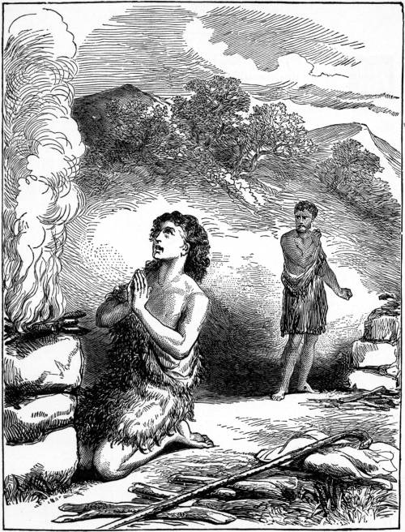
Restoring the foundation of faith
“Cain brought to the Lord an offering of the fruit of the ground, and Abel brought of the firstlings of his flock. And the Lord had regard for Abel and his offering, but for Cain and his offering he had no regard.” Genesis 4:3-5
Cain and Abel making their offerings
Notes:
Abel made acceptable offering and afterwards felt incredible joy and blessing. He was very happy. Cain didn’t do it acceptably and afterwards felt down, angry and empty. He was now in position of Lucifer. Had to be in a similar situation to Adam and Lucifer but this time reverse what Lucifer felt and did.
Hebrews 11:14 By faith Abel offered to God a more acceptable sacrifice than Cain, through which he was commended as righteous,
“Abel should not have bragged that he felt happy because he received the blessing from God. Instead, when he received the blessing, he should have realized his shortcomings and said, ‘Older brother, I am sorry.’ If he did that, would Cain have beaten him to death? He probably would not have killed him. This is the mistake of Abel.” “Do you like Abel or do you like Cain? [Abel] I like neither Cain nor Abel. Why? Abel made the offering together with his older brother Cain, so even when God accepted only his offering and rejected his older brother's, he should have been nice to his older brother. He should have been more considerate toward his brother. What do you think God would have done if at that moment Abel wept and make a havoc protesting, ‘Father, why did you only receive my offering?’ and then go to his older brother and say, ‘I dislike God who only accepted my offering.’ God would have had to love Cain for sure. However, since God accepted only his offering, Abel thought that this was because he was better and God only liked him. Thus, he must have bragged to his older brother, ‘Older brother, see, my offering was accepted.’ This must be what he did. Otherwise, why should Cain, who did not do anything, grow red in his face? Do you think this took place even when Abel did not do anything? For sure, Abel went before Cain to mock him, ‘What are you? My offering was received.’ Abel must never be arrogant. He must be humble. For this reason, he deserved to be beaten to death. There was no choice but to be beaten to death.”
According to Islamic commentary Cain brought bundle of worst crops
Sisters
Broken fences

Slide 133
How should one make an offering?
“If you are offering your gift at the altar, and there remember that your brother has something against you, leave your gift there before the altar and go; first be reconciled to your brother, and then come and offer your gift.”
Matthew 5:23-24
Notes:
Abel should have resolved things with Cain before they made the offering

Slide 134
Cain and Abel make offerings
Cain said to Abel, “I will kill you so that you may not marry my sister.”
(Commentary on the Qur’an)
Cain complained “Your offering
was accepted but mine was
not.” Abel replied “Allah accepts
only from those who are pious.”
Commentary on the Qur’an
God
Cain was jealous of Abel on account of his female,
Zohar 1.36b (W.S. 257)
Cain
Abel
Cain’s offering not accepted
Abel’s offering accepted
Notes:
Why did God accept Abel's offering but reject Cain's? God received Abel's sacrifice because he stood in a proper relationship with God and made the offering in a manner acceptable to Him
Abel successfully laid the foundation of faith in Adam's family. He serves as an example that any fallen person can make an offering acceptable to God provided he satisfies the necessary conditions. Abel fulfilled the indemnity conditions for the restoration of all things and the symbolic restoration of human beings. God had Abel make the symbolic offering for two reasons: first, to have him establish the foundation of faith in Adam's place; second, to qualify him to be the central figure of the substantial offering.
God did not reject Cain's sacrifice because He hated him. Rather, because Cain stood in a position to relate with Satan which gave Satan rights over the sacrifice, God could not accept Cain's sacrifice unless he first made some condition justifying its acceptance. The example of Cain shows that in order for a person who has a connection with Satan to return to God's side, he must make a requisite indemnity condition. What indemnity condition should Cain have made? It was the indemnity condition to remove the fallen nature.
Had Cain fulfilled the indemnity condition to remove the fallen nature, God would have gladly accepted his sacrifice.
-If Cain had made foundation of substance with Abel then God would have accepted his offering. => need to make foundation of substance before making offering!
If Cain and Abel had then fulfilled the indemnity condition for the restoration of the children by making an acceptable substantial offering, their father Adam would have shared in the victory of this foundation of substance.
The foundation of substance would then have been laid in Adam's family. How should Cain have made the indemnity condition to remove the fallen nature? The first human ancestors fell by succumbing to the Archangel, from whom they inherited the fallen nature. To remove the fallen nature, a person must make an indemnity condition in accordance with the Principle of Restoration through Indemnity, by taking a course which reverses the process through which human beings initially acquired the fallen nature.
Cain was the one to fulfill the indemnity condition to remove the fallen nature, yet his accomplishment would have resulted in the entire family of Adam fulfilling the condition. How was this possible? It may be compared to the situation of the first human ancestors, who could have helped God accomplish His entire Will had they obeyed His Word. It may also be compared to the situation of the Jewish people of Jesus' day, who could have helped Jesus accomplish his will to bring complete salvation to humankind had they believed in him. If Cain had yielded to Abel and fulfilled the indemnity condition to remove the fallen nature, both children would have been regarded as having fulfilled the indemnity condition together. Cain and Abel were the offspring of Adam, the embodiment of both good and evil. Had they unshackled themselves from Satan's chains by fulfilling the indemnity condition to remove the fallen nature, then Adam, their father, also could have separated from Satan and stood upon the foundation of substance. Thus, the foundation for the Messiah would have been established by the family as a whole. In short, had Cain and Abel succeeded in making the symbolic and substantial offerings, the indemnity condition for the restoration of the parents would have been fulfilled.

Slide 135
How good a younger brother was Abel?
Original nature
Fallen nature
Loveable
Humble
Sharing
Cooperative
Hard to love
Arrogant
Not helpful
Uncooperative
Notes:
FN Abel – arrogant winner

Slide 136
Why didn’t God accept Cain’s offering?
God did not reject Cain's sacrifice because He hated him
Cain stood in a position to relate with Satan which gave Satan rights over the sacrifice
Therefore God could not accept Cain's sacrifice unless he first made some condition justifying its acceptance
What indemnity condition should Cain have made?
The indemnity condition to remove fallen nature
Notes:
Abel should have tried to make things up with Cain before making the offering so that Cain could overcome his fallen nature and establish the foundation of substance. That is Abel’s job – to make it easy for Cain to overcome fallen nature

Slide 137
Different ways to be Cain
Original nature
Fallen nature
Loves Abel
Respects Abel
Wants to be guided by Abel
Wants to work together
Can’t love Abel
Can’t respect Abel
Doesn’t want to be guided
Doesn’t want to work together
Notes:
FN of Cain – bad loser

Slide 138
God counselled Cain
The Lord said to Cain, “Why are you angry, and why has your countenance fallen? If you do well, will you not be accepted. And if you do not do well, sin is crouching at the door; its desire is for you, but you must master it.”
Genesis 4:6-7
Notes:
1 John 3:12 We should not be like Cain, who was of the evil one and murdered his brother. And why did he murder him? Because his own deeds were evil and his brother's righteous.
God expected Cain to be able to overcome fallen nature. Even after killing Abel God gave him a chance. Where is your brother Abel? If broke down in tears and repentance could have been forgiven. But hardened heart just as Adam and Eve did. When God asks question giving person chance to repent. God doesn’t judge or condemn. Just asks questions.
Cain “I will kill you so that you cannot marry my sister.”
Cain complained “Your offering was accepted but mine was not.” Abel replied “Allah accepts only from those who are pious.”
Cain told Adam that Abel’s offering had only been accepted because Adam had prayed for him and not Cain

Slide 139
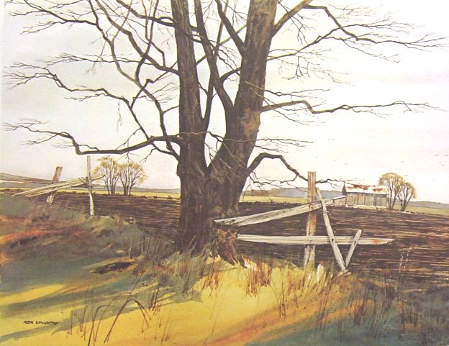
Abel’s sheep and Cain’s crops
Abel’s sheep and cattle wandered into Cain’s field and destroyed his crops
Talmud
And Cain said to Abel
And it came to pass when they were in the field . . .
And while they were in the field, Cain attacked his brother Abel and killed him.
Genesis 4:8
Abel: “Yet if you stretch out your
hand against me to kill me, I shall
not stretch out my hand to kill you,
for I fear Allah the Lord of the worlds.”
Qur’an 5:28 (W.S. 256)
Notes:
Good fences make good neighbours
And recite for them the story of the two sons
of Adam truthfully, when they offered a sacrifice,
and it was accepted of one of them, and not
accepted of the other. “I will surely slay you,”
said one. “God accepts only of the god-fearing,”
said the other.
“Yet if you stretch out your hand against
me, to slay me, I will not stretch out my hand
Evil, Sin and the Human Fall 257
against you, to slay you; I fear God, the Lord
of all Beings. I desire that you should be laden
with my sin and your sin, and so become an
inhabitant of the Fire; that is the recompense of
the evildoers.”
Then his soul prompted him to slay his
brother, and he slew him, and became one of
the losers.
Then God sent forth a raven, scratching
into the earth, to show him how he might
conceal the vile body of his brother. He said,
“Woe is me! Am I unable to be as this raven,
and so conceal my brother’s vile body?” And he
became one of the remorseful.
Qur’an 5.27-31

Slide 140
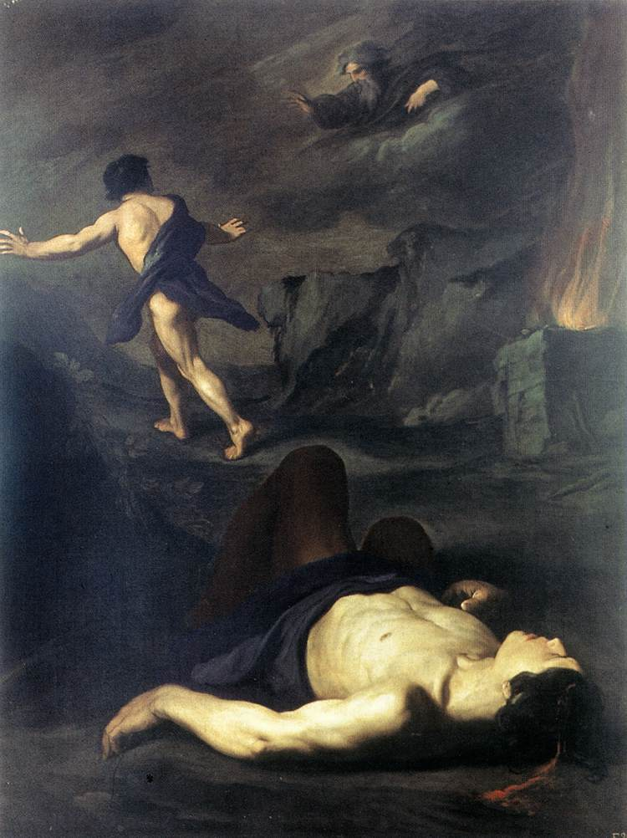
Cain murders Abel
And the Lord said to Cain, “Where is your brother Abel?” And he said, “I do not know. Am I my brother’s keeper?
Genesis 4:9
Notes:
Abel stronger than Cain. He said to Cain “If you stretch your hand against me to kill me, I shall not stretch my hand to kill you, for I fear Allah, the lord of the worlds.”

Slide 141
Failure in Adam’s family
God
Satan
Adam
Foundation
of Faith
Abel
Cain
Foundation
of Substance
Notes:
God had no idea that fall wouldn’t be quickly restored. Expected A& E to repent. Expected C&A to sort it.
However, when Cain murdered Abel, they re-enacted the Fall, in which the Archangel murdered Eve spiritually.

Slide 142
Father on Cain and Abel
However, since God accepted only his offering, Abel thought that this was because he was better and God only liked him. Thus, he must have bragged to his older brother, ‘Older brother, see, my offering was accepted.’ This must be what he did. Otherwise, why should Cain, who did not do anything, grow red in his face? Do you think this took place even when Abel did not do anything? For sure, Abel went before Cain to mock him, ‘What are you? My offering was received.’ Abel must never be arrogant. He must be humble.
Sun Myung Moon The Way of the Spiritual Leader

Slide 143
Abel should not have bragged that he felt happy because he received the blessing from God. Instead, when he received the blessing, he should have realized his shortcomings and said, ‘Older brother, I am sorry.’ If he did that, would Cain have beaten him to death? He probably would not have killed him. This is the mistake of Abel. (34-51)
Abel made the offering together with his older brother Cain, so even when God accepted only his offering and rejected his older brother's, he should have been nice to his older brother. He should have been more considerate toward his brother. What do you think God would have done if at that moment Abel wept and make a havoc protesting, ‘Father, why did you only receive my offering?’ and then go to his older brother and say, ‘I dislike God who only accepted my offering.’ God would have had to love Cain for sure.
Notes:
When you look at it centering on Abel, Abel made the offering with the same degree of devotion as Cain. However, because Abel was on the side of God from the beginning point God accepted it. For this reason, Abel should have been grateful and humble even if God accepted his offering. Then would Cain have tried to kill him? Nevertheless, since God only received his offering, Abel must have expressed great joy to the extent that aroused intense feeling of jealousy in Cain. It would have been good if he just kept the feeling of happiness to himself and not expressed it, but he boasted to his older brother. Don't you also want to boast about some happy events in your life? Don't you want to brag about it? Similarly, Abel must have boasted to his brother. In the process, he must have gone overboard and said, "God did not receive older brother's offering and just accepted mine. Therefore, I am better than my older brother." Thus, Cain's face must have grown red, and he must have felt intense anger. It is reasonable to have this kind of thought.
“Abel should not have bragged that he felt happy because he received the blessing from God. Instead, when he received the blessing, he should have realized his shortcomings and said, ‘Older brother, I am sorry.’ If he did that, would Cain have beaten him to death? He probably would not have killed him. This is the mistake of Abel.” (34-51)
“Do you like Abel or do you like Cain? [Abel] I like neither Cain nor Abel. Why? Abel made the offering together with his older brother Cain, so even when God accepted only his offering and rejected his older brother's, he should have been nice to his older brother. He should have been more considerate toward his brother. What do you think God would have done if at that moment Abel wept and make a havoc protesting, ‘Father, why did you only receive my offering?’ and then go to his older brother and say, ‘I dislike God who only accepted my offering.’ God would have had to love Cain for sure.
Cain and Abel probably made the same preparation to make the offering to God. Cain prepared grains and Abel prepared lamb for one year, and with greatly devout attitude they offered them. It is good that they both put in great effort. However, without considering the question of who put in more effort, and just looking at the question of receiving or rejecting the offering, God accepted the offering of Abel because He had to.
However, since God accepted only his offering, Abel thought that this was because he was better and God only liked him. Thus, he must have bragged to his older brother, ‘Older brother, see, my offering was accepted.’ This must be what he did. Otherwise, why should Cain, who did not do anything, grow red in his face? Do you think this took place even when Abel did not do anything? For sure, Abel went before Cain to mock him, ‘What are you? My offering was received.’ Abel must never be arrogant. He must be humble. For this reason, he deserved to be beaten to death. There was no choice but to be beaten to death.”

Slide 144
When you look at it centring on Abel, Abel made the offering with the same degree of devotion as Cain. However, because Abel was on the side of God from the beginning point God accepted it. For this reason, Abel should have been grateful and humble even if God accepted his offering. Then would Cain have tried to kill him? Nevertheless, since God only received his offering, Abel must have expressed great joy to the extent that aroused intense feeling of jealousy in Cain. It would have been good if he just kept the feeling of happiness to himself and not expressed it, but he boasted to his older brother. Don't you also want to boast about some happy events in your life? Don't you want to brag about it? Similarly, Abel must have boasted to his brother. In the process, he must have gone overboard and said, "God did not receive older brother's offering and just accepted mine. Therefore, I am better than my older brother." Thus, Cain's face must have grown red, and he must have felt intense anger. It is reasonable to have this kind of thought.

Slide 145
8b. Restoring the relationship between Adam and the Archangel
Jacob and Esau

Slide 146
Isaac and Rebekah
Isaac
Rebekah
Jacob
Esau
(Abel)
(Cain)
“Two nations are in your womb, and two peoples, born of you, shall be divided; the one shall be stronger than the other, the elder shall serve the younger.”
Genesis 25:23
Notes:
Abraham sent servant to find wife for Isaac - Rebekah gave water at the well – hospitable. Isaac 40 when he married. 60 when J&E born
Rebecca difficulty in having a child,
Meaning ambiguous. Could mean younger will serve elder.
Abraham asks his servant – traditionally identified as Eliezer – to find a wife for Isaac his son. The commentators suggest that he felt a profound ambivalence about his mission. Were Isaac not to marry and have children, Abraham’s estate would eventually pass to Eliezer or his descendants. Abraham had already said so before Isaac was born: “Sovereign Lord, what can you give me since I remain childless and the one who will inherit my estate is Eliezer of Damascus?” (Genesis 15: 2). If Eliezer succeeded in his mission, bringing back a wife for Isaac, and if the couple had children, then his chances of one day acquiring Abraham’s wealth would disappear completely. Two instincts warred within him: loyalty to Abraham and personal ambition. Loyalty won, but not without a deep struggle. Hence the shalshelet (Genesis 24: 12).

Slide 147
What needs to be restored?
Relationship between Archangel and Adam
  Adam needs to win the respect of the AA to become the Lord of creation
  Abel, in the position of Adam, needs to restore the birthright by winning the respect of Cain, in the position of the AA, and become the elder brother, head of the family

Slide 148
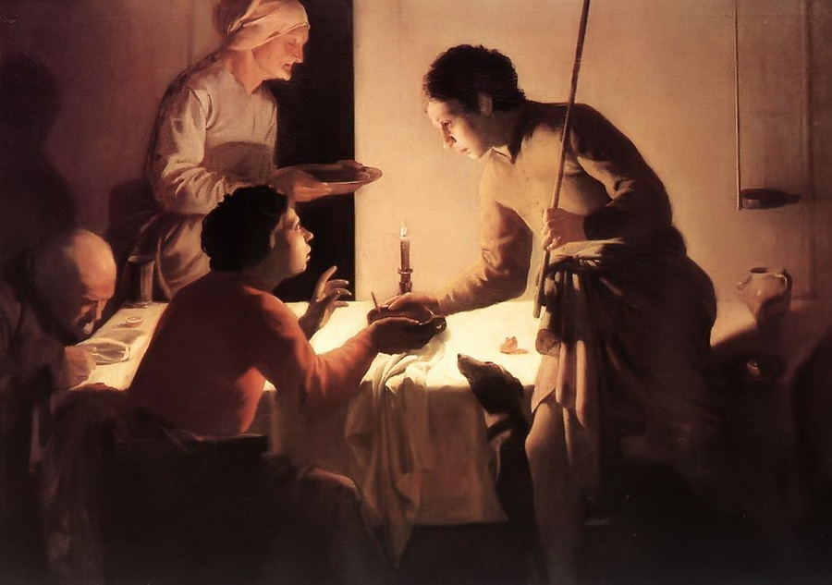
Jacob acquires birthright
Isaac tells his sons about the birthright
Jacob buys the birthright from Esau with bread and lentils
“Thus Esau despised the birthright.”
Genesis 25: 34
Jacob buys the birthright
Notes:
Hendrick Terbrugghen, 1625
²⁹ Once when Jacob was cooking stew, Esau came in from the field, and he was exhausted. ³⁰ And Esau said to Jacob, “Let me eat some of that red stew, for I am exhausted!” (Therefore his name was called Edom.^{[e]}) ³¹ Jacob said, “Sell me your birthright now.” ³² Esau said, “I am about to die; of what use is a birthright to me?” ³³ Jacob said, “Swear to me now.” So he swore to him and sold his birthright to Jacob. ³⁴ Then Jacob gave Esau bread and lentil stew, and he ate and drank and rose and went his way. Thus Esau despised his birthright.
The Or HaChaim suggests that the reason that Jacob is making a stew is that he saw that his father loved Esau because Esau made him food. Jacob saw that his father’s love was given to the son that brought him food. So Jacob decides that he too will make food for his father. Jacob tries to turn himself into a person who will be lovable by his father. If only he performs in the right way, if only he can please his father, then maybe….maybe….. his father will love him too.
Important to stress that Jacob bought birthright. Showed how much Esau despised the birthright.
Jacob purchased the birthright from Esau with bread and lentils, which symbolized flesh and spirit. EDP 227

Slide 149
How should Jacob have got the birthright?
Original nature
of Cain
Original nature
of Abel
Loves Abel
Respects Abel
Wants to be guided by Abel
Wants to work together
Loveable
Humble
Sharing
Cooperative

Slide 150
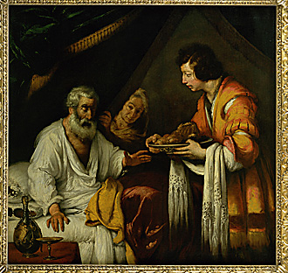
Jacob takes Esau’s blessing
Isaac wants to bless Esau
Rebekah tells Jacob to take Esau’s blessing
Jacob deceives his father and receives Esau’s blessing
Isaac blessing Jacob
Notes:
Should Jacob have taken Esau’s blessing. Why didn’t Rebecca question Isaac? Why didn’t Isaac explain to Rebecca what he was doing?
Was Jacob right to take Esau’s blessing in disguise? Was he right to deceive his father and to take from his brother the blessing Isaac sought to give him? Was Rivka right in conceiving the plan in the first place and encouraging Jacob to carry it out? These are fundamental questions. What is at stake is not just biblical interpretation but the moral life itself. How we read a text shapes the kind of person we become.
Here is one way of interpreting the narrative. Rivka was right to propose what she did and Jacob was right to do it. Rivka knew that it would be Jacob, not Esau, who would continue the covenant and carry the mission of Abraham into the future. She knew this on two separate grounds. First, she had heard it from God himself, in the oracle she received before the twins were born:
‘Two nations are in your womb,
and two peoples from within you will be separated;
one people will be stronger than the other,
and the elder will serve the younger.’ (Gen. 25: 23)
Esau was the elder, Jacob the younger. Therefore it was Jacob who would emerge with greater strength, Jacob who was chosen by God.
Second, she had watched the twins grow up. She knew that Esau was a hunter, a man of violence. She had seen that he was impetuous, mercurial, a man of impulse, not calm reflection. She had seen him sell his birthright for a bowl of soup. She had watched while he “ate, drank, rose and left. So Esau despised his birthright” (Gen. 25: 34). No one who despises his birthright can be the trusted guardian of a covenant intended for eternity.
Third, just before the episode of the blessing we read: “When Esau was forty years old, he married Judith daughter of Beeri the Hittite, and also Basemath daughter of Elon the Hittite. They were a source of grief to Isaac and Rivka”(Gen. 26: 34). This too was evidence of Esau’s failure to understand what the covenant requires. By marrying Hittite women he proved himself indifferent both to the feelings of his parents and to the self-restraint in the choice of marriage partner that was essential to being Abraham’s heir.
The blessing had to go to Jacob. If you had two sons, one indifferent to art, the other an art-lover and aesthete, to whom would you leave the Rembrandt that has been part of the family heritage for generations? And if Isaac did not understand the true nature of his sons, if he was “blind” not only physically but also psychologically, might it not be necessary to deceive him? He was by now old, and if Rivka had failed in the early years to get him to see the true nature of their children, was it likely that she could do so now?
This was, after all, not just a matter of relationships within the family. It was about God and destiny and spiritual vocation. It was about the future of an entire people since God had repeatedly told Abraham that he would be the ancestor of a great nation who would be a blessing to humanity as a whole. And if Rivka was right, then Jacob was right to follow her instructions.
This was the woman whom Abraham’s servant had chosen to be the wife of his master’s son, because she was kind, because at the well she had given water to a stranger and to his camels also. Rivka was not Lady Macbeth. She was the embodiment of loving-kindness. She was not acting out of favouritism or ambition. And if she had no other way of ensuring that the blessing went to one who would cherish it and live it, then in this case the end justified the means. This is one way of reading the story and it is taken by many of the commentators.
However it is not the only way. Consider, for example, the scene that transpired immediately after Jacob left his father. Esau returned from hunting and brought Isaac the food he had requested. We then read this:
Isaac trembled violently and said, ‘Who was it, then, that hunted game and brought it to me? I ate it just before you came and I blessed him – and indeed he will be blessed!’
When Esau heard his father’s words, he burst out with a loud and bitter cry and said to his father, ‘Bless me – me too, my father!’
But he said, ‘Your brother came deceitfully and took your blessing.’
Esau said, ‘Isn’t he rightly named Jacob? This is the second time he has taken advantage of me: he took my birthright, and now he’s taken my blessing!’ Then he asked, ‘Haven’t you reserved any blessing for me?’ (Gen. 27: 33-36)
It is impossible to read Genesis 27 – the text as it stands without commentary – and not to feel sympathy for Isaac and Esau rather than Rivka and Jacob. The Torah is sparing in its use of emotion. It is completely silent, for example, on the feelings of Abraham and Isaac as they journeyed together toward the trial of the binding. Phrases like “trembled violently” and “burst out with a loud and bitter cry” cannot but affect us deeply. Here is an old man who has been deceived by his younger son, and a young man, Esau, who feels cheated out of what was rightfully his. The emotions triggered by this scene stay with us long in the memory.
Then consider the consequences. Jacob had to leave home for more than twenty years in fear of his life. He then suffered an almost identical deceit practised against him by Laban when he substituted Leah for Rachel. When Jacob cried out “Why did you deceive me [rimitani]” Laban replied: “It is not done in our place to place the younger before the elder” (Gen. 29: 25-26). Not only the act but even the words imply a punishment, measure for measure. “Deceit,” of which Jacob accuses Laban, is the very word Isaac used about Jacob. Laban’s reply sounds like a virtually explicit reference to what Jacob had done, as if to say, “We do not do in our place what you have just done in yours.”
The result of Laban’s deception brought grief to the rest of Jacob’s life. There was tension between Leah and Rachel. There was hatred between their children. Jacob was deceived yet again, this time by his sons, when they brought him Joseph’s bloodstained robe: another deception of a father by his children involving the use of clothes. The result was that Jacob was deprived of the company of his most beloved son for twenty-two years just as Isaac was of Jacob.
Asked by Pharaoh how old he was, Jacob replied, “Few and evil have been the years of my life” (Gen. 47: 9). He is the only figure in the Torah to make a remark like this. It is hard not to read the text as a precise statement of the principle of measure for measure: as you have done to others, so will others do to you. The deception brought all concerned great grief, and this persisted into the next generation.
My reading of the text is therefore this. The phrase in Rivka’s oracle, Ve-rav yaavod tsair (Gen. 25: 23), is in fact ambiguous. It may mean, “The elder will serve the younger,” but it may also mean, “The younger will serve the elder.” It was what the Torah calls a chidah (Numbers 12: 8), that is, an opaque, deliberately ambiguous communication. It suggested an ongoing conflict between the two sons and their descendants, but not who would win.
Isaac fully understood the nature of his two sons. He loved Esau but this did not blind him to the fact that Jacob would be the heir of the covenant. Therefore Isaac prepared two sets of blessings, one for Esau, the other for Jacob. He blessed Esau (Gen. 27: 28-29) with the gifts he felt he would appreciate: wealth and power: “May God give you heaven’s dew and earth’s richness – an abundance of grain and new wine” – that is, wealth. “May nations serve you and peoples bow down to you. Be lord over your brothers, and may the sons of your mother bow down to you” – that is, power. These are not the covenantal blessings.
The covenantal blessings that God had given Abraham and Isaac were completely different. They were about children and a land. It is this blessing that Isaac later gave Jacob before he left home (Gen. 28: 3-4): “May God Almighty bless you and make you fruitful and increase your numbers until you become a community of peoples” – that is, children. “May He give you and your descendants the blessing given to Abraham, so that you may take possession of the land where you now reside as a foreigner, the land God gave to Abraham” – that is, land. This was the blessing Isaac had intended for Jacob all along. There was no need for deceit and disguise.
Jacob eventually came to understand all this, perhaps during his wrestling match with the angel during the night before his meeting with Esau after their long estrangement. What happened at that meeting is incomprehensible unless we understand that Jacob was giving back to Esau the blessings he had wrongly taken from him. The massive gift of sheep, cattle and other livestock represented “heaven’s dew and earth’s richness,” that is, wealth. The fact that Jacob bowed down seven times to Esau was his way of fulfilling the words, “May the sons of your mother bow down to you,” that is, power.
Jacob gave the blessing back. Indeed he said so explicitly. He said to Esau: “Please accept the blessing [birkati] that was brought to you, for God has been gracious to me and I have all I need” (Gen. 33: 11). On this reading of the story, Rivka and Jacob made a mistake, a forgivable one, an understandable one, but a mistake nonetheless. The blessing Isaac was about to give Esau was not the blessing of Abraham. He intended to give Esau a blessing appropriate to him. In so doing, he was acting on the basis of precedent. God had blessed Ishmael, with the words “I will make him into a great nation” (Gen. 21: 18). This was the fulfilment of a promise God had given Abraham many years before when He told him that it would be Isaac, not Ishmael, who would continue the covenant:
Abraham said to God, “If only Ishmael might live under your blessing!” Then God said, “Yes, but your wife Sarah will bear you a son, and you will call him Isaac. I will establish my covenant with him as an everlasting covenant for his descendants after him. As for Ishmael, I have heard you: I will surely bless him; I will make him fruitful and will greatly increase his numbers. He will be the father of twelve rulers, and I will make him into a great nation.” (Gen. 17: 18-21)
Isaac surely knew this because, according to midrashic tradition, he and Ishmael were reconciled later in life. We see them standing together at Abraham’s grave (Gen. 25: 9). It may be that this was a fact that Rivka did not know. She associated blessing with covenant. She may have been unaware that Abraham wanted Ishmael blessed even though he would not inherit the covenant, and that God had acceded to the request.
If so then it is possible all four people acted rightly as they understood the situation, yet still tragedy occurred. Isaac was right to wish Esau blessed as Abraham sought for Ishmael. Esau acted honourably toward his father. Rivka sought to safeguard the future of the covenant. Jacob felt qualms but did what his mother said, knowing she would not have proposed deceit without a strong moral reason for doing so.
Do we have here one story with two possible interpretations? Perhaps, but that is not the best way of describing it. What we have here, and there are other examples in Genesis, is a story we understand one way the first time we hear it, and a different way once we have discovered and reflected on all that happened later. It is only after we have read about the fate of Jacob in Laban’s house, the tension between Leah and Rachel, and the animosity between Joseph and his brothers that we can go back and read Genesis 27, the chapter of the blessing, in a new light and with greater depth.
There is such a thing as an honest mistake, and it is a mark of Jacob’s greatness that he recognized it and made amends to Esau. In the great encounter twenty-two years later the estranged brothers meet, embrace, part as friends and go their separate ways. But first, Jacob had to wrestle with an angel.
That is how the moral life is. We learn by making mistakes. We live life forward, but we understand it only looking back. Only then do we see the wrong turns we inadvertently made. This discovery is sometimes our greatest moment of moral truth.
For each of us there is a blessing that is ours. That was true not just of Isaac but also Ishmael, not just Jacob but also Esau. The moral could not be more powerful. Never seek your brother’s blessing. Be content with your own.
Yet the real question is about Rebecca. It was her plan, not his. How did she consider it permissible [1] to deceive her husband, [2] to deprive Esau of his father’s blessing, and [3] to order Jacob to commit an act of dishonesty? Jacob on his own would not have conceived such a plan. He was an ish tam, meaning “a simple, straightforward, plain, quiet, innocent man, a man of integrity” (25: 27)? How then did Rebecca come to do what she did?
There are three possible answers. The first: she loved Jacob (25: 28). She preferred him to Esau. She knew Isaac felt otherwise. So she was driven by maternal instinct. She wanted her beloved son to be blessed.
This is an unlikely answer. The patriarchs and matriarchs are role models. They were not driven by mere instinct or vicarious ambition. Rebecca was not Lady Macbeth. Nor was she Bat-sheva, engaging in court politics to ensure that her son, Solomon, would inherit David’s throne (see 1 Kings 1). It would be a serious misreading to read the narrative this way.
The second possibility is that she believed strongly that Esau was the wrong person to inherit the blessing. She had already seen how readily he had sold his birthright and “despised” it (25: 31-34). She did not believe a “hunter” and “a man of the field” fitted the template of the Abrahamic covenant. She knew that this was one of the reasons why God chose Isaac not Ishmael, because Ishmael was destined to be “a wild ass of a man” (16: 12). She knew that Isaac loved Esau but felt – for various reasons, depending on which commentary one follows – that he was blind to his faults. It was vital to the future of the covenant that it be entrusted to the child who had the right qualities to live by its high demands.
The third possibility is simply that she was guided by the oracle she had received prior to the twins’ birth: “Two nations are in your womb, and two peoples from within you will be separated; one people will be stronger than the other, and the older will serve the younger” (25: 23). Jacob was the younger. Therefore, Rebecca must have assumed, he was destined to receive the blessing.
Possibilities two and three make sense, but only at the cost of raising a more fundamental question. Did Rebecca share her thoughts with Isaac? If she did, then why did Isaac persist in seeking to bless Esau? If she did not, then why not?

Slide 151
What went wrong?
Jacob and Esau haven’t made foundation of substance
Lack of communication between Isaac and Rebekah
Rebekah doesn’t ask Isaac
Rebekah dominates Jacob
Jacob doesn’t follow conscience
Jacob deceives his father Isaac

Slide 152
What needs to be restored?
Relationship between Adam and Eve
  Man needs the respect of his wife
  Man needs to love his wife
  Become a good subject
  Woman needs the love of her husband
  Woman needs to respect her husband
  Become a good object

Slide 153
Why didn’t Rebecca talk to Isaac?
Isaac went out to the field one evening to meditate, and as he looked up, he saw camels approaching. Rebekah also looked up and saw Isaac. She got down from her camel and asked the servant, “Who is that man in the field coming to meet us?” “He is my master,” the servant answered. So she took her veil and covered herself. Genesis 24:62-65
  Gap of age
  Rebecca awed by Isaac
  Isaac a meditator and not a talker (trauma?)
Notes:
Now Isaac had come from Beer Lahai Roi, for he was living in the Negev. He went out to the field one evening to meditate, and as he looked up, he saw camels approaching. Rebekah also looked up and saw Isaac. She got down from her camel and asked the servant, “Who is that man in the field coming to meet us?” “He is my master,” the servant answered. So she took her veil and covered herself. (24: 62-65)
On this Netziv comments, “She covered herself out of awe and a sense of inadequacy as if she felt she was unworthy to be his wife, and from then on this trepidation was fixed in her mind. Her relationship with Isaac was not the same as that between Sarah and Abraham or Rachel and Jacob. When they had a problem they were not afraid to speak about it. Not so with Rebecca” (Commentary to Gen. 24: 65).
Netziv understood that in this description of the first encounter between Rebekah and Isaac, nothing is incidental. The text emphasizes distance in every sense. Isaac is physically far away when Rebekah spots him. He is also mentally far away: meditating, deep in thought and prayer. Rebekah imposes her own distance by covering herself with a veil.
The distance goes deeper still. Isaac is the most withdrawn of the patriarchs. Rarely do we see him as the initiator of a course of action. The events of his life seem to mirror those of his father. The Torah associates him with pachad, “fear” (Gen. 31: 42). Jewish mysticism connected him with gevurah, best understood as “self-restraint.” This is the man who had been bound as a sacrifice on an altar, whose life had been reprieved only at the last moment. Isaac, whether because of the trauma of that moment or because of the inhibiting effect of having a strong father, is a man whose emotions often lie too deep for words.
It is hard to avoid the conclusion that the Torah is telling us that communication is vital, however hard it is. Rebekah acts at all times out of the highest of motives. She holds back from troubling Isaac out of respect for his inwardness and privacy. She does not want to disillusion him about Esau, the son he loves. She does not want to trouble him with her oracle, suggesting as it did that the two boys would be locked into a lifelong struggle. Yet the alternative – deception – is worse.
We have here a story of the tragedy of good intentions. Honesty and openness are at the heart of strong relationships. Whatever our fears and trepidations, it is better to speak the truth than practice even the most noble deception.
In an earlier Covenant and Conversation I quoted the Netziv (Naftali Zvi Yehudah Berlin, 1816-1893, dean of the yeshiva in Volozhin), who made the sharp observation that Isaac and Rebecca seem not to have communicated closely. Rebecca’s “relationship with Isaac was not the same as that between Sarah and Abraham or Rachel and Jacob. When they had a problem they were not afraid to speak about it. Not so with Rebecca” (Commentary to Gen. 24: 65).
The Netziv senses this distance from the very first moment when Rebecca saw Isaac “meditating in the field” at which point she “covered herself with a veil.” He comments, “She covered herself out of awe and a sense of inadequacy as if she felt she was unworthy to be his wife, and from then on this trepidation was fixed in her mind.”
Their relationship, suggests Netziv, was never casual, intimate. The result was, at a series of critical moments, a failure of communication. It seems likely that Rebecca never informed Isaac of the oracle she had before the twins, Esau and Jacob, were born, in which God told her “the elder will serve the younger.” That apparently is one reason she loved Jacob rather than Esau, knowing that he was the one chosen by God. If Isaac knew this, why did he favour Esau? Therefore he probably did not know, because Rebecca had not told him.
That is why, many years later, when she heard that Isaac was about to bless Esau she was forced into a plan of deception: she told Jacob to pretend he was Esau. Why did she not simply tell Isaac that it was Jacob who was to be blessed? Because that would have forced her to admit that she had kept her husband in ignorance about the prophecy all the years the children were growing up.
Had she spoken to Isaac on the day of the blessing, Isaac might have said something that would have changed the entire course of their, and their children’s, lives. I imagine Isaac saying this: ‘Of course I know that it will be Jacob not Esau who will continue the covenant. But I have two quite different blessings in mind, one for each of our sons. I will give Esau a blessing of wealth and power: “May God give you the dew of heaven and the richness of the earth … May nations serve you and peoples bow down to you” (Gen. 27: 28-29). I will give Jacob the blessing God gave Abraham and me, the blessing of children and the promised land: “May God Almighty bless you and make you fruitful and increase your numbers until you become a community of peoples. May he give you and your descendants the blessing given to Abraham, so that you may take possession of the land where you now reside as a foreigner, the land God gave to Abraham” (Gen. 28: 3-4)’
Isaac never did intend to give the blessing of the covenant to Esau. He intended to give each child the blessing that suited them. The entire deceit planned by Rebecca and carried out by Jacob was never necessary in the first place. Why did Rebecca not understand this? Because she and her husband did not communicate.
Now let us count the consequences. Isaac, old and blind, felt betrayed by Jacob. He “trembled violently” when he realised what had happened, and said to Esau, “Your brother came deceitfully.” Esau likewise felt betrayed and felt such violent hatred toward Jacob that he vowed to kill him. Rebecca was forced to send Jacob into exile, thus depriving herself for more than two decades of the company of the son she loved. As for Jacob, the consequences of the deceit lasted a lifetime, resulting in strife between his wives, and between his children. “Few and evil have been the days of my life,” he said as an old man to Pharaoh. Four lives scarred by one act which was not even necessary in the first place since Isaac did in fact give Jacob “the blessing of Abraham” without any deception, knowing him to be Jacob not Esau.
Such is us the human price we pay for a failure to communicate. The Torah is exceptionally candid about such matters, which is what makes it so powerful a guide to life: real life, among real people with real problems. Communication matters. In the beginning God created the natural world with words: “And God said: Let there be.” We create the social world with words. The Targum translated the phrase in Genesis 2, “And man became a living soul” as “and man became a speaking soul.” For us, speech is life. Life is relationship. And human relationships only exist because we can speak. We can tell other people our hopes, our fears, our feelings and thoughts.
That is why any leader – from a parent to a CEO – must set as his or her task good, strong, honest, open communication. That is what makes families, teams and corporate cultures healthy. Everyone must know what their overall aims are as a team, what their specific role is, what responsibilities they carry, and what values and behaviours they are expected to exemplify. There must be praise for those who do well, as well as constructive criticism when people do badly – criticism of the act not the person, who must feel respected whatever his or her failures. This last is one of the fundamental differences between a “guilt morality” of which Judaism is the supreme example, and a “shame morality” like that of ancient Greece (guilt makes a clear distinction between the act and the person, which shame does not).
There are times when much depends on clear communication. It is not too much to say that there was a moment at which the fate of the world depended on it. It happened during the Cuban missile crisis of 1962 when the United States and the Soviet Union were on the brink of nuclear war. At the height of the crisis, as described by Robert McNamara in his film, The Fog of War, John F. Kennedy received two messages from the Soviet leader Nikita Khrushchev. One was conciliatory, the other far more hawkish. Most of Kennedy’s advisers believed that the second represented Khrushchev’s real views and should be taken seriously.
However one man, Llewellyn Thompson Jr., had been American ambassador to the Soviet Union from 1957 to 1962 and had come to know the Russian president well. He had even spent a period of time living with Khrushchev and his wife. He told Kennedy that the conciliatory message sounded like Khrushchev’s own personal view while the hawkish letter, which did not sound like him, had probably been written to appease the Russian generals. Kennedy listened to Thompson, gave Khrushchev a way of backing down without losing face, and the result was that war was averted. It is fearful to imagine what might have happened had Thompson not been there to establish which was and which wasn’t the real act of communication.
Parents and leaders must establish a culture in which honest, open, respectful communication takes place, and that involves not just speaking but also listening. Without it, tragedy is waiting in the wings.

Slide 154
Isaac’s blessing for Esau
“May God give you heaven’s dew
and earth’s richness—
an abundance of grain and new wine.
May nations serve you
and peoples bow down to you.
Be lord over your brothers, and may the sons of your mother bow down to you.
May those who curse you be cursed
and those who bless you be blessed.”
Genesis 27:28-29

Slide 155
No foundation of substance
Isaac
Jacob
Esau
(Abel)
(Cain)
Now Esau hated Jacob because of the blessing with which his father had blessed him, and Esau said to himself, “The days of mourning for my father are approaching; then I will kill my brother Jacob.”
Genesis 27:41
Notes:
On the other hand Jacob hadn’t won the respect of Esau such that Esau would tell Isaac that Jacob was the one who deserved and was most qualified to receive the birthright. So Jacob had restored the birthright and blessing externally but not internally.
So just as Cain killed Abel, Esau wanted to kill Jacob
Believing Mr. Finkelstein, that the core stories of the Bible were put together into one book in 7th century b.c. in Kingdom of Judah (Southern kingdom) after the destruction of Kingdom of Israel (Northern kingdom) I try to understand the intention of the authors based on the situation in the region at that time.There is the whole set of younger and elder brothers in the Bible, so what their story might tell us about the time, when they were edited?CAIN and ABEL:When we look at the map of Israel, we might understand, why "Abel was a keeper of sheep, and Cain a tiller of the ground." Kingdom of Judah's territory was mountainous and more suitable for pasturing (keeper of sheep), while the Kingdom of Israel's territory had fertile soil and enough watter, so people lived from agricultural (tiller of the ground). In the temple of Jerusalem in the South were offered fruits of people's work same as in the temple of Betel in the North. But North was destroyed, while South lived - a clear sign, whose offering was accepted. Besides, when the Northern kingdom was one of the most powerfull in the region, the Southern kingdom was yet undeveloped area with low population. It started to prosper after destruction of Northern kingdom, when many people moved to South, so it was obvious, who was the elder and younger brother. MANASSEH and EPHRAIM:When we look at the map of tribes of Israel, we can see, that those two tribes covered almost the whole area of Northern kingdom, or at least its best part. Manasseh, the elder brother, controled the area with the crossroads of the trade roats, connecting Egypt and Mesopotamia, the area with fertile soil and water. It was the most developed and prosperous part of Northern kingdom with rich cities and luxurious palaces, like in Medigo and Samaria. Ephraim, the younger brother, had fruitfull land too, but in addition to it the centers of religion like Betel, Shiloh and Sheckem were located on his territory, so it was kind of spiritual center, providing guidance and connection to God. Ephraim was the most dominant tribe of the Northern kingdom. May be this was the reason, why he was portrayed in the Bible like the one, who was blessed first.When Assyria started to decline, king Josiah of the Southern Kingdom wanted to conquer this rich northern area again. He had to unite people and made them to feel, that to gain again control over Ephraim and Manasseh is their God's given right. May be that is whay Joshua, who conquered this area for the first time (according the legend), was descendant of Ephraim.Josiah however was not the only one, who wanted to conquer north. All nations around wanted to have control over this rich and strategically important area. The fall of Northern Kingdom had little to do with the faith of its kings. It was rather result of fight for this prosperous region.EZAU and JACOB:God told to Rebeca: "Two nations are in your womb, and two peoples from within you will be separated; one people will be stronger than the other, and the older will serve the younger."And Ezau got this blessing from his father: "Your dwelling will be away from the earth's richness, away from the dew of heaven above.40 You will live by the sword and you will serve your brother.But when you grow restless, you will throw his yoke from off your neck."Ezau was an ancestor of Edom. Kingdom of Edom was located South of Judah and its territory is just the desert. Edomites were nomadic raiders, moving here and there. The area was first inhabited in 8. century b.c., but we can speak about kingdom rather in 7. century b.c. At that time Edomites joined the profitable bussiness with Arabia and became strong competitor of Judah, who started to develop just at this time. So it was in the interest of the Kingdom of Judah to portray Edom and his ancestor Ezau as the one, who should serve his younger brother.ISHMAEL and ISAAC:Ismael is the elder brother, son of Abraham and Hagar from Egypt. He is portrayed in the Bible as "wild donkey of a man; his hand will be against everyone and everyone's hand against him,and he will live in hostility toward[a] all his brothers."He was ancestor of many Arab tribes living south of Judah. Many of these tribes listed in the Bible came in contact with Judah just in 7. century b.c. They were important for Judah, because they played an important role in the trade with spicy and incense from Southern Arabia. They transported the product through the Kingdom of Judah to the harbors around Meditterian Sea.Very similar thing can be seen in the case of Aramaean Kingdom, the home of uncle Laban. Aram controled the territory north of Northern Kingdom of Israel and he also had desire to control this rich part of the land, but not enough power to conquer it, so there were often small conflicts amont Israel and Aram, but at the same time the population mixed together as people from both nations married each other. So this was the background of the story of Jacob and uncle Laban.Little bit different was the situation of Amon and Moab, who lived behind the Jordan river, so they were portrayed as descendants of incest relationship of Lot with his daughters. Conclusion? The authors of the Bible accepted all semitic tribes in the region into the family, but did not leave any space for doubt and showed very clearly who is the chosen one, the blessed younger brother.

Slide 156
Should it have happened this way?
Jacob tricked Esau twice in order to take Esau's elder sonship . . . once with lentil stew and tricked him again when receiving Isaac's blessing.
However, that actually wasn't the correct way according to the Principle. Had Jacob wanted to inherit the rights of the elder son, he should have served and behaved well to his older brother. Then the older son's heart would have been moved and he would have said, "Yes, you are not only smarter than me but better in every aspect. So you should be my elder brother." If Jacob brought his older brother into natural subjugation like this, so much could have been saved in the course of indemnity.
Gil Ja Sa Eu, A testimony to God’s Word, 331
Notes:
Gil Ja Sa Eu has to tell us about this biblical episode in "A Testimony to God's Word" (p. 331 f.):
Like King Sejong

Slide 157
Mother - son cooperation
  Since it was a mother and son who allowed Satan to enter and bear the fruit of sin, according to the principle of restoration through indemnity, a mother and son must separate from Satan through their joint efforts. EDP, 229
  Rebekah should have restored Eve and Sarah’s role by helping her sons to love each other
  Rebekah favoured Jacob based on her dream
  She saved Jacob’s life by sending him to Haran
Notes:
Mother has to love other sons. My mother loves me the most - gives me the best of everything. Have to put others first. Law of hospitality. Sarah challenged on this with Hagar an Ishmael. Rebecca.
Jacob should have won the blessing in his native home in total harmony with Esau and not have had to go to Haran. Jacob's Course And Our Life In Faith
Reverend Sun Myung Moon
Second 100-Day Training Session
Master Speaks
May 27, 1973

Slide 158
What is Eve’s responsibility?
The way of the mother, Eve, is to unite Cain and Abel and bring them to Adam.
Father (124-074, 1983.01.23)

Slide 159
Isaac blesses Jacob
“May God Almighty bless you and make you fruitful and increase your numbers until you become a community of peoples.
May he give you and your descendants the blessing given to Abraham, so that you may take possession of the land where you now live as an alien, the land God gave to Abraham.”
Genesis 28:3-4
This is the birthright blessing
Notes:
Isaac sends Jacob to his uncle to marry his cousin. And gives him his blessing – Adam and Abraham’s blessing. More spiritual and religious/covenatal than Esau’s blessing

Slide 160
Should Jacob have gone to Haran?
“Did Jacob as Abel become really one with Esau as his Cain, thus subjugating Satan completely? Not originally. Jacob should have won his blessing in his native home in total harmony with Esau and not have had to go to Haran. However, he had to escape from the danger brought about by Esau's intention to kill him. Thus, the condition of indemnity was not completed.”
Sun Myung Moon Jacob’s course and our life of faith, 27 May 1973
Notes:
Jacob's Course And Our Life In Faith
Reverend Sun Myung Moon
Second 100-Day Training Session
Master Speaks
May 27, 1973
http://tparents.org/Moon-Talks/SunMyungMoon73/SM730527.htm

Slide 161
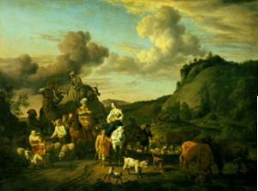
Jacob matures
21 years in Haran with Uncle Laban
Three Blessings
Man of character
Establishes family with twelve sons
Acquires wealth
Jacob leaving Laban
Notes:
Jacob was tricked many times by Laban. But he didn’t get angry and try to kill him or run away. Instead he endured and developed a deep character. He also married Rachel and Leah and with their maids as concubines had 12 sons and 1 daughter. He also worked very hard and was a good husbandman so that despite Laban’s trickery he became wealthy.
Jacob had twelve sons to restore through indemnity in his generation (horizontally) the indemnity conditions
accumulated (vertically) through the twelve generations from Noah to Jacob which had been lost to Satan. EDP 228
He felt sorry for what he had done to his elder brother. He thought it was understandable for Esau to want to kill him when he had taken away the birthright by cheating; and he was sympathetic with his brother. SMM 1973
You know also that when Jacob was well on, his way, Laban caught up with him and quarreled with him over the idol which he had stolen. If Leah, in sympathy with her father, had told him the truth about the idol, Jacobs 21-year course would have come to nothing. But Leah deceived her father, Laban. What is interesting here is that Leah cheated her father, and Jacob also cheated his father. If Leah and Jacob had both deceived their fathers for their own benefit, it would have been wrong. However, they did this for God and His people, and we know that this is a necessary condition in the course of restoration. Leah was strictly on the side of Jacob. If Leah had cheated her own father, this would mean that she had become completely one with Jacob. In terms of becoming a God's side family, we can define Jacob's family as one which history had never before seen. Leah was one with Jacob without becoming one with her father, Laban, and this made it possible for Jacob to remain the owner of all his possessions. SMM 1973
Sacks: Jacob, in flight from Esau’s anger, has travelled to the house of Laban. Arriving, he meets Laban’s younger daughter Rachel and falls in love with her. Laban proposes a deal: work for me for seven years and I will give her to you in marriage. Jacob does so, but on the wedding night Laban substitutes Leah for Rachel. The next morning, when Jacob discovers the deception, he protests, “Why did you deceive me?” Laban pointedly replies, “It is not the done thing in our place to give the younger before the elder” (a reference, intended or otherwise, to Jacob’s deception of Isaac, a case of the younger taking the blessing of the elder, Esau). Laban agrees, however, that in return for a further seven years’ labour, Jacob may marry Rachel. He will not have to wait until the seven years are complete, but he must, however, wait for seven days until Leah’s wedding celebration is complete (an early example of a custom we still keep: the week of sheva berakhot). The seven days pass. Jacob marries Rachel. We then read the following:
It seems that Rachel in particular was still angry at her father for what he had done to her. Before they set out, she took the small figurines that represented the spirits of ancestors and the protective deities of her father's family (the teraphim), telling no-one at all what she was doing. See Bible Archaeology: Ancient Religions for information about ancient religious beliefs and practices.
This was not a random act of malice, for years ago on what should have been her wedding night, Laban had stolen Rachel's happiness. Now she stole something that was precious to him - pay-back for a life-time of bullying.
But her act had wider significance than this, because the teraphim were a form of title deed, and the person who possessed them could claim the tribe's wealth. BIBLE WOMEN: RACHEL: Ancient clay statuette, possibly of Asherah and similar to the terephim stolen by Rachel Ownership of the household deities was the prerogative of the head of the family, and by taking them Rachel secured this position for her husband.
aban searched the tents of Jacob, Leah, and the two maids to find the teraphim- each woman in a polygamous marriage had her own separate tent.
For interesting images of tents used by nomadic herders like Jacob and Rachel, see Bible Architecture: Housing.
Nomadic tents
'The front section of the tent was used for work. It was the public area, open to visitors. The men of the family lived there. The second or rear part of the tent was private. A dividing curtain separated it from the front area. It was here that the women, children and babies lived and slept.'
Nomadic Tents
Laban found nothing. Then he went into Rachel's tent, where the teraphim were hidden. What he did not know was that Rachel had hidden them in the saddle-bags of her camel. She greeted her father respectfully but did not rise from where she was sitting. She explained demurely that she could not do so, since she was menstruating.
'Let not my lord be angry that I cannot rise before you, for the way of women is upon me.'
This meant that the cloth on which she was sitting was ritually unclean, and could not be touched by anyone. Most ancient tribes had customs that allowed menstruating women to withdraw from physical contact with the tribe while they had their periods, and women welcomed this time of rest from their usual tasks.
Rachel's manner towards her father was so sweet and yielding that Laban did not argue or tell her to move, and the upshot was that he left her tent empty-handed. She had used the laws of ritual cleanliness to her own advantage. The irony was that it was a lie. She was already pregnant with a son.
Since Laban could not find the teraphim, he had to back down. The two men made a face-saving covenant, and early the next morning Laban said good-bye to them all, and left.
http://www.womeninthebible.net/1.4.Rachel.htm

Slide 162
Jacob’s wives
When morning came, it was Leah! And Jacob said to Laban, ‘What is this you have done to me? Did I not serve with you for Rachel? Why then have you deceived me?’ Laban said, ‘This is not done in our country—giving the younger before the firstborn. Complete the week of this one, and we will give you the other also in return for serving me for another seven years.’
Father and older daughter deceived Jacob
  Jacob was being reminded that how he treated his father and older brother was wrong
  If he had not stolen Esau’s blessing Jacob would have married at the right time and had only one wife
  So Jacob went in to Rachel also, and he loved Rachel more than Leah. Genesis 29:30
Notes:
Abraham – 1 wife
Isaac – 1 wife
Monogamy was the tradition and teaching of Abraham and family from Genesis Adam and Eve
20 So Jacob served seven years for Rachel, and they seemed to him but a few days because of the love he had for her.
Jacob, who had with the help of his mother outwitted his brother Esau (see the story of this deception at Bible Men and Women: Jacob ) was now outwitted by someone even wilier than himself. Moreover, he had been fooled with the same trick: he had pretended to be his brother Esau, and now he had been fooled when Leah pretended to be her sister Rachel. Who says the Bible has no sense of humour? It was a terrible start to their marriage: his new wife Leah had colluded with her father to deceive him. This soured their relationship from the start.
But there was not much that could be done. During the night he had taken Leah's virginity, and in tribal society this meant she was his wife, like it or not. But he never forgave her for what she had done - she is usually described as 'unloved' in the English translation of the story, but the original Hebrew word is better translated as 'hated'.

Slide 163
Why did Jacob have two wives?
Arranges to marry Rachel
Married to Leah
Jacob, “Why did you deceive me?”
Laban, “It is not the done thing in our place to give the younger before the elder”
What goes around comes around
10 times Laban cheated Jacob out of his wages
Notes:
Jacob, in flight from Esau’s anger, has travelled to the house of Laban. Arriving, he meets Laban’s younger daughter Rachel and falls in love with her. Laban proposes a deal: work for me for seven years and I will give her to you in marriage. Jacob does so, but on the wedding night Laban substitutes Leah for Rachel. The next morning, when Jacob discovers the deception, he protests, “Why did you deceive me?” Laban pointedly replies, “It is not the done thing in our place to give the younger before the elder” (a reference, intended or otherwise, to Jacob’s deception of Isaac, a case of the younger taking the blessing of the elder, Esau). Laban agrees, however, that in return for a further seven years’ labour, Jacob may marry Rachel. He will not have to wait until the seven years are complete, but he must, however, wait for seven days until Leah’s wedding celebration is complete (an early example of a custom we still keep: the week of sheva berakhot). The seven days pass. Jacob marries Rachel. We then read the following:
He also [gam] married Rachel, and he also [gam] loved Rachel . . . (29:30)
The implication at this point is clear. The repeated word gam, “also,” leads us to believe that the two sisters are equal in Jacob’s eyes. The story of the deception has – or so we must suppose on the basis of what we have so far heard – a happy ending after all. Jacob has married both. He loves them both. The sibling rivalry that is so pronounced a theme of Bereishith (Cain and Abel, Isaac and Ishmael, Jacob and Esau) seems to be reaching a positive resolution. It is possible to love two siblings equally. The next word sends our expectation crashing to the ground:
…more than Leah (29:30)
This is an ungrammatical construction. The words “also” and “more than” do not belong together in the same sentence. Either one loves X and also Y, or one loves X more than Y, but not both. The effect – like a sudden discord in the middle of a Mozart symphony – is strident and shocking. Jacob does not love the two sisters equally. He may love them both, but his passion is for Rachel. The next verse contains an even sharper discord:
God saw that Leah was hated [senuah]. . .
This is a phrase that cannot be understood literally. The previous verse has just said that Leah was not hated but loved. The commentators and translators wrestled with this difficulty. Ramban (on his second interpretation) and Radak read the word senuah not as “hated” but as “[relatively] unloved.” Yet though the text is semantically strange, is it psychologically lucid. Leah knew that Jacob’s heart was elsewhere. She may have been loved but she felt the lesser love as a rejection. The words “God saw” mean that God felt her sense of humiliation. Laban’s deception had human consequences, and they were tragic. Leah weeps inwardly for the husband she acquired as a result of her father’s wiles, whose love is for someone else.
Only now, perhaps, do we understand the significance of the Torah’s first mention of Leah:
Now Laban had two daughters; the name of the older was Leah, and the name of the younger was Rachel. The eyes of Leah were weak (rakot), but Rachel was lovely in form, and beautiful.
The word rakot could mean many things: beautiful (Targum, Rashbam), weak (Ibn Ezra), or sensitive (Netziv suggests that Leah was unable to go out with the flocks because the bright sunlight hurt her eyes). The ambiguity is deliberate. Only rarely and sparingly does the Torah give us physical descriptions of its characters, and always for a reason that will eventually be disclosed (so, for example, we hear in 2 Samuel 14 about Absolom’s hair; four chapters later we discover why: it became caught in a tree, which led to his death).
The meaning of the phrase “Leah’s eyes were rakot,” is (as Rashi, Radak and various midrashic traditions explain) “Leah was easily moved to tears.” She was emotionally vulnerable. She had none of the resilience that might have carried her through her husband’s attachment to her younger sister. She was thin-skinned, sensitive, attuned to nuance, easily hurt. She knew she was Jacob’s lesser love, and it caused her pain.
The subtlety with which all this is conveyed is remarkable. The Torah has sketched Leah’s portrait in a few deft strokes, each of which we will only hear if we are listening carefully. Nor has this been done for the sake of description. Rather, it has set the scene for the drama that is about to unfold – and once again we find it done with the utmost brevity and delicacy. In fact, unless we are paying the closest attention we will not notice it at all.
What follows next is, on the face of it, a simple account of the birth of four children. Beneath the surface, however, these verses are as eloquent as any in the entire Torah:
God saw that Leah was hated, and He opened her womb. Rachel remained barren. Leah became pregnant and gave birth to a son. She named him Reuben, saying: “God has seen (ra’ah) my troubles. Now my husband will love me.” She became pregnant again and had a son. “God has heard (shama) that I was unloved,” she said, “and has given me also this son.” She named the child Shimon. She became pregnant again and had a son. “Now my husband will become attached (lavah) to me,” she said, “because I have given him three sons.” Therefore he named the child Levi. She became pregnant again and had a son. She said, “This time let me praise (odeh) God,” and she named the child Judah (Yehudah). She then stopped having children.
Read superficially, these verses are no more than a genealogy, a list of births, of the kind of which there are many in Bereishith. As soon as our ear is attuned to Leah’s plight, however, we listen more carefully, and what we hear is heart-breaking.
Leah is pleading for attention. Each of the names of her first three children is a cry to her husband Jacob – to see, to listen, to be attached, to notice her, to love. Significantly, it is she, not Jacob, who names three of the children (The exception is Levi. The commentators who emphasise the plain sense of the text, Rashbam and Radak, assume that the “he” who names Levi is Jacob. Rashi, whose commentary goes deeper, says, on the basis of midrashic tradition, that it was an angel. Rashi has understood that a key fact about the four births is the absence of Jacob).
Sadly, the lack of relationship between Jacob and Leah at the birth of her children is carried through in the years to come. Jacob’s relationship with Reuben, Shimon and Levi breaks down completely (with Reuben after the episode of Bilhah’s couch, with Shimon and Levi after the incident with Shechem). On his death-bed he curses them instead of blessing them. Yet it is from Levi that Israel’s spiritual leaders will eventually come (Moses, Aaron, Miriam, and eventually the cohanim and levi’im), and from Judah will come its kings (David and his descendants).
It is not only Leah’s cry that Jacob does not hear. He fails equally to respond to Rachel’s distress when she sees her sister having children while she has none:
When Rachel saw that she was not bearing Jacob any children, she became jealous of her sister. So she said to Jacob, “Give me children, or I will die.” Jacob became angry with her and said, “Am I in the place of G-d? It is He who has kept you from having children.”
The sages noticed a parallel between Jacob’s words here, and Joseph’s at the end of Bereishith when the brothers fear that, now that their father is dead, Joseph will take revenge. Joseph comforts them, saying, “Do not be afraid. Am I in the place of God?” Joseph uses the same words his father had said before he was born, but to opposite effect: to bring comfort. Using this contrast to maximal effect, the sages said about Jacob’s reply to Rachel:
Said the Holy One, blessed be He [to Jacob]: “Is that the way to answer a woman in distress? By your life, your children will one day stand before her son [Joseph, who will answer them, Am I in the place of G-d?].”
What is going on in this intense and sometimes tragic drama between Leah and Jacob? Jacob is unlike the other patriarchs. If the word that comes to mind in relation to Abraham is chessed, kindness, and to Isaac pachad, fear, the idea that characterises Jacob is struggle.
Already in the womb he struggles with his brother. He competes with him for the birthright and the blessing. The defining scene in his life is his wrestling match at night with an unnamed adversary. Both his names – Jacob, “he who grasps by the heel,” and Israel, “he who struggles with G-d and man and prevails” – convey a sense of conflict.
While Abraham and Isaac represent modes of being, Jacob stands for becoming. The gifts he has, he has fought for. None has come naturally. Jacob is the supreme figure of persistence. He is the man who said to the angel, “I will not let you go until you bless me.” More than Abraham and Isaac, Jacob is the person who wrestles with life and refuses to let go.
The Torah describes him as an ish tam, sometimes translated as “a simple man” but better understood (according to R. Samson Raphael Hirsch) as “a single-minded man.” The prophet Micah associated him with truth – “You give truth to Jacob, kindness to Abraham.” 15 Jacob’s life embodies the fact that truth must be fought for with single-minded determination. It rarely comes without a struggle and the pain of experience. What is the truth at stake in Jacob’s life?
There are many, but one is a truth about love. One of the most striking facts about the Jacob narrative is the frequency with which the word “love” appears. It figures once in the story of Abraham (Ber. 22: 2) 16, twice in the life of Isaac (24: 6717, 25: 2818, though there are also three references to Isaac’s love of a particular kind of food: 27:4, 9, 14) 19, but seven times in the case of Jacob (29: 18, 20, 30, 3220; 37: 3, 421; 44: 2022). Jacob loves more than any other figure in Bereishith.
But through painful experience, Jacob must learn a truth about love. There are times when love not only unites but also divides. It did so in his childhood, when Isaac loved Esau and Rebekah loved Jacob. It did so again when he married two sisters. It did so a third time when he loved Rachel’s child Joseph more than his other sons. What Jacob learned – and what we learn, reading his story – is that love is not enough. We must also heed those who feel unloved. Without that, there will be conflict and tragedy. That requires a specific capacity – the ability to listen, in Jacob’s case, to the unspoken tears of Leah and her feeling of rejection, made explicit in the names she gave her sons.
I began by pointing out that the Torah was a text intended to be read aloud and listened to. It is the single greatest expression of faith in a G-d we cannot see, but only hear. Judaism is supremely a religion of the ear, unlike all other ancient civilizations, which were cultures of the eye. This is more than a metaphysical fact. It is a moral one as well. In Judaism the highest spiritual gift is the ability to listen – not only to the voice of G-d, but also to the cry of other people, the sigh of the poor, the weak, the lonely, the neglected and, yes, sometimes the un- or less-loved. That is one of the meanings of the great command Shema Yisrael, “Listen, O Israel.” Jacob’s other name, we recall, was Israel.
Jacob wrestles with this throughout his life. It is not that he has a moral failing. To the contrary, he is the most tenacious of all the patriarchs – and the only one all of whose children become part of the covenant. It is rather that every virtue has a corresponding danger. Those who are courageous are often unaware of the fears of ordinary people. Those of penetrating intellect are often dismissive of lesser minds. Those who, like Jacob, have an unusual capacity to love must fight against the danger of failing to honour the feelings of those they do not love with equal passion. The antidote is the ability to listen. That is what Jacob learns in the course of his life – and why he, above all, is the role model for the Jewish people – the nation commanded to listen.
How beautiful it is that this message – one of the deepest and most subtle in the Torah – is conveyed in a series of passages whose meaning does not lie on the surface of the text, but discloses itself only to those who listen to what is going on beneath the words: the unspoken cry, the implicit appeal, the unheard tears, the unarticulated pain. Those who wish to learn to listen to G-d must learn to listen to other people – to the kol demamah dakah, “the still, small voice” of those who need our love.

Slide 164
How did Jacob change?
“He felt sorry for what he had done to his elder brother. He thought it was understandable for Esau to want to kill him when he had taken away the birthright by cheating; and he was sympathetic with his brother.”
Sun Myung Moon, Jacob’s course and our life of faith, 27 May 1973

Slide 165
Jacob goes to meet Esau
Jacob sent messengers before him to his brother Esau . . .
[saying] “I [Jacob] have sent to tell my lord, in order that
I may find favour in your sight.”
Genesis 32: 3
And the messengers returned to Jacob, saying, “We came to your brother Esau, and he is coming to meet you, and four hundred men with him.” Then Jacob was greatly afraid and distressed.
Genesis 32: 6-7
Notes:
Jacob was ‘afraid’ (vayyira) and ‘distressed’ (vayezer) (32:8). Why are both of these recorded? The answer given in the name of Rabbi Judah bar Rabbi Illai is that Jacob was afraid that he might be killed by Esau and he was distressed that he might kill Esau. Both scenarios are disturbing: harm to the self by the other and fear of harm by the self to the other.
Jacob came up with a plan. He made a large present of cattle, sheep and camels for Esau, divided them up and sent them to him, one gift of animals after another.
Esau must have wondered if perhaps his brother had changed.
Now Jacob was on his way home to meet his brother, Esau. He could have gone somewhere else to enjoy his wealth if he did not think of God's will. He could have said, "Esau is Esau, and I am I; what have I to do with his life?" But his mind was so occupied by God's will that he wanted to meet his brother and reconcile the past and soothe his heart until his resentment vanished. SMM 1973

Slide 166
Jacob’s strategy
Jacob divided possessions in two and sent gifts to Esau
“They belong to your servant Jacob; they are a present sent to my lord Esau; and moreover he is behind us.” Genesis 32:18
“I may appease him with the present that goes before me, and afterwards I shall see his face; perhaps he will accept me.” Genesis 32:20
Notes:
he took a present for his brother Esau, ¹⁴ two hundred female goats and twenty male goats, two hundred ewes and twenty rams, ¹⁵ thirty milking camels and their calves, forty cows and ten bulls, twenty female donkeys and ten male donkeys.

Slide 167
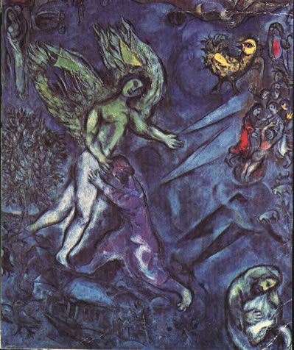
Victory over the angel
“Your name shall no longer be called Jacob, but Israel, for you have striven with God and with men, and have prevailed.” Genesis 32:28
The Ford of Jabbok
Notes:
Wrestling with the angel – victorious. The angel had defeated Adam but Jacob defeated the angel. Hip put out of joint.
Wrestling with spirit world. Won the respect of the angel. Like studying and passing exams to be qualified and win respect.
Jacob wrestling with and overcoming fears. Wanted to escape or run away. Cos overcame fears then was serene. If felt afraid Esau would have noticed and not respected.
Limping – had scars.
Not letting angel go till blessed him – determined to bring something good out of suffering. Person of character.
Jacob
Chagall, Ford of Jabbok
Jacob was the first fallen man to make indemnity condition to restore dominion over the angel
Israel - he set the pattern for victory over Satan. Subjugated Satan.
Striven with God (F of F) and man (F of S)
for Jacob to complete the restoration of
Canaan at the family level-that is, return to Canaan with his family and wealth and
there restore the foundation to receive the Messiah-he had to triumph in a fight at the
risk of his life with an angel, representing Satan. Jacob was desperate to overcome this
trial as he wrestled with the angel at the ford of Jabbok. He triumphed and received
the name “Israel.”4 In this trial, it was God who tested Jacob by putting the angel in
the position of Satan. God’s purpose in doing this was not to make Jacob miserable,
but to help him secure the position of Abel and complete the restoration of his family
by winning the qualification to rule the angel. Furthermore, through the angel playing
the leading role in the trial, the way was opened for the angelic world to be restored.
Yet Jacob has no control over Esau, only over himself. To alleviate fear and distress he can only alter his own attitude, expectations and behaviour. This is a painful process. To understand, to come to terms with, and impact on the core of our being is challenging to say the least. This is the challenge that Jacob wrestles with at the centre of one of the most stunning, powerful and enigmatic passages that follows: “Jacob was left alone. And a man wrested with him until the break of dawn (32:25).”The midrash understands this to be an encounter with the angel Michael aimed at showing Jacob that he should trust in God. Zornberg builds on the traditional readings with a distinctly modern vocabulary. For her, this moment constitutes a ‘therapeutic encounter’ with Israel, Jacob’s own shadow-self. In his journey to wholeness he must wrestle with his inner demons; he must delve inwards to better understand his own psyche. This encounter changes Jacob. He is given a new name, Israel, ‘he who struggles with God’ and by seeing “God face to face” (32:31) comes closer to understanding himself. The pain and power of this experience is mapped symbolically onto Jacob’s injured thigh.

Slide 168
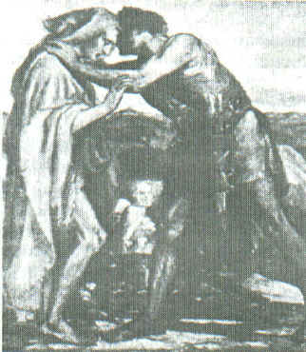
Jacob and Esau embrace
Jacob went on bowing himself to the ground seven times, until he came near to his brother.
But Esau ran to meet him, and embraced him, and fell on his neck and kissed him, and they wept.
Genesis 33:3-4
Jacob and Esau reconciled
Notes:
Jacob really humbled himself

Slide 169
Their conversation
Esau: “What do you mean by all this company which I met?”
Jacob: “To find favour in the sight of my lord.”
Esau: “I have enough, my brother; keep what you have for yourself.”
Jacob: “I pray you, if I have found favour in your sight, then accept my present from my hand; for truly to see your face is like seeing the face of God, with such favour you have received me. Accept, I pray you, my gift that is brought to you, because God has dealt graciously with me, and because I have enough.”
Genesis 33:8-11
Notes:
and it is a mark of Jacob’s greatness that he recognized it and made amends to Esau. Sacks

Slide 170
Jacob restores his mistake
He realises he was not a good younger brother
He understands that he did something wrong and hurt his older brother
So at the risk of his life he returns the blessing he stole
  He gives Esau gifts
  He bows down to his older brother 7 times
He becomes a good younger brother
  He becomes loveable
  He becomes worthy of respect

Slide 171
Lasting foundation
Jacob established the pattern for the natural and voluntary subjugation of Satan by winning Esau’s heart and respect
It is the pattern followed later by Joseph, Moses, Jesus and Sun Myung Moon
Abraham’s family established the heavenly tradition
“God of Abraham, Isaac and Jacob” Three Great Kingships

Slide 172
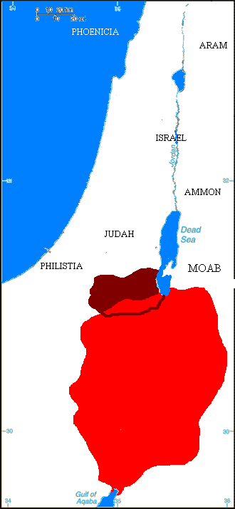
What happened next?
Jacob and Esau go separate ways
Meet up to bury Isaac
Jacob becomes ancestor of Hebrews
Esau becomes ancestor of Edomites
They were enemies
Eventually Edomites converted to Judaism
Edom

Slide 173
Did Jacob and Esau make the foundation of substance?
“For Jacob and Esau to fulfill the indemnity condition to remove the fallen nature, Esau needed to love Jacob, respect him as his mediator to God, obediently submit to Jacob's directions, and finally, multiply goodness by inheriting goodness from the bearer of God's blessing.” EDP, 183
Notes:
He loved Jacob – as older brother. He respected him because he was very successful – family and wealth. But never got to stage of following directions or of multiplying goodness

Slide 174
Jacob’s family
Leah
Jacob
Rachel
Zilpah
Bilhah
Asher
Gad
8
Joseph
Benjamin
7
Simeon
11
12
2
Reuben
Levi
Dan
Napthali
1
3
5
6
Judah
4
Issachar
9
Zebulun
Dinah
10

Slide 175
Leah’s heart
Leah conceived and bore a son, and she named him Reuben; for she said, ‘Because the Lord has looked on my affliction; surely now my husband will love me.’
She conceived again and bore a son, and said, ‘Because the Lord has heard that I am hated, he has given me this son also’; and she named him Simeon.
Again she conceived and bore a son, and said, ‘Now this time my husband will be joined to me, because I have borne him three sons’; therefore he was named Levi.
Notes:
This was important for her, since a woman’s status depended to a large extent on the number of male children she produced. Leah's own story is filled with pathos. She bore Reuben, then Simeon, then Levi, then Judah. Each time she had another son she prayed that Jacob would finally love her. He did not.
Her pitiful words emphasize her isolation and longing for love, love she would never receive, no matter how many sons she gave Jacob. He would never trust her, and Rachel was still the one he loved.

Slide 176
Rachel’s heart
When Rachel saw that she bore Jacob no children, she envied her sister; and she said to Jacob, ‘Give me children, or I shall die!’ Jacob became very angry with Rachel and said, ‘Am I in the place of God, who has withheld from you the fruit of the womb?’ Then she said, ‘Here is my maid Bilhah; go in to her, that she may bear upon my knees and that I too may have children through her.

Slide 177
Bitter rivalry
Then Rachel said, ‘God has judged me, and has also heard my voice and given me a son’; therefore she named him Dan. Rachel’s maid Bilhah conceived again and bore Jacob a second son. Then Rachel said, ‘With mighty wrestlings I have wrestled with my sister, and have prevailed’; so she named him Naphtali.
When Leah saw that she had ceased bearing children, she took her maid Zilpah and gave her to Jacob as a wife. Then Leah’s maid Zilpah bore Jacob a son. And Leah said, ‘Good fortune!’ so she named him Gad. Leah’s maid Zilpah bore Jacob a second son. And Leah said, ‘Happy am I! For the women will call me happy’; so she named him Asher.
Notes:
Rachel faced a different problem. No matter how she prayed to God, no matter how much she was loved by Jacob, Rachel did not conceive. In desperation she gave her maid Bilhah to Jacob, so that he could conceive a child with Bilhah as a surrogate mother for Rachel. This practice was common in the ancient world; the woman became a concubine instead of a servant, and it was a step up the social ladder for her. She might become the mother of the future tribal leader.
Bilhah had a son, whom Rachel named Dan. Then she had a second son, and Rachel called him Naphtali. In response, Leah gave her own maid Zilpah to Jacob, and this resulted in yet more sons: Gad and Asher. A bitter rivalry grew up between the two women.

Slide 178
Still struggling
In the days of wheat harvest Reuben went and found mandrakes in the field, and brought them to his mother Leah. Then Rachel said to Leah, ‘Please give me some of your son’s mandrakes.’ But she said to her, ‘Is it a small matter that you have taken away my husband? Would you take away my son’s mandrakes also?’ Rachel said, ‘Then he may lie with you tonight for your son’s mandrakes.’
Then Leah said, ‘God has endowed me with a good dowry; now my husband will honour me, because I have borne him six sons’; so she named him Zebulun.
Notes:
The root is hallucinogenic and narcotic. In sufficient quantities, it induces a state of unconsciousness and was used as an anaesthetic for surgery in ancient times.[14] In the past, juice from the finely grated root was applied externally to relieve rheumatic pains.[14] It was also used internally to treat melancholy, convulsions, and mania.[14] When taken internally in large doses, however, it is said to excite delirium and madness

Slide 179
Rachel had her own son
Then God remembered Rachel, and God heeded her and opened her womb. She conceived and bore a son, and said, ‘God has taken away my reproach’; and she named him Joseph
In the Bible polygamy always leads to problems within the family and is not approved of

Slide 180
What happened next?
When his brothers saw that their father loved him more than all his brothers, they hated him and could not speak peacefully to him. Genesis 37:4
They saw him from afar, and before he came near to them they conspired against him to kill him. Genesis 37:18
God
God
Father’s favourite
Dreams
Robe
Bad reports
Joseph
Brothers
Joseph
(Abel)
(Cain)
Hated Joseph
Jealous of Joseph
Wanted to kill
Reuben defended pit
Slavery
Notes:
Joseph - arrogant Abel. Brought bad reports about brothers, father’s favourite, long robe, dreams
Brothers - jealous, hated
The classical rabbinical sources argue that Simeon was very fearless, but also was particularly envious, and so had always been antagonistic and spiteful towards Joseph, owing to Joseph being Jacob's favourite son. The midrashic book of Jasher argues that Simeon was the one who proposed that the brothers should kill Joseph, and other classical sources argue that it was Simeon who threw Joseph into a pit, and became furious when he found out that Judah had sold Joseph rather than killed him;
Plotted to kill him. Reuben defended so threw into pit. Judah suggested seeling to Ishmaelite instead of killing him. Reuben distraught.

Slide 181
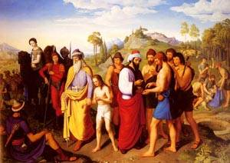
Joseph sold into slavery
Then Judah said to his brothers, “What profit is it if we kill our brother and conceal his blood? Come, let us sell him to the Ishmaelites, and let not our hand be upon him, for he is our brother, our own flesh.” And his brothers listened to him. Then Midianite traders passed by. And they drew Joseph up and lifted him out of the pit, and sold him to the Ishmaelites. They took Joseph to Egypt.
Genesis 37:26-28
Joseph sold into slavery
Notes:
Judah saves Joseph’s life. Risks himself to protect him. He is our brother. C.f Cain ‘am I my brother’s keeper?’
17 years old

Slide 182
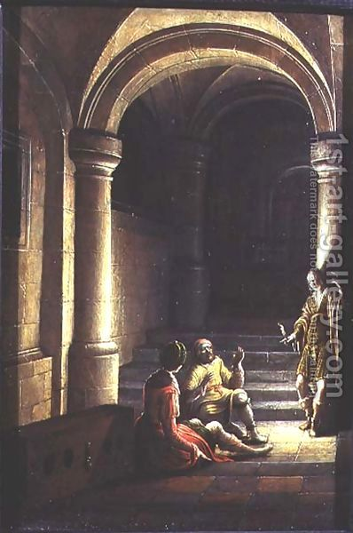
Joseph in prison
But the Lord was with Joseph and showed him steadfast love and gave him favour in the sight of the keeper of the prison. And the keeper of the prison put Joseph in charge of all the prisoners who were in the prison. Whatever was done there, he was the one who did it. The keeper of the prison paid no attention to anything that was in Joseph’s charge, because the Lord was with him. And whatever he did, the Lord made it succeed.
Genesis 39:21-23
Joseph interprets dreams
Notes:
Butler - vine 3 branches of grapes. And pharaoh’s cup. -> 3 days released
Baker - 3 baskets cakes on head. Birds ate it. -> 3 days be hanged

Slide 183
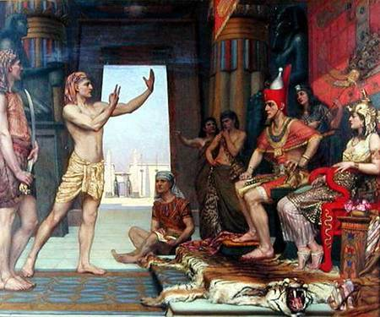
Joseph and Pharaoh
Joseph interprets Pharaoh’s dream
7 years of plenty followed by 7 years
of famine
Joseph appointed Prime Minister of Egypt when 30 years old
Marries Asenath
Joseph interprets Pharaoh’s dream
Notes:
Dinah was already pregnant by Shechem, and bore him a posthumous daughter. Her brothers wished to kill the child, as custom demanded, lest any Canaanite might say 'The maidens of Israel are without shame!' Jacob, however, restrained them, hung about his grand-daughter's neck a silver disk on which were engraved the words 'Holy to God!', and laid her underneath a thorn bush -- hence she was called 'Asenath'. That same day Michael, in the shape of an eagle, flew off with Asenath to On in Egypt, and there laid her beside God's altar. The priest, by name Potipherah, seeing his wife was barren, brought up Asenath as his own child. Many years later, when Joseph had saved Egypt from famine and made a progress through the land, women threw him thank-offerings. Among them was Asenath who, having no other gift, tossed Joseph her silver disk, which he caught as it flew by. He recognized the inscription and, knowing the she must be his own niece, married her.^{[5]}
Genesis records nothing more about Asenath, but her story is elaborated in the apocryphal Joseph and Asenath. There, she is a virgin who rejects several worthy suitors in favor of Joseph, but Joseph will not have a pagan for a wife. She locks herself in a tower and rejects her idolatry in favor of Joseph's God Yahweh, and receives a visit from an angel who accepts her conversion. A ritual involving a honeycomb follows. Bees cover her and sting her lips to remove the false prayers to the pagan gods of her past. Joseph now consents to marry her. She bears him their sons Mannaseh and Ephraim. Pharaoh's son wants Asenath for himself, however, and with the aid of Joseph's brothers Dan and Gad, he conspires to kill her husband. The loyal brother Benjamin interferes, and Pharaoh's son is ultimately slain. Asenath forgives the conspirators, and she and Joseph rule over Egypt for 48 years, after which they pass the crown to Pharaoh's grandson.

Slide 184
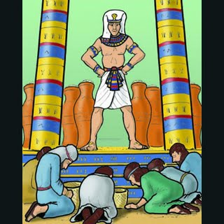
Joseph meets his brothers
10 brothers go to Egypt to buy grain
Joseph, “You are spies.”
All in prison for 3 days
Simeon to remain behind
“Bring youngest brother next time.”
The brothers before Joseph
Notes:
3 days – separation from Satan?
Then they said to one another, "In truth we are guilty concerning our brother, in that we saw the distress of his soul, when he begged us and we did not listen. That is why this distress has come upon us.” And Reuben answered them, "Did I not tell you not to sin against the boy? But you did not listen. So now there comes a reckoning for his blood.” They did not know that Joseph understood them, for there was an interpreter between them. Then he turned away from them and wept.
Simeon had wanted to kill Joseph. Also eldest brother so most responsible to take care of younger brothers.
The classical rabbinical sources argue that Simeon was very fearless, but also was particularly envious, and so had always been antagonistic and spiteful towards Joseph, owing to Joseph being Jacob's favourite son. The midrashic book of Jasher argues that Simeon was the one who proposed that the brothers should kill Joseph, and other classical sources argue that it was Simeon who threw Joseph into a pit, and became furious when he found out that Judah had sold Joseph rather than killed him;

Slide 185
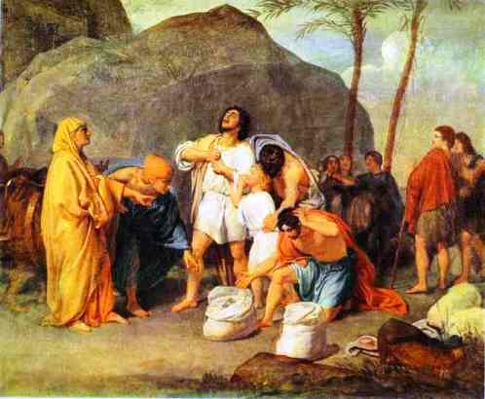
Benjamin comes to Egypt
Judah makes himself a surety for Benjamin
Dinner with Joseph
Silver cup put in Benjamin’s sack
All brought before Joseph
Silver cup found in Benjamin’s sack
Notes:
It is one of the most dramatic moments in Bereishith, a book full of dramatic moments. Judah has made a passionate plea for Benjamin’s release. Yes, the missing silver cup has been found in his possession. Judah does not challenge the facts. Instead he throws himself on the mercy of the Egyptian ruler, of whose identity he is still unaware. He asks him to think of the impact Benjamin’s imprisonment will have on his father. He has already lost one beloved son. The shock of losing another will kill him.
Now then, please let your servant remain here as my lord’s slave in place of the boy, and let the boy return with his brothers. How can I go back to my father if the boy is not with me? No! Do not let me see the misery that would come upon my father.
These are the words that finally break Joseph’s heart. He is overcome with emotion. He commands all his attendants to leave, turns to his brothers, and reveals his identity:
Then Joseph could no longer control himself before all his attendants, and he cried out, “Have everyone leave my presence!” So there was no one with Joseph when he made himself known to his brothers. And he wept so loudly that the Egyptians heard him, and Pharaoh’s household heard about it. Joseph said to his brothers, “I am Joseph! Is my father still living?” But his brothers were not able to answer him, because they were terrified at his presence.
Their silence is eloquent. They are bewildered. The stranger turns out to be their brother. The ruler of Egypt is the young man that, years earlier, they had sold as a slave. The combination of shock and guilt paralyses them.
Breaking the silence, Joseph continues. He has yet another surprise for them. He does not hold them guilty. There is no anger in his words. Instead he does the least expected thing. He comforts them. He forgives them. He speaks with a majestic graciousness:
Then Joseph said to his brothers, “Come close to me.” When they had done so, he said, “I am your brother Joseph, the one you sold into Egypt! And now, do not be distressed and do not be angry with yourselves for selling me here, because it was to save lives that G-d sent me ahead of you. 6 For two years now there has been famine in the land, and for the next five years there will not be plowing and reaping. But G-d sent me ahead of you to preserve for you a remnant on earth and to save your lives by a great deliverance. “So then, it was not you who sent me here, but G-d.”
With this, the long story reaches closure. The estrangement, which began with the words, ‘[The brothers] hated him and could not speak peaceably to him,” is at an end. Joseph is, as he twice dreamed he would be, a ruler. His brothers have bowed down to him. He has survived their attempt to kill him. He has risen from slavery to become the second most powerful man in the most powerful empire of the ancient world. But a question remains. What kind of story is this? What is its theme? What has been driving Joseph in these successive encounters with his brothers?
First, let us recall the sequence of events. Some time earlier, the brothers had come before Joseph for the first time. He recognises them. They do not recognise him. He “speaks harshly” to them, accusing them of being spies. He puts them in prison for three days.
He then releases them, holding Shimon as a hostage, telling them that they must bring Benjamin with them next time, to verify their story. Unbeknown to them, he has the money they had paid for the grain put back into their sacks. When they discover this, they are unnerved again. Something is happening to them, but they do not know what.
Eventually the food runs out and they have to return. It takes much persuasion on the part of Judah to convince Jacob to let Benjamin come with. This time, Joseph greets them with warmth, inviting them to eat with him. Eventually, having provided them with fresh supplies of grain, he sends them on their way. Now, however, he does more than place money in their sacks. He has his favourite divination cup placed in Benjamin’s grain.
The brothers have left the city, relieved that the visit has been unexpectedly painless. No sooner have they gone than they are overtaken by Joseph’s steward. Someone has stolen his master’s silver cup. The brothers protest their innocence. The steward searches their bags, starting with the eldest. Finally they reach Benjamin, and there, in his sack, is the cup. It is their worst nightmare come true. They knew that having once come home without Joseph, they could not lose Benjamin also. Judah had staked his honour on it. So the brothers appear before Joseph once more, and the drama moves toward its climax.
What is the logic of this sequence of events? The first possibility, suggested by the Torah itself (“Then he remembered his dreams about them and said to them: You are spies”), is that Joseph was acting so as to fulfil his childhood dreams, in which his family bowed down to him.
This, however, cannot be the case. Before Joseph acts like a stranger, we read “When Joseph’s brothers arrived, they bowed down to him with their faces to the ground” (42: 6). If the story were simply about the fulfilment of Joseph’s dreams he should have devised a strategy that would bring the whole family, including Jacob and Benjamin, to Egypt. Jacob would have bowed down to him, the dreams would be fulfilled, and Joseph could then reveal his identity. Nothing of this kind happens. Joseph’s actions do not advance, but actually delay, this outcome. Therefore Joseph was not acting so as to fulfil his dreams.
The second possibility is that the Joseph story is a tale of revenge. He is making his brothers suffer as they once made him suffer. This too is untenable. At every significant stage (42:24, 43:30, 45:1-2), Joseph turnsaside to weep , careful not to let the brothers see him in this state. People engaged in revenge do not weep. That is why we are told this detail three times – precisely to exclude the possibility that Jacob was acting out of desire to do to his brothers what they once did to him. Those who repay evil with evil take satisfaction in so doing. Joseph takes no satisfaction at all. It is clear that he is acting against his inclination and that it causes him pain. The question therefore returns in full force. What is the logic of Joseph’s carefully constructed plot?
One of the key concepts of Judaism – the theme of its holiest days from Rosh Hashanah to Yom Kippur – is teshuvah, a complex term involving remorse, repentance and return. The abstract noun teshuvah is post-biblical, but the idea it embodies is central to the Hebrew Bible. It is what the prophets call on Israel to do. It is what Jonah is sent to Nineveh to achieve. In a related sense it is what certain sacrifices (guilt and sin offerings) were intended to accompany.
Teshuvah, as analysed by the sages and later by Maimonides, has certain key elements. The first is confession and acknowledgement of wrongdoing:
How does one confess? The penitent says, “I beseech you, O Lord, I have sinned, I have acted perversely, I have transgressed before you, and have done such and such, and I repent and am ashamed of my deeds.”
The second in to commit oneself not to repeat the offence:
What he has repentance? It consists in this, the person abandon his sin, remove it from his thoughts, and resolve in his heart never to repeat it, as it is said, “Let the wicked forsake his way, and the man of iniquity his thoughts.”
There is a further condition of complete repentance. This is how Maimonides puts it:
What is perfect repentance? It occurs when an opportunity presents itself for repeating the offence once committed, and the offender, while able to commit the offence, nevertheless refrains from doing so because he is penitent, and not out of fear or failure of vigour.
As soon as we understand these three points, the logic of Joseph’s course of action becomes clear. The drama to which he subjects his brothers has nothing to do with the dreams, or with revenge. To the contrary, Joseph is not acting for himself but for the sake of his brothers. He is taking them – for the first time in recorded history – through the three stages of teshuvah.
Recall what happened as a result of his intervention. His initial move was to accuse them of a crime they have not committed (of being spies) to see whether this would remind them of a crime they did commit (selling their brother into slavery). The effect is immediate:
They said to one another, “Surely we are being punished [aval ashemim anachnu] because of our brother. We saw how distressed he was when he pleaded with us for his life, but we would not listen. That is why this distress has come upon us.” . . . They did not realise that Joseph could understand them, since he was using an interpreter.
The brothers have confessed and expressed remorse for what they did. The first stage of teshuvah has taken place.
The second takes place far away from Joseph, but he has so arranged matters that he will know whether it has happened or not. Joseph is holding Shimon as hostage (This is a significant detail. Shimon is the second oldest of the sons. By rights he should have held Reuben, the eldest. However, he knows that Reuben was the one brother who tried to save him. Shimon is therefore the eldest of those who conspired to kill Joseph). He tells the brothers that he will only release him if they return with Benjamin. Knowing his father as he does, Joseph has calculated, rightly, that Jacob will only let Benjamin go if his sons have convinced him that they will not let happen to him what they let happen to Joseph. This indeed happens when Judah says to Jacob:
“I myself will guarantee [Benjamin’s] safety; you can hold me personally responsible for him. If I do not bring him back to you and set him here before you, I will bear the blame before you all my life.”
The second condition of repentance has been achieved: a commitment not to repeat the offence. Judah, on behalf of the brothers, undertakes not to let happen this time what happened last time, namely that they returned without their youngest sibling whose safety they should have guaranteed.
The third act is a master-stroke. Joseph constructs a scene – one could almost call it a controlled experiment – to see if his brothers have indeed changed. They had once sold him into slavery. He now puts them in a situation in which they will have overwhelming temptation to repeat the crime by abandoning Benjamin to slavery. That is why he plants the cup in Benjamin’s sack, arranges for him to be accused of theft, rules that his punishment will be to remain in Egypt as a slave, and tells the other brothers that they are free to leave.
Why Benjamin? Because he, like Joseph, is a son of Rachel – and therefore envied and despised by the other brothers. There is, of course, one difference. The brothers’ resentment of Joseph was heightened by the jealousy they felt at the sight of the many-coloured robe Jacob had given him. How can he put them into a similar situation now? How can he provoke them into being jealous of Benjamin? This is what he does: when he sits the brothers down for a meal he arranges that they be seated in order of age (Benjamin is the youngest) and then that “Benjamin’s portion was five times as much as anyone else’s” (43:34). There is only one explanation for this strange detail. Joseph is trying to make them jealous of their youngest brother.
As far as possible, the circumstances of their original crime have now been replicated. Their youngest brother, a child of Rachel, is about to be taken as a slave in Egypt. They have reason to be jealous of him as they were of Joseph. They rise to the challenge. As Benjamin is about to be taken into custody, they offer to join him in prison. Joseph declines: “Far be it from me to do such a thing! Only the man who was found to have the cup will become my slave. The rest of you go back to your father in peace.”
The moment of trial has now begun. Joseph has offered the brothers a simple escape route. All they have to do is walk away. It is then, when “Judah went up to him and said . . .” that the story reaches its climax. Judah, the very brother who was responsible for selling Joseph into slavery, now offers to sacrifice his own freedom rather than let Benjamin be held as a slave.
The circumstances are similar to what they were years earlier, but Judah’s behaviour is now diametrically opposite to what it was then. He has the opportunity and ability to repeat the offence, but he does not do so. Judah has fulfilled the conditions set out by the sages and Maimonides for “complete repentance.” As soon as he does so, Joseph reveals his identity and the drama is at an end.
Not dreams, not revenge, but teshuvah is what has driven Joseph all along. His brothers once sold him as a slave. He survived – more than survived, he has prospered. He knows (he says so constantly) that everything that has happened to him is somehow part of G-d’s plan. His concern is not for himself but for his brothers. Have they survived? Do they realise the depth of the crime they committed? Are they capable of remorse? Can they change? The entire sequence of events between the brothers’ first arrival in Egypt and the moment Joseph tells them who he is, is an extended essay in teshuvah, a precise rehearsal of what will later become normative Jewish law.
Why now? Because – unbeknown to any of the participants – the family of Abraham is about to undergo exile in Egypt, prior to their becoming a nation under the sovereignty of G-d. That will place more demands on Israel than on any other people in history. G-d knows that they will often fail – they will sin, complain, worship idols, break His laws. That He accepts, though at times it gives Him great grief. G-d does not demand perfection. By giving us freewill He empowers us to make mistakes. All He asks is that we acknowledge our mistakes and commit ourselves not to make them again – in a word, that we are capable of teshuvah. Judah showed they were. Jewish history, starting with exile and exodus in Egypt, could now begin.

Slide 186
The brothers before Joseph
Judah said, “What shall we say to my lord? What shall we speak? Or how can we clear ourselves? God has found out the guilt of your servants; behold, we are my lord’s servants, both we and he also in whose hand the cup has been found.”
But Joseph said, “Far be it from me that I should do so! Only the man in whose hand the cup was found shall be my servant. But as for you, go up in peace to your father.”
Genesis 44:16-17
Notes:
AM I MY BROTHER’S KEEPER?

Slide 187
Judah speaks up
“Now therefore, as soon as I come to my father, and Benjamin is not with us, then, as his life is bound up in the boy’s life, as soon as he sees that the boy is not with us, he will die. For I became a pledge of safety for Benjamin to my father, saying, ‘If I do not bring him back to you, then I shall bear the blame before my father all my life.’ Now therefore, please let me remain instead of the boy as a servant to my lord, and let the boy go back with his brothers. For how can I go back to my father if the boy is not with me? I fear to see the evil that would find my father.”
Genesis 44:30-34
Notes:
This is why lineage went through Judah. Went through crossing point of life and death.
Judah is the first person in the Torah to achieve perfect repentance (teshuvah gemurah), defined by the sages as one who finds himself in a situation to repeat an earlier sin but who does not do so because he is now a changed person.
Judah said to his brothers, “What will we gain if we kill our brother and cover up his blood? Come, let’s sell him to the Ishmaelites and not lay our hands on him; after all, he is our brother, our own flesh and blood.” His brothers agreed. (Gen. 37: 26-27)
Now, faced with the prospect of leaving Benjamin as a slave, he says, “Let me stay as a slave and let my brother go free.” That is perfect repentance, and it is what allows Joseph to reveal his identity and forgive his brothers.
The Torah had already hinted at the change in Judah’s character. Having accused his daughter-in-law Tamar of becoming pregnant by a forbidden sexual relationship, he is confronted by her with evidence that he himself is the father of the child and immediately admits: “She is more righteous than I” (Gen. 38: 26). This is the first time in the Torah we see a character admit that he is wrong. If Judah was the first penitent, it was Tamar – mother of Perez from whom king David was descended – who was ultimately responsible.
Sacks

Slide 188
Joseph reveals himself
And Joseph said to his brothers, “I am Joseph! Is my father still alive?” But his brothers could not answer him, for they were dismayed at his presence. So Joseph said to his brothers, “Come near to me, please.” And they came near. And he said, “I am your brother, Joseph, whom you sold into Egypt. And now do not be distressed or angry with yourselves because you sold me here, for God sent me before you to preserve life. So it was not you who sent me here, but God. He has made me a father to Pharaoh, and lord of all his house and ruler over all the land of Egypt.”
Genesis 45:3-8
Notes:
Turned defeat into victory. No rancour or accusation. Like Jacob and Jesus and Father. He found meaning in what happened.

Slide 189
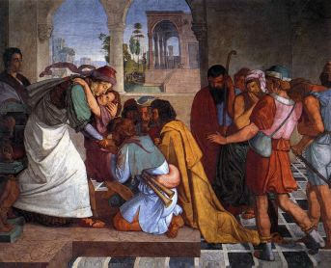
Joseph and brothers reconciled
“You must tell my father of all my honour in Egypt, and of all that you have seen. Hurry and bring my father down here.” Then he fell upon his brother Benjamin’s neck and wept, and Benjamin wept upon his neck. And he kissed all his brothers and wept upon them. After that his brothers talked with him.
Genesis 45:13-15
Joseph and his brothers reconciled
Notes:
All those who went to Egypt with Jacob—those who were his direct descendants, not counting his sons’ wives—numbered sixty-six persons. With the two sons who had been born to Joseph in Egypt, the members of Jacob’s family, which went to Egypt, were seventy in all.

Slide 190
A successful example
Jonathan and David

Slide 191
How did David inherit the throne?
Samuel
Own sons corrupt
Saul
Tried to
kill
Filial
piety
Providence for the start
Filial
piety
Won love and respect
Jonathan
David
Goliath
Offered his position
Satan
Cain
Abel
Jonathan made a covenant with David, because he loved him as his own
soul. And Jonathan gave his robe and armour and sword and bow to David.
I Samuel 18:3-4
Notes:
Saul tragic figure. Wanted to do right but let down by Samuel.
David killed Goliath - providence for start like Moses killing Egyptian and God smiting Pharaoh
David established position of Abel before Jonathan
Won Jonathan’s love and respect. Voluntarily submitted
Practising filial piety to Saul - played lute. Evil spirit and Saul tried to kill
Jonathan filial piety but wouldn’t follow Saul’s evil direction. Loyalty to friendship and covenant
Saul tried to kill David. David didn’t kill Saul when twice had the chance to
Saul and Jonathan died together fighting
David lamented when hear they’d been killed

Slide 192
How did David inherit the throne?
Samuel
Own sons corrupt
Saul
Tried to
kill
Filial
piety
Providence for the start
Filial
piety
Won love and respect
Jonathan
David
Goliath
Offered his position
Satan
Cain
Abel
Jonathan, Saul’s son visited David at Horesh and encouraged him in God. He said,
“Don’t despair. My father, Saul, can’t lay a hand on you. You will be Israel’s king
and I’ll be right at your side to help. And my father knows it.” I Samuel 23:16-18
Notes:
Saul tragic figure. Wanted to do right but let down by Samuel.
David killed Goliath - providence for start like Moses killing Egyptian and God smiting Pharaoh
David established position of Abel before Jonathan
Won Jonathan’s love and respect. Voluntarily submitted
Practising filial piety to Saul - played lute. Evil spirit and Saul tried to kill
Jonathan filial piety but wouldn’t follow Saul’s evil direction. Loyalty to friendship and covenant
Saul tried to kill David. David didn’t kill Saul when twice had the chance to
Saul and Jonathan died together fighting
David lamented when hear they’d been killed

Slide 193
Project to translate My World and I into Arabic

Slide 194

My World and I
Spiritual and moral education of young people in Russian and former Soviet Union
Based on multi-faith approach
Universal values and virtues
Self-development
Support marriage and family

Slide 195

Project for Arabic edition
Publish is Arabic
For Palestine
Dr Ghassan Abdullah
CARE
$15 000 to translate, edit publish 4000 books
https://www.justgiving.com/my-journey-in-life

