Slide 1

Strong Abel and Freedom Society
Strong Abel and Freedom Society
Unificationism
World Headquarters Church
I. The Roots of the Teaching in True Father’s Words
II. Freedom Society and the Garden of Eden
The Roots of the Teaching in TF’s Words -
- Anthony J. Guerra Ph.D.

Slide 2

Strong Abel and Freedom Society
“
STRONG ABEL
The Roots
of
the Teaching
in
True Father’s
Words
”
The Roots of the Teaching in TF’s Words -

Slide 3

Strong Abel and Freedom Society
Strong Abel is an understanding of
the proper relationship between nations
during the Last Days,
the end of Fallen History
that the True Parents are effectuating right now.
The Roots of the Teaching in TF’s Words -

Slide 4
Strong Abel and Freedom Society
The first successful Cain and Abel relationship
in God’s Providence according to Abonim’s words occurred
because Esau recognized that
Jacob was successful, strong and blessed by God:
When Jacob returned home and wanted to claim the position of the elder son that he had beenblessed with years before, who should publicly acknowledge him? Who should sign the certificate? It is Esau, in the position of Cain, who should signify his approval. Without Esau’s approval, Jacob could not receive the blessing from God.
During his twenty-one years in a foreign land, Jacob had prospered and gathered his own clan. He knew he had to make a superior foundation in every aspect in order to overcome Esau… That is why Jacob worked hard to gain cattle, servants and property; he needed to have more wealth than his brother. Then he could send gifts of servants and possessions to his brother, and to his elderly parents as well.
Through these gifts, Jacob wanted to make his elder brother think: “My brother is a fearful man. Indeed, God blessed him. It was my mistake that I sold my birthright so cheaply; hence I deserve to be less successful than my younger brother. So, when my brother comes, I should not reject him. I should rather welcome him.” In this way, Jacob could move Esau to recognize that God was with him, and to acknowledge that he was in the position of Abel. This is the path we should walk; this is the tradition we should follow. It is a formula, applicable in any situation and in every age.
(106:183-84, December 30, 1979)
The Roots of the Teaching in TF’s Words -

Slide 5
Strong Abel and Freedom Society
Joseph, Issac’s favorite was ultimately successful Abel
on the tribal level by uniting his brothers and 70 clansmen to him.
He was a strong Abel
who had risen to a position of authority in Egypt:
“So Pharaoh said to Joseph,
‘I hereby put you in charge of the whole land of Egypt.’”
(Genesis 41:41)
By virtue of his strong position, Joseph could bring his entire clan to Egypt and literally save them from the certain destruction that would have come upon them because of the remaining years of famine.
The Roots of the Teaching in TF’s Words -

Slide 6
Strong Abel and Freedom Society
The Same paradigm applies to Moses who was able to liberate the Israelites from the slavery in Egypt because of his strength.
Moses manifested his physical strength personally in the killing of the Egyptian and also spiritual power through the 3 sign and 10 plagues that ultimately brought the Pharaoh to agree to letting Moses with the Israelites to go for 3 days and to get free from slavery.
Joshua, the successor of Moses, is a great military general
who defeats 31 Kings and is responsible for the Israelites successfully occupying the Promised Land of Canaan. The DP only comment on this, in accord with the Scripture, is that the Israelites made a mistake in not completely eliminating the seven Canaanite tribes and as a result were defiled by living among them.
The Roots of the Teaching in TF’s Words -

Slide 7
Strong Abel and Freedom Society
The National level foundation to Receive the Messiah should have been completed under the United Kingdom of Saul but was extended to David and finally Solomon.
These three Kings were conquering Kings extraordinaire.
Under their leadership Israel grew to its largest size
and was a formidable powerful nation in the region.
Israel was never so strong as in this period of the United Kingdom.
According to True Father,
God’s will was to send Christ at this time.
God would have done so but for the spiritual idolatry and lust of the Kings who failed to build the temple or to keep it pure.
The Roots of the Teaching in TF’s Words -

Slide 8
Strong Abel and Freedom Society
Compare God’s first choice for the Time of sending Christ to the time when finally God could send Jesus.
We see that Jesus came to Israel when it had endured centuries of domination, destruction and occupation by conquering nations.
God’s first choice was a strong Israel and not the weakened and dominated nation of the first century Israel.
The Roots of the Teaching in TF’s Words -

Slide 9
Strong Abel and Freedom Society
What does True Father say about the much exalted Jesus ethic of “turning the other cheek?”
Abonim in Wolli Won Bon is quite clear on this point:
The coming of the Lord of the Second Advent is the time when believers should take the opposite direction from the past, when they were [pleased to receive] love. [Today] we should have a different attitude.
This is [because] when God loved us [in the past] it was a time to sow seeds, but after the coming of the Lord of the Second Advent it is the time to harvest. Therefore, if you love someone who is not in the bosom of the Lord of the Second Advent, it is as if you are [still] sowing seeds at harvest time. Then, heavenly love will be nullified.
That is to say, this is a time when we should erect heavenly righteousness, even [if it means] striking [those who strike us on] the right cheek rather than responding with the kind of love [that turns the other cheek]. This is so because those who belong to Heaven should advance on those who do not belong to Heaven.
In other words, it is the time when we Abel-type heavenly people should fundamentally restore Cain-type non-heavenly people by having them follow and obey, so that God can claim them.
The Roots of the Teaching in TF’s Words -

Slide 10
Strong Abel and Freedom Society
The condition for the birth of the Lord at the Second Advent was the victory of the Allied Nations over the Axis Power Nation in World War I. If USA, England and France had not been strong Abels, then the birth of the LSA would have been jeopardized.
The condition for the LSA to begin his public ministry was the defeat of Cain Nations by those same Abel Nations in World War II. What would have happened if Germany and Japan had won in WWII?
With the victory of Allied Nations in WWII, then the LSA could have quickly brought the world into God’s Dominion. The internal unity was needed between the LSA and Christianity. God had prepared a propitious environment geopolitically.
Already USA, England, France are engaged in Korea, Japan and the Far East. The Soviets also did not test the Atomic bomb until 29 August 1949, Thus there were several years when USA was the only nation with the atomic bomb making it truly a super power.
The Roots of the Teaching in TF’s Words -

Slide 11
Strong Abel and Freedom Society
The failure of Christianity to unite with LSA resulted in untold suffering for the Son of God, the nation of Korea and the world that endured the so-called Cold War.
It necessitated the 40 year indemnity period of the second course of the LSA. Why did Abonim support Ronald Reagan?
People in America and around the world thought Reagan would cause the third World War.
Reagan challenged Soviets to arms race (SDI).
The Soviets surrendered without war because they came to understand that America was a strong Abel.;
Cain only attacks when Abel is perceived as weak.
The Roots of the Teaching in TF’s Words -

Slide 12
Strong Abel and Freedom Society
Now is the time when Abonim and his people is
to fulfill Cheon Il Guk.
CIG can only be fulfilled when North and South Korea unites centered on Godism and worldwide Cain Nations unite with Abel Nations.
If Cain Nations defeat Abel Nations, there can be no CIG or KofH.:
Abonim asked:
Island nations to form a Federation to defend against larger Cain Nations. Korea and Japan to become one nation and create military alliance. Abel Nations need to form Abel alliance.
The Roots of the Teaching in TF’s Words -

Slide 13
Strong Abel and Freedom Society
Abel Nations must be stronger than Cain Nations
to prevent war or to quickly defeat them
so the world is not destroyed or its people come under slavery.
The Cain Nations do not treat their own people
fairly or humanely.
How do you think they will treat the people
of the nations they conquer?
Abel needs to be strong to prevent Cain
from acting against God’s people and to liberate all people throughout the world.
The Roots of the Teaching in TF’s Words -

Slide 14
Strong Abel and Freedom Society
“
FREEDOM SOCIETY
Freedom
Society
and
the
Garden
Eden
of
”
The Roots of the Teaching in TF’s Words -

Slide 15
Strong Abel and Freedom Society
The Freedom Society Philosophy
arises out of a fundamental analysis of the nation state in light of the paradigm of Adam, Eve (the parents of Cain and Abel) and the archangel in the Garden of Eden.
In the Garden of Eden, there are four actors, however God is always steadily moving according to His own absolute, eternal and unchanging nature.
So it is the three beings:
Adam, Eve and the Archangel who are given the freedom that allows them to obey or to disobey God. God’s ideal is for love to be the center of God and human relationship so God gives freedom and responsibility to allow Adam and Eve to more fully reflect God’s original nature. It is for this reason that God does not intervene in the Fall! Thus, freedom is the absolute prerequisite for God’s ideal society. Freedom is so important that God is willing to suffer the pain of Heart for thousands and thousands of years.
Think about it:
all God had to do is to exercise his absolute power and coerce Adam and Eve as well as the Archangel to obey the commandment. God does not do so because God will not take away human freedom and responsibility. Freedom Society is ultimately grounded in this absolute commitment of God to human freedom.
The Roots of the Teaching in TF’s Words -

Slide 16
Strong Abel and Freedom Society
Before the Fall,
the relationship in the Garden of Eden
among the three beings of Adam, Eve and Archangel was
in accord with God’s ideal of Creation:
Adam and Eve stood as the growing children of God and the Archangel as God’s and their servant.
The Fall occurs when the Archangel, Lucifer, leaves his position of servant and takes false dominion over Adam and Eve.
In doing so Lucifer became Satan, the enemy of God and the god of this world. Since the original ideal of the Garden of Eden is yet unfulfilled, then we need to understand how it applies to today, the time God intends to finalize His original Purpose.
The Roots of the Teaching in TF’s Words -

Slide 17
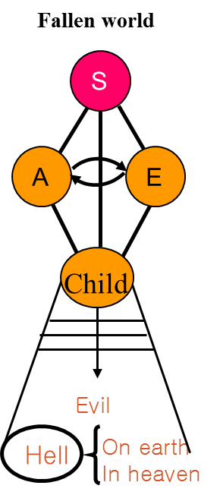
Strong Abel and Freedom Society
The Divine Principle teaches us
how the Garden of Eden paradigm
applies to individuals, families
and as well as to the relationship
among nations(international relationships)
“
”
1) Humanity becomes Satan’s children
2) Satan is the parent of humanity
3) Original sin ⇒ fallen nature
4) Satan is the owner of the world
The Roots of the Teaching in TF’s Words -

Slide 18
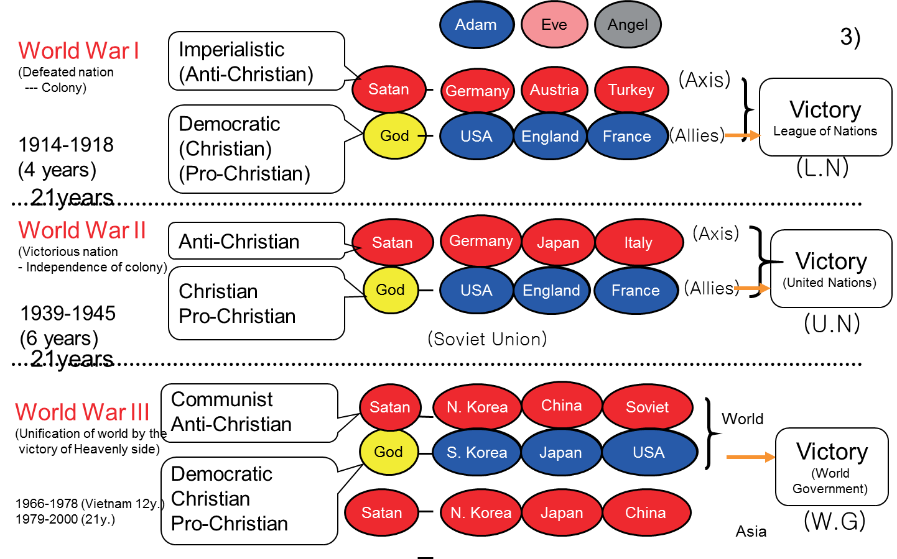
Strong Abel and Freedom Society
Adam, Eve Lucifer Paradigm for the Relationship between Nations:
TAIWAN
The Roots of the Teaching in TF’s Words -

Slide 19

Strong Abel and Freedom Society
Freedom Society Applies
Adam, Eve, Archangel Paradigm to the Dynamics within each Nation:
Adam represent all men and Eve represents all women; together they represent all the families (the core unit of society) comprising the nation.
In democratic nations we commonly say that the government is the servant of the people and government officials are called Public Servants.
The government on the national level represents the third being in the garden of Eden, the Archangel and should be in the servant position to its citizens.
This is the core insight of the Freedom Society and from it flows innumerable policy implications including political, economic and social.
It is the key to understanding the Freedom Society
Men of nation
Women of nation
Government of nation
All families of nation
The Roots of the Teaching in TF’s Words -

Slide 20

END
Strong Abel and Freedom Society
Of
Document
The Roots of the Teaching in TF’s Words -

